Slide 1
Introduction(1/2)
Eukaryotic cells can synthesize up to 10,000 different kinds of proteins
The correct transport of a protein to its final destination is crucial to its function
Protein targeting / Protein sorting
  The process of directing a newly synthesized protein to its target organelle

Slide 2
Introduction(2/2)
Computational methods aiming to assign subcellular localization in an automated and high-throughput fashion
Challenges to the prediction method developers
  The enormous complexity of the protein sorting process
  Alternative means of transportation pathways
  Lack of complete data for every organelle

Slide 3
Biological Background(1/4)
Types of cells
  Prokaryotes
  Eukaryotes
There are at least ten main subcellular localizations in eukaryotes
  It can be further subdivided into intraorganellar compartments
  Bacteria consist of a single intracellular space and a plasma membrane.
  Organelles have distinct well-defined functions in the cellular machinery

Slide 4
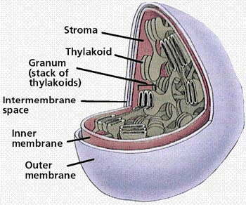
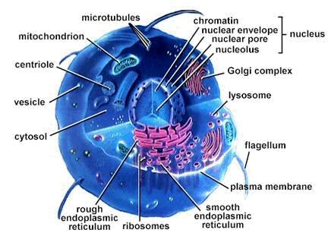
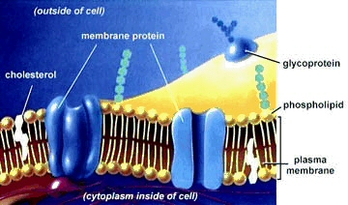
Biological Background(2/4)
Protein structure & Function

Slide 5
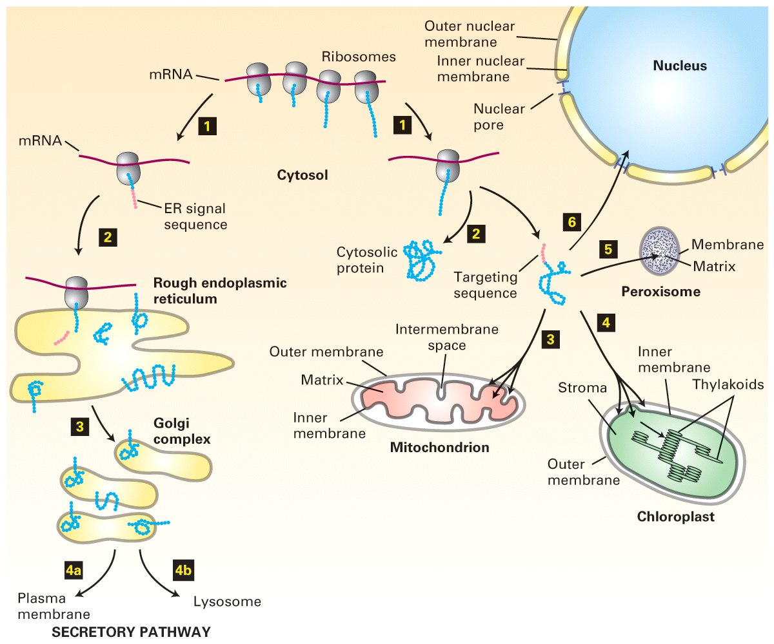
Biological Background(3/4)
Protein targeting

Slide 6
Biological Background(4/4)
Common to all signal sequences is that they show a high specificity
  It is not necessarily evident within the primary amino acid sequence
The organelles present unique biological conditions to the proteins
  proteins from different organelles differ in their overall amino acid composition
Underlying hypothesis
  Each protein has evolved to function optimally in a certain subcellular localization can be formed

