Slide 1
Building Java Programs
Bonus Slides
I/O Streams; Exceptions; Inheritance
read 9.3, 6.4

Slide 2
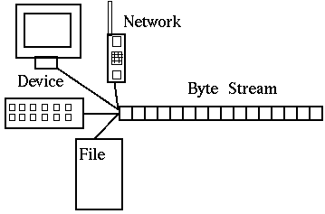
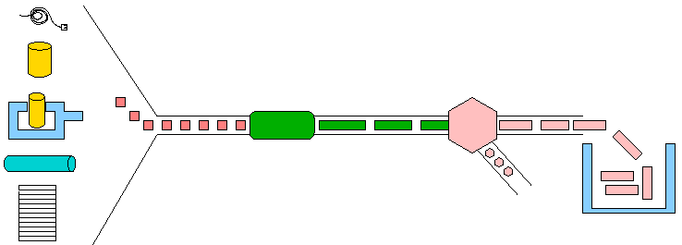
Input and output streams
stream: an abstraction of a source or target of data
  8-bit bytes flow to (output) and from (input) streams
can represent many data sources:
  files on hard disk
  another computer on network
  web page
  input device (keyboard, mouse, etc.)
represented by java.io classes
  InputStream
  OutputStream

Slide 3
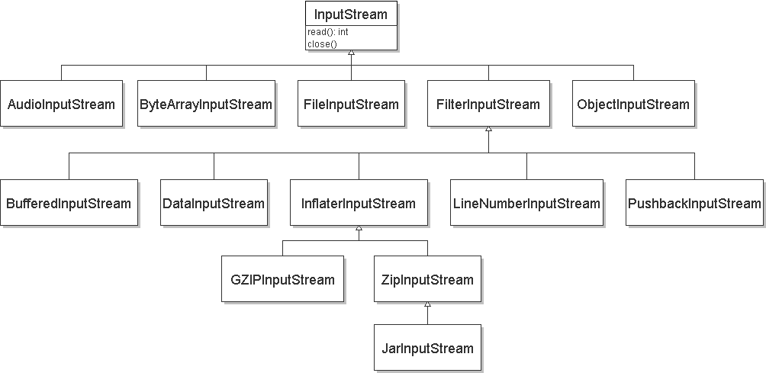
Streams and inheritance
all input streams extend common superclass InputStream;
all output streams extend common superclass OutputStream
  guarantees that all sources of data have the same methods
  provides minimal ability to read/write one byte at a time

Slide 4
Input streams
constructing an input stream:
  (various objects also have methods to get streams to read them)
methods common to all input streams:
Constructor
public FileInputStream(String name) throws IOException
public ByteArrayInputStream(byte[] bytes)
public SequenceInputStream(InputStream a, InputStream b)
Method | Description
public int read() throws IOException | reads/returns a byte (-1 if no bytes remain)
public void close() throws IOException | stops reading

Slide 5
Output streams
constructing an output stream:
methods common to all output streams:
Constructor
public FileOutputStream(String name) throws IOException
public ByteArrayOutputStream()
public PrintStream(File file) public PrintStream(String fileName)
Method | Description
public void write(int b) throws IOException | writes a byte
public void close() throws IOException | stops writing (also flushes)
public void flush() throws IOException | forces any writes in buffers to be written

Slide 6
int vs. char
The read and write methods work an int (byte) at a time.
For text files, each byte is just an ASCII text character.
  an int can be cast to char as needed:
  FileInputStream in = new FileInputStream("myfile.txt");
  int n = in.read(); // 81
  char ch = (char) n; // 'Q'
  a char can be passed where an int is wanted without casting:
  FileOutputStream out = new FileOutputStream("outfile.txt");
  char ch = 'Q';
  out.write(ch);

Slide 7
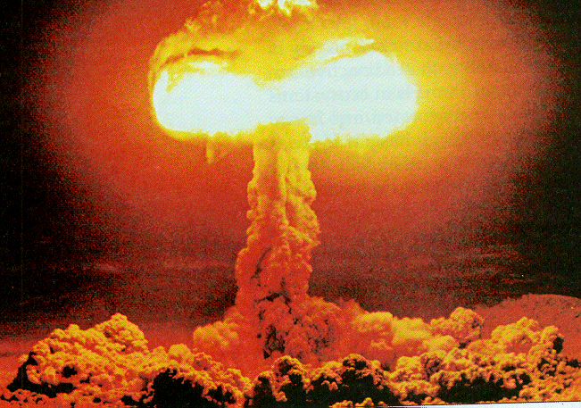
I/O and exceptions
exception: An object representing an error.
  checked exception: One that must be
  handled for the program to compile.
Many I/O tasks throw exceptions.
  Why?
When you perform I/O, you must either:
  also throw that exception yourself
  catch (handle) the exception

Slide 8
Throwing an exception
  public type name(params) throws type {
throws clause: Keywords on a method's header that state that it may generate an exception.
  Example:
  public class ReadFile {
  public static void main(String[] args)
  throws FileNotFoundException {
  "I hereby announce that this method might throw an exception, and I accept the consequences if it happens."

Slide 9
Catching an exception
  try {
  statement(s);
  } catch (type name) {
  code to handle the exception
  }
  The try code executes. If the given exception occurs, the try block stops running; it jumps to the catch block and runs that.
  try {
  Scanner input = new Scanner(new File("foo"));
  System.out.println(input.nextLine());
  } catch (FileNotFoundException e) {
  System.out.println("File was not found.");
  }

Slide 10
Dealing with an exception
All exception objects have these methods:
Some reasonable ways to handle an exception:
  try again; re-prompt user; print a nice error message;
  quit the program; do nothing (!)
Method | Description
public String getMessage() | text describing the error
public String toString() | a stack trace of the line numbers where error occurred
public InputStream openStream() throws IOException | opens a stream for reading data from the document at this URL
getCause, getStackTrace, printStackTrace | other methods

Slide 11
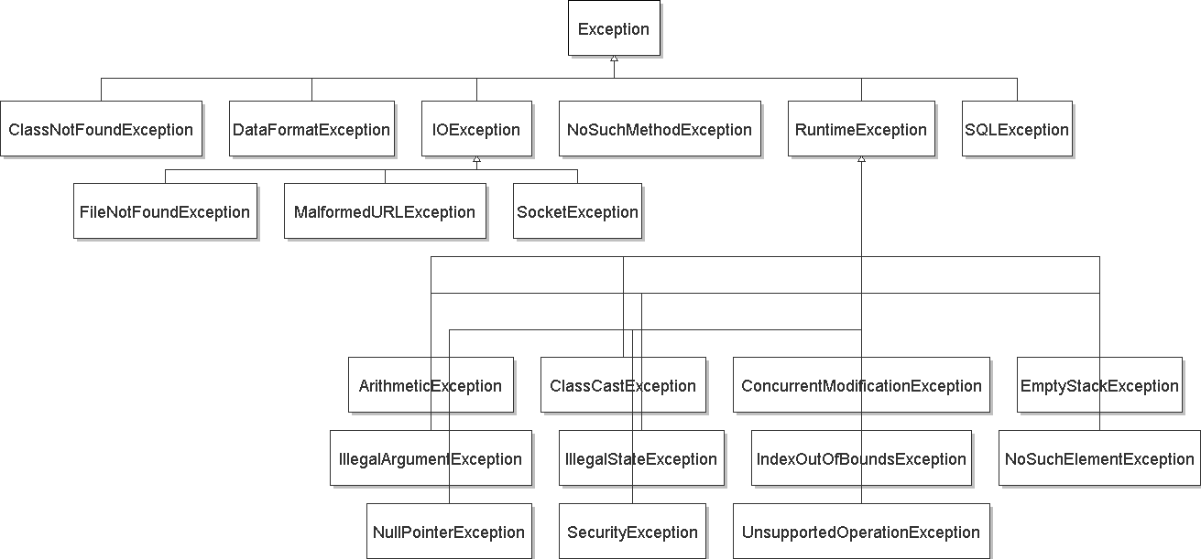
Exception inheritance
All exceptions extend from a common superclass Exception

Slide 12
Inheritance and exceptions
You can catch a general exception to handle any subclass:
  try {
  Scanner input = new Scanner(new File("foo"));
  System.out.println(input.nextLine());
  } catch (Exception e) {
  System.out.println("File was not found.");
  }
Similarly, you can state that a method throws any exception:
  public static void foo() throws Exception { ...
  Are there any disadvantages of doing so?

Slide 13
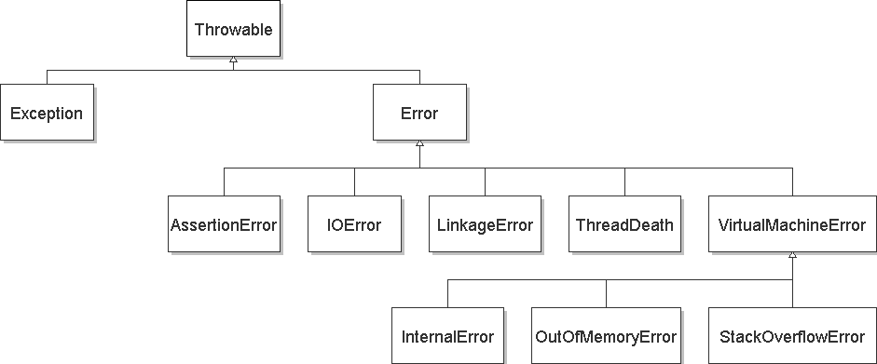
Exceptions and errors
There are also Errors, which represent serious Java problems.
  Error and Exception have common superclass Throwable.
  You can catch an Error (but you probably shouldn't)

Slide 14
Reading from the web
  class java.net.URL represents a web page's URL
  we can connect to a URL and read data from that web page
Method/Constructor | Description
public URL(String address) throws MalformedURLException | creates a URL object representing the given address
public String getFile(), getHost(), getPath(), getProtocol() public int getPort() | returns various parts of the URL as strings/integers
public InputStream openStream() throws IOException | opens a stream for reading data from the document at this URL

Slide 15
Exercise
Write a class Downloader with the following behavior:
  public Downloader(String url)
    Initializes the downloader to examine the given URL.
  public void download(String targetFileName)
    Downloads the file from the URL to the given file name on disk.
Write client program DownloadMain to use Downloader:
  URL to download? foo bar
  Bad URL! Try again: http://zombo.com/
  Target file name: out.html
  Contents of out.html:
  <html>
  <head>
  <title>ZOMBO</title>
  ...
  </body>
  </html>

Slide 16
Exercise solution
import java.io.*;
import java.net.*;
public class Downloader {
private URL url;
// Constructs downloader to read from the given URL.
public Downloader(String urlString) throws MalformedURLException {
url = new URL(urlString);
}
// Reads downloader's URL and writes contents to the given file.
public void download(String targetFileName) throws IOException {
InputStream in = url.openStream();
FileOutputStream out = new FileOutputStream(targetFileName);
while (true) {
int n = in.read();
if (n == -1) { // -1 means end-of-file
break;
}
out.write(n);
}
in.close();
out.close();
}
}

Slide 17
Exercise solution 2
import java.io.*;
import java.net.*;
import java.util.*;
public class DownloadMain {
public static void main(String[] args) {
Scanner console = new Scanner(System.in);
System.out.print("URL to download? ");
String urlString = console.nextLine();
Downloader down = null; // create a downloader;
while (down == null) { // re-prompt the user if this fails
try {
down = new Downloader(urlString);
} catch (MalformedURLException e) {
System.out.print("Bad URL! Try again: ");
urlString = console.nextLine();
}
}
System.out.print("Target file name: ");
String targetFileName = console.nextLine();
try { // download bytes to file (print error if it fails)
down.download(targetFileName);
} catch (IOException e) {
System.out.println("I/O error: " + e.getMessage());
}
}
}

Slide 18
Exercise 2
Write class TallyDownloader to add behavior to Downloader:
  public TallyDownloader(String url)
  public void download(String targetFileName)
    Downloads the file, and also prints the file to the console, and prints the number of occurrences of each kind of character in the file.
  URL to download? http://zombo.com/
  <html>
  <head>
  <title>ZOMBO</title>
  <!--Please Visit 15footstick.com our other website. ThankZ -->
  ...
  </body>
  </html>
  {
  =21, =42, !=1, "=18, #=4, %=4, ,=3, -=14, .=10, /=18, 0=15, 1=9, 2=2, 3=1, 4=5, 5=5, 6=4, 7=1, 8=3, 9=2, :=3, ;=1, <=17, ==24, >=17, ?=1, A=1, B=3, C=2, D=3, E=2, F=19, M=1, O=2, P=3, S=1, T=2, V=2, Z=2, _=2, a=42, b=13, c=27, d=18, e=47, f=7, g=10, h=28, i=32, j=2, k=5, l=24, m=21, n=17, o=36, p=12, q=3, r=17, s=24, t=37, u=8, v=10, w=15, x=5, y=6, z=2}

Slide 19
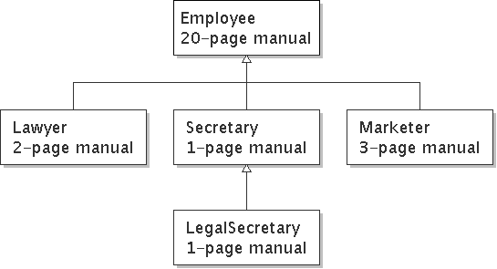
Inheritance
inheritance: Forming new classes based on existing ones.
  a way to share/reuse code between two or more classes
  superclass: Parent class being extended.
  subclass: Child class that inherits behavior from superclass.
    gets a copy of every field and method from superclass
  is-a relationship: Each object of the subclass also "is a(n)" object of the superclass and can be treated as one.

Slide 20
Inheritance syntax
  public class name extends superclass {
  public class Lawyer extends Employee {
  ...
  }
override: To replace a superclass's method by writing a new version of that method in a subclass.
  public class Lawyer extends Employee {
  // overrides getSalary method in Employee class;
  // give Lawyers a $5K raise
  public double getSalary() {
  return 55000.00;
  }
  }

Slide 21
super keyword
Subclasses can call inherited methods/constructors with super
  super.method(parameters)
  super(parameters);
  public class Lawyer extends Employee {
  public Lawyer(int years) {
  super(years); // calls Employee constructor
  }
  // give Lawyers a $5K raise
  public double getSalary() {
  double baseSalary = super.getSalary();
  return baseSalary + 5000.00;
  }
  }
  Lawyers now always make $5K more than Employees.

Slide 22
Exercise solution
public class TallyDownloader extends Downloader {
public TallyDownloader(String url) throws MalformedURLException {
super(url); // call Downloader constructor
}
// Reads from URL and prints file contents and tally of each char.
public void download(String targetFileName) throws IOException {
super.download(targetFileName);
Map<Character, Integer> counts = new TreeMap<Character, Integer>();
FileInputStream in = new FileInputStream(targetFileName);
while (true) {
int n = in.read();
if (n == -1) {
break;
}
char ch = (char) n;
if (counts.containsKey(ch)) {
counts.put(ch, counts.get(ch) + 1);
} else {
counts.put(ch, 1);
}
System.out.print(ch);
}
in.close();
System.out.println(counts); // print map of char -> int
}
}

Slide 23
Exercise solution 2
import java.io.*;
import java.net.*;
import java.util.*;
public class DownloadMain {
public static void main(String[] args) {
Scanner console = new Scanner(System.in);
System.out.print("URL to download? ");
String urlString = console.nextLine();
Downloader down = null; // create a tallying downloader;
while (down == null) { // re-prompt the user if this fails
try {
down = new TallyDownloader(urlString);
} catch (MalformedURLException e) {
System.out.print("Bad URL! Try again: ");
urlString = console.nextLine();
}
}
...
}
}

