Slide 1
Developing Trust Networks based on User Tagging Information for Recommendation Making
Touhid Bhuiyan et al.
WISE 2010
4 May 2012
SNU IDB Lab.
Hyunwoo Kim

Slide 2
Outline
Introduction
Proposed Trust Estimation
Evaluation
Conclusion
Discussion

Slide 3
Introduction
Definition of trust*
“A subjective expectation an agent has about another’s future behavior based on the history of their encounters”
* Mui et al. “A computational model of trust and reputation” HICSS 2002

Slide 4


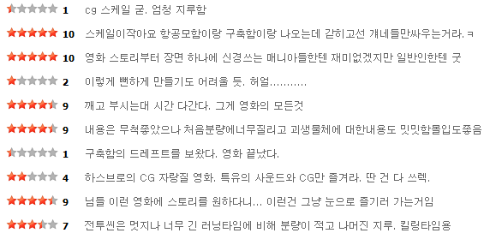

Introduction
Trust issues in recommender systems
Wisdom of Crowds?
Trust!

Slide 5

Introduction
No explicit trust relationship in recommender systems
Extracting trust relationship from tags
Tagging information
Trust relationship

Slide 6

Proposed Trust Estimation
a tag
item 1
item 2
item 3
item 4
keyword 1
keyword 2
keyword 3
Topic
keyword 4
keyword 5
keyword 6

Slide 7



Proposed Trust Estimation
Trust measure
keyword 1
keyword 1
keyword 2
tag tag tag tag tag tag tag tag tag tag tag tag
tag tag tag tag tag tag tag tag tag tag tag tag
keyword 2
…
…
keyword n
tag tag tag tag tag tag tag tag tag tag tag tag
keyword n
$$\frac{2}{6}$$

Slide 8




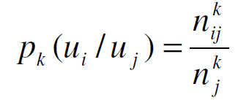
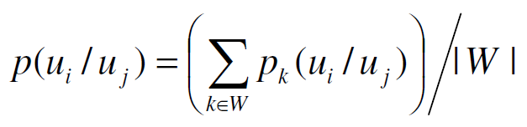
Proposed Trust Estimation
: a set of tags that are used by u_{i}
: a set of frequent keywords given t_{ij}
: the frequency of the keywords
Measuring the strength of each keyword in tag t_{ij} to represent the meaning of the tag
Calculating the similarity of two tags in terms of their semantic meaning
: the set of tags used by user u_{i} and u_{j}
The collection of keyword sets for the tags in T_{i} and T_{j}
How similar user u_{i} is interested in keyword k given that user u_{j} is interested in the keyword k

Slide 9
Proposed Trust Estimation
Recommendation process: CF
item
item
item
Similar neighbors

Slide 10
Proposed Trust Estimation
Trust propagation
Trust relationship

Slide 11
Evaluation
Book dataset from www.amazon.com
3,872 users
29,069 books
54,091 records
Evaluation measures
Precision
Recall
F-measure

Slide 12
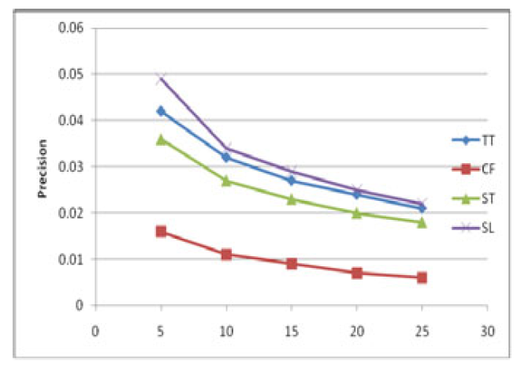
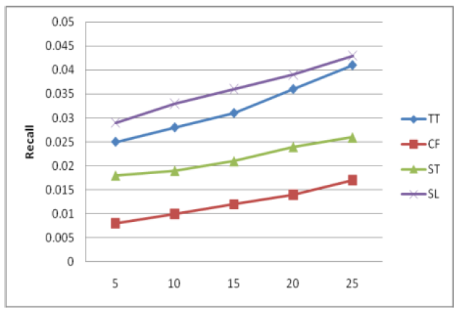
Evaluation
Compared approaches
CF: traditional CF
ST: proposed approach
TT: proposed approach + Tidal Trust algorithm
SL: proposed approach + previously proposed DSPG using Subjective Logic
# of recommended items
# of recommended items

Slide 13
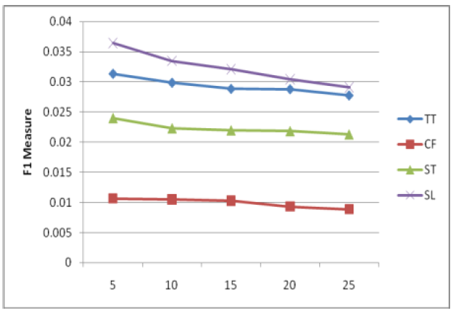
Evaluation
Compared approaches
CF: traditional CF
ST: proposed approach
TT: proposed approach + Tidal Trust algorithm
SL: proposed approach + previously proposed DSPG using Subjective Logic
# of recommended items

Slide 14
Conclusion
A new algorithm for generating trust networks based on user tagging information
Helpful to deal with data sparsity problem

Slide 15
Discussion
Strong points
First research on extracting implicit trust relationship from tags
Weak points
Does this research extract real trust relationships?
No evaluation on developed trust relationships
Requiring descriptions of items
Not applicable to multimedia data, especially pictures and videos

Slide 16
In Tags We Trust: Trust Modeling in Social Tagging of Multimedia Content
Ivan Ivanov et al.
IEEE Signal Processing Magazine 2012

Slide 17
Thank You

