Slide 1
Chapter 17: Database System Architectures

Slide 2
Database System Concepts
Chapter 1: Introduction
Part 1: Relational databases
  Chapter 2: Introduction to the Relational Model
  Chapter 3: Introduction to SQL
  Chapter 4: Intermediate SQL
  Chapter 5: Advanced SQL
  Chapter 6: Formal Relational Query Languages
Part 2: Database Design
  Chapter 7: Database Design: The E-R Approach
  Chapter 8: Relational Database Design
  Chapter 9: Application Design
Part 3: Data storage and querying
  Chapter 10: Storage and File Structure
  Chapter 11: Indexing and Hashing
  Chapter 12: Query Processing
  Chapter 13: Query Optimization
Part 4: Transaction management
  Chapter 14: Transactions
  Chapter 15: Concurrency control
  Chapter 16: Recovery System
Part 5: System Architecture
  Chapter 17: Database System Architectures
  Chapter 18: Parallel Databases
  Chapter 19: Distributed Databases
Part 6: Data Warehousing, Mining, and IR
  Chapter 20: Data Mining
  Chapter 21: Information Retrieval
Part 7: Specialty Databases
  Chapter 22: Object-Based Databases
  Chapter 23: XML
Part 8: Advanced Topics
  Chapter 24: Advanced Application Development
  Chapter 25: Advanced Data Types
  Chapter 26: Advanced Transaction Processing
Part 9: Case studies
  Chapter 27: PostgreSQL
  Chapter 28: Oracle
  Chapter 29: IBM DB2 Universal Database
  Chapter 30: Microsoft SQL Server
Online Appendices
  Appendix A: Detailed University Schema
  Appendix B: Advanced Relational Database Model
  Appendix C: Other Relational Query Languages
  Appendix D: Network Model
  Appendix E: Hierarchical Model

Slide 3
Chapter 17: Database System Architectures
17.1 Centralized and Client-Server Systems
17.2 Server System Architectures
17.3 Parallel Systems
17.4 Distributed Systems
17.5 Network Types

Slide 4
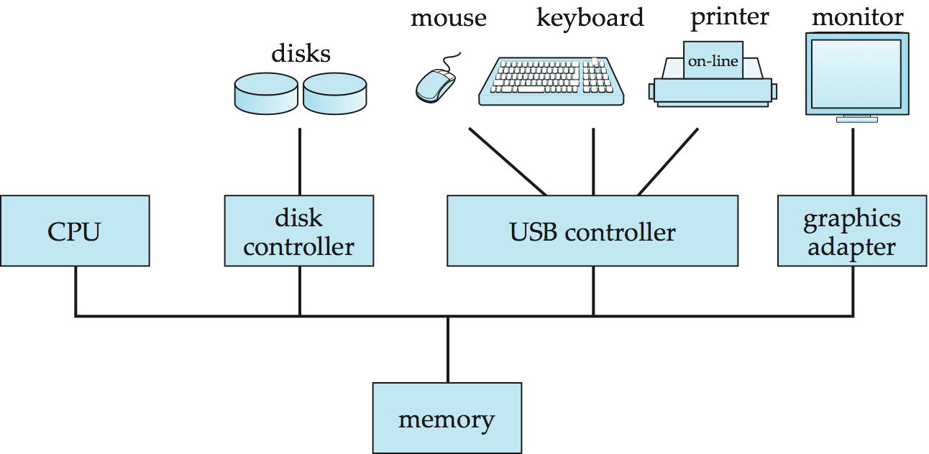
Centralized Systems
Run on a single computer system and do not interact with other computer systems.
General-purpose computer system: one to a few CPUs and a number of device controllers that are connected through a common bus that provides access to shared memory.
Single-user system (e.g., personal computer or workstation): desk-top unit, single user, usually has only one CPU and one or two hard disks; the OS may support only one user.
Multi-user system: more disks, more memory, multiple CPUs, and a multi-user OS. Serve a large number of users who are connected to the system vie terminals. Often called server systems.

Slide 5
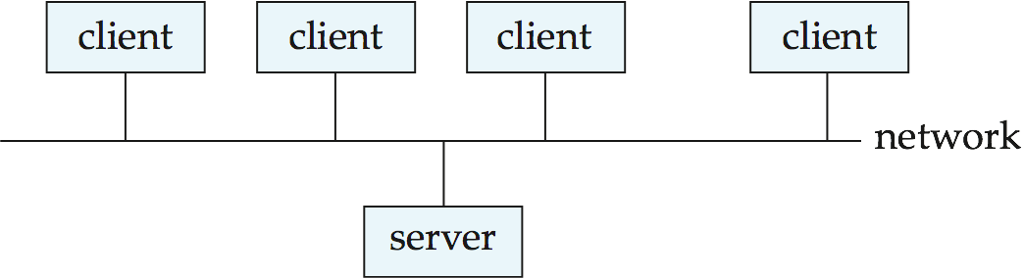
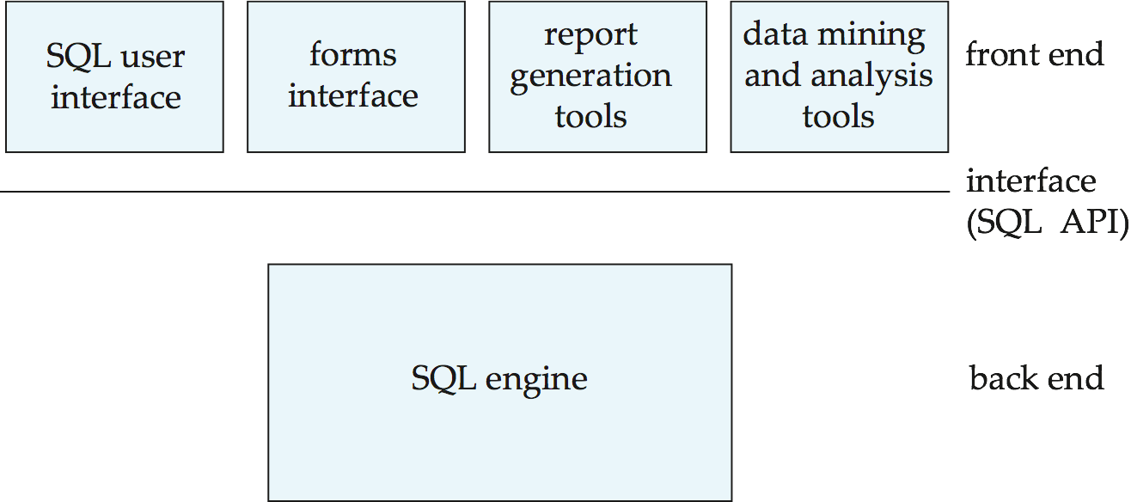
Client-Server Systems
Server systems satisfy requests generated at m client systems, whose general structure is shown below:
Database functionality can be divided into:
  Back-end: manages access structures, query evaluation & optimization, CC and recovery.
  Front-end: consists of tools such as forms, report-writers, and graphical UI facilities.
The interface between the front-end and the back-end is through SQL or through an application program interface (ex. CLI)

Slide 6
Client-Server Systems (Cont.)
Advantages of replacing mainframes with networks of workstations or personal computers connected to back-end server machines:
  better functionality for the cost
  flexibility in locating resources and expanding facilities
  better user interfaces
  easier maintenance
Server systems can be broadly categorized into two kinds:
  transaction servers which are widely used in relational database systems
  data servers, used in object-oriented database systems

Slide 7
Chapter 17: Database System Architectures
17.1 Centralized and Client-Server Systems
17.2 Server System Architectures
17.3 Parallel Systems
17.4 Distributed Systems
17.5 Network Types

Slide 8
Transaction Server vs. Data Server
client
Application
Half of DBMS or
Full DBMS
* Application
client
Push SQL
& Transactions
Request Pages
Query Results
Requested Pages
Updated Pages
Half of DBMS or
Full DBMS
* DBMS
server
server

Slide 9
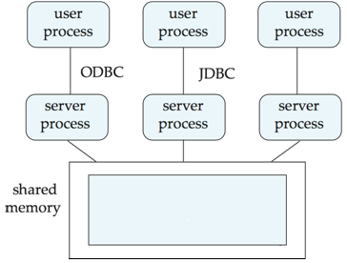
Transaction Servers
Also called query server systems or SQL server systems
  clients send requests to the server system where the transactions are executed, and results are shipped back to the client.
Requests specified in SQL, and communicated to the server through a remote procedure call (RPC) mechanism.
  Transactional RPC allows many RPC calls to collectively form a transaction.
Open Database Connectivity (ODBC) is a C API standard from Microsoft for connecting to a server, sending SQL requests, and receiving results.
JDBC standard similar to ODBC, for Java
RPC
Query Server
or
SQL Server

Slide 10
Transaction Server Process Structure
A typical transaction server consists of multiple processes accessing data in shared memory.
Server processes
  Receive user queries (transactions), execute them & send results back
  Typically multiple multithreaded server processes allowing a single process to execute several user queries concurrently
Lock manager process: More on this later
Database writer process: Output modified buffer blocks to disks continually
Log writer process
  Server processes simply add log records to log record buffer
  Log writer process outputs log records to stable storage.
Checkpoint process: Performs periodic checkpoints
Process monitor process
  Monitors other processes, and takes recovery actions if any of the other processes fail
    E.g. aborting any transactions being executed by a server process and restarting it

Slide 11
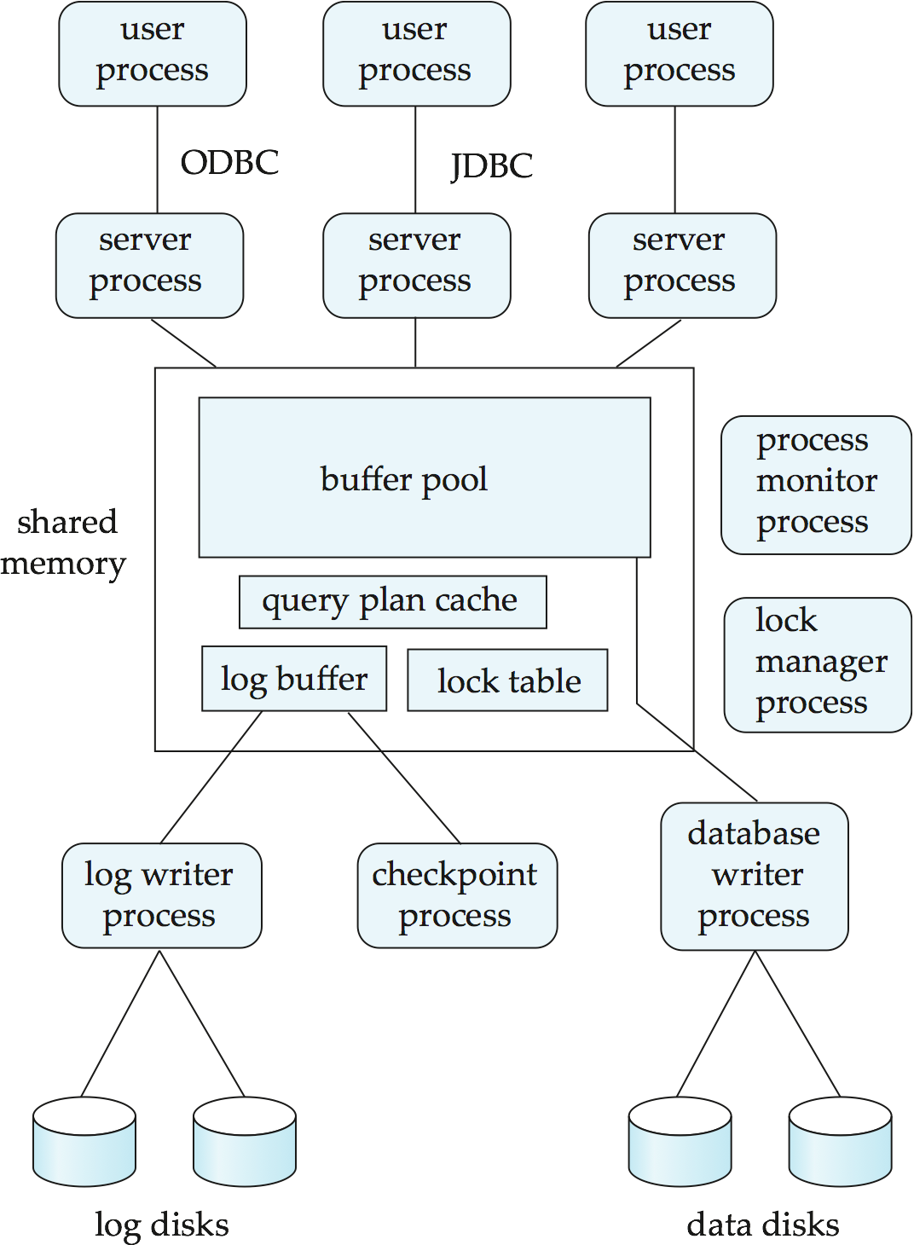
Transaction System Processes (Cont.)
RPC
Shared memory contains shared data
  Buffer pool // Lock table // Log buffer // Cached query plans
  All database processes can access shared memory
To ensure that no two processes are accessing the same data structure at the same time, databases systems implement mutual exclusion using either
  OS semaphores or Atomic instructions such as test-and-set

Slide 12
Transaction System Processes (Cont.)
Sending requests to lock manager process creates severe overhead of interprocess communication for lock request/grant
Instead each DB process operates directly on the lock table (Section 16.1.4)
  Mutual exclusion ensured on the lock table using semaphores, or more commonly, atomic instructions
  If a lock can be obtained, the lock table is updated directly in shared memory
  If a lock cannot be immediately obtained, a lock request is noted in the lock table and the process (or thread) then waits for lock to be granted
  When a lock is released, releasing process updates lock table to record release of lock, as well as grant of lock to waiting requests (if any)
  Process/Thread waiting for lock may either:
    Continually scan lock table to check for lock grant, or
    Use OS semaphore mechanism to wait on a semaphore.
      Semaphore identifier is recorded in the lock table
      When a lock is granted, the releasing process signals the
      semaphore to tell the waiting process/thread to proceed
  Lock manager process still used for deadlock detection

Slide 13
Data Servers
Used in high-speed LANs, in cases where
  The client machines are comparable in processing power to the server machine
  The tasks to be executed in the client machines are compute intensive.
Data are shipped to client machiness where processing is performed, and then shipped results back to the server machine.
This architecture requires full back-end functionality at the clients.
Used in many object-oriented database systems
Issues:
  Page-Shipping versus Item-Shipping
  Locking
  Data Caching
  Lock Caching

Slide 14
Data Servers (Cont.)
Page-Shipping versus Item-Shipping
  Smaller unit of shipping ⇒ more messages
  Worth prefetching related items along with requested item
  Page shipping can be thought of as a form of prefetching
Locking
  Overhead of requesting and getting locks from server is high due to message delays
    With item shipping, locks are granted on requested and prefetched items
    With page shipping, locks are granted on whole page
  Locks on a prefetched item can be called back by the server, and returned by client transaction if the prefetched item has not been used
  Locks on the page can be deescalated to locks on items in the page when there are lock conflicts.
    Locks on unused items can then be returned to server.

Slide 15
Data Servers (Cont.)
Data Caching
  Data can be cached at client even in between transactions
  But need to check that data is up-to-date before it is used (cache coherency)
  Check can be done when requesting lock on data item
Lock Caching
  Locks can be retained by client system even in between transactions
  Transactions can acquire cached locks locally, without contacting server
    Reduce communication overhead
  Server calls back locks from clients when it receives conflicting lock request
    Client returns lock once no local transaction is using it
  Similar to deescalation, but across transactions

Slide 16
Chapter 17: Database System Architectures
17.1 Centralized and Client-Server Systems
17.2 Server System Architectures
17.3 Parallel Systems
17.4 Distributed Systems
17.5 Network Types

Slide 17
Parallel Systems
Parallel database systems consist of multiple processors and multiple disks connected by a fast interconnection network.
  A coarse-grain parallel machine consists of a small number of powerful processors
  A fine grain parallel or massively parallel machine utilizes thousands of smaller processors.
Two main performance measures:
  throughput --- the number of tasks that can be completed in a given time interval
  response time --- the amount of time it takes to complete a single task from the time it is submitted

Slide 18
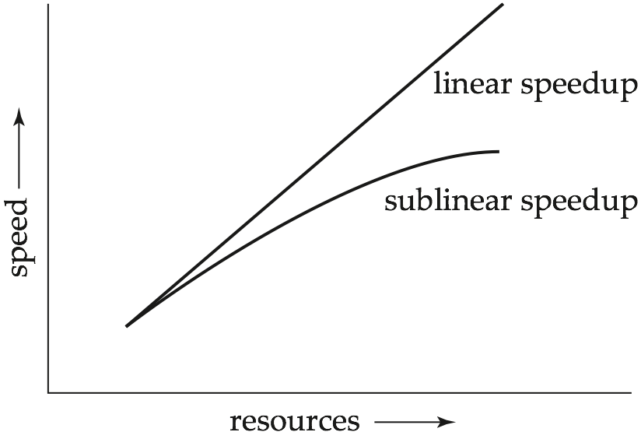
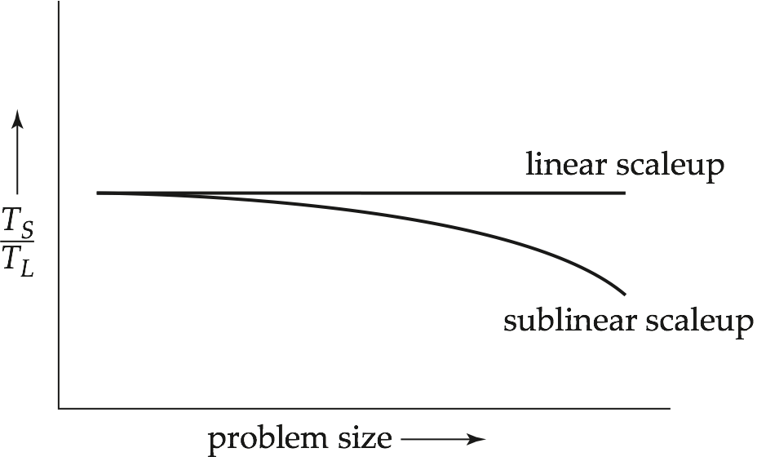
Speed-Up and Scale-Up
Speedup: a fixed-sized problem executing on a small system is given to a N-times larger system
  speedup = small system elapsed time / large system elapsed time
  Speedup is linear if equation equals N.
Scaleup: increase the size of both the problem and the system
  N-times larger system used to perform N-times larger job
  scaleup = small system small problem elapsed time (TS) / big system big problem elapsed time (TL)
  Scale up is linear if equation equals 1.
Speedup
Scaleup

Slide 19
Batch and Transaction Scaleup
Batch scaleup:
  A single large job
    typical of most database queries and scientific simulation
  Use an N-times larger computer on N-times larger problem
Transaction scaleup:
  Numerous small queries submitted by independent users to a shared database
    typical transaction processing and timesharing systems.
  N-times as many users submitting requests (hence, N-times as many requests) to an N-times larger database, on an N-times larger computer.
  Well-suited to parallel execution

Slide 20
Factors Limiting Speedup and Scaleup
Speedup and scaleup of parallel processing are often sublinear due to:
Startup costs
  Cost of starting up multiple processes may dominate computation time, if the degree of parallelism is high.
Interference
  Processes accessing shared resources (e.g.,system bus, disks, or locks) compete with each other, thus spending time waiting on other processes, rather than performing useful work.
Skew
  Increasing the degree of parallelism increases the variance in service times of parallely executing tasks.
  Overall execution time determined by slowest of parallely executing tasks.

Slide 21
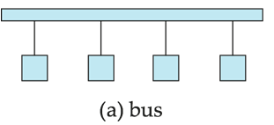
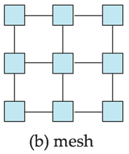
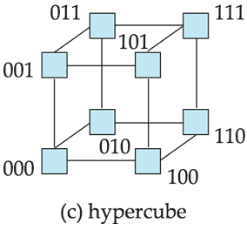
Interconnection Network Architectures
Bus
  System components send data on and receive data from a single bus
  Does not scale well with increasing parallelism
Mesh
  Components are arranged as nodes in a grid, and each component is connected to all adjacent components
  Communication links grow with growing number of components, and so scales better
  But may require 2√n hops to send message to a node (or √n with wraparound connections at edge of grid)
Hypercube
  Components are numbered in binary
  Components are connected to one another if their binary representations differ in exactly one bit
  N components are connected to log(n) other components and can reach each other via at most log(n) links; reduces communication delays

Slide 22
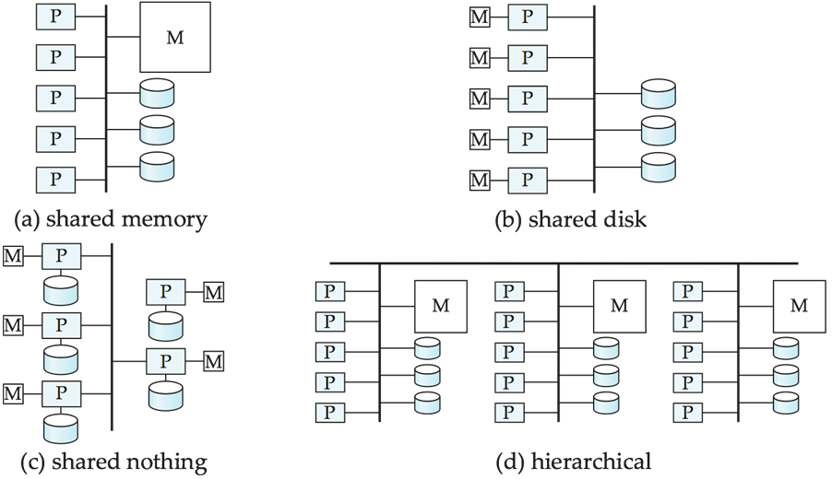
Parallel Database Architectures
Shared memory -- processors share a common memory
Shared disk -- processors share a common disk, sometimes called clusters
Shared nothing -- processors share neither a common memory nor common disk
Hierarchical -- hybrid of the above architectures

Slide 23
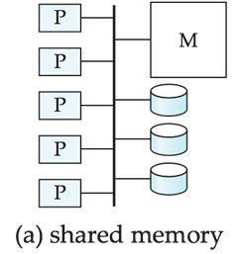
Shared-Memory Parallel DB
Processors and disks have access to a common memory, typically via a bus or through an interconnection network.
Advantage
  Extremely efficient communication between processors
  Data in shared memory can be accessed by any processor without having to move it using software.
Downside
  Architecture is not scalable beyond 32 or 64 processors since the bus or the interconnection network becomes a bottleneck
Widely used for lower degrees of parallelism (4 to 8).

Slide 24
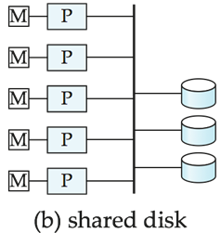
Shared-Disk Parallel DB
All processors can directly access all disks via an interconnection network, but the processors have private memories.
  The memory bus is not a bottleneck
  Architecture provides a degree of fault-tolerance — if a processor fails, the other processors can take over its tasks since the database is resident on disks that are accessible from all processors.
Examples: IBM Sysplex and DEC clusters (now part of Compaq) running RDBMS (now Oracle RDBMS) were early commercial users of this architecture
Downside: bottleneck now occurs at interconnection to the disk subsystem.
Shared-disk systems can scale to a somewhat larger number of processors, but communication between processors is slower.

Slide 25
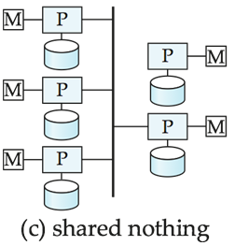
Shared-Nothing Parallel DB
Node consists of a processor, memory, and one or more disks.
  Processors at one node communicate with another processor at another node using an interconnection network.
  A node functions as the server for the data on the disk the node owns.
Examples: Teradata, Tandem, Oracle n-CUBE
Data in local disks (and local memory) cannot be accessed through interconnection network, thereby minimizing the interference of resource sharing.
Shared-nothing multiprocessors can be scaled up to thousands of processors without interference.
Main drawback: cost of communication and non-local disk access
  Sending data involves software interaction at both ends.

Slide 26
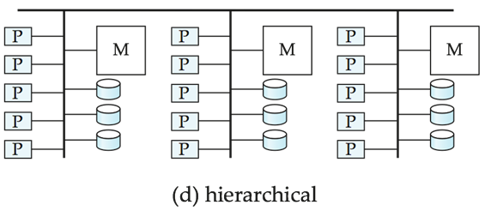
Hierarchical Parallel DB
Combines characteristics of shared-memory, shared-disk, and shared-nothing
  Top level is a shared-nothing architecture – nodes connected by an interconnection network, and do not share disks or memory with each other.
  Each node could be a shared-memory system with a few processors.
  Alternatively, each node could be a shared-disk system, and each of the systems sharing a set of disks could be a shared-memory system.
Reduce the complexity of programming such systems by distributed virtual-memory architectures
  Also called non-uniform memory architecture (NUMA)

Slide 27
Chapter 17: Database System Architectures
17.1 Centralized and Client-Server Systems
17.2 Server System Architectures
17.3 Parallel Systems
17.4 Distributed Systems
17.5 Network Types

Slide 28
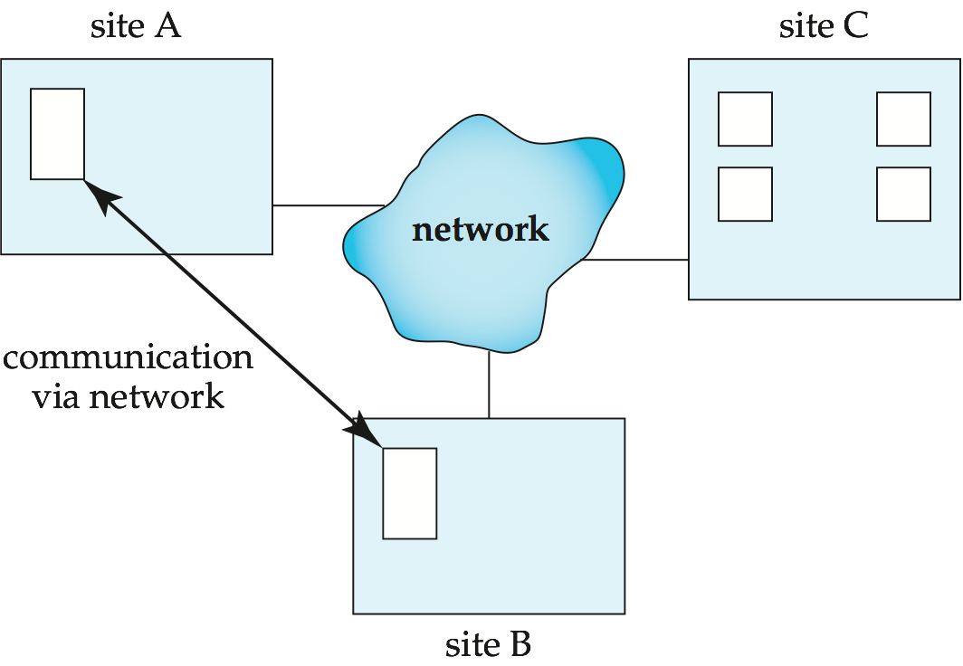
Distributed Systems
Data spread over multiple machines (also referred to as sites or nodes)
Network interconnects the machines
Data shared by users on multiple machines

Slide 29
Distributed Databases
Homogeneous distributed databases
  Same software/schema on all sites, data may be partitioned among sites
  Goal: provide a view of a single database, hiding details of distribution
Heterogeneous distributed databases
  Different software/schema on different sites
  Goal: integrate existing databases to provide useful functionality
Differentiate between local and global transactions
  A local transaction accesses data in the single site at which the transaction was initiated.
  A global transaction either accesses data in a site different from the one at which the transaction was initiated or accesses data in several different sites.

Slide 30
Trade-offs in Distributed Systems
Advantages
  Sharing data
    Users at one site able to access the data residing at some other sites.
  Autonomy
    Each site is able to retain a degree of control over data stored locally.
  Higher system availability through redundancy
    Data can be replicated at remote sites, and system can function even if a site fails.
Disadvantages: added complexity for proper coordination among sites
  Software development cost
  Greater potential for bugs
  Increased processing overhead

Slide 31
Implementation Issues for Distributed Databases
Atomicity needed even for transactions that update data at multiple sites
The two-phase commit protocol (2PC) used to ensure atomicity (Section 19.4.1)
  Basic idea: each site executes transaction till just before commit, and the leaves final decision to a coordinator
  Each site must follow decision of coordinator: even if there is a failure while waiting for coordinators decision
  2PC is not always appropriate
    Other transaction models (persistent messaging, workflows), may be used
Distributed concurrency control (and deadlock detection) required
Distributed query processing: reducing communication overhead
Replication of data items required for improving data availability
Details of above in Chapter 22

Slide 32
Chapter 17: Database System Architectures
17.1 Centralized and Client-Server Systems
17.2 Server System Architectures
17.3 Parallel Systems
17.4 Distributed Systems
17.5 Network Types

Slide 33
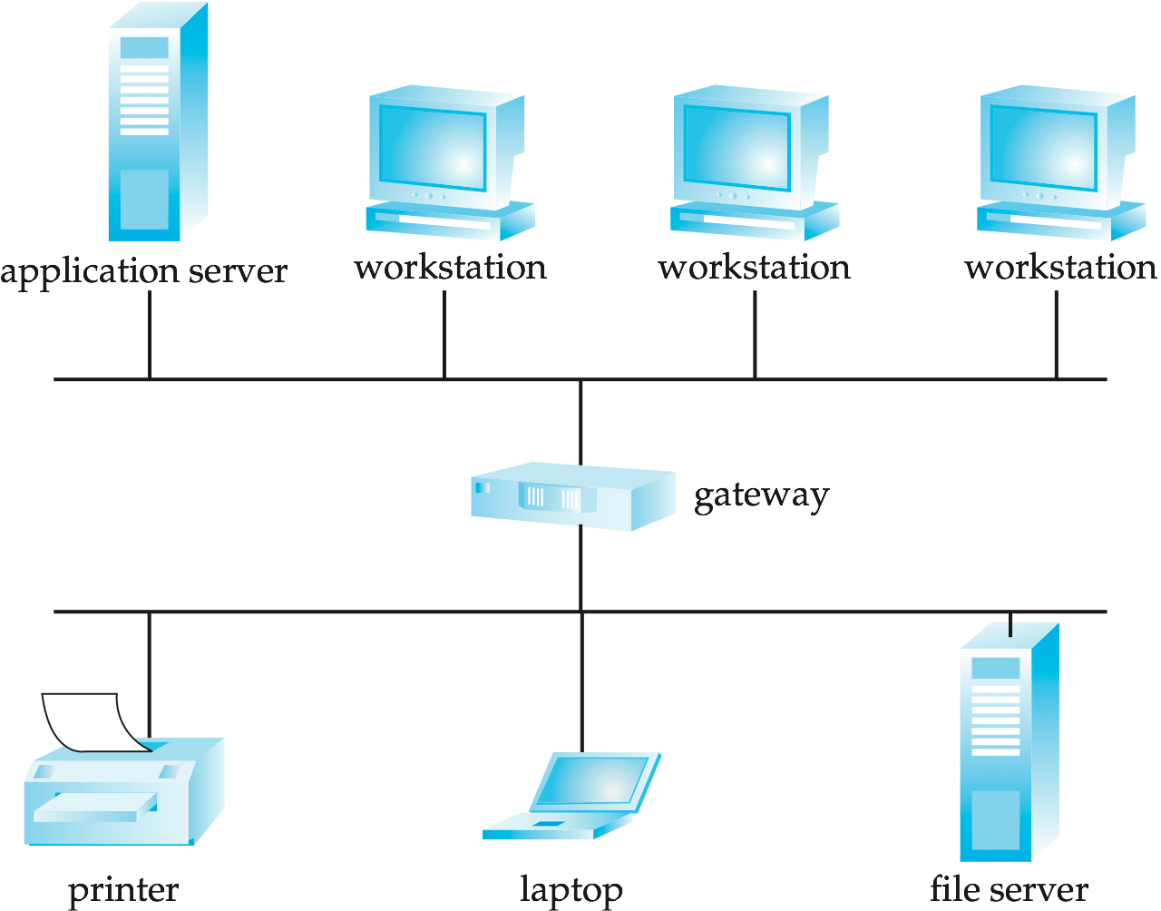
Local-Area Network
Local-area networks (LANs) – composed of processors that are distributed over small geographical areas, such as a single building or a few adjacent buildings.

Slide 34
Wide Area Networks
Wide-area networks (WANs) – composed of processors distributed over a large geographical area.
  Discontinuous Connection WANs, such as those based on periodic dial-up (e.g. using UUCP), that are connected only for part of the time
  Continuous Connection WANs, such as the Internet, where hosts are connected to the network at all times
WANs with continuous connection are needed for distributed database systems
WANs with discontinuous connection
  Earlier groupware applications such as Lotus Notes can work on this
  Data is replicated, so updates are propagated to replicas periodically
  No global locking is possible, and copies of data may be independently updated
  Non-serializable executions can thus result
    Conflicting updates may have to be detected, and resolved in an application dependent manner.

Slide 35
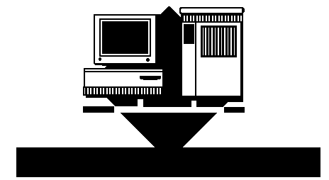

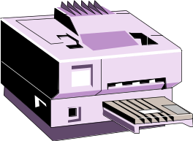
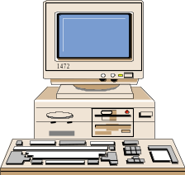
WAN (Wide Area Network)
Dedicated Computer: Stanford Gateway
Dedicated Computer: SNU ERCC Gateway
SNU LAN
Stanford LAN
Dedicated Computer: Oxford Gateway
Oxford LAN

Slide 36
End of Chapter 17

Slide 37
Figure 17.01

Slide 38
Figure 17.02

Slide 39
Figure 17.03

Slide 40
Figure 17.04

Slide 41
Figure 17.05

Slide 42
Figure 17.06

Slide 43
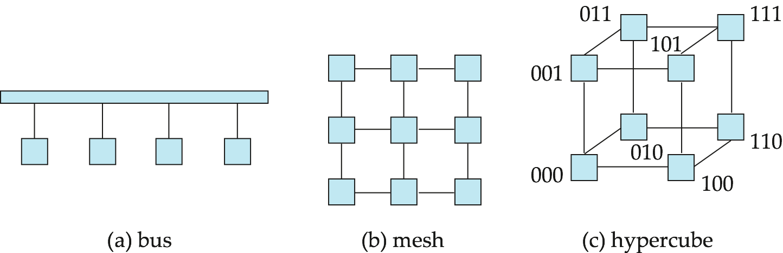
Figure 17.07

Slide 44
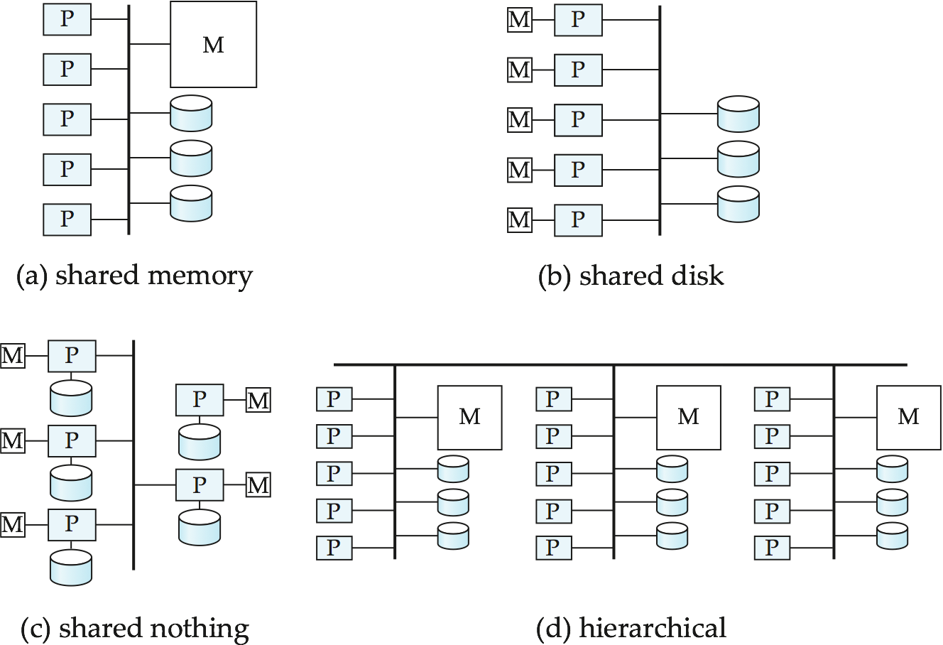
Figure 17.08

Slide 45
Figure 17.09

Slide 46
Figure 17.10

Slide 47
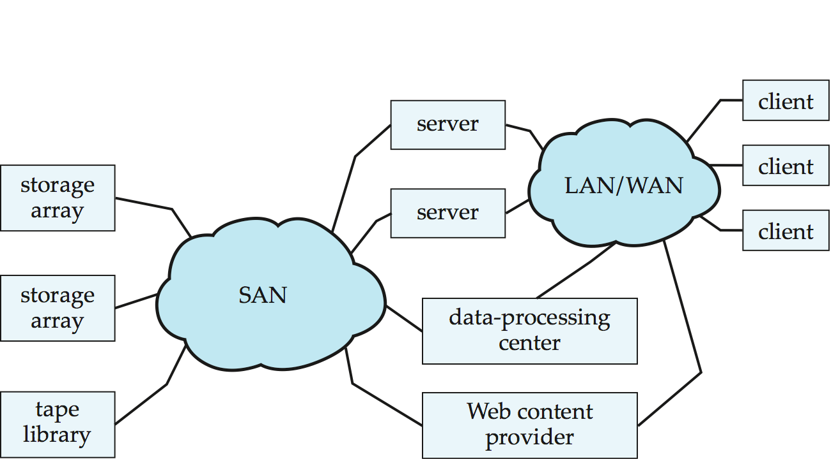
Figure 17.11

