Slide 1
Head First Python: Ch 3. Files and Exceptions: Dealing with Errors
Aug 26, 2013
Kyung-Bin Lim

Slide 2
Outline
Data is external to your program
It’s all lines of text
Take a closer look at the data
Know your data
Know your methods and ask for help
Modified code
Know your data (better)
Two very different approaches
First approach: Add extra logic
First approach: Code
Second approach: Try first, then recover
Second approach: Code
What if file doesn’t exist?
Using another level of exception handling
Conclusion: So which is better?

Slide 3
Data is external to your program
Most of your programs conform to the input-output model; data comes in, gets manipulated, and then stored, displayed, printed, or transferred
So far, you’ve learned how to process data as well as display it on screen
But, HOW does Python read data from a file?

Slide 4
It’s all lines of text
The basic input mechanism in Phython is line based: when read into your program from a text file, data arrives one line at a time
Python’s open() function lives to interact with files. When combined with a for statement, reading file is straightforward.
the_file = open(‘sketch.txt)
# Do something with the data
# in “the_file”
The_file = close()

Slide 5
Exercise
Start an IDEL session and import the OS to move to the correct directory
import os
os.getcwd()
os.chdir(‘... your file directory…’)
Now, open your data file and read the first two lines from the file
data = open(‘sketch.txt’)
print(data.readline(), end=‘’)
Man: Is this the right room for an argument?
print(data.readline(), end=‘’)
Other Man: I've told you once.

Slide 6
Exercise
Let’s rewind the file back to the start
data.seek(0)
You can read every line in the file using for statement
for each_line in data:
print(each_line, end=‘’)

Slide 7
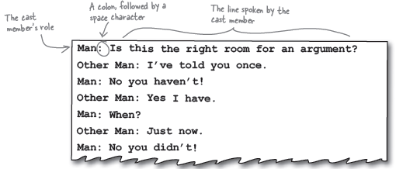
Take a closer look at the data
Look closely at the data. It appears to conform to a specific format.

Slide 8
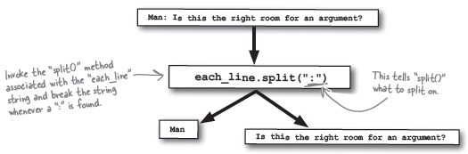
Take a closer look at the data
With this format in mind, you can process each line to extract parts of the line as required. the split() method can help here:
The split() method returns a list of string, which are assigned to a list of target identifiers. This is known as multiple assignments.
(role, line_spoken) = each_line.split(“:”)

Slide 9
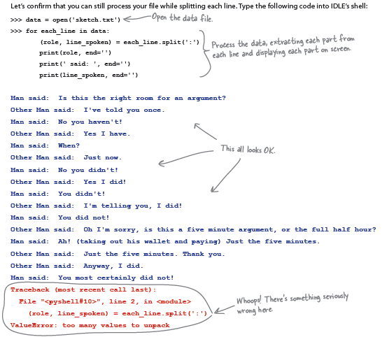
Exercise

Slide 10
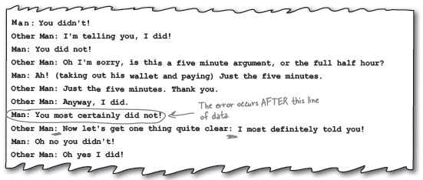
Know your data
Your code worked fine for a while, then crashed with a runtime error.
Let’s look at the data file and see where it crashed.
The line has TWO colons! This caused split() method to crash, since our code currently expects it to break the line into two parts.
When there is two colons, the split() method breaks the line into three parts and our code doesn’t know what to do if it gets three pieces of string. So is raises a ValueError.

Slide 11
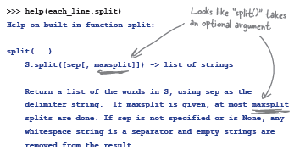
Know your methods and ask for help
help() tells you more about BIF methods
The optional argument to split() controls how many breaks occur
By default, the data is broken into as many parts as is possible
Since we need only two parts, we will set it to 1

Slide 12
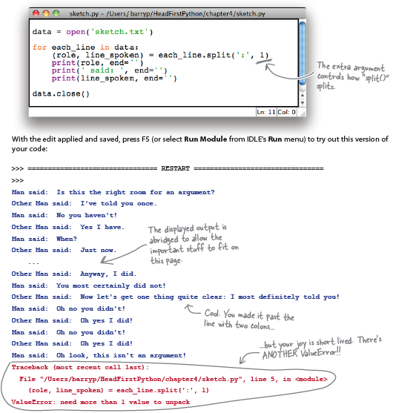
Modified code

Slide 13
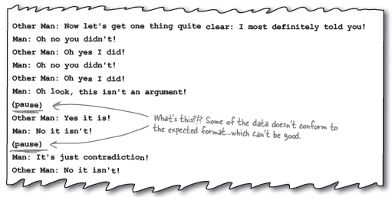
Know your data (better)
Your code has raised another ValueError.
Problem: Some of the lines of data contain no colon, which causes a problem when the split() method goes looking for it. The lack of a colon prevents split() from doing its job, causes the runtime error, which then results in the complaint that the interpreter needs “more than 1 value.”

Slide 14
Two very different approaches
First approach:
Add extra logic required work out whether it’s worth invoking split() on the line of data
Second approach:
Let the error occur, then simply handle each error if and when it happens

Slide 15
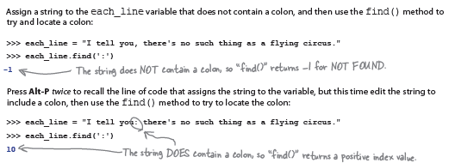
First approach: Add extra logic
find() method finds location of a substring in another string, and if it can’t be found, the find() method returns the value -1. If the method locates the substring, it returns the index of the substring

Slide 16
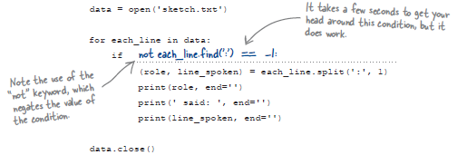
First approach: Code

Slide 17
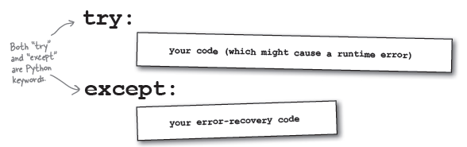
Second approach: Try first, then recover
Exception handling: Lets the error occur, spots that it has happened, and then recover
try/except mechanism: A way to systematically handle exceptions and errors at runtime

Slide 18
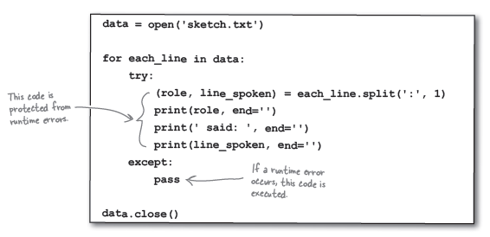
Second approach: Code

Slide 19
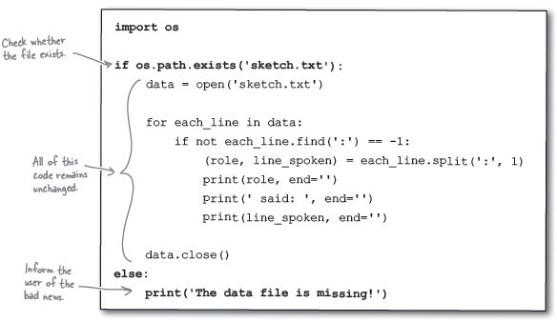
What if file doesn’t exist?
Python’s OS module has exist() method that can help determine whether a data file exists.

Slide 20
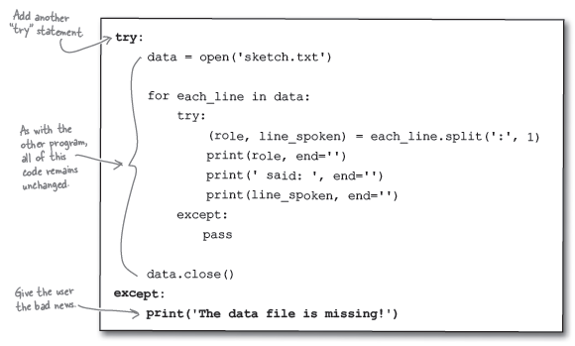
Using another level of exception handling

Slide 21
Conclusion: So which is better?
First approach (adding more logic/code)
Too complex
Code gets longer and complicated
Second approach (exception handling)
Simple
You can concentrate on what your code needs to do
Easier to read, write, and fix

