Slide 1
A Media-based Social Interactions Analysis Procedure
Alan Keller Gomes and Maria da Graça Campos Pimentel
SAC’12
17 March 2015
Hyewon Lim

Slide 2
Outline
Introduction
Measuring Social Interactions
Proposed Analysis Procedure
A Case Study using Facebook
Conclusion

Slide 3
Introduction
Social interactions
Defined as the acts, actions, or practices of two or more people
Any behavior that tries to affect or take account of each other’s subjective experiences or intentions
A demand for providing a human-readable model
for the representation and the evaluation of situations which involve users in social interactions
Suggestions
Graph from Sociology
The form of if-then rules from Experimental Social Psychology

Slide 4
Introduction
Observation
Social interactions can be specified as behavioral contingencies
Modeled as if-then rules
Social interactions can be measured using data mining procedures
“An analysis procedure of media-based social interactions”
by ranking rules associated with social interactions which involve not only posts, comments and likes, but also different types of media

Slide 5
Outline
Introduction
Measuring Social Interactions
Proposed Analysis Procedure
A Case Study using Facebook
Conclusion

Slide 6
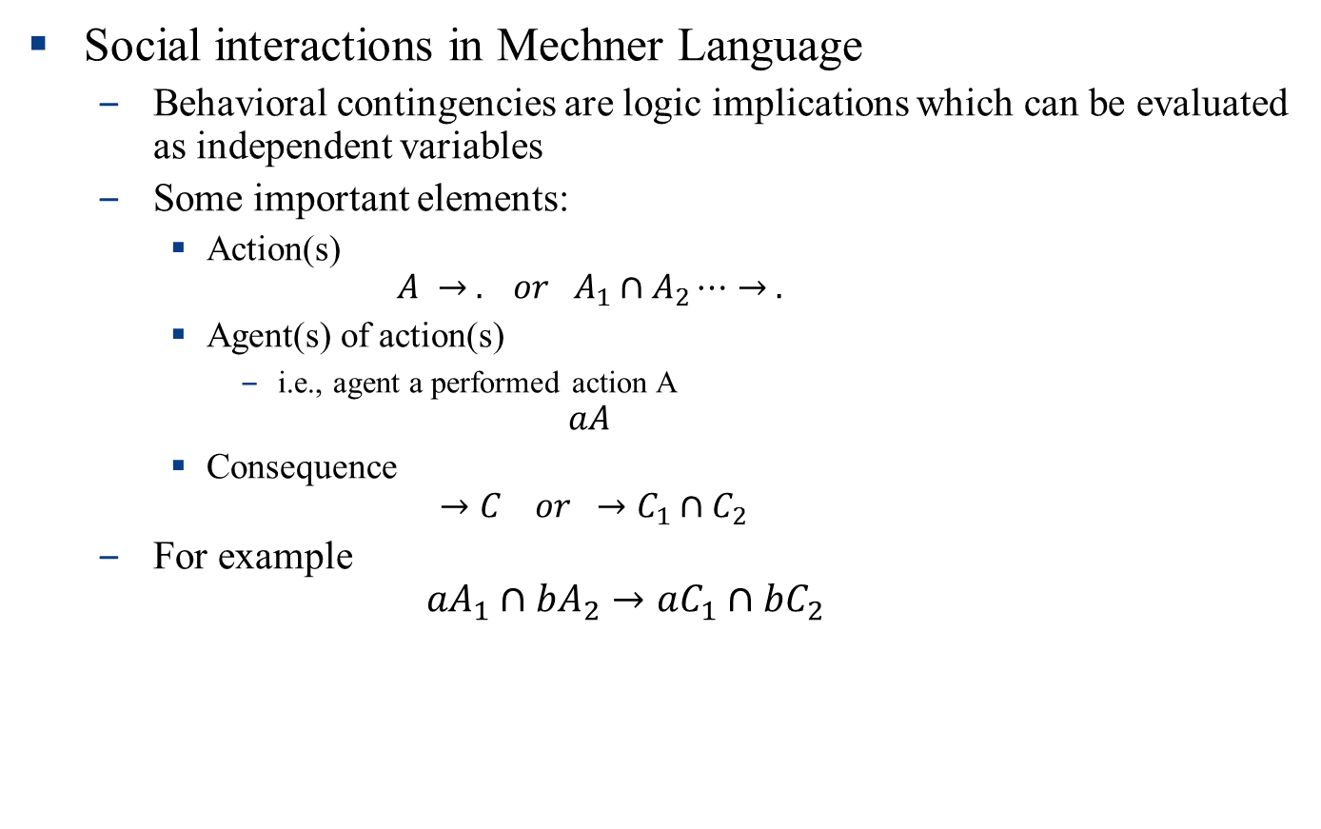
Measuring Social Interactions
Social interactions in Mechner Language
Behavioral contingencies are logic implications which can be evaluated as independent variables
Some important elements:
Action(s)
$$A → . or A_{1}∩A_{2}⋯→ .$$
Agent(s) of action(s)
i.e., agent a performed action A
$$aA$$
Consequence
$$→C or →C_{1}∩C_{2}$$
For example
$${aA}_{1}∩bA_{2}→aC_{1}∩bC_{2}$$

Slide 7
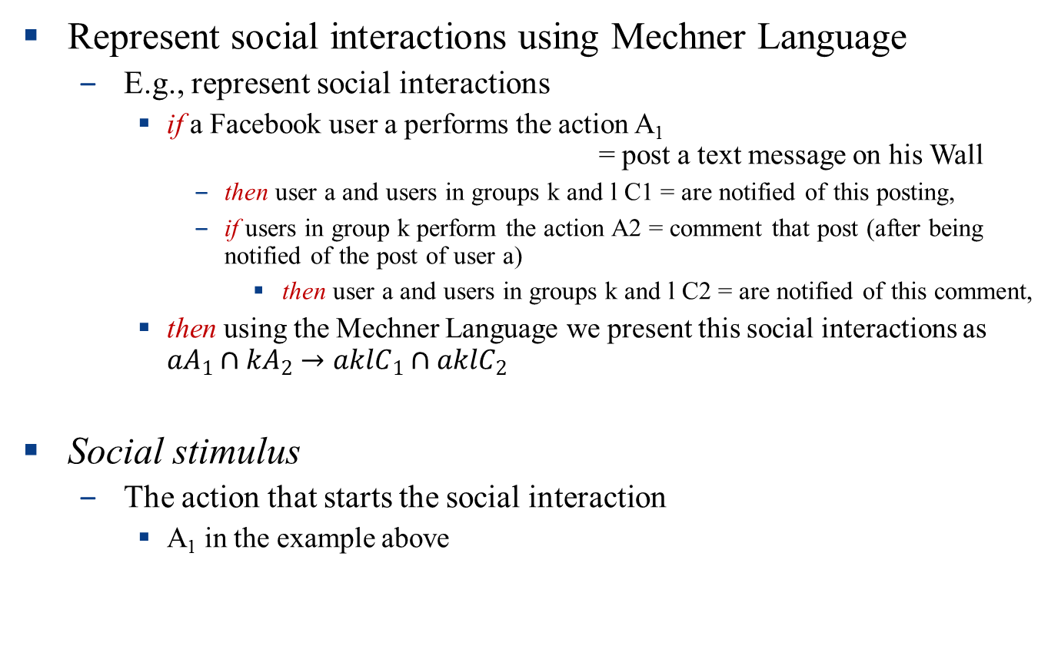
Measuring Social Interactions
Represent social interactions using Mechner Language
E.g., represent social interactions
if a Facebook user a performs the action A₁ = post a text message on his Wall
then user a and users in groups k and l C1 = are notified of this posting,
if users in group k perform the action A2 = comment that post (after being notified of the post of user a)
then user a and users in groups k and l C2 = are notified of this comment,
then using the Mechner Language we present this social interactions as ${aA}_{1}∩kA_{2}→aklC_{1}∩aklC_{2}$
Social stimulus
The action that starts the social interaction
A₁ in the example above

Slide 8
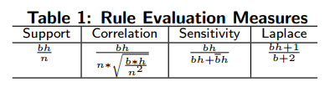

Measuring Social Interactions
Behavioral contingencies measurement
Comparing it with a set of observations
Behavioral contingences R = Body → Head
$$n=bh+b\overline{h}+\overline{b}h+\overline{b}\overline{h}$$
Rule evaluation measures
symmetric
asymmetric

Slide 9
Outline
Introduction
Measuring Social Interactions
Proposed Analysis Procedure
A Case Study using Facebook
Conclusion

Slide 10
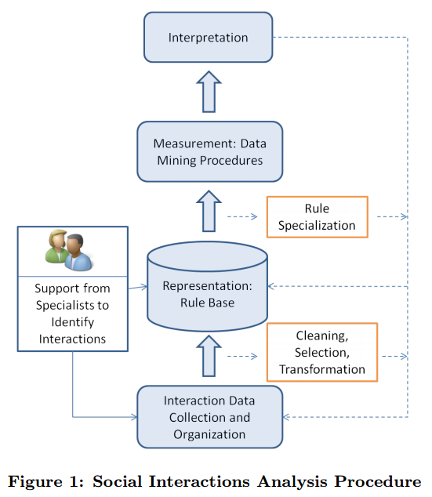
Proposed Analysis Procedure
Overview

Slide 11

A Case Study using Facebook
1. Data collection and preparation
1,400 profiles
> 600,000 actions
27,137 behavioral contingencies (observation)

Slide 12
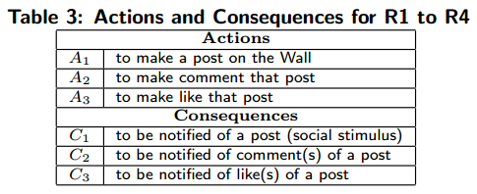
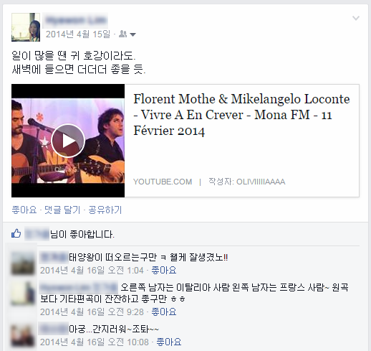
A Case Study using Facebook
2. Media-based social interactions
A₁
A₂, group k
A₃, group l

Slide 13
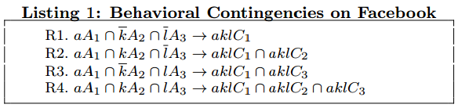
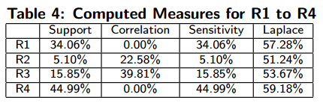
A Case Study using Facebook
2. Media-based social interactions (cont.)
Mapping user actions in the Mechner language
Computing how much they occur in the data set
Correlation: R3 > R2 > R1, R4
Others: R4 > R1 > R3 > R2
: No response
: Comment
: Like
: Comment & like

Slide 14
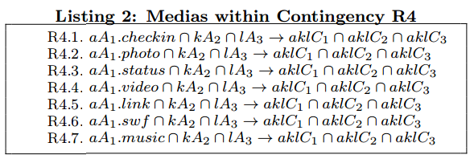
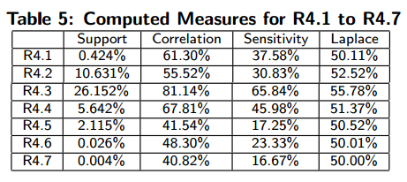
A Case Study using Facebook
2. Media-based social interactions (cont.)
Specializing as media-based social interactions
Computing how much they occur in the data set
Video!

Slide 15
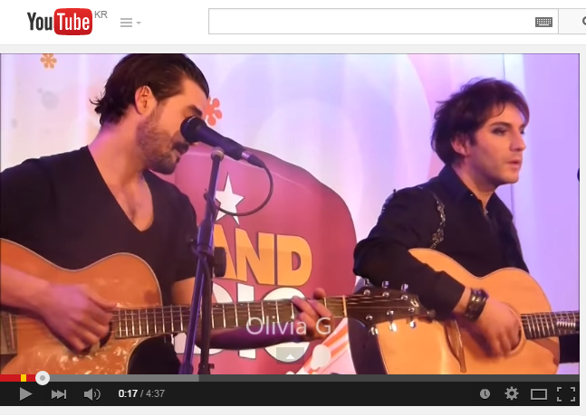
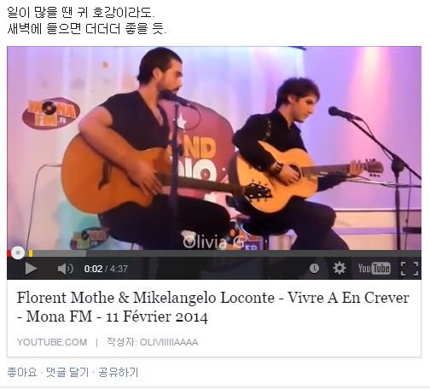
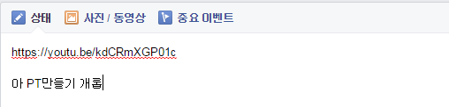
A Case Study using Facebook
3. Media-based sharing
It is important to observe the responses to original actions
✓

Slide 16
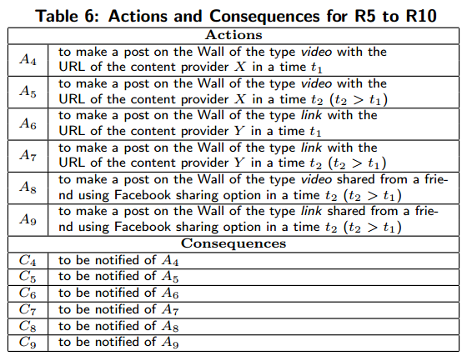
A Case Study using Facebook
3. Media-based sharing
It is important to observe the responses to original actions
Original action
New interaction
Original action
New interaction
Response (sharing media)

Slide 17
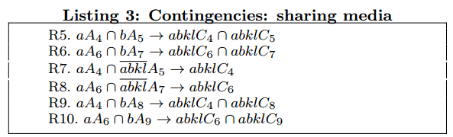
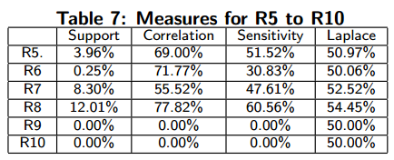
A Case Study using Facebook
3. Media-based sharing
It is important to observe the responses to original actions
Computing how much they occur in the data set
R8 > R5 > R6 > R7 > R9 > R10 (cf. video, link)
① Original action + new interaction
② Original action + no replies
③ Original action + response (sharing media)
②
①
③

Slide 18
Outline
Introduction
Measuring Social Interactions
Proposed Analysis Procedure
A Case Study using Facebook
Conclusion

Slide 19
Conclusion
Proposed a human-readable technique
for the representation and the evaluation of social interactions
Case study
Users are more involved in social interaction via comments and likes
Video is the most frequent media type to receive comments and likes
Identify a common behavior in the media sharing
Video: go to the original media provider and start a new social interaction
Link: not shared with others

Slide 20
Conclusion
Future work
Make all timing information explicit in the rules
to facilitate identifying the dynamics of media sharing in the social network
Extend the analysis to consider the diversity of the social connections
Investigate the use of the analysis
in the context of reputation systems and community-authored content

