Slide 1

Session 14
Modeling the Functional View:
The Activity Diagram
Written by Thomas A. Pender
Published by Wiley Publishing, Inc.
October 20, 2011
Presented by Jee-bum Park

Slide 2
Contents
Introducing the Activity Diagram
Taking a Look at Activity Diagram Notation

Slide 3
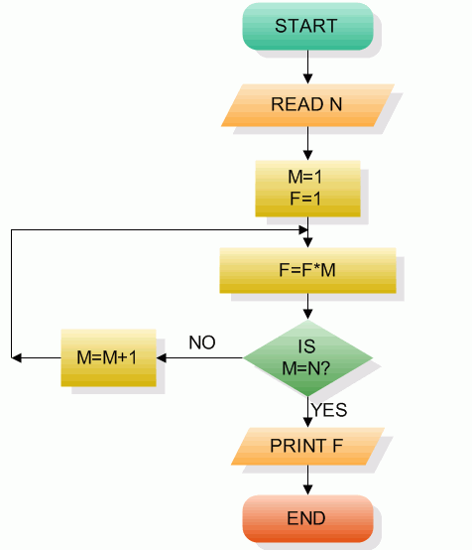
Introducing the Activity Diagram (1/2)
In the past, you used flowcharts
  A simple technique with a wide range of applications
The Activity diagram
  An enhanced version of flowcharts
Where might you use the Activity diagram?
  Workflow
  Use Cases
  Operations

Slide 4
Introducing the Activity Diagram (2/2)
When modeling a Use Case,
  Use the Activity diagram to follow the user through a procedure
A workflow-level Activity diagram represents the order of execution
The Activity diagram will likely reveal the essential elements of the process in a way that is familiar to the users
The Activity diagram contains all the logical constructs
  In fact, it can translate quite well into pseudo-code or even native code

Slide 5
Contents
Introducing the Activity Diagram
Taking a Look at Activity Diagram Notation

Slide 6
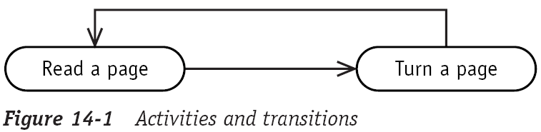
Taking a Look at Activity Diagram Notation (1/7)
Activities and transitions
  An activity is a step in a process where some work is getting done
  An Activity diagram is a series of activities linked by transitions, arrows connecting each activity

Slide 7
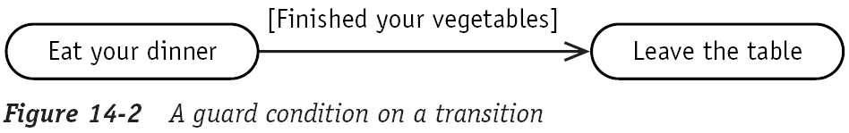
Taking a Look at Activity Diagram Notation (2/7)
Guard condition
  A guard condition can be assigned to a transition to restrict use of the transition

Slide 8
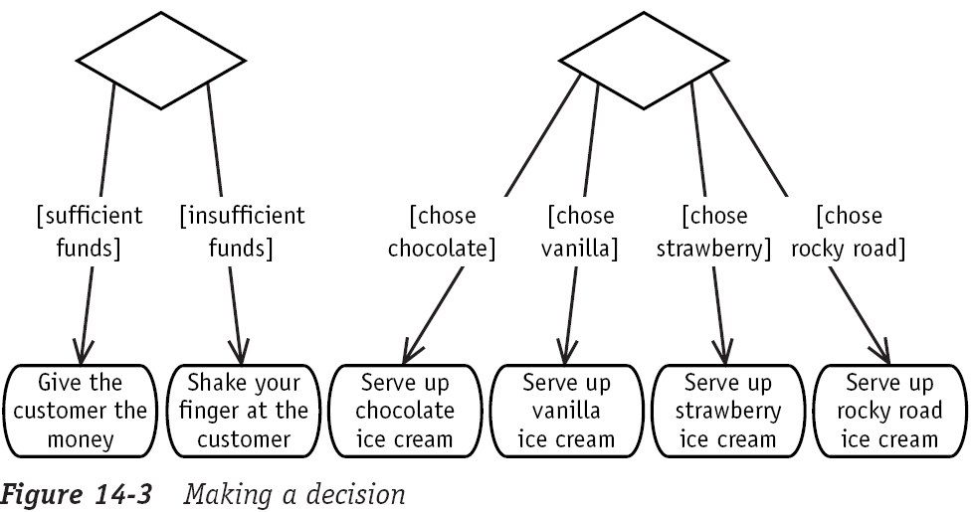
Taking a Look at Activity Diagram Notation (3/7)
Decisions
  The Activity diagram diamond is a Decision icon, just as it is in flowcharts
  Each option is identified using a guard condition

Slide 9
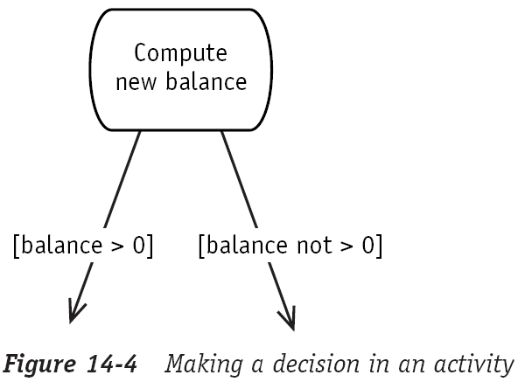
Taking a Look at Activity Diagram Notation (4/7)
Decisions
  When the completion of the activity provides all the required information to support the decision, use the below form

Slide 10
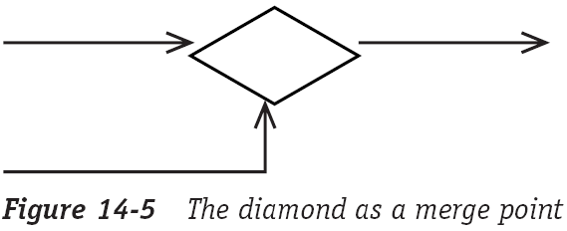
Taking a Look at Activity Diagram Notation (5/7)
Merge point
  The diamond icon is also used to model a merge point, the place where two alternative paths come together and continue as one

Slide 11
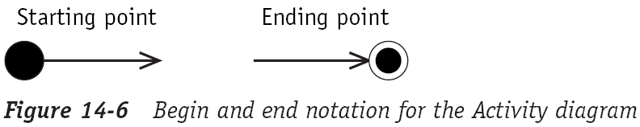
Taking a Look at Activity Diagram Notation (6/7)
Start and end
  The UML also provides icons to begin and end an Activity diagram
  There may be more than one end point in an Activity diagram

Slide 12
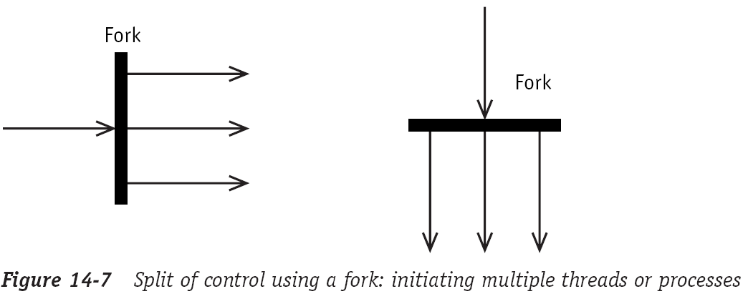
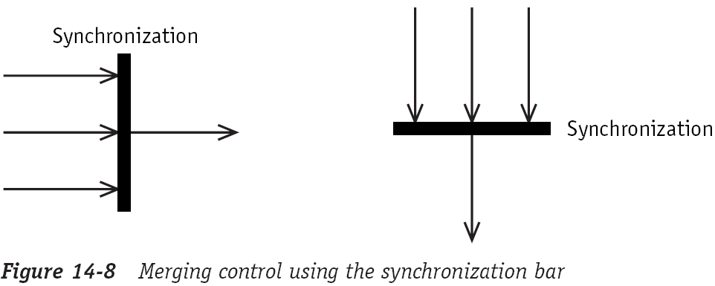
Taking a Look at Activity Diagram Notation (7/7)
Concurrency
  The UML notation for the Activity diagram also supports concurrency
  A single process starts multiple concurrent threads or processes
  Synchronization or merging threads is shown in much the same way

Slide 13
The End

