Slide 1
Fraud Detection System: A Survey
Abdallah Aisha et al.
Journal of Network and Computer Applications, 2016
2016. 12. 22 임유빈

Slide 2
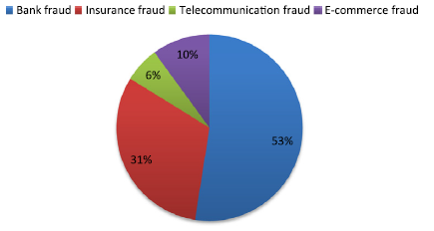
Fraud
Deliberate misuse of resources or assets for personal enrichment
Areas
Credit card
Healthcare insurance
Automobile insurance
Telecommunication
Online auction

Slide 3
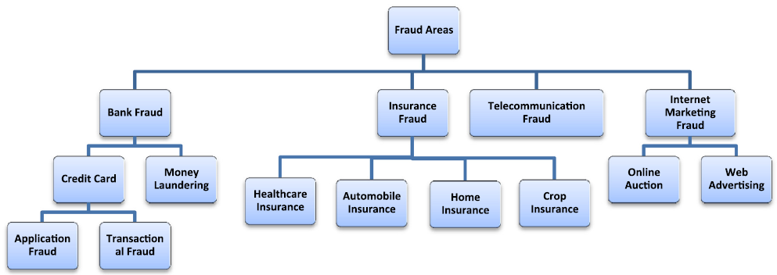
Fraud Areas

Slide 4
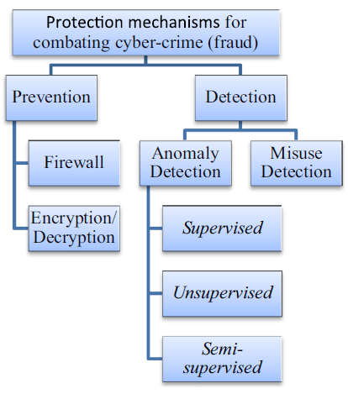
Fraud Protection
Fraud prevention system(FPS)
Prevent fraud from occurring in the first place
Suppress, restrict, prevent occurrence of fraud
Not enough to halt fraud
Firewall, Encryption/Decryption
Fraud detection system(FDS)
Detects fraudulent activities as they enter the system and report them
Integration of data mining methods
ANN, SVM, k-means, etc.
Pattern recognition from data
Priority on “fraud likelihood”
Detection of novelty
Difficulties
concept drift, skewed distribution, etc.

Slide 5
Fraud Detection System
Anomaly based
Monitor deviation from the norm
Have potential to detect novel fraud
Supervised
requires label data and discriminate fraud from non-fraud
labeling is very difficult job
e.g. classification, regression
Unsupervised: assume that majority of instances is non-fraud
e.g. clustering, dimensionality reduction, etc.
Semi-supervised: small number of labeled data with many unlabeled data
Misuse based
Monitor if previously occurred frauds happen
Hybrid of anomaly and misuse
Misuse can’t detect novel fraud
Anomaly suffers from lack of generalization capability and frequent false alarm

Slide 6
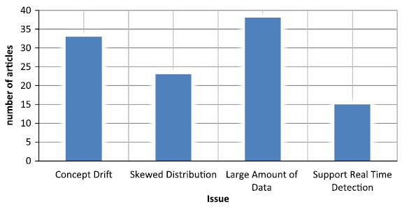
Fraud Detection Challenges
Concept drift
Skewed class distribution
Large amount of data
Support real time detection

Slide 7
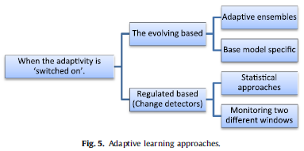
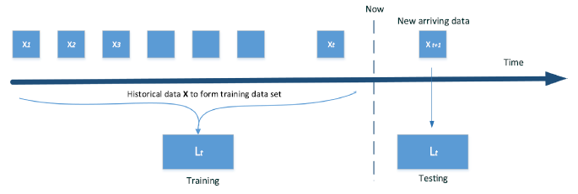
Fraud Detection Challenges
Concept drift
Behavior of legitimate user or fraudster is continuously changing
Deal with non-stationary behavior and dynamically update model
Adaptive learning algorithm: incremental learning
Evolving based: learner automatically adapts behavior staying up-to-date with stream dynamics
Regulated based: separate concept drift from classification
Evolving based methods are used more

Slide 8
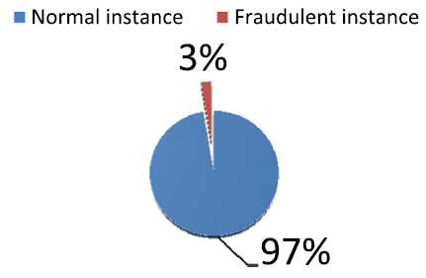
Fraud Detection Challenges
Skewed class distribution
Class imbalance problem when minority class is very small
Learner is impossible to discover patterns of minority
Data level
Data pre-processing step
Under sampling, over sampling
Algorithmic level
Cost-sensitive learning with cost-matrix to minimize cost
Use learners which are resistant to class imbalance problem. k-NN, SVM..
Usually, data methods are better than algorithmic methods
Easier and do not lead to increase in computation cost

Slide 9
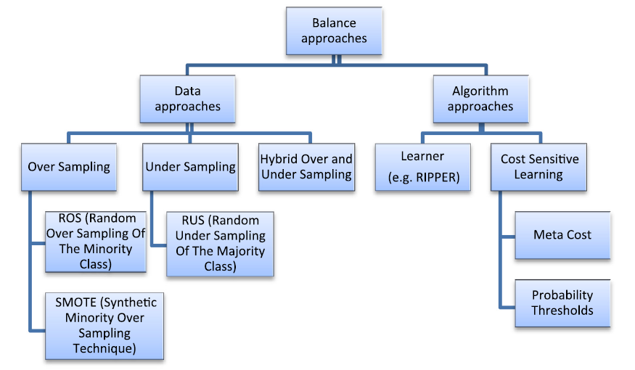
Fraud Detection Challenges

Slide 10
Fraud Detection Challenges
Reduction of large amount of data
Dimensionality reduction
Data compression: PCA
Feature selection: select most significant features
Filter: preprocessing algorithm ranking features
Wrapper: find subset of predictor with highest performace
Embedded: selection is included in training with whole data
Feature construction: derive new useful features from the original
Numerosity reduction
Replace data using data aggregation
Supports real time detection
Fraud detection algorithm should be able to deal with limited resources

Slide 11
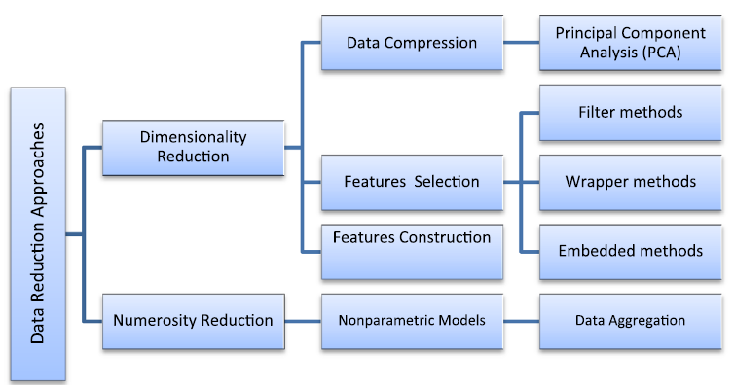
Fraud Detection Challenges
Reduction of large amount of data

Slide 12
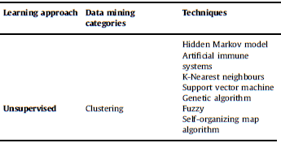

Credit Card Fraud
Detection system
Strategy: recognizing patterns by analyzing users’ spending behaviors
Transaction which is inconsistent with profile = fraud
False alarm is very harmful due to consumer’s feedback
Anomaly based detection based on profile
Owner based: profile base on credit card history
Operation based: detect fraud based on geographic location
Misuse detection
Use fraudsters’ finger prints
Misuse is seldom used, focus on anomaly based

Slide 13
Credit Card Fraud
Challenges
Concept drift
Purchasing power increases by specific condition e.g. Christmas
Evolving based approach
Ensemble of C4.5, RIPPER, naïve Bayesian, etc.
Adaptive model addressing fluctuation, evolution or behavior of users
Base model specific techniques. Adaptation of artificial immune system
Using artificial neural network
Regulated based approach
Handling concept drift by monitoring profiles
Skewed distribution issue
Data level: under sampling, oversampling
Algorithmic level
Imbalance Class weighted support vector machine(ICWSVM)
Racing method which selects most appropriate strategy adaptively
Binary SVM with genetic algorithm(GA)
Very Fast Decision Tree(VFDT)

Slide 14
Credit Card Fraud
Challenges
Large data issue
Numerosity reduction with aggregation
Dimension reduction: PCA, adaptation of ID3, GA
Real time issue
Use algorithms to reduce process time
Hybridization of Basic Local Alignment Search Tool(BLAST) and Sequence Search and Alignment by Hashing Algorithm(SSAHA)
SOM to filter out number of transactions for review
Very Fast Decision Tree(VFDT)

Slide 15
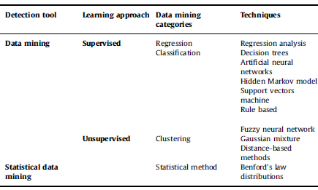
Healthcare Fraud
Detection System
Profile based on insurance claims , clinical-instance data, etc.
Concept drift
Adaptive Benford’s Law combined with reinforcement learning

Slide 16
Healthcare Fraud
Large data issue
Dimension reduction
Use clustering to reduce dimension
Systematic feature construction/extraction transforming multi-relation, dimensional data into feature vectors
Real time issue
Most systems are static, lack real time detection
Human gives final decision about fraud
SVM to speed up process time
Use knowledge engineering methodology

