Slide 1
Chapter 8: Application Design and Development

Slide 2
Database System Concepts
Chapter 1: Introduction
Part 1: Relational databases
  Chapter 2: Relational Model
  Chapter 3: SQL
  Chapter 4: Advanced SQL
  Chapter 5: Other Relational Languages
Part 2: Database Design
  Chapter 6: Database Design and the E-R Model
  Chapter 7: Relational Database Design
  Chapter 8: Application Design and Development
Part 3: Object-based databases and XML
  Chapter 9: Object-Based Databases
  Chapter 10: XML
Part 4: Data storage and querying
  Chapter 11: Storage and File Structure
  Chapter 12: Indexing and Hashing
  Chapter 13: Query Processing
  Chapter 14: Query Optimization
Part 5: Transaction management
  Chapter 15: Transactions
  Chapter 16: Concurrency control
  Chapter 17: Recovery System
Part 6: Data Mining and Information Retrieval
  Chapter 18: Data Analysis and Mining
  Chapter 19: Information Retreival
Part 7: Database system architecture
  Chapter 20: Database-System Architecture
  Chapter 21: Parallel Databases
  Chapter 22: Distributed Databases
Part 8: Other topics
  Chapter 23: Advanced Application Development
  Chapter 24: Advanced Data Types and New Applications
  Chapter 25: Advanced Transaction Processing
Part 9: Case studies
  Chapter 26: PostgreSQL
  Chapter 27: Oracle
  Chapter 28: IBM DB2
  Chapter 29: Microsoft SQL Server
Online Appendices
  Appendix A: Network Model
  Appendix B: Hierarchical Model
  Appendix C: Advanced Relational Database Model

Slide 3
Part 2: Database Design
(Chapters 6 through 8).
Chapter 6: Database Design and the E-R Model
  provides an overview of the database-design process, with major emphasis on database design using the entity-relationship data model. UML class-diagram notation is also covered in this chapter.
Chapter 7: Relational Database Design
  introduces the theory of relational-database design. The theory of functional dependencies and normalization is covered, with emphasis on the motivation and intuitive understanding of each normal form. Instructors may chose to use only this initial coverage in Sections 7.1 through 7.3 without loss of continuity.
Chapter 8: Application Design and Development
  emphasizes the construction of database applications with Web-based used interfaces. In addition, the chapter covers application security.

Slide 4
Chapter 8: Application Design and Development
8.1 User Interfaces and Tools
8.2 Web Interfaces to Databases
8.3 Web Fundamentals
8.4 Servlets and JSP
8.5 Building Large Web Applications
8.6 Triggers
8.7 Authorization in SQL
8.8 Application Security
8.9 Summary

Slide 5
User
User
Web Browser
Application
WEB Interface
: Servlet
JSP
Monitoring DBMS
using Trigger
Limited Access
by Authorization
Protecting DBMS
by Security
DBMS

Slide 6
User Interfaces and Tools
Most database users do not use a query language like SQL.
  Forms
  Graphical user interfaces
  Report generators
  Data analysis tools (see Chapter 18)
Many interfaces are Web-based
Back-end (Web server) uses such technologies as
  Java Servlets
  Java Server Pages (JSP)
  Active Server Pages (ASP)

Slide 7
The World Wide Web
The Web is a distributed information system based on hypertext.
Most Web documents are hypertext documents formatted via the HyperText Markup Language (HTML)
HTML documents contain
  text along with font specifications, and other formatting instructions
  hypertext links to other documents, which can be associated with regions of the text.
  forms enabling users to enter data which can then be sent back to the Web server

Slide 8
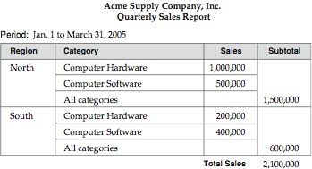
A formatted report

Slide 9
Chapter 8: Application Design and Development
8.1 User Interfaces and Tools
8.2 Web Interfaces to Databases
8.3 Web Fundamentals
8.4 Servlets and JSP
8.5 Building Large Web Applications
8.6 Triggers
8.7 Authorization in SQL
8.8 Application Security
8.9 Summary

Slide 10
Web Interfaces to Databases
Why interface databases to the Web?
Web browsers have become the de-facto standard user interface to databases
  Enable large numbers of users to access databases from anywhere
  Avoid the need for downloading/installing specialized code, while providing a good graphical user interface
  Examples: banks, airline and rental car reservations, university course registration and grading, an so on.

Slide 11
Web Interfaces to Database (Cont.)
Dynamic generation of documents
  Limitations of static HTML documents
    Cannot customize fixed Web documents for individual users.
    Problematic to update Web documents, especially if multiple Web documents replicate data.
  Solution: Generate Web documents dynamically from data stored in a database.
    Can tailor the display based on user information stored in the database.
      E.g. tailored ads, tailored weather and local news, …
    Displayed information is up-to-date, unlike the static Web pages
      E.g. stock market information, ..
    DHTML, Java Applet, Java Script, ActiveX

Slide 12
Chapter 8: Application Design and Development
8.1 User Interfaces and Tools
8.2 Web Interfaces to Databases
8.3 Web Fundamentals
8.4 Servlets and JSP
8.5 Building Large Web Applications
8.6 Triggers
8.7 Authorization in SQL
8.8 Application Security
8.9 Summary

Slide 13
Uniform Resources Locators
In the Web, functionality of pointers is provided by Uniform Resource Locators (URLs).
URL example:
http://www.bell-labs.com/topics/book/db-book
  The first part indicates how the document is to be accessed
    “http” indicates that the document is to be accessed using the Hyper Text Transfer Protocol.
  The second part gives the unique name of a machine on the Internet.
  The rest of the URL identifies the document within the machine.
The local identification can be:
    The path name of a file on the machine, or
    An identifier (path name) of a program, plus arguments to be passed to the program
      E.g. http://www.google.com/search?q=silberschatz

Slide 14
HTML and HTTP
HTML provides formatting, hypertext link, and image display features.
HTML also provides input features
    Select from a set of options
      Pop-up menus, radio buttons, check lists
    Enter values
      Text boxes
  Filled-in input sent back to the server, to be acted upon by an executable at the server
HyperText Transfer Protocol (HTTP) used for communication between browser and the Web server

Slide 15
Sample HTML Source Text
<html>
<body>
<table border cols = 3>
<tr> <td> A-101 </td> <td> Downtown </td> <td> 500 </td> </tr>
…
</table>
<center> The <i> account </i> relation </center>
<form action=“BankQuery” method=get>
Select account/loan and enter number <br>
<select name=“type”>
<option value=“account” selected> Account </option>
<option value=“loan”> Loan </option>
</select>
<input type=text size=5 name=“number”>
<input type=submit value=“submit”>
</form>
</body>
</html>

Slide 16
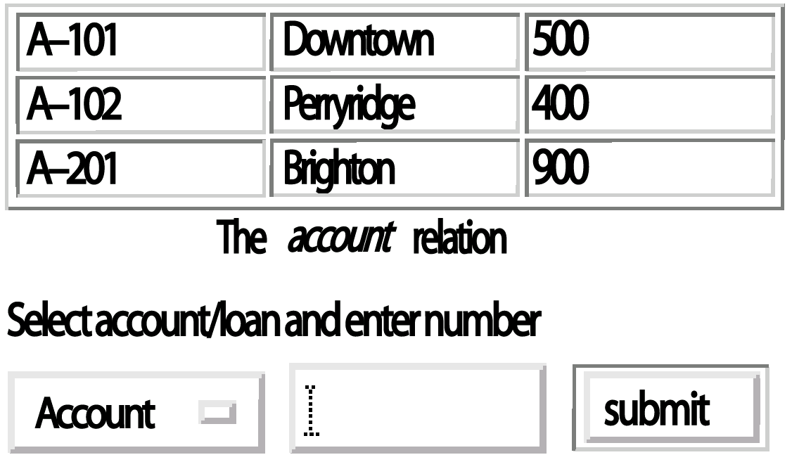
Display of Sample HTML Source

Slide 17
Client Side Scripting and Applets
Browsers can fetch certain scripts (client-side scripts) or programs along with documents, and execute them in “safe mode” at the client site
  Javascript
  Macromedia Flash and Shockwave (mostly for animation/games)
  VRML
  Java Applets
Client-side scripts/programs allow documents to be active
  E.g. animation by executing programs at the local site
  E.g. ensure that values entered by users satisfy some correctness checks
  Permit flexible interaction with the user.
    Executing programs at the client site speeds up interaction by avoiding many round trips to server

Slide 18
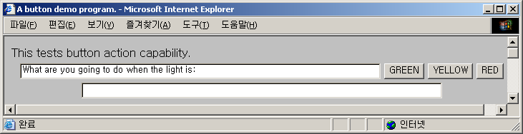
Sample Java Applet (1)
보조자료
Show Green, Red, Yello button on the screen
If the user clicks any button, trigger the action method by showing the corresponding message (“stop”, “go”, “ready to stop”)
TrafficLight.htm
<HTML>
<HEAD> <TITLE> A button demo program. </TITLE> </HEAD>
<BODY>
This tests button action capability.
<APPLET code="TrafficLight.class" WIDTH=700 HEIGHT=325> </APPLET>
</BODY>
</HTML>

Slide 19
Sample Java Applet (2)
보조자료
import java.awt.*;
import java.awt.event.*;
public class TrafficLight extends java.applet.Applet
implements ActionListener
{
TextField m1, m2;
Button b1, b2, b3;
public void init ()
{
m1 = new TextField(80);
m1.setText("What are you going to do when the light is:");
b1 = new Button("GREEN");
b2 = new Button("YELLOW");
b3 = new Button("RED");
m2 = new TextField(80);
add(m1) ;
add(b1) ;
add(b2) ;
add(b3) ;
add(m2) ;
b1.addActionListener(this);
b2.addActionListener(this);
b3.addActionListener(this);
}
public void actionPerformed(ActionEvent event)
{
Object cause = event.getSource();
if (cause == b1)
{
m2.setText("Keep on rolling.");
}
if (cause == b2)
{
m2.setText("Step on it! You can make it!");
}
if (cause == b3)
{
m2.setText("I suppose you'll have to stop.");
}
}
}
TrafficLight.java

Slide 20
Sample Java Applet (3)
보조자료
public class TrafficLight extends java.applet.Applet
implements ActionListener
{
TextField m1, m2;
Button b1, b2, b3;
public void init ()
{ m1 = new TextField(80);
m1.setText("What are you going to do when the light is:");
b1 = new Button("GREEN");
b2 = new Button("YELLOW");
b3 = new Button("RED");
m2 = new TextField(80);
add(m1) ;
add(b1) ;
add(b2) ;
add(b3) ;
add(m2) ;

Slide 21
Sample Java Applet (4)
보조자료
import java.awt.* 와 import java.awt.event.* 의 차이
  Java.awt.* 는 awt의 하위 클래스들만 (예, event) 사용가능
    즉 awt의 하위 클래스의 아래에 있는 클래스를 사용 불가능
  Java.awt.event.*를 선언해야만 event 하위 클래스들을 사용
b1.addActionListener(this)
  b1이라는 button 컴포넌트에 어떤 동작을 추가
  실제 동작은 다음 함수가 수행한다.
  public void actionPerformed (ActionEvent event) { …… }
    action 발생하면, actionPerformed method 내부적으로 수행
    event.getSource() 는 action의 원인을 return 한다.

Slide 22
Client Side Scripting and Security
Security mechanisms needed to ensure that malicious scripts do not cause damage to the client machine
  Easy for limited capability scripting languages, harder for general purpose programming languages like Java
E.g. Java’s security system ensures that the Java applet code does not make any system calls directly
  Disallows dangerous actions such as file writes
  Notifies the user about potentially dangerous actions
  Allows the option to abort the program or to continue execution.

Slide 23
Web Servers
A Web server can easily serve as a front end to a variety of information services.
The document name in a URL may identify an executable program, that, when run, generates a HTML document.
  When a HTTP server receives a request for such a document, it executes the program, and sends back the HTML document that is generated.
  The Web client can pass extra arguments with the name of the document.
To install a new service on the Web, one simply needs to create and install an executable that provides that service.
  The Web browser provides a graphical user interface to the information service.
Common Gateway Interface (CGI)
  a standard interface between web server and application server

Slide 24
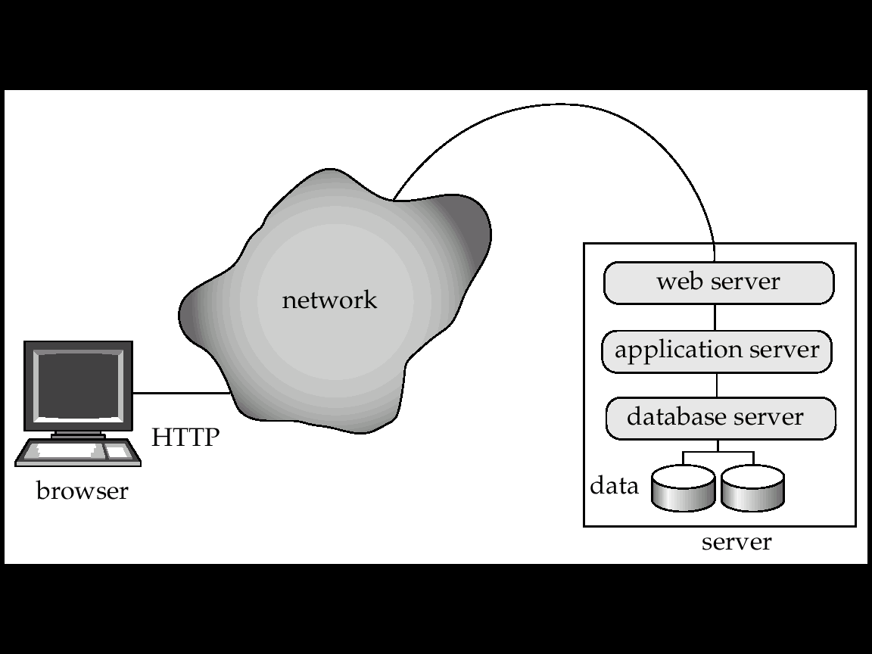
Three-Tier Web Architecture
Javascript, Flash,
Java Applets
JAVA
CGI
ODBC, JDBC

Slide 25
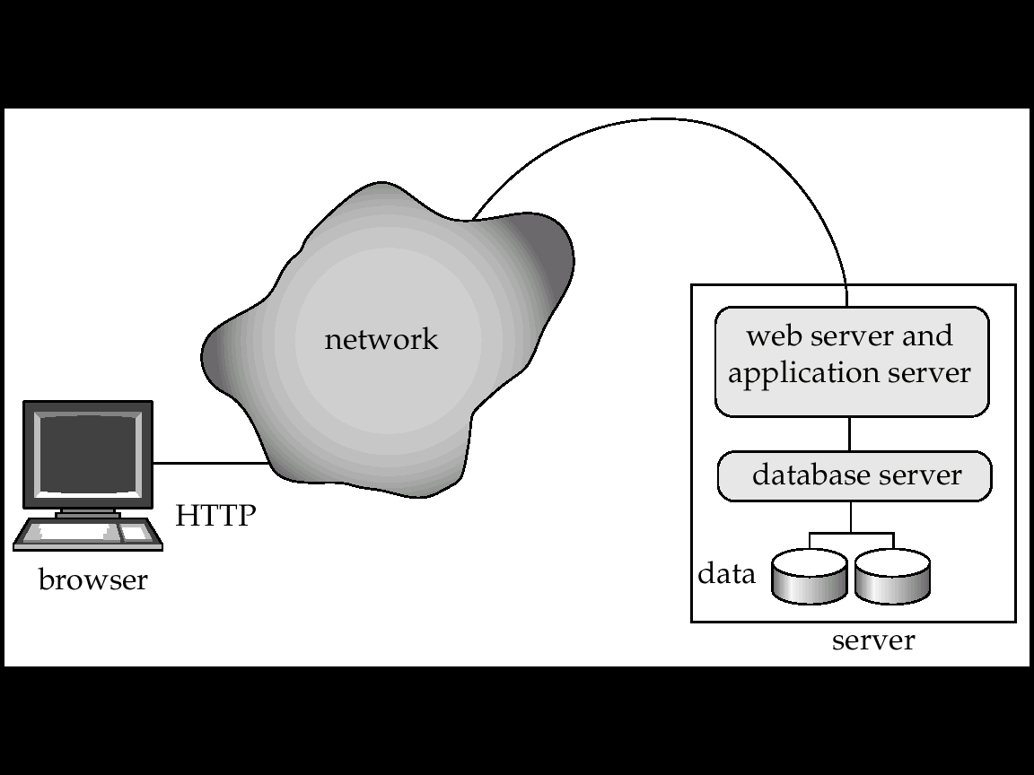
Two-Tier Web Architecture
Multiple levels of indirection have overheads
  Alternative: two-tier architecture
Javascript, Flash,
Java Applets
JAVA Servlet, JSP
JDBC

Slide 26
HTTP and Sessions
The HTTP protocol is connectionless
  That is, once the server replies to a request, the server closes the connection with the client, and forgets all about the request
  In contrast, Unix logins and JDBC/ODBC connections stay connected until the client disconnects
    retaining user authentication and other information
  Motivation: reduces load on server
    operating systems have tight limits on number of open connections on a machine
Information services need session information
  E.g. user authentication should be done only once per session
Solution: use a cookie

Slide 27
Sessions and Cookies
A cookie is a small piece of text containing identifying information
  Sent by server to browser on first interaction
  Sent by browser to the server that created the cookie on further interactions
    part of the HTTP protocol
  Server saves information about cookies it issued, and can use it when serving a request
    E.g., authentication information and user preferences
Cookies can be stored permanently or for a limited time

Slide 28
Chapter 8: Application Design and Development
8.1 User Interfaces and Tools
8.2 Web Interfaces to Databases
8.3 Web Fundamentals
8.4 Servlets and JSP
8.5 Building Large Web Applications
8.6 Triggers
8.7 Authorization in SQL
8.8 Application Security
8.9 Summary

Slide 29
Servlets
Java Servlet specification defines an API for communication between the Web server and application program
  E.g. methods to get parameter values from the client and to send the generated HTML text back to the client
Application program (also called a servlet) is loaded into the Web server
  Two-tier model
  Each user request spawns a new thread in the Web server
    thread is closed once the request is serviced
Servlet API provides a getSession() method
  Sets a cookie on first interaction with browser, and uses it to identify session on further interactions
  Provides methods to store and look-up per-session information
    E.g. user name, preferences, ..
Servlet API calls and JDBC API calls are mixed in a servlet program

Slide 30
Example Servlet Code
Public class BankQueryServlet extends HttpServlet {
public void doGet(HttpServletRequest request, HttpServletResponse result)
throws ServletException, IOException {
String type = request.getParameter(“type”);
String number = request.getParameter(“number”);
…code to find the loan amount/account balance …
…using JDBC to communicate with the database..
…we assume the value is stored in the variable balance
result.setContentType(“text/html”);
PrintWriter out = response.getWriter( );
out.println(“<HEAD><TITLE>Query Result</TITLE></HEAD>”);
out.println(“<BODY>”);
out.println(“Balance on “ + type + number + “=“ + balance);
out.println(“</BODY>”);
out.close ( );
}
}
This generated HTML
is sent to the client

Slide 31
Server-Side Scripting
Server-side scripting simplifies the task of connecting a database to the Web
  Define a HTML document with embedded executable code/SQL queries.
  Input values from HTML forms can be used directly in the embedded code/SQL queries.
  When the document is requested, the Web server executes the embedded code/SQL queries to generate the actual HTML document.
Numerous server-side scripting languages
  Web-programming purpose script language
    JSP, Server-side Javascript, ColdFusion’s Markup Language (cfml), PHP, Jscript
  General purpose scripting languages
    VBScript, Perl, Python

Slide 32
Chapter 8: Application Design and Development
8.1 User Interfaces and Tools
8.2 Web Interfaces to Databases
8.3 Web Fundamentals
8.4 Servlets and JSP
8.5 Building Large Web Applications
8.6 Triggers
8.7 Authorization in SQL
8.8 Application Security
8.9 Summary

Slide 33
Constructing Web Interface Easily
Functions for reducing the programming effort in UI
Java side
  Java Server Page (JSP)
    Java UI functions for Menu, Forms, Displaying results
  Unfortunately no (widely used) standard Java API for UI
MicroSoft side
  MicroSoft Active Server Pages (MS ASP)
  Recently MS ASP.NET
    Embedding Visual Basic or C# within HTML
    DataSet Object: drop-down menu, list box
    Validator Control: controling the validity of data (ex. range)
    DataGrid control: displaying results
    MicroSoft Visual Studio: GUI for creating ASP pages

Slide 34
Improving Web Server Performance
Performance is an issue for popular Web sites
  May be accessed by millions of users every day, thousands of requests per second at peak time
Caching techniques used to reduce cost of serving pages by exploiting commonalities between requests
  At the server site
    Caching of JDBC connections between servlet requests
    Caching results of database queries
      Cached results must be updated if underlying database changes
    Caching of generated HTML
  At the client’s network
    Caching of pages by Web proxy

Slide 35
Caching of Pages by Web Proxy
Miss
Request “http://idb.snu.ac.kr/”
Hit
Internet
Web Proxy
Request “http://idb.snu.ac.kr/”

Slide 36
Chapter 8: Application Design and Development
8.1 User Interfaces and Tools
8.2 Web Interfaces to Databases
8.3 Web Fundamentals
8.4 Servlets and JSP
8.5 Building Large Web Applications
8.6 Triggers
8.7 Authorization in SQL
8.8 Application Security
8.9 Summary

Slide 37
Triggers
Mechanism for Monitoring Database from Application
A trigger is a statement that is executed automatically by the system as a side effect of a modification to the database.
To design a trigger mechanism, we must:
  Specify the conditions under which the trigger is to be executed.
  Specify the actions to be taken when the trigger executes.
Triggers introduced to SQL standard in SQL:1999
  but supported even earlier using non-standard syntax by most databases.

Slide 38
Trigger Example
Suppose that instead of allowing negative account balances, the bank deals with overdrafts by
  setting the account balance to zero
  creating a loan in the amount of the overdraft
  giving this loan a loan number identical to the account number of the overdrawn account
The condition for executing the trigger is an update to the account relation that results in a negative balance value.

Slide 39
Trigger Example in SQL:1999
create trigger overdraft-trigger after update on account
referencing new row as nrow for each row
when nrow.balance < 0
begin atomic
insert into borrower
(select customer-name, account-number
from depositor
where nrow.account-number = depositor.account-number );
insert into loan values
(nrow.account-number, nrow.branch-name, – nrow.balance);
update account set balance = 0
where account.account-number = nrow.account-number
end

Slide 40
Triggering Events and Actions in SQL
Triggering event can be insert, delete or update
Triggers on update can be restricted to specific attributes
  E.g. create trigger overdraft-trigger after update of balance on account
Values of attributes before and after an update can be referenced
  referencing old row as : for deletes and updates
  referencing new row as : for inserts and updates
Triggers can be activated before an event, which can serve as extra constraints. E.g. convert blanks to null.
create trigger setnull-trigger before update on r
referencing new row as nrow
for each row
when nrow.phone-number = ‘ ‘
set nrow.phone-number = null

Slide 41
Statement Level Triggers
Instead of executing a separate action for each affected row, a single action can be executed for all rows affected by a transaction
  Use for each statement instead of for each row
  Use referencing old table or referencing new table to refer to temporary tables (called transition tables) containing the affected rows
  Can be more efficient when dealing with SQL statements that update a large number of rows

Slide 42
External World Actions
We sometimes require external world actions to be triggered on a database update
  E.g. re-ordering an item whose quantity in a warehouse has become small, or turning on an alarm light,
Triggers cannot be used to directly implement external-world actions, BUT
  Triggers can be used to record actions-to-be-taken in a separate table
  Have an external process that repeatedly scans the table, carries out external-world actions and deletes action from table
E.g. Suppose a warehouse has the following tables
  inventory (item, level ): How much of each item is in the warehouse
  minlevel (item, level ) : What is the minimum desired level of each item
  reorder (item, amount ): What quantity should we re-order at a time
  orders (item, amount ) : Orders to be placed (read by external process)

Slide 43
External World Actions (Cont.)
create trigger reorder-trigger after update of amount on inventory
referencing old row as orow, new row as nrow
for each row
when nrow.level < = (select level
from minlevel
where minlevel.item = orow.item)
and orow.level > (select level
from minlevel
where minlevel.item = orow.item)
begin
insert into orders
(select item, amount
from reorder
where reorder.item = orow.item)
end

Slide 44
Triggers in MS-SQLServer Syntax
create trigger overdraft-trigger on account
for update
as
if inserted.balance < 0
begin
insert into borrower
(select customer-name,account-number
from depositor, inserted
where inserted.account-number = depositor.account-number)
insert into loan values
(inserted.account-number, inserted.branch-name, – inserted.balance)
update account set balance = 0
from account, inserted
where account.account-number = inserted.account-number
end

Slide 45
When Not To Use Triggers
Triggers were used earlier for tasks such as
  Maintaining summary data (e.g. total salary of each department)
  Replicating databases by recording changes to special relations (called change or delta relations) and having a separate process that applies the changes over to a replica
There are better ways of doing these now:
  Databases today provide built in materialized view facilities to maintain summary data
  Databases provide built-in support for replication
Encapsulation facilities can be used instead of triggers in many cases
  Define methods to update fields
  Carry out actions as part of the update methods instead of through a trigger

Slide 46
Chapter 8: Application Design and Development
8.1 User Interfaces and Tools
8.2 Web Interfaces to Databases
8.3 Web Fundamentals
8.4 Servlets and JSP
8.5 Building Large Web Applications
8.6 Triggers
8.7 Authorization in SQL
8.8 Application Security
8.9 Summary

Slide 47
Authorizations in SQL (see also Section 4.3)
Mechanism for controlling application’s (or user’s) access to database
Forms of authorization on parts of the database:
  Read authorization - allows reading, but not modification of data.
  Insert authorization - allows insertion of new data, but not modification of existing data.
  Update authorization - allows modification, but not deletion of data.
  Delete authorization - allows deletion of data
Forms of authorization to modify the database schema:
  Index authorization - allows creation and deletion of indices.
  Resources authorization - allows creation of new relations.
  Alteration authorization - allows addition or deletion of attributes in a relation.
  Drop authorization - allows deletion of relations.
  References authrization - ability to declare foreign keys when creating relations.
  Usage authorization - In SQL-92; authorizes a user to use a specified domain
All privileges authorization: used as a short form for all the allowable privileges

Slide 48
Authorization Specification in SQL
The grant statement is used to confer authorization
grant <privilege list>
on <relation name or view name> to <user list>
<user list> is:
  a user-id
  public (which allows all valid users the privilege granted)
  a role (more on this later)
Granting a privilege on a view does not imply granting any privileges on the underlying relations.
The grantor of the privilege must already hold the privilege on the specified item (or be the database administrator).
with grant option: allows a user who is granted a privilege to pass the privilege on to other users.
  Example: grant select on branch to U₁ with grant option

Slide 49
Granting Privileges
The passage of authorization from one user to another may be represented by an authorization graph.
  The nodes of this graph are the users.
  The root of the graph is the database administrator.
Consider graph for update authorization on loan.
  An edge U_{i} → U_{j} indicates that user U_{i} has granted update authorization on loan to U_{j.}
U₁
U₄
DBA
U₂
U₅
U₃

Slide 50
Properties of Authorization Graph
Requirement: All edges in an authorization graph must be part of some path originating with the database administrator
If DBA revokes grant from U₁ in the previous slide:
  Grant must be revoked from U₄ since U₁ no longer has authorization
  Grant must not be revoked from U₅ since U₅ has another authorization path from DBA through U₂
Must prevent cycles of grants with no path from the root:
  Suppose DBA grants authorization to U₇
    U₇ grants authorization to U₈
    U₈ grants authorization to U₇
  Later suppose DBA revokes authorization from U₇
    Must revoke grant from U₇ to U₈ and from U₈ to U₇ since there is no path from DBA to U₇ or to U₈ anymore.
DBA U7 U8

Slide 51
Revoking Authorization in SQL
The revoke statement is used to revoke authorization.
  revoke<privilege list>
  on <relation name or view name> from <user list> [ restrict | cascade ]
Example:
  revoke select on branch from U₁, U₂, U₃ cascade
  Revocation of a privilege from a user may cause other users also to lose that privilege; referred to as cascading of the revoke.
We can prevent cascading by specifying restrict:
  revoke select on branch from U₁, U₂, U₃ restrict
If DBA wants to revoke the authorization to U7 in the following example, the revoke command with restrict is supposed to fail
  The following case requires cascading revokes
DBA U7 U8

Slide 52
Revoking Authorization in SQL (Cont.)
<privilege-list> may be “all” to revoke all privileges the revokee may hold.
If <revokee-list> includes “public” all users lose the privilege except those granted it explicitly.
If the same privilege was granted twice to the same user by different grantees, the user may retain the privilege after the revocation.
All privileges that depend on the privilege being revoked are also revoked.

Slide 53
Roles
Roles permit common privileges for a class of users can be specified just once by creating a corresponding “role”
Privileges can be granted to or revoked from roles, just like user
Roles can be assigned to users, and even to other roles
SQL:1999 supports roles
      create role teller
      create role manager
      grant select on branch to teller
      grant update (balance) on account to teller
      grant all privileges on account to manager
      grant teller to manager
      grant teller to alice, bob
      grant manager to avi

Slide 54
Authorization and Views
Users can be given authorization on views, without being given any authorization on the relations used in the view definition
Ability of views to hide data serves both to simplify usage of the system and to enhance security by allowing users access only to data they need for their job
A combination or relational-level security and view-level security can be used to limit a user’s access to precisely the data that user needs.

Slide 55
View Example
Suppose a bank clerk needs to know the names of the customers of each branch, but is not authorized to see specific loan information.
  Approach: Deny direct access to the loan relation, but grant access to the view cust-loan, which consists only of the names of customers and the branches at which they have a loan.
  The cust-loan view is defined in SQL as follows:
create view cust-loan as
select branchname, customer-name
from borrower, loan
where borrower.loan-number = loan.loan-number
The clerk is authorized to see the result of the query:
        select *
        from cust-loan
When the query processor translates the result into a query on the actual relations in the database, we obtain a query on borrower and loan.
Authorization must be checked on the clerk’s query before query processing replaces a view by the definition of the view.

Slide 56
Authorization on Views
Creation of view does not require resources authorization since no real relation is being created
The creator of a view gets only those privileges that provide no additional authorization beyond that he already had.
E.g. if creator of view cust-loan had only read authorization on borrower and loan, he gets only read authorization on cust-loan

Slide 57
Limitations of SQL Authorization
SQL does not support authorization at a tuple level
  E.g. we cannot restrict students to see only (the tuples storing) their own grades
With the growth in Web access to databases, database accesses come primarily from application servers.
  End users don't have database user ids, they are all mapped to the same database user id
All end-users of an application (such as a web application) may be mapped to a single database user
The task of authorization in above cases falls on the application program, with no support from SQL
  Benefit: fine grained authorizations, such as to individual tuples, can be implemented by the application.
  Drawback: Authorization must be done in application code, and may be dispersed all over an application
    Checking for absence of authorization loopholes becomes very difficult since it requires reading large amounts of application code

Slide 58
Audit Trails
An audit trail is a log of all changes (inserts/deletes/updates) to the database along with information such as which user performed the change, and when the change was performed.
Used to track erroneous/fraudulent updates.
Can be implemented using triggers, but many database systems provide direct support.

Slide 59
Chapter 8: Application Design and Development
8.1 User Interfaces and Tools
8.2 Web Interfaces to Databases
8.3 Web Fundamentals
8.4 Servlets and JSP
8.5 Building Large Web Applications
8.6 Triggers
8.7 Authorization in SQL
8.8 Application Security
8.9 Summary

Slide 60
Modern Encryption (1)
보조자료
DES (Data Encryption Standard)
미국 표준기술협회인 NIST가 1977년에 발표한 암호방식.
64bit Key와 개별 키 암호화 방식을 통해 텍스트를 암호화
메시지는 64비트블록으로 나뉜뒤 데이터 암호화 알고리즘을 통해 암호화
개별 키 암호화 방식에서는 발신자과 수신자만이 키를 공유
키를 모르면 코드를 풀기가 어렵지만, 해당키의 보안유지는 사용자의 몫
신용카드에 많이 사용

Slide 61

Modern Encryption (2)
보조자료
E
D
Same Key
The Secure Message Exchange Problem
  A Padlock Analogy solution by Whitfield Diffie, Martin Hellman, and Ralph Merkle
    The sender puts a message into a box attached with a padlock A and sends the box to the receiver
      The sender has the key to the padlock A
    The receiver receives the box and attach another padlock B and sends the box to the sender back
      The receiver has the key to the padlock B
    The sender opens the padlock A and send the box to the receiver
    The receiver opens the padlock B and gets the message inside

Slide 62
Modern Encryption (3)
보조자료
E
D
Encryption Key
Decryption Key
Public Key Encryption Idea by Diffie in 1975
  Scenario
    The user A sends the millions of same padlocks all over the world
      The user A has the key to the same padlocks
    If anyone wants to send a box to the user, use the padlock
  Asymmetric System
    Encryption key is public while Decryption key is private
RSA Encryption Method
  1977, MIT’s Lab, Rivest, Shamir, and Adleman
  Practical algorithm to Diffie’s proposal
    Implement the mechanism of Public Key and Private Key
  Depends on the difficulty of factoring very large integers into component prime factors

Slide 63
Modern Encryption (4)
보조자료
RSA Encryption
Key 생성
choose 2 primes, p and q and compute n = p∗q,
φ(n) = (p-1) ∗(q-1), where p, q are 100-digit numbers
choose e ∈ [1, φ(n)-1] such that gcd (e, φ(n)) = 1 and
d ∈ [1, φ(n)-1] such that e∗d mod φ(n) = 1
(e,n) : public-key
(d,n) : private-key
RSA
Encryption and Decryption
m, c ∈ {1, 2,..., n-1} where m is a message, c is a encrypted message
Encryption : c = m^{e} mod n ( m into c by public key)
Decryption : m = c^{d} mod n = m^{ed} mod n, where e∗d mod φ(n) = 1 ( c into m by private key)

Slide 64
Modern Encryption (5)
보조자료
RSA Encryption (cont’d)
Breaking the RSA Code
  Primes and Factoring: multiplication of two large integer primes
    Ex) we can easily guess 4453 = 73 * 61
    But Factoring hundreds of digits is beyond any current and expected computing capability.
  The Remainder Operator %: another barrior
    Usually called modulus ("Wrap Around" Property)
    Clock or Odometer Analogy
PGP (Pretty Good Privacy) Encryption Method
  Phil Zimmerman at MIT
  Combination of DES and RSA
  Free Encryption method for masses

Slide 65
Modern Encryption (6)
보조자료
Digital Signatures
  RSA encryption
    Encrypt a message with the private key and decrypt it with the public key
  The receiver wants to make sure the sender’s identity
  Example: Juliet wants to send a message to Romeo
    2 parts of message
      the main body and the signature part
    Juliet encrypts the signature part with her private key
    Juliet the whole message with Romeo’s public key and sends it to Romeo
    Romeo receives the encrypted message and decrypts it using his private key
    Romeo decrypts the signature part with Juliet’s public key

Slide 66
Application Security
Data may be encrypted when database authorization provisions do not offer sufficient protection.
Properties of good encryption technique:
  Relatively simple for authorized users to encrypt and decrypt data.
  Encryption scheme depends not on the secrecy of the algorithm but on the secrecy of a parameter of the algorithm called the encryption key.
  Extremely difficult for an intruder to determine the encryption key.

Slide 67
Encryption (Cont.)
Data Encryption Standard (DES)
  substitutes characters and rearranges their order on the basis of an encryption key which is provided to authorized users via a secure mechanism.
  Scheme is no more secure than the key transmission mechanism since the key has to be shared.
Advanced Encryption Standard (AES)
  a new standard replacing DES, and is based on the Rijndael algorithm, but is also dependent on shared secret keys
Public-key encryption is based on each user having two keys:
  public key – publicly published key used to encrypt data, but cannot be used to decrypt data
  private key -- key known only to individual user, and used to decrypt data.
  Need not be transmitted to the site doing encryption.
Encryption scheme is such that it is impossible or extremely hard to decrypt data given only the public key.
The RSA public-key encryption scheme is based on the hardness of factoring a very large number (100's of digits) into its prime components.

Slide 68
Authentication
Password based authentication is widely used, but is susceptible to sniffing on a network
Challenge-response systems avoid transmission of passwords
  DB sends a (randomly generated) challenge string to user
  User encrypts string and returns result.
  DB verifies identity by decrypting result
  Can use public-key encryption system by DB sending a message encrypted using user’s public key, and user decrypting and sending the message back
Digital signatures are used to verify authenticity of data
  E.g. use private key (in reverse) to encrypt data, and anyone can verify authenticity by using public key (in reverse) to decrypt data. Only holder of private key could have created the encrypted data.
  Digital signatures also help ensure nonrepudiation: sender
  cannot later claim to have not created the data

Slide 69
Digital Certificates
Digital certificates are used to verify authenticity of public keys.
Problem: when you communicate with a web site, how do you know if you are talking with the genuine web site or an imposter?
  Solution: use the public key of the web site
  Problem: how to verify if the public key itself is genuine?
Solution:
  Every client (e.g. browser) has public keys of a few root-level certification authorities
  A site can get its name/URL and public key signed by a certification authority: signed document is called a certificate
  Client can use public key of certification authority to verify certificate
  Multiple levels of certification authorities can exist. Each certification authority
    presents its own public-key certificate signed by a
    higher level authority, and
    Uses its private key to sign the certificate of other web sites/authorities

Slide 70
Chapter 8: Application Design and Development
8.1 User Interfaces and Tools
8.2 Web Interfaces to Databases
8.3 Web Fundamentals
8.4 Servlets and JSP
8.5 Building Large Web Applications
8.6 Triggers
8.7 Authorization in SQL
8.8 Application Security
8.9 Summary

Slide 71
Ch 8: Summary (1)
Most users interact with databases via forms and graphical user interfaces, and there are numerous tools to simplify the construction of such interfaces.
  Report generators are tools that help create human-readable reports from the contents of the database.
The Web browser has emerged as the most widely used user interface to databases. HTML provides the ability to define interfaces that combine hyper- links with forms facilities.
  Web browsers communicate with Web servers by the HTTP protocol. Web servers can pass on requests to application programs, and return the results to the browser.
There are several client-side scripting languages - Javascript is the most widely used - that provide richer user interaction at the browser end.
Web servers execute application programs to implement desired functionality. ServIets are a widely used mechanism to write application programs that run as part of the Web server process, in order to reduce overheads.
  There are also many server-side scripting languages that are interpreted by the Web server and provide application program functionality as part of the Web server.

Slide 72
Ch 8: Summary (2)
Triggers define actions to be executed automatically when certain events occur and corresponding conditions are satisfied.
  Triggers have many uses, such as implementing business rules, audit logging, and even carrying out actions outside the database system.
  Although triggers were added only lately to the SQL standard as part of SQL:1999, most database systems have long implemented triggers.
A user who has been granted some form of authority may be allowed to pass on this authority to other users.
  However we must be careful about how authorization can be passed among users as if we are to ensure that such authorization can be revoked at some future time.
Roles help to assign a set of privileges to a user according to the role that the user plays in the organization.
SQL authorization mechanisms are coarse grained and of limited value to applications that deal with large numbers of users.
  Extensions to provide row-level access controI and to deal with large numbers of application users have been developed, but are not standard as yet.

Slide 73
Ch 8: Summary (3)
Encryption plays a key role in protecting information and in authentication of users and Web sites.
  Challenge-response systems are often used to authentic-ate users. Digital certificates play a key role in authenticating Web sites.
Application developers must pay careful attention to security to prevent SQL injection attacks and other attacks by malicious users.
Protecting the privacy of data is an important task for database applications.
  Many countries have legal requirements on maintaining privacy of certain kinds of data, such as medical data.

Slide 74
Ch 8: Bibliographical Notes
Information about servlets, including tutorials, standard specifications, and software is available on java.sun.com/products/servlet.
Information about JSP is available at java.sun.com/products/jsp. Information on JSP tag libraries can also be found at this URL.
Information about the .NET framework and about Web application development using ASP.NET can be found at msdn.microsoft.com.
The original SQL proposals for assertions and triggers are discussed in Astrahan et al. [1976], Chamberlin et al. [1976] and Chamberlin et al. [1981].
Melton and Simon[2001], Melton [2002], and Eisenberg and Melton [I999] provide textbook coverage of SQL:1999, including coverage of assertions and triggers in SQL:1999.
More information on Oracle’s Virtual Private Database (VPD), which provides fine-grained authorization among other features, may be found at www.oracle.com/technology/deploy/security/index-html.
Fine-grained authorization is also discussed in Rizvi et al. [2004].
Atreya et al. [2OO2] provide textbook coverage of digital signatures, including X509 digital certificates and public-key infrastructure.
Information about the Pubcookie single-sign-on system may be found at www.pubcookie.org.

Slide 75
Ch 8: Tools
Development of a Web application requires several software tools such as an application server, a complier and editor for a programming language such as Java or C#, and other optional tools such as a Web server.
We list a few of the better known tools here: the Java SDK from Sun (iava.sun.com), the Apache Tomcat system (jakarta.apache.org), which support servlets and JSP, the Apache Web server (apache.org), the JBoss application server (jboss.org), Microsoft’s ASP.NET tools (msdn.microsoft.com/asp.net/), IBM Websphere (www.sotware.ibm.com), Caucho’s Resin (www.caucho.com), AlIaire’s CoIdfusion and JRun products (www.allaire.com), and Zope (www.zope.org).
A few of these, such as Apache Tomcat and Apache Webserver are free for any use, some are free for noncommercial use or for personal use, while others need to be paid for. See the respective Web sites for more information.

Slide 76
Chapter 8: Application Design and Development
8.1 User Interfaces and Tools
8.2 Web Interfaces to Databases
8.3 Web Fundamentals
8.4 Servlets and JSP
8.5 Building Large Web Applications
8.6 Triggers
8.7 Authorization in SQL
8.8 Application Security
8.9 Summary

Slide 77
End of Chapter

