Slide 1
Like like alike – Joint Friendship and Interest Propagation in Social Networks
Shuang Hong Yang et al. (Georgia Tech & Yahoo!)
WWW 2011
9 Jan 2013
Hyewon Lim

Slide 2
Outline
Introduction
Problem definition
Model
Experiments
Conclusions

Slide 3
Introduction
Friendship prediction and interest targeting
Homophily
Interest network
Friendship network
People connected to each other tend to have similar interest;
People with similar interest are more likely to be friends

Slide 4
Introduction: Interests and Friendship
Information of a user’s behavior
Scattered in both friendship and interest networks
Traditional user profiling approach
Do not take full advantage of homophily
Generate hand-crafted meta-descriptors, or
Extract a set of latent features by factorizing a user’s profile data
Collaborative filtering
Performs well in recommendation systems
where decisions are mainly made individually and independently
Could fail in the context of social networks
Where user interactions substantially influence decision making

Slide 5
Introduction: Friendship Interest Propagation
A friendship-interest propagation (FIP) model
Integrates the learning for interest targeting and friendship prediction into one single process
Provides a single unified framework to address both link prediction and interest targeting
Key idea
Defines a shared latent factor, and
Integrates both interest and friendship networks
To connect a user to both items of potential interest and other users with similar interest

Slide 6
Outline
Introduction
Problem definition
Model
Experiments
Conclusions

Slide 7

Problem Definition
Dyadic interactions
I, J: two parties such as users and items, Y: responses
Goal: infer the value of a missing entry y_{i’j’}, given an incoming pair (i’, j’)
Bipartite (I ≠ J)
Unipartite (I = J)

Slide 8

Problem Definition: Interest Targeting
“Matching the best item j* to a given user i” with CF
Neighborhood models
Based on the principle of locality of dependencies
Item-oriented or user-oriented
Predicts the interest of user i to item j by averaging the neighboring observations
Drawbacks of similarity-based neighborhood methods^{[1]}
Lack of bias correction
Co-related item is looked at in isolation
Choice of similarity measure is based on experimentation not on mathematical reason
: user-oriented
Notes:
Item-oriented: 특정 사용자의 item과 비슷한 것들을 주는 것.
User-oriented: 비슷한 사용자들 정보를 가지고 특정 item을 추천하는 것.

Slide 9
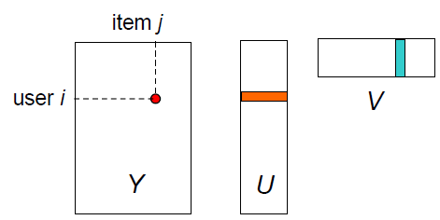


Problem Definition: Interest Targeting
Latent factor models^{[1, 2]}
Users and items are characterized by latent factors
Each decision is approximated by the dot production
$y_{ij} \sim \sum_{k}{u_{ik}v_{jk}} = {ui}^{T}v_{j}$
Squared error as a measure of loss
Use the loss function
e.g.,${(y}_{ij} − {ui}^{T}v_{j})2$
user i
item j
user i ^{T}
item j

Slide 10

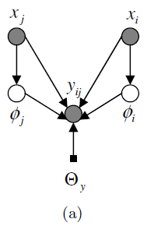

Problem Definition: Interest Targeting
Latent factor models (cont.)
Drawback
Cold-start problem
Regression based latent factor model (RLFM)
Neighborhood based latent factor models
Combine the neighborhood models and latent factor models
RLFM
: apply the locality of dependencies directly to the latent factors

Slide 11

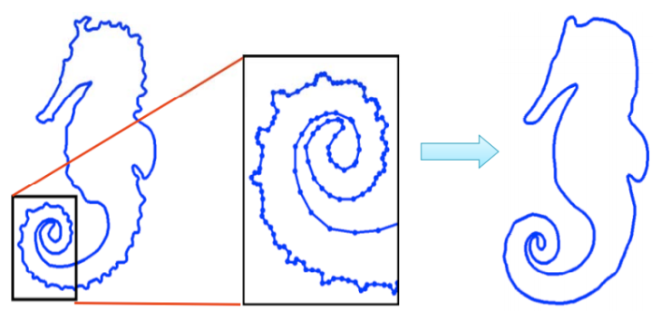
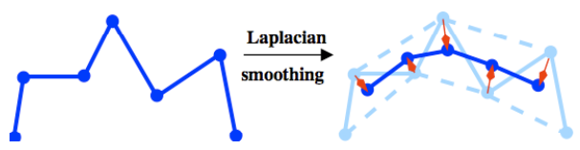
Problem Definition: Friendship Prediction
Random walk
d_{i}: degree of vertex i; s_{ii’}: connection weight between nodes i and i’
Spectral Algorithm
“diffuse the connections by maximizing the spectral smoothness to obtain the intrinsic kinship defined by the dominant eigen-vectors of the Laplacian.”
Smoothing^{[3]}

Slide 12
Outline
Introduction
Problem definition
Model
Experiments
Conclusions

Slide 13

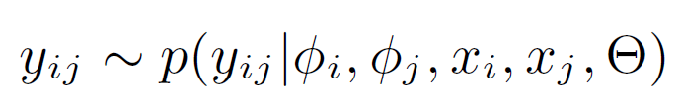
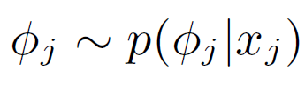

Model
Modeling Interests: collaborative filtering
Modeling friendship: latent-factor-based random walk
i: user
j: item
y: interest indication
φ: latent profiles
x_{i}: user features (age, gender, income)
x_{j}: item features (words, visual features)
i, i': user
s: friendship connection
φ: latent profiles
x_{i}: user features (age, gender, income)
Notes:
Interest model의 경우, 만약 latent factor만 존재한다면 factorization-style의 collaborative filtering algorithm이 될 수 있고,
Observable factor만 존재한다면 일반적인 feature-based recommendation algorithm이 될 수 있다.
이런 modeling의 경우, unipartite relationships만 다루는 CF나 graph topology를 기반으로 하는
전통적인 random walk와는 다르게, heterogeneous graphs를 다루거나,
computationally-efficient한 알고리즘을 만들 수 있다는 장점이 있음.

Slide 14
Model
FIP model
i: user
j: item
y: interest indication
s: friendship connection
φ: latent profiles
x_{i}: user features (age, gender, income)
x_{j}: item features (words, visual features)

Slide 15
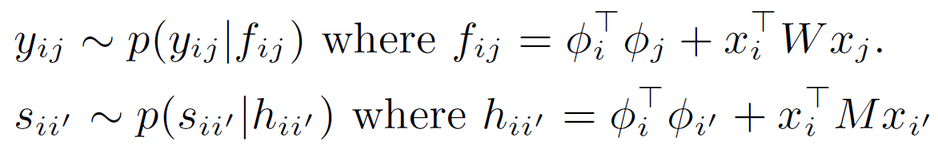
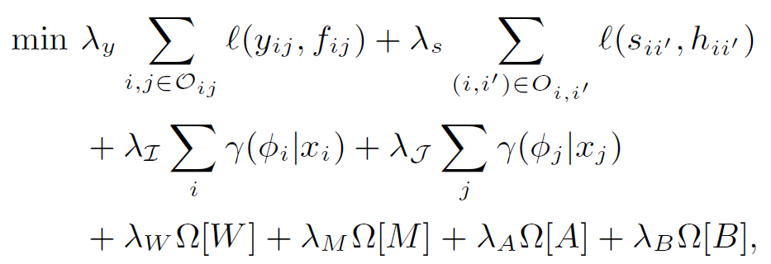
Model: Model Specification

Slide 16
Model: Model Specification
Interest:
Friendship:
Latent
features
Observable properties
reconstruction
decomposition

Slide 17






Model: Model Specification
interest
friendship
reconstruction
regularization
Notes:
Regularization을 하는 이유는 overfitting을 막기 위해서!!!

Slide 18
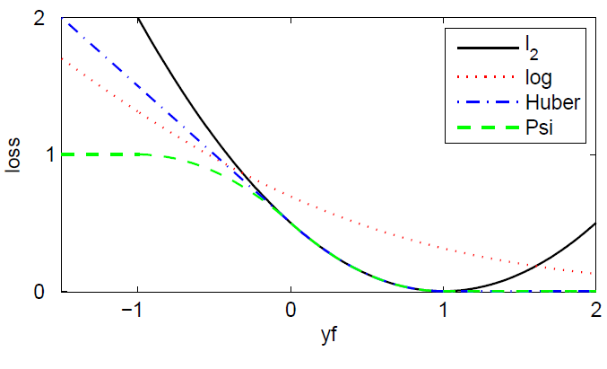
Model: Loss
Least Mean Squares
Lazy Least Mean Squares
Logistic regression
Huber loss
Ψ loss

Slide 19
Model: Bias Correction
Observations are extremely sparse!
Absence of information should not be interpreted absolutely as negative information
Hate it? or
Just don’t know?
+ the set of unobserved tuples

Slide 20
Outline
Introduction
Problem definition
Model
Experiments
Conclusions

Slide 21
Experiments
Yahoo! Pulse
As the item set is pretty small, the interest network is relatively dense
As the user population is large, the friendship network is extremely sparse
Evaluation metrics
AP (Average Precision)
AR (Average Recall)
nDCG (normalized Discounted Cumulative Gain)
Normalized position-discounted precision score
gives larger credit to top-ranked entities
Notes:
실험은 5번씩 돌려서 평균 냈음.
n=5 로 했는데 그 이유는 요새 소셜네턱이나 추천시스템에서 5개 or 5명 정도씩 보여주는 게 일반적이라서 그렇다고 함 ㅎㅎ

Slide 22
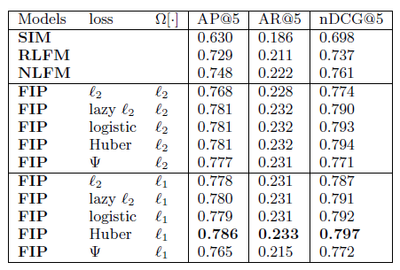
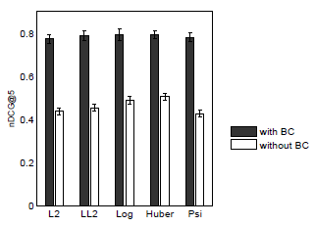
Experiments: Interest Targeting
SIM: item-oriented neighborhood model
RLFM: regression based latent factor model
NLFM: neighborhood based latent factor model
Bias-correction
Notes:
0.7xx 의 의미 -> 5개 중에 평균 3.5개는 relevent한 결과를 얻었다는 것. 성능이 좋다는 얘기.
Bias-correction을 하지 않는 경우는 over-fitting이 발생해서 성능이 떨어짐.

Slide 23
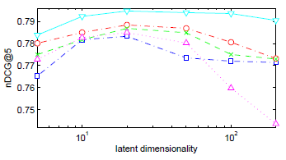
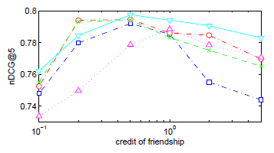
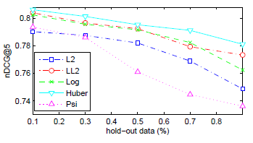
Experiments: Interest Targeting
10~20 latent factors are sufficient for prediction
If too much weight is given to friendship,
the latter may pollute the interest evidence
and in turn harm interest targeting performance
Quite stable performance except of the Ψ loss

Slide 24
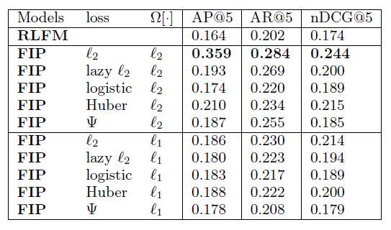
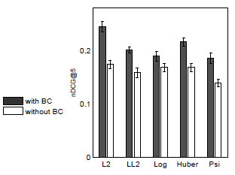
Experiments: Friendship Prediction
RLFM: regression based latent factor model
Bias-correction
Notes:
Interest에 비해 bias-correction에서 성능이 크게 향상되지 않음.
그 이유는 friendship network가 sparse하기 때문에 training set에서도 친구가 될만한 놈 찾기가 어려움.............

Slide 25
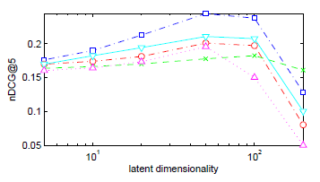
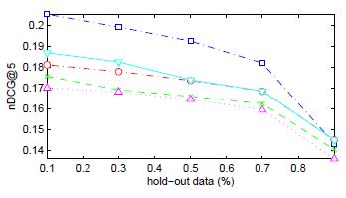
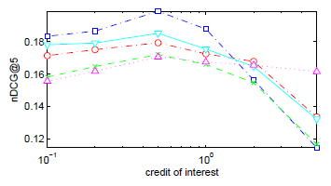
Experiments: Friendship Prediction
Similar trends as in the previous task,
although the performance is more sensitive
Notes:
Latent factor의 수를 늘려서 모델의 복잡도를 높이거나
Training data 수를 줄이면(= hold-out data를 늘리면)
Bias나 variance가 발생해서 성능이 확 떨어져버림.

Slide 26
Outline
Introduction
Problem definition
Model
Experiments
Conclusions

Slide 27
Conclusions
Show that interest and friendship information is highly relevant and mutually helpful
Establish a joint FIP model
Collaborative filtering + random walk
Offers a latent factor for each user that captures both interest and friendship information
Future work
Leverage deeper user profiles
to detect interest communities and to identify the macro-behavior of each interest group
Investigate the underlying mechanism between the interactions and individual decision making

Slide 28
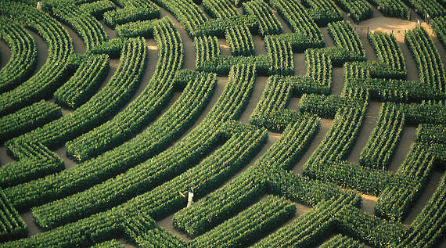

Slide 29
Reference
Latent factor models for collaborative filtering, Technische Universitaet Berlin
http://www.slideshare.net/sscdotopen/latent-factor-models-for-collaborative-filtering
Latent Factor Models for Web Recommender Systems, Yahoo! Research & Yahoo! Labs
http://www.ideal.ece.utexas.edu/seminar/LatentFactorModels.pdf
Spectral Algorithms I
http://graphics.stanford.edu/courses/cs468-10-fall/LectureSlides/16_spectral_methods1.pdf

