Slide 1
Pregel: A System for Large-Scale Graph Processing
Grzegorz Malewicz et al.
Google, Inc.
SIGMOD 2010
23 January 2013
SNU IDB Lab.
Min Sup Lee

Slide 2
Outline
Introduction
Model of computation
Implementation
Experiments
Conclusion
Discussion

Slide 3
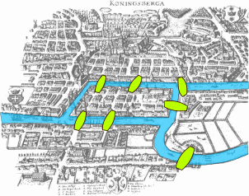
Introduction
Many practical computing problems concern large graphs
Web graph, social network
Transportation routes
Similarity of newspaper articles
Paths of disease
Pregel
Suitable for large graph task
Efficient, scalable and fault-tolerant implementation
Vertex centric approach
Flexible enough to express a broad set of algorithms

Slide 4

Issues for Processing of Large Graphs
Poor locality of memory
Changing degree of parallelism
Fault tolerance
MapReduce is ill-suited for graph processing
Model for fault-tolerant parallel processing of graphs
C++ API allowing users to apply this model

Slide 5
Outline
Introduction
Model of computation
Implementation
Experiments
Conclusion
Discussion

Slide 6
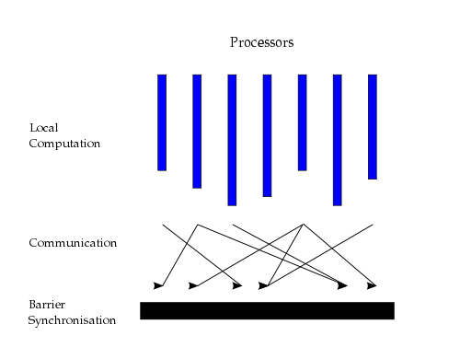
Pregel computation
Superstep
Receives messages set in the previous superstep
Sends messages to other vertices
Modifies its value or that of its outgoing edges

Slide 7
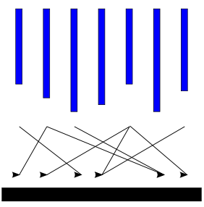
Model of Computation
Pregel computation consist of a sequence of iterations
Supersteps
Input
Invoke a user defined
function for each vertex
Superstep S
Superstep S+1
Superstep S+2
Ouput

Slide 8
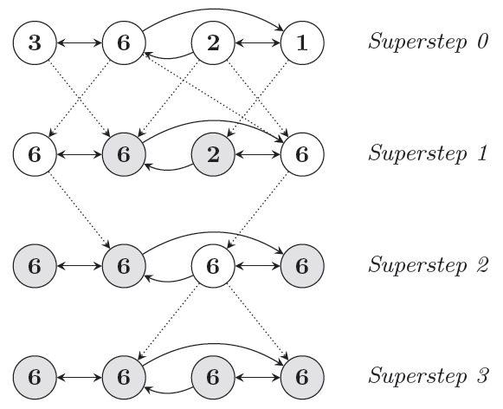
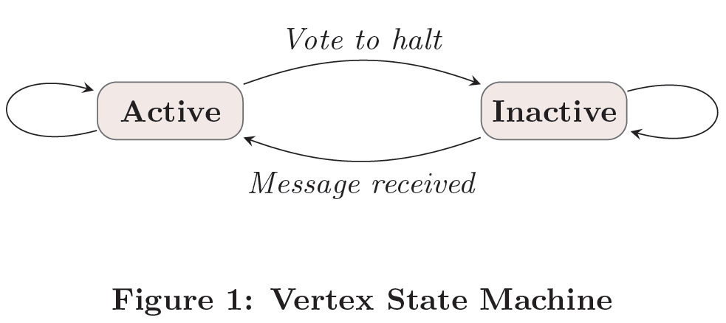
Maximum Value Example
A vertex deactivates itself by voting to halt
When no further vertices change, the algorithm terminates
Dotted lines are messages.
Shaded vertices have voted to halt.

Slide 9
C++ API
Message passing
Vertices communicate directly with one another by sending messages
Combiners
Sending a message incurs some overhead
Set from the user
Aggregators
Min, max, or sum operations

Slide 10
Outline
Introduction
Model of computation
Implementation
Experiments
Conclusion
Discussion

Slide 11
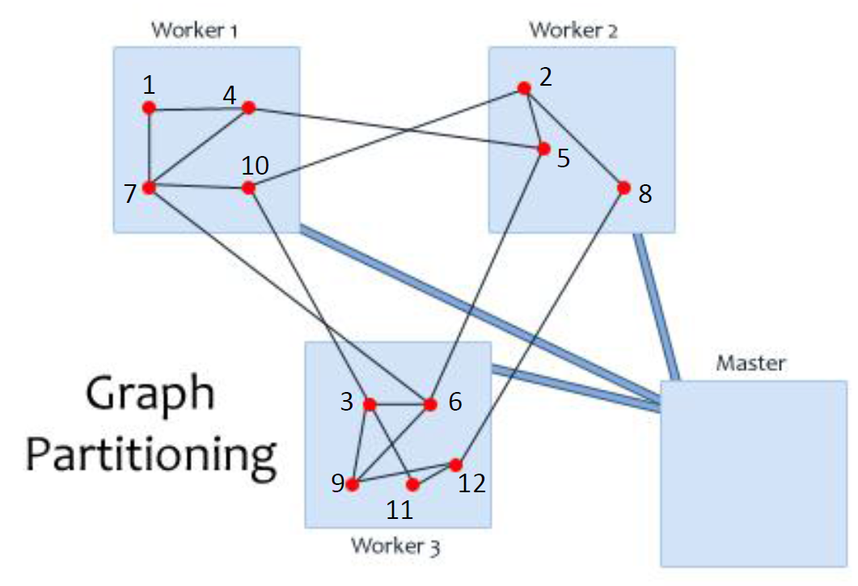
Basic Architecture
The Pregel library divides a graph into partition
The default partitioning function
Hash(ID) mod N (N is the number of partition)
Users can replace it

Slide 12
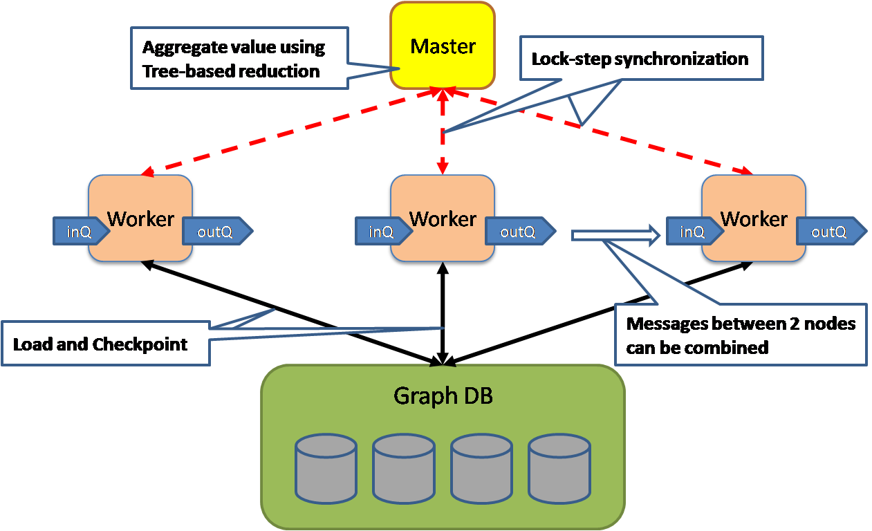
Pregel-Overview
Pregel-Overview

Slide 13
Implementation
Execution of a Pregel program (Master)
1. responsible for coordinating worker activity
2. Determines how many partitions the graph will have
Assigns partitions to each worker machine
3. Assigns a portion of the user’s input
4. Instruct each worker to perform a superstep
5. Instruct each worker to save its portion of the graph
After the computation halts
Fault tolerance
Checkpoint
At the beginning of a superstep, save the state of their partitions
Worker failures
Detected using regular “ping” messages

Slide 14
Outline
Introduction
Model of computation
Implementation
Experiments
Conclusion
Discussion

Slide 15
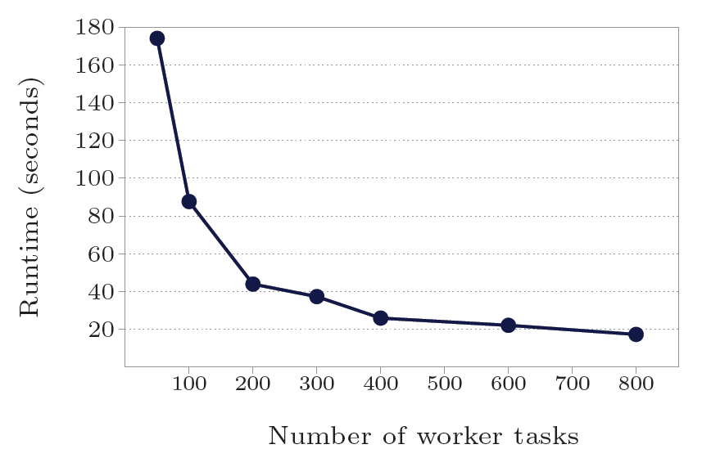
Experiments
Experiment 1:
SSSP (Single-source shortest paths) on 1 billion vertex binary tree, vary number of workers

Slide 16
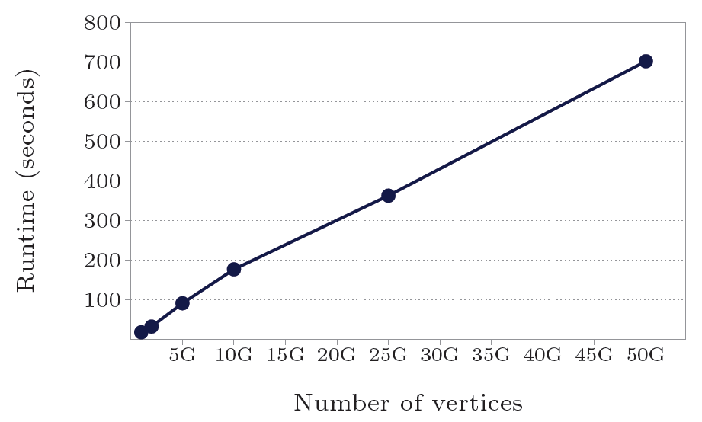
Experiments
Experiment 2:
SSSP on variable size binary trees, constant 800 workers

Slide 17
Experiments
Experiment 3:
SSSP on log-normal random graphs (mean out-degree = 127.1)

Slide 18
Outline
Introduction
Model of computation
Implementation
Experiments
Conclusion
Discussion

Slide 19
Conclusion
Suitable for large-scale graph computing
Performance, scalability, and fault-tolerant
The API is intuitive, flexible, and easy to use
Need to devise more partitioning mechanisms

Slide 20
Outline
Introduction
Model of computation
Implementation
Experiments
Conclusion
Discussion

Slide 21
Discussion
Strong points
Easy to use
High performance
Weak points
More experimental data

Slide 22
Thank you

