Slide 1
Real-Time Clinical Decision Support System with Data Stream Mining
Yang Zhang, Simon Fong, University of Macau
Jinan Fiaidhi, Sabah Mohammed, Lakehead University
Journal of Biomedicine and Biotechnology, Volume 2012
8 April 2016
Yubin Lim

Slide 2
Context
Introduction
Classification process
Training process
Prediction process
Feedback process
Conclusion

Slide 3
Introduction
Traditional commercial clinical decision support systems
Based on decision tree, Bayesian network, neural network
Requires static database
Only diagnosis, no prediction
To handle data stream
Efficient, accurate decision tree
Very Fast Decision Tree (VFDT)
Proposed algorithm
VFDT represent current situation
Add pointer for prediction

Slide 4
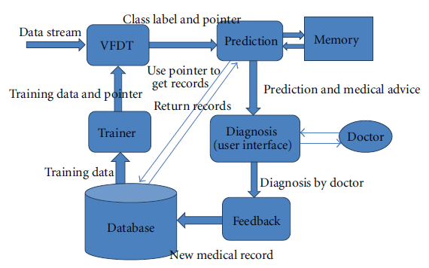
Overview

Slide 5
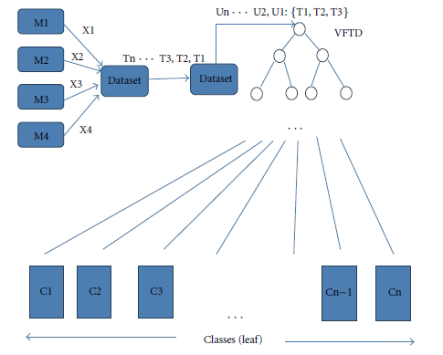
Classification process
M: features
T: time point
C: illness or medical situation
Notes:
Data가 입력되면 current situation을 leaf node의 class로 표현
이 정보는 prediction algorithm으로 입력됨
P 과거 데이터 중 current situation과 유사함

Slide 6

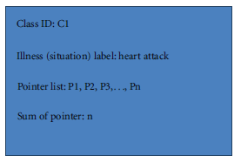
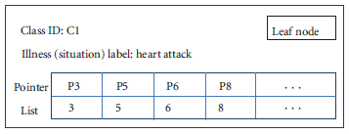
Mapping
Mapping table
Leaf node structure

Slide 7
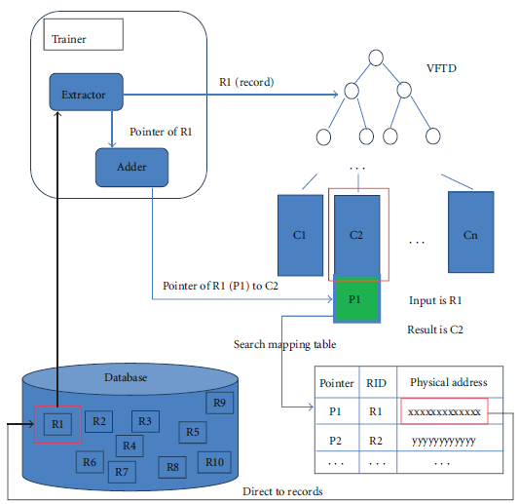
Training process
2
1
2
3
4

Slide 8
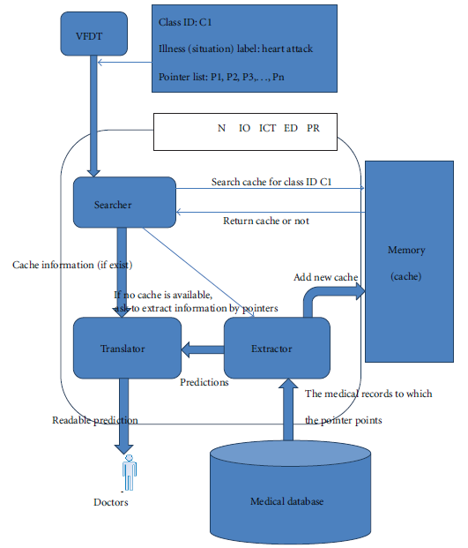
Prediction process
1
2
3-1
3-2

Slide 9
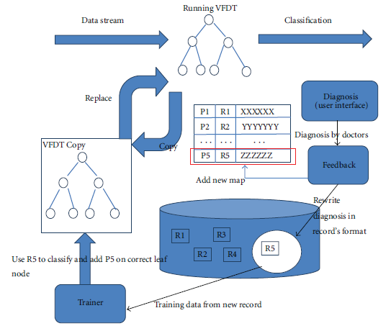
Feedback process

Slide 10
Conclusion
New system for medical data stream with real-time prediction
Extension of VFDT using pointers

