Slide 1
Processing and Visualizing the Data in Tweets
Adam Marcus et al.
SIGMOD Record 40(4), 2011
February 3, 2012
Hyewon Lim

Slide 2
Outline
Introduction
TweeQL
TwitInfo
Conclusion
Discussion

Slide 3



Introduction
Twitter service is wildly popular
Stream of messages from a variety of users contains information on an array of topics
Twitter interface does not make it easy to access this information
Majority of useful information is embedded in unstructured tweet text
Obfuscated by abbreviations, social practices and references

Slide 4
Introduction
Twitter’s APIs
Provide access to tweets from a particular time range, user, keyword, or geographic region
Provide no facility to extract structure from tweets and no aggregate views of tweets on different topics
In this paper
Describe two approaches to help programmers and end-users make sense of the tweet stream
TweeQL for programmers, TwitInfo for end-users

Slide 5
Outline
Introduction
TweeQL
TwitInfo
Conclusion
Discussion

Slide 6
TweeQL
TweeQL
Provide a SQL-like query interface on top of the Twitter streaming API
Provides windowed select-project-join-aggregate queries over the stream
TweeQL is based on SQL’s select-project-join-aggregate syntax
Utilizes user-defined functions for deeper processing of tweets and tweet text

Slide 7
TweeQL Streams
twitter_stream
Primary stream that TweeQL provides
CREATE STREAM
Creates a named substream of the main twitter stream that satisfies a particular set of filters
Twitter API only allow certain filters
to be used as access method for defining a stream
CREATE STREAM obama_tweets
FROM twitter_stream
WHERE text contains ‘obama’;

Slide 8
TweeQL Streams
When defining a new stream on top of twitter_stream,
The developer must provide:
A key lookup on userid,
A text match on text, or
A range lookup on latitude and longitude
If omits API-required filters, TweeQL will raise an error
twitter_sample
Complete, unfiltered stream is not provided by Twitter for performance and financial reasons
Also wrap other streaming sources
RSS feeds, Facebook news feeds, Google+ feed

Slide 9
TweeQL UDFs
User-defined functions (UDFs)
Provide operations over unstructured data such as text blobs
Complex Data Types
Accept and return array- and table-valued attributes
APIs often allow a variable number of parameters
For batched APIs and for many text-processing tasks
E.g., build an index of wards that appear in tweets
tokenize(“Tweet number one”) = [“Tweet”, “number”, “one”]
SELECT tweetid, tokenize(text)
FROM obama_tweets;

Slide 10
TweeQL UDFs
FLATTEN
Users wish to relationalize arrays
Produce a result without arrays
E.g., a tweet with tweetid = 5 and text = “Tweet number one”
Query:
Result:
SELECT tweetid, FLATTEN(tokenize(text))
FROM obama_tweets;
(5, ‘Tweet’)
(5, ‘number’)
(5, ‘one’)

Slide 11
TweeQL UDFs
Web Services as UDFs
Much of TweeQL’s structure-extraction functionality is provided by third parties as web APIs
Benefit: Often the functionality requires large datasets that are implementer can not or does not wish to package with their UDF
Wrapping services comes at a cost as service calls generally incur high latency
Service providers often limit how frequently a client can make requests to their service
TweeQL UDF developer can specify several parameters in addition to the UDF implementation
Because calls to other web services may be slow or rete-limited
E.g., cache invalidation policy, rate-limiting policy, timeout

Slide 12
TweeQL Strong Data and Generating Streams
Allow the results of SELECT to write data to named tables
To support useful operations
Break the workflows into multiple steps
write final results into a table
Intermediate steps can be named to allow subsequent queries in a workflow to utilize their results
INTO TABLE tablename
Outputs to a table and temporarily naming tuples
INTO STREAM streamname
Names a set of results that can be loaded as a stream by another query
INTO STDOUT
Outputs the contents of a stream to a user’s console

Slide 13
TweeQL Strong Data and Generating Streams
E.g.,
CREATE STREAM sampled
FROM twitter_sample;
SELECT text, sentiment(text) AS sent
FROM sampled
INTO STREAM text_sentiment;
SELECT text
FROM text_sentiment
WHERE sent > 0
INTO TABLE positive_sentiment;
SELECT text, sent
FROM text_sentiment
WHERE text contains ‘obama’
INTO TABLE obama_sentiment;

Slide 14
TweeQL Structure Extraction UDFs
TweeQL provides a library of useful UDFs
Most important class of operators are those that allow programmers to extract structure from unstructured content
String processing: tokenize
String functions help extract structure from text
Location: geocode
Extract structure from self-reported location strings
Classification: sentiment
Identify structure in unstructured text content
Other classifiers: identify the topic, language, or veracity of a tweet
SELECT sentiment(text) AS sent,
geocode(loc).latitude AS lat,
geocode(loc).longitude AS long
FROM obama_tweets
INTO STREAM obama_sent_loc;

Slide 15
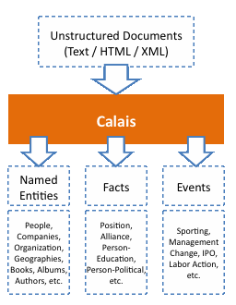
TweeQL Structure Extraction UDFs
TweeQL provides a library of useful UDFs (cont.)
Named entity extraction: namedEntities
Reduces ambiguity, identifies potential entities in context
E.g., namedEntities(“Secretary Clinton accepts Crowley resignation”) → [“Hillary Clinton”, “P. J. Crowley”]
Implementation of namedEntities is an API wrapper around OpenCalais
A web service for performing named entity extraction and topic identification
Designed to handle longer text blobs for better contextual named entity extraction
Future work!
SELECT text, FLATTEN(namedEntities(text)) AS entity
FROM obama_tweets
INTO STREAM obama_entities;

Slide 16
TweeQL Structure Extraction UDFs
TweeQL provides a library of useful UDFs (cont.)
Windowed operators: WINDOW, EVERY, __created_at
To support aggregates and joins on streams
SELECT AVG(sent) AS sent, floor(lat) AS lat, floor(long) AS long
FROM obama_sent_loc
GROUP BY lat, long
WINDOW 3 hours
EVERY 1 hour
INTO STREAM obama_sent_by_area;
Notes:
EWMA: exponentially weighted moving mean

Slide 17
TweeQL Structure Extraction UDFs
TweeQL provides a library of useful UDFs (cont.)
Event detection: meanDeviation
Returns the difference between the value and an EWMA of recent values
SELECT COUNT(text) as count, __created_at as time
FROM obama_tweets
WINDOW 1 minute
EVERY 1 minute
INTO STREAM obama_count;
SELECT meanDeviation(count) AS dev, time
FROM obama_counts
WHERE dev > 2
INTO TABLE obama_peaks;
Notes:
EWMA: exponentially weighted moving mean

Slide 18
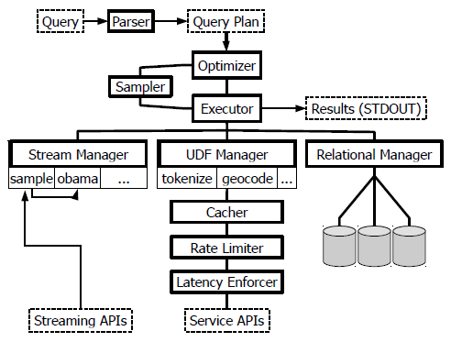
TweeQL System Design
Key architectural components of the TweeQL stream processor
INTO TABLE
CREATE STREAM
INTO STREAM
TIMEOUT

Slide 19
TweeQL Current Status
Python, 2500 lines of code
Open source distribution
https://github.com/marcua/tweeql
At work
Add the rate-limiting and latency-enforcing logic to web service UDF wrappers
Add FLATTEN syntax in the next TweeQL release

Slide 20
TweeQL Challenges
Uncertain selectivities
Only one filter type can be submitted to the API
Issue two requests for recent tweets with both filters applied
Determine which stream is less frequent
High-latency operators
Caching responses and batching multiple requests when an API allows can reduce some request overhead
Aggregate classifiers are misleading
In TwitInfo[7]
CREATE STREAM obama_nyc
FROM twitter_stream
WHERE text contains ‘obama’;
AND location in [bounding box for NYC];

Slide 21
Outline
Introduction
TweeQL
TwitInfo
Conclusion
Discussion

Slide 22
TwitInfo
TwitInfo
An application written on top of the TweeQL stream processor
A user interface that summarizes events and people in the news by following what Twitter users say about those topics over time
Offers an example of how aggregate data extracted from tweets can be used in a user interface
Focuses on the streaming nature of tweet data and uses event detection to relay a story

Slide 23
TwitInfo Creating an Event
Users define an event by specifying a Twitter keyword query
TwitInfo saves the event and begins loging tweets containing the keywords using a TweeQL query like the following:
This query results in some irrelevant tweets (e.g., tweets about American Football)
Remove noisy terms and rank tweets by relevance
CREATE STREAM twitinfo
FROM twitter_stream
WHERE text contains ‘soccer’
OR text contains ‘football’
OR text contains ‘premierleague’
OR text contains ‘manchester’
OR text contains ‘liverpool’;

Slide 24
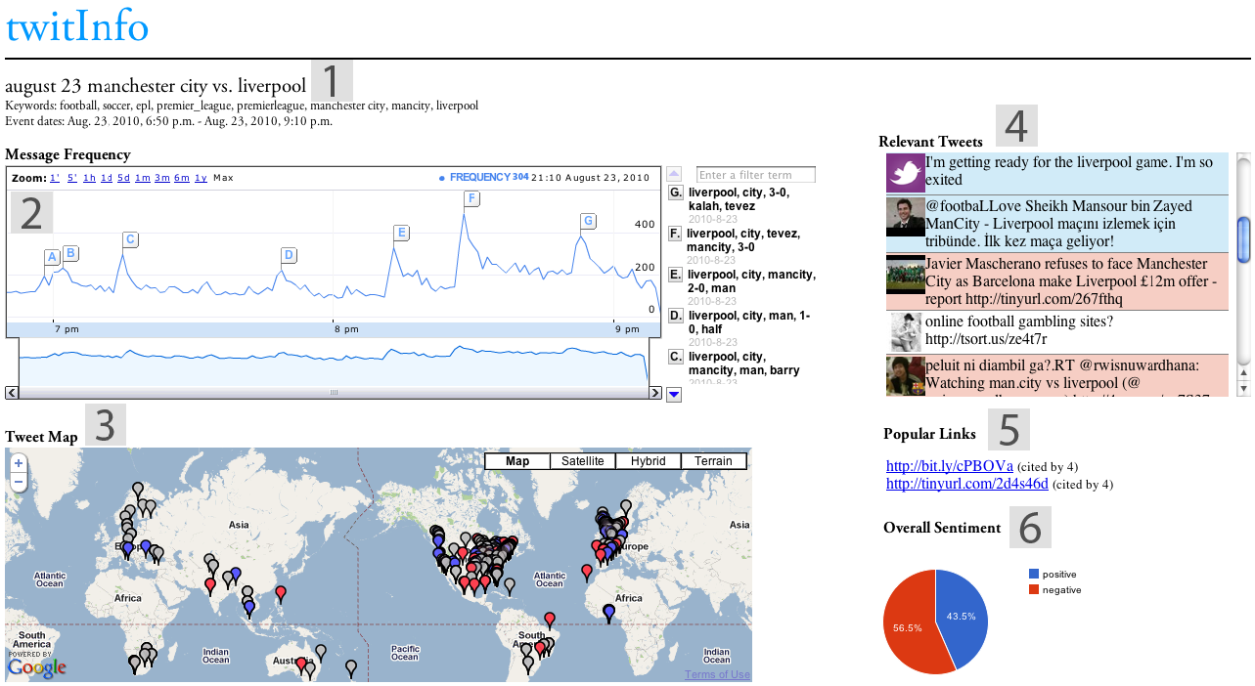
TwitInfo Timeline and Tweets
Once a user has created an event, TwitInfo creates a page on which the user can monitor the event

Slide 25
TwitInfo Aggregate Metadata Views
Overall Sentiment panel
Displays a pie chart with the proportion of positive and negative tweets during an event
Show the general sentiment on Twitter about a given topic
Popular Links panel
Aggregates the top URLs extracted from tweets in the timeframe being explored
Users share links as a story unfolds
Tweet Map
Displays tweets that provide geolocation metadata
Opinion on an event differs by geographic region

Slide 26
TwitInfo Uses and Study
Track events of different duration and content using TwitInfo
Soccer matches
Successfully identifies goals, half-time, the end of a game, some penalties
All major earthquakes over a 1-month timespan
Sixteen days in Barack Obama’s life and policy making
Tested the TwitInfo interface with 12 users
A Pulizer Prize-winning former Washington Post investigative reporter thought of two user-cases for TwitInfo in journalism
Backgrounding
Find eyewitnesses

Slide 27
Outline
Introduction
TweeQL
TwitInfo
Conclusion
Discussion

Slide 28
Conclusion
Describe two tools to make the information more accessible
TweeQL for programmers
TwitInfo for end-users
Social streams offer the database community an opportunity to build systems for streaming, unstructured data, and social networks in the sild

Slide 29
Outline
Introduction
TweeQL
TwitInfo
Conclusion
Discussion

Slide 30
Discussion
Pros
Research the social stream from a new angle
“Real” expert opinion
Cons
Evaluation with user interview
Uncompleted implementation

