Slide 1
Apache Hadoop Ecosystem Data Collection
Hyewon Lim, Min Sup Lee, WooHyun Lee (Team A)
12 Sep 2013

Slide 2
Flume

Slide 3
Current Problem
Situation
You have hundreds of services running in different servers that produce lots of large logs which should be analyzed altogether. You have hadoop to process them.
Problem
How do I send all my logs to a place that has hadoop? I need a reliable, scalable, extensible and manageable way to do it!

Slide 4
What is Apache Flume?
Distributed data collection service
Gets flows of data (like logs) from their source
Aggregates them to where they have to be processed
Goals: reliability, scalability, extensibility, manageability
Flume
Collector
Server | Agent
HDFS
Collector
Server | Agent
Collector
Server | Agent
Agent Tier
Collector Tier

Slide 5
What Flume Does?
A service for streaming logs into Hadoop
Collecting, aggregating, and moving large amounts of streaming data
Simple and flexible architecture based on streaming data flows
Robust and fault tolerant for failover and recovery
Stream data from multiple sources into Hadoop
Collect high-volume web logs in real time
Guarantee data delivery
Scale horizontally to handle additional data volume

Slide 6
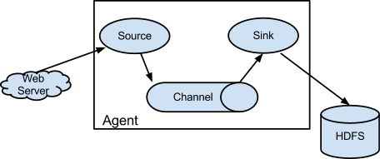
The Flume Model: Agent, Processor and Collector Nodes
Agent
Receives data from an application
Processor (optional)
Intermediate processing
Collector
Writes data to permanent storage
Agent Tier
Processor
Collector Tier
Flume
Collector
Server | Agent
HDFS
Collector
Server | Agent
Collector
Server | Agent

Slide 7
Flumes’s High-level Architecture
Component | Function
Event | - A singular unit of data that is transported by Flume - A single datum; a log record, etc.
Agent | - The JVM running Flume - One per machine - Runs many sources and sinks
Source | - The entity through which data enters into flume
Sink | - Receives events from a channel - Delivers the data to the destination
Channel | - Connects sources to sinks (like a queue) - Implements the reliability semantics
Client | - Produces and transmits the Events to the Source - Runs in a separate thread

Slide 8
The Flume Model: Flows
A flow
A type of data source (server logs, machine monitoring metrics)
Flows
Comprised of nodes chained together
Web-clicks Reliable Delivery, Compressed, Batched
DATA
EVENTS
DATA
Process Monitoring Best Effort Delivery
EVENTS
DATA
EVENTS
Advertisement Impressions Reliable Delivery

Slide 9
The Features of Flume
Horizontally scalable data path
Load balancing
Simple source and sink API
Event streaming and composition of simple operation
Centralized data flow management interface
Agent
HDFS
Agent
Collector
Agent
Agent
Agent
Collector
Agent
Collector
Agent
Agent
Agent
Collector
Agent
Agent
Agent
Agent
Collector
Agent
Collector
Agent
Agent

Slide 10
Conclusion
Flume
Distributed data collection service
Suitable for enterprise setting
Large amount log data to process

Slide 11
References
http://www.slideshare.net/arinto/apache-flume
http://www.slideshare.net/mapredit/apache-flume-ng
http://hortonworks.com/hadoop/flume/
http://www.slideshare.net/cloudera/clouderas-flume
http://archive.cloudera.com/cdh/3/flume/UserGuide/#_architecture
http://flume.apache.org

Slide 12
Scribe

Slide 13

Scribe
Developed by Facebook using Apache Thrift in 2008 (Open Source)
A thrift server using the non-blocking C++ server
LOG COLLECTION TOOL
A server for aggregating log data that's streamed in real time from clients.
Designed to be scalable and reliable.
NODE
NODE
SCRIBE
LOG
LOG
NODE
NODE

Slide 14
Reliability
If unable to send messages to the central server,
it writes the message to a file on local disc and send them when central server recovers.
- The resender waits a random time between reconnect attempts to avoid overloading.
Client
SCRIBE
{ LOG }

Slide 15
Log
struct LogEntry
{
1: string category,
2: string message
}
{ ‘memory’, ‘DHCPREQUEST on eth0’ }
Client
log_entry = scribe.LogEntry(category, message);
result = client.log(messages=[log_entry]);

Slide 16
Stores
Scribe server determines how to log messages based on the Stores defined in the configuration.
<store>
category=statistics
type=file
file_path=/tmp/stat
base_filename=stat_log
</store>
<store>
category=bucket_me
type=bucket
num_buckets=2
bucket_type=random
<bucket0>
type=file
fs_type=std
file_path=/tmp/scribetest/bucket0
base_filename=bucket0
</bucket0>
<bucket1>
type=network
remote_host=wopr
remote_port=1463
</bucket1>
</store>
Client
SCRIBE
{ A }
{ B }
Client
{ C }
{ A }
<store>
category=statistics
type=network
remote_host=idb.snu.ac.kr
remote_port=1453
</store>
Client
{ B }
{ C }

Slide 17
Dependencies
[libevent] asynchronous event notification
[boost] C++ libraries
[thrift] binary communication protocol
Fb303
Python
Ruby
THRIFT
C++
Boost
libevent

Slide 18
Chukwa

Slide 19

Overview
Log processing: one of the original purpose of MapReduce
Log
MR
Notes:
Logs are generated incrementally across many machines.
Hadoop MapReduce works best on a small number of large files.

Slide 20


Overview
Require additional MapReduce jobs
Creates some overhead for data management on Hadoop
MR
jobs

Slide 21
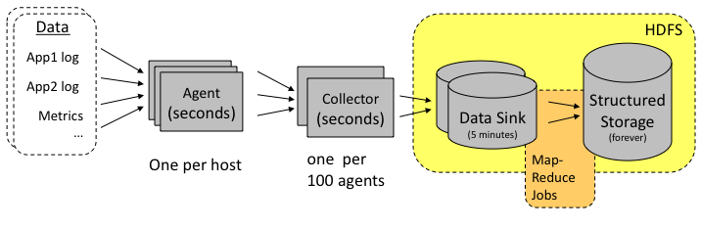
Overview
Chukwa
A System for large-scale reliable log collection and processing with Hadoop
A Hadoop subproject
To bridging the gap between logs processing and Hadoop ecosystem
Provide a flexible and powerful platform
for distributed data collection and rapid data processing

Slide 22
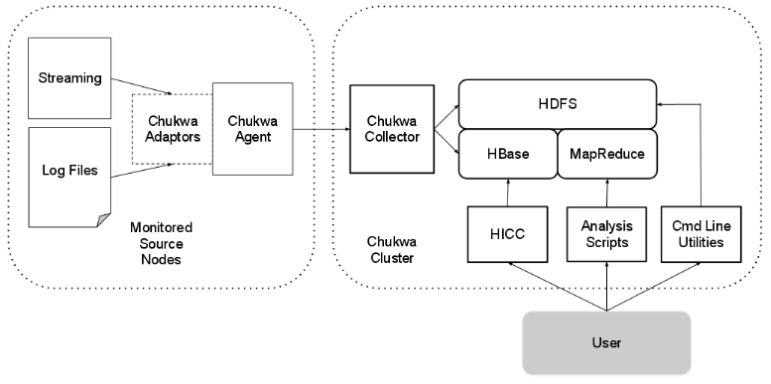
Architecture

Slide 23
Architecture Agents
Chukwa agents
Do not collect particular fixed set of data
Support dynamically starting and stopping Adaptors
Adaptors
Dynamically controllable data sources
Generally wrap some other data source
A file or a Unix command-line tool

Slide 24
Architecture Adaptors
Chukwa Adaptors emit data in Chunks
Chunk: a sequence of bytes with some metadata
Chunk Metadata fields
Field | Meaning | Source
Source | Hostname where Chunk was generated | Automatic
Cluster | Cluster host is associated with | Specified by user in agent config
Datatype | Format of output | Specified by user when Adaptor started
Sequence ID | Offset of Chunk in stream | Automatic, initial offset specified when Adaptor started
Name | Name of data source | Automatic, chosen by Adaptor
Notes:
Sequence ID specifies how many bytes each Adaptor has sent, including the current chunk

Slide 25

Architecture Collectors
Benefits
Reduce the number of HDFS files generated by Chukwa
Hide the details of the HDFS file system in use
When Using Chukwa to monitor a development cluster running a different version of Hadoop
When using Chukwa to monitor a non-Hadoop cluster
Chukwa Collector
Sink file
A Hadoop sequence file of serialized Chunks

Slide 26
Architecture ETL Processes & Data Analytics Scripts
Toolbox of MapReduce jobs
For organizing and processing incoming data
Archiving
Take Chunks from their input
Output new sequence files of Chunks, ordered and grouped
Do not parsing or modification of the contents
Demux
Take Chunks as input and parse them to produce ChukwaRecords
ChukwaRecords: sets of key-value pairs
Can run as a MapReduce job or as part of Chukwa Collector
Data analytics scripts
Provide visualization and interpretation of health of Hadoop cluster
Notes:
HBase provides index by primary key, and manage data compaction.
-- It is better for continuous monitoring of data stream, and periodically produce reports
HDFS provides better throughput for working with large volume of data.
-- It is more suitable for one time research analysis job.
-- But it’s less convenient for finding particular data items.
As a result, Chukwa has a toolbox of MapReduce jobs for organizing and processing incoming data.

Slide 27
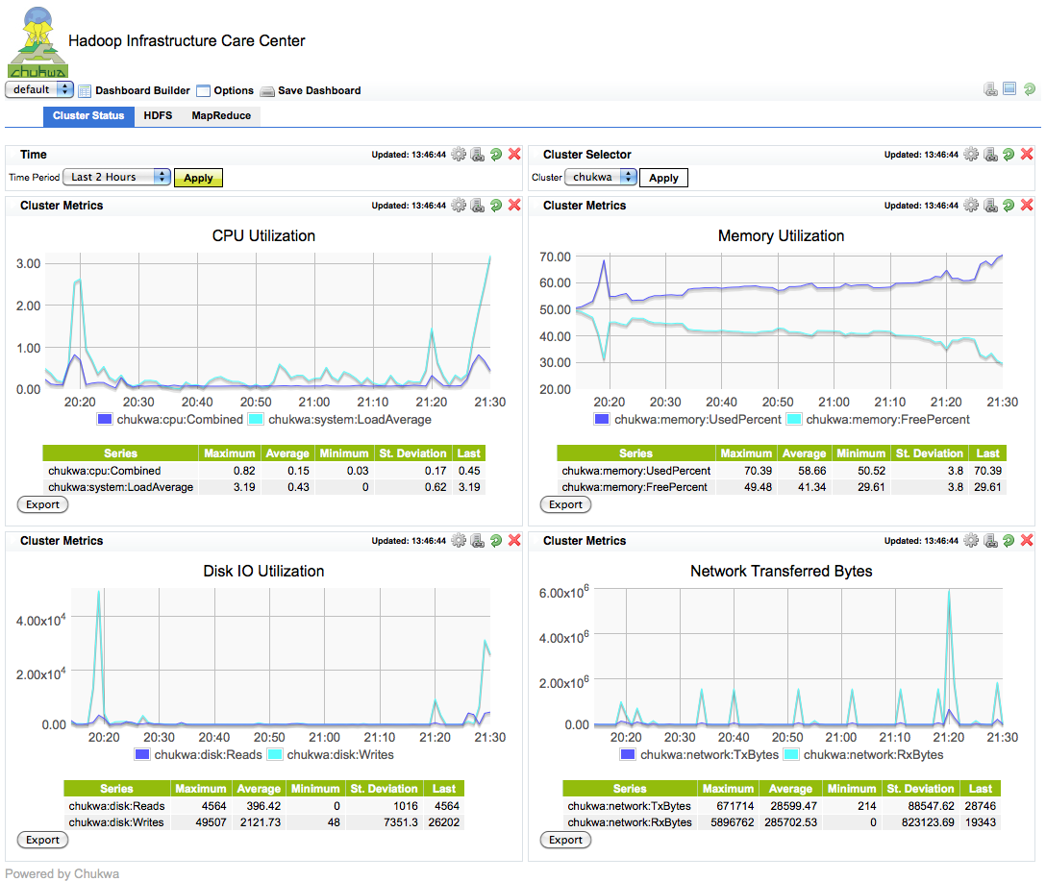
Architecture HICC
Hadoop Infrastructure Care Center (HICC)
The central dashboard for visualize and monitoring of metrics collected by Chukwa

Slide 28
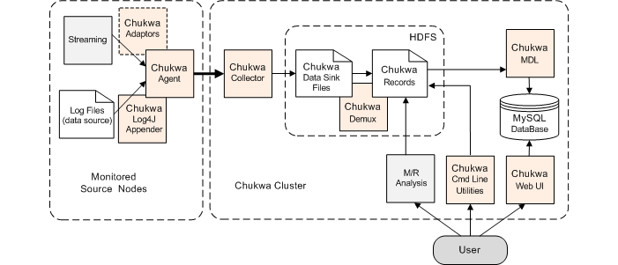
Installation
Pre-requisites
Java 1.6 or better
Hadoop 0.20.205.0+
Hbase 0.90.4 for HICC
Three components for a minimal Chukwa deployment
Notes:
A Hadoop and HBase cluster on which Chukwa will process data (referred to as the Chukwa cluster).
A collector process, that writes collected data to HBase.
One or more agent processes, that send monitoring data to the collector.
-- The nodes with active agent processes are referred to as the monitored source nodes.
In addition, you may wish to run the Chukwa Demux jobs, which parse collected data, or HICC, the Chukwa visualization tool.

