Slide 1
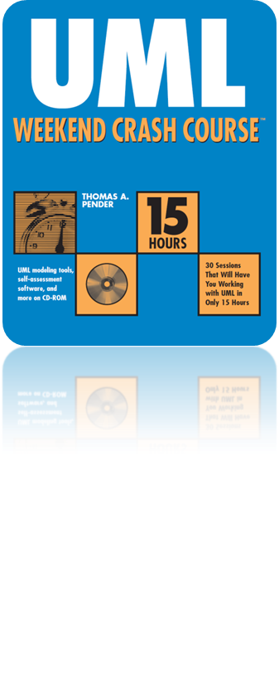
Session 24
Modeling the Development
Environment
Written by Thomas A. Pender
Published by Wiley Publishing, Inc.
October 27, 2011
Presented by Hyewon Lim

Slide 2
Contents
Describing the Purpose and Function of Packages
Packages Provide a Namespace
Defining the Notation for Packages and Package Diagrams
Constructing a Package Diagram for the Case Study

Slide 3
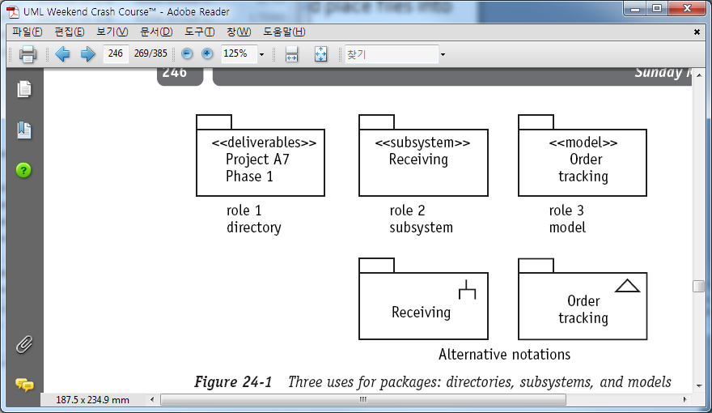
Describing the Purpose and Function of Packages (1/3)
Package
  The UML tool for organizing the diagrams and other work products of the project
Three purposes
  Organize any and all of the diagrams that you create during the project
    Can place the diagrams into various packages just like you would place files into various directories on your computer
    Name the directories and packages to indicate the purpose of the contained files
Notes:
Folder icon 으로 표시.

Slide 4
Describing the Purpose and Function of Packages (2/3)
Three purposes
  Represent a subsystem
    Subsystem
      A UML-defined stereotype that identifies
      a cohesive subset of the total system
    Elements placed in a subsystem type of
    package are, by default, visible only
    within the package
      The visibility of individual model elements
      within the package may be defined as public,
      private, or protected
      Every subsystem package must have
      at least one public interface
Notes:
Subsystem의 예.
Inventory Control System은 Receiving subsystem과 Shipping subsystem 등으로 구성된다.

Slide 5
Describing the Purpose and Function of Packages (3/3)
Three purposes
  A model
    A UML-defined stereotype
    Contains a cohesive set of elements of the system
      Focuses on a topic or type of behavior within the system
    Not contain any system elements that do not help explain the topic
Notes:
Subsystem의 예.
Inventory Control System은 Receiving subsystem과 Shipping subsystem 등으로 구성된다.

Slide 6
Contents
Describing the Purpose and Function of Packages
Packages Provide a Namespace
Defining the Notation for Packages and Package Diagrams
Constructing a Package Diagram for the Case Study

Slide 7
Packages Provide a Namespace
All these package types provide a separate namespace for the model elements contained within them, including other packages
  Names must be unique across elements of the same type within a package
  But, do not have to be unique across different
Requires two pieces of information
  Element name & Element type
Package :: element
  Model elements in different packages may have the same name
  But whenever the two elements are used together they must be qualified with the owning package name
Notes:
Class 타입의 Product와 Statechart diagram 타입의 Product는 같은 패키지 안에 들어갈 수 있음.
그러나 똑같은 타입의 똑같은 이름을 가진 것들은 같은 패키지 안에 들어갈 수는 없다.
- 예를 들면 Class 타입의 Product라는 element가 두 개 이상 존재할 수 없음.
서로 다른 패키지라면 같은 이름을 가진 element들이 존재할 수 있는데,
만약 두 element들이 함께 쓰이는 경우에는, package::element로 어느 패키지에 속한 element인지 표기해줘야 함.
- Receiving::Product & Shipping::Product

Slide 8
Contents
Describing the Purpose and Function of Packages
Packages Provide a Namespace
Defining the Notation for Packages and Package Diagrams
Constructing a Package Diagram for the Case Study

Slide 9
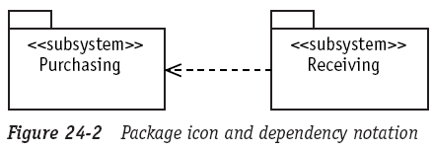
Defining the Notation for Packages and Package Diagrams (1/6)
Package icon
  A tabbed folder
Package reference
  The dependency notation, a dashed arrow
Notes:
Figure 24-2: “the Receiving subsystem depends on, or needs help from, the Purchasing subsystem package.”

Slide 10
Defining the Notation for Packages and Package Diagrams (2/6)
Package stereotypes
  Allows to characterize the contents of the package
  Provide specific naming of its contents
  Stereotypes are not part of the package name
    They do not help make it unique
      i.e., <<documentation>> Receiving <<subsystem>> Receiving
  If the packages themselves are contained within other packages,
  then they are qualified by their containers, making them unique
    Need to check how your modeling tool implements these rules

Slide 11
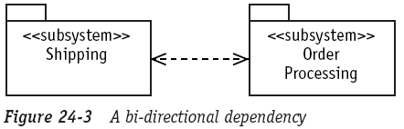
Defining the Notation for Packages and Package Diagrams (3/6)
Package dependency
  Dependency relationship means that at least one class in a package has to communicate with at least one class in the other package
  It is entirely valid for a dependency to run both directions
Notes:
Figure 24-3: Shipping은 Order Processing subsystem 내의 Order의 Update가 필요하고,
Order Processing은 Order 내의 Product의 Shipment 상태를 체크해야만 한다.
양방향을 허용하지만, 이 세션에서는 한 방향 dependency 예제만 다룬다.

Slide 12
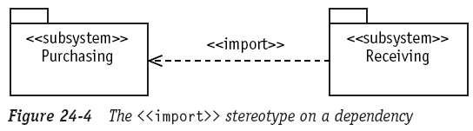
Defining the Notation for Packages and Package Diagrams (4/6)
Dependency stereotypes
  The package dependency may be labeled with a stereotype to describe the nature of the dependency
  <<import>>
    Allow internal references (references within the package) to the class without specifying the source package name
Notes:
<<import>> : Java 에서의 import 랑 같은 효과를 낸다고 보면 됨.

Slide 13
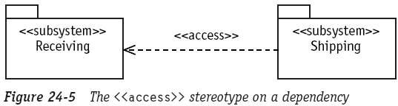
Defining the Notation for Packages and Package Diagrams (5/6)
Dependency stereotypes
  The package dependency may be labeled with a stereotype to describe the nature of the dependency
  <<access>>
    Not actually pull the classes at runtime
      Some object from calling subsystem make calls in the interface of the caller subsystem

Slide 14
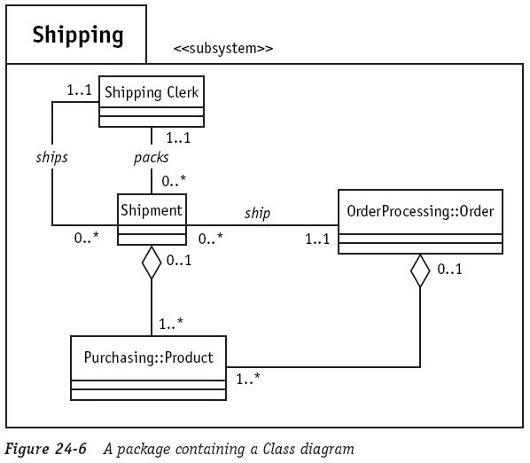
Defining the Notation for Packages and Package Diagrams (6/6)
Model elements in a package
  In most modeling tools, packages provide a nesting mechanism
    The packages in this scheme refer to systems, subsystems, and diagrams
    The scheme can contain as many levels as the problem requires
Notes:
여러 수준(level)을 포함할 수 있다는 것을, 모델링 툴에서 표현하는 일반적인 방법은 하나의 패키지를 만들고, 새 창 또는 캔버스에 다이어그램을 그리는 것.
개념적으로 다이어그램은 figure 24-6에서처럼 패키지 내에 존재한다. 그러나 툴은 24-6처럼 표현하지 않는다.
그리고 24-6은 중요한 관계를 나타내고 있는데, 보라색 네모 부분을 보면 “package::element” 표기를 사용한 것을 볼 수 있다.
이는 두 클래스가 지정된 패키지로부터 온다는 것을 나타낸다. 즉, 이 클래스들은 다른 패키지에 정의되어 있으며, 이 패키지에서 참조된다는 것을 분명하게 나타내는 것.

Slide 15
Contents
Describing the Purpose and Function of Packages
Packages Provide a Namespace
Defining the Notation for Packages and Package Diagrams
Constructing a Package Diagram for the Case Study

Slide 16
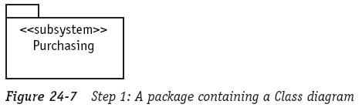
Constructing a Package Diagram for the Case Study (1/6)
The creation of a Package diagram
  using the subsystem stereotype
  to organize the Inventory Control System elements
Add a package to represent the Purchasing subsystem

Slide 17
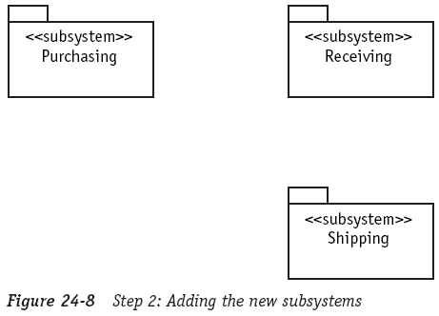
Constructing a Package Diagram for the Case Study (2/6)
Add the Shipping and Receiving subsystems

Slide 18
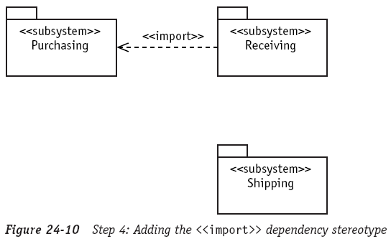
Constructing a Package Diagram for the Case Study (3/6)
Create a dependency between Receiving and Purchasing
  to show that Receiving needs help from classes in the Purchasing package
Stereotype the dependency as <<import>>
  to show that Receiving makes references to classes within Purchasing by adding them into its own set of classes at run time

Slide 19
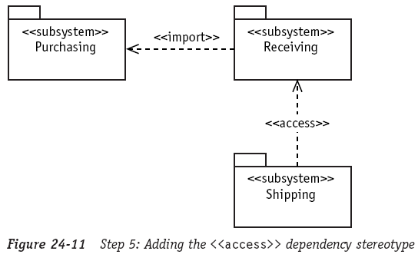
Constructing a Package Diagram for the Case Study (4/6)
Add the <<access>> stereotype to the dependency between Shipping and Receiving
Notes:
to show that shipping needs to communicate with classes within Receiving without actually making them part of the Shipping subsystem at run time

Slide 20
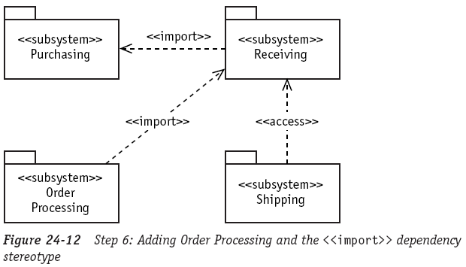
Constructing a Package Diagram for the Case Study (5/6)
Add a package to handle the order processing requirements of the system
Notes:
Order processing 패키지는 Receiving 패키지의 Inventory class를 사용해야 하기 때문에 저런 관계가 생성됨.

Slide 21
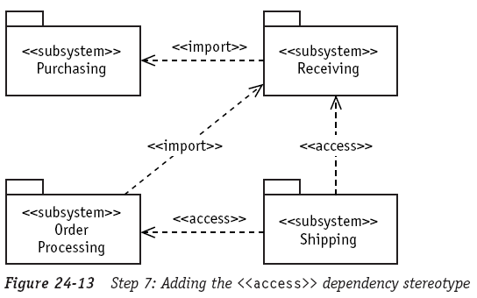
Constructing a Package Diagram for the Case Study (6/6)
The shipping package needs to use the Order class in the Order Processing package
  Simply communicate with it rather than add it the itself
Notes:
Order processing 패키지는 Receiving 패키지의 Inventory class를 사용해야 하기 때문에 저런 관계가 생성됨.

Slide 22
The End

