Slide 1
State & Activity Diagram
© copyright 2001 SNU OOPSLA Lab.

Slide 2
Contents – Part1. State Diagram
Basic State Machine Concepts
Statecharts and Objects
Advanced Modeling Concepts
Case Study

Slide 3
Next slides are…
Basic State Machine Concepts
Statecharts and Objects
Advanced Modeling Concepts
Case Study

Slide 4

Automata
A machine whose output behavior is not only a direct consequence of the current input, but of some past history of its inputs
Characterized by an internal state which represents this past experience
ON
ON
ON
ON
OFF

Slide 5
State Machine (Automaton) Diagram
Graphical rendering of automata behavior
on
Lamp On
on
off
Lamp Off
off

Slide 6
Outputs and Actions
As the automaton changes state it can generate outputs:
on
on
Lamp On
print(”on”)
Lamp On
on/print(”on”)
on
off
off
off
off
Lamp
Off
Lamp
Off
Mealy automaton
Moore automaton

Slide 7
Extended State Machines
Addition of variables (“extended state”)
on
Lamp On
ctr : Integer
on/ctr := ctr + 1
off
Lamp Off
off

Slide 8
A Bit of Theory
An extended (Mealy) state machine is defined by:
  a set of input signals (input alphabet)
  a set of output signals (output alphabet)
  a set of states
  a set of transitions
    triggering signal
    action
  a set of extended state variables
  an initial state designation
  a set of final states (if terminating automaton)

Slide 9
Basic UML Statechart Diagram
“top” state
State
Initial
pseudostate
top
Trigger
Ready
Transition
stop
/ctr := 0
Done
Final
state
Action
stop

Slide 10
What Kind of Behavior?
In general, state machines are suitable for describing event-driven, discrete behavior
  inappropriate for modeling continuous behavior
threshold
time

Slide 11
Event-Driven Behavior
Event = a type of observable occurrence
  interactions:
    synchronous object operation invocation (call event)
    asynchronous signal reception (signal event)
  occurrence of time instants (time event)
    interval expiry
    calendar/clock time
  change in value of some entity (change event)
Event Instance = an instance of an event (type)
  occurs at a particular time instant and has no duration

Slide 12
The Behavior of What?
In principle, anything that manifests event-driven behavior
  NB: there is no support currently in UML for modeling continuous behavior
In practice:
  the behavior of individual objects
  object interactions
The dynamic semantics of UML state machines are currently mainly specified for the case of active objects

Slide 13
Next slides are…
Basic State Machine Concepts
Statecharts and Objects
Advanced Modeling Concepts
Case Study

Slide 14
Statecharts
UML uses an object-oriented variant of Harel’s statecharts
  adjusted to software modeling needs
Used to model event-driven (reactive) behavior
  well-suited to the server model inherent in the object paradigm
Primary use for modeling the behavior of active event-driven objects
  systems modeled as networks of collaborating state machines
  run-to-completion paradigm significantly simplifies concurrency management

Slide 15
Statecharts (cont’d)
Includes a number of sophisticated features that realize common state-machine usage patterns:
  entry/exit actions
  state activities
  dynamic and static conditional branching
Also, provides hierarchical modeling for dealing with very complex systems
  hierarchical states
  hierarchical transitions
  orthogonality

Slide 16

What is a State
  A state diagram may have a starting point (solid circle) and several end points (bull’s eyes).
  A state is shown as a rounded rectangle.
  Each state has a name, optionally state variables (i.e., attributes of the state-owning class), and optionally activities.
  Standard events in the activity compartment include entry, exit, and do.
Name
State
variables
Activities

Slide 17
State Transition
  Transitions between states are shown as arrows. Fork and join using the synch. bar are allowed.
  A transition can be labeled with an event that causes it. When an event occurs, the transition from one state to another fires.
  If no event is specified, the transition will fire when internal actions of the source state are executed.

Slide 18
State Transition
  Syntax:
    event-name ( parameters ) [guard condition] / action expressions
  An event can be one of the following cases:
    A message is received from another object (or the object itself)
    A specified time has passed; e.g., after(2 seconds)
    There has been a change in some state; e.g., when(quantity < 10)
  When a guard condition is specified, the event must occur and the condition be true for the transition to fire.
  Action expressions are written in terms of operations and attributes of the owning class (the classifier) and/or with parameters of the event.

Slide 19
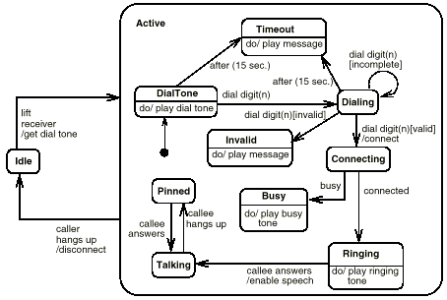
State Diagram

Slide 20
Object Behavior - General Model
Simple server model:
Initialize
Object
Handling depends on
specific request type
Wait for
Request
void:offHook ();
{busy = true;
obj.reqDialtone();
…
};
Handle
Request
Terminate
Object

Slide 21
Object Behavior and State Machines
Direct mapping:
on
Initialize
Object
Lamp On
Wait for
Event
on/print(”on”)
Handle
Event
off
off
Lamp
Off
Terminate
Object
stop

Slide 22
Object and Threads
Passive objects: depend on external power (thread of execution)
Active objects: self-powered (own thread of execution)
Initialize
Object
Initialize
Object
Wait for
Request
Wait for
Request
Handle
Request
Handle
Request
Terminate
Object
Terminate
Object

Slide 23
Passive Objects: Dynamic Semantics
Initialize
Object
Wait for
Request
Handle
Request
Terminate
Object
Encapsulation does not protect the object from concurrency conflicts!
Explicit synchronization is still required

Slide 24
Active Objects and State Machines
Objects that encapsulate own thread of execution
anActiveObject
#currentEvent : Event
poll/defer
created
created
+ start ( )
+ poll ( )
+ stop ( )
start
start/^master.ready()
ready
start/^master.ready()
ready
ready
stop/
poll/^master.ack()

Slide 25
Active Objects: Dynamic Semantics
ActiveObject:
Run-to-completion model:
  serialized event handling
  eliminates internal concurrency
  minimal context switching overhead

Slide 26
The Run-to-Completion Model
A high priority event for (another) active object will preempt an active object that is handling a low-priority event
Active1
Active2
lo
hi
hi

Slide 27
Next slides are …
Basic State Machine Concepts
Statecharts and Objects
Advanced Modeling Concepts
Case Study

Slide 28
State Entry and Exit Actions
A dynamic assertion mechanism
LampOn
e2
entry/lamp.on();
exit/lamp.off();
e1

Slide 29
Order of Actions: Simple Case
Exit actions prefix transition actions
Entry action postfix transition actions
LampOn
LampOff
off/printf(“to off”);
entry/lamp.on();
entry/lamp.off();
exit/printf(“exiting”);
exit/printf(“exiting”);
Resulting action sequence:
printf(“exiting”);
printf(“to off”);
lamp.off();
off/printf(“needless”);
printf(“exiting”);
printf(“needless”);
lamp.off();

Slide 30
Internal Transitions
Self-transitions that bypass entry and exit actions
Internal transition
triggered by
an “off” event
LampOff
entry/lamp.off();
exit/printf(“exiting”);
off/null;

Slide 31
State (“Do”) Activities
Forks a concurrent thread that executes until:
  the action completes or
  the state is exited through an outgoing transition
“do” activity
Error
entry/printf(“error!”)
do/while (true) alarm.ring();

Slide 32
Guards
Conditional execution of transitions
  guards (Boolean predicates) must be side-effect free
bid [value < 100] /reject
Selling
bid [value >= 200] /sell
Happy
bid [(value >= 100) & (value < 200)] /sell
Unhappy

Slide 33
Static Conditional Branching
Merely a graphical shortcut for convenient rendering of decision trees
Selling
Happy
bid
[value >= 200] /sell
[value < 100] /reject
[(value >= 100) & (value < 200)] /sell
Unhappy

Slide 34
Dynamic Conditional Branching
Choice pseudostate: guards are evaluated at the instant when the decision point is reached
Selling
Happy
bid /gain := calculatePotentialGain(value)
[gain >= 200] /sell
[gain < 100] /reject
[(gain >= 100) & (gain < 200)] /sell
Dynamic
choicepoint
Unhappy

Slide 35
Hierarchical State Machines
Graduated attack on complexity
  states decomposed into state machines
LampOff
LampFlashing
flash/
entry/lamp.off()
FlashOn
off/
entry/lamp.on()
1sec/
1sec/
on/
on/
FlashOff
on/
LampOn
entry/lamp.off()
entry/lamp.on()

Slide 36
“Stub” Notation
Notational shortcut: no semantic significance
LampOff
LampFlashing
flash/
entry/lamp.off()
off/
FlashOn
on/
on/
on/
FlashOff
LampOn
entry/lamp.on()

Slide 37
Group Transitions
Default transition to
the initial pseudostate
Higher-level transitions
LampOff
LampFlashing
entry/lamp.off()
flash/
FlashOn
off/
entry/lamp.on()
1sec/
1sec/
on/
FlashOff
on/
LampOn
entry/lamp.off()
entry/lamp.on()
Group transition

Slide 38
Completion Transitions
Triggered by a completion event
  generated automatically when an immediately nested state machine terminates
completion
transition (no trigger)
Committing
Phase1
CommitDone
Phase2

Slide 39
Triggering Rules
Two or more transitions may have the same event trigger
  innermost transition takes precedence
  event is discarded whether or not it triggers a transition
LampFlashing
FlashOn
on/
off/
on/
FlashOff

Slide 40
Deferred Events
Events can be retained if they do not trigger a transition
Deferred event
LampOff
entry/lamp.off()
off/defer
off/
on/
LampOn
entry/lamp.on()

Slide 41
Order of Actions: Complex Case
Same approach as for the simple case
S1
exit/exS1
S2
entry/enS2
initS2
S11
exit/exS11
E/actE
S21
entry/enS21
Actions execution sequence:
exS11 ⇨ exS1 ⇨ actE ⇨ enS2 ⇨ initS2 ⇨ enS21

Slide 42
History
Return to a previously visited hierarchical state
  deep and shallow history options
Diagnosing
suspend/
Diagnostic1
Diagnostic2
Step11
Step21
resume/
Step12
Step22
H*

Slide 43

Orthogonality
Multiple simultaneous perspectives on the same entity
age
financialStatus
Child
Poor
Adult
Rich
Retiree

Slide 44
Orthogonal Regions
Combine multiple simultaneous descriptions
age
financialStatus
Child
Poor
Adult
age
financialStatus
Child
Rich
Retiree
Poor
Adult
Retiree
Rich

Slide 45
Orthogonal Regions - Semantics
All mutually orthogonal regions detect the same events and respond to them “simultaneously”
  usually reduces to interleaving of some kind
legalStatus
financialStatus
LawAbiding
Poor
robBank/
robBank/
Outlaw
Rich

Slide 46
Interactions Between Regions
Typically through shared variables or awareness of other regions’ state changes
sane : Boolean
flying : Boolean
Catch22
sanityStatus
flightStatus
Crazy
entry/sane := false;
Flying
entry/flying := true;
(flying)/
(sane)/
request
Grounding/
(~sane)/
Sane
entry/sane := true;
Grounded
entry/flying := false;

Slide 47
Transition Forks and Joins
For transitions into/out of orthogonal regions:
age
Child
Adult
Retiree
Staff
Member
Manager
employee

Slide 48
Common Misuse of Orthogonality
Using regions to model independent objects
Person1
Person2
Person1
Person2
Child
Child
Adult
Adult
Retiree
Retiree

Slide 49
Next slides are …
Basic State Machine Concepts
Statecharts and Objects
Advanced Modeling Concepts
Case Study

Slide 50

Case Study: Protocol Handler
A multi-line packet switch that uses the alternating-bit protocol as its link protocol
AB protocol
line card 1
AB
sender
End user
.
.
.
SWITCH
AB
receiver
End user
unreliable
telecom lines
AB
sender
line card N
AB
receiver
End user

Slide 51
Alternating Bit Protocol (1)
A simple one-way point-to-point packet protocol
AB protocol
packetizer
Sender
Receiver
unpacker
data(1)
pktA
data(1)
ack
ackA
ack
data(2)
pktB
data(2)
ack
ackB
ack
…etc.

Slide 52
Alternating Bit Protocol (2)
State machine specification
Sender SM
Receiver SM
AcceptPktA
RcvdPktA
ackB/^ack
pktA/^data
data/^pktA
ack/^ackA
timeout/^pktB
timeout/^ackB
WaitAckA
WaitAckB
WaitPktB
WaitPktA
timeout/^pktA
timeout/^ackA
ackA/^ack
data/^pktB
pktB/^data
ack/^ackB
AcceptPktB
RcvdPktB

Slide 53
Additional Considerations
Support (control) infrastructure
SWITCH
operator
interface
System
operator
AB
receiver
AB lines
manager
AB
sender
DB
interface
DBase

Slide 54
Control
The set of (additional) mechanisms and actions required to bring a system into the desired operational state and to maintain it in that state in the face of various planned and unplanned disruptions
For software systems this includes:
  system/component start-up and shut-down
  failure detection/reporting/recovery
  system administration, maintenance, and provisioning
  (on-line) software upgrade

Slide 55
Retrofitting Control Behavior
JustCreated
Hardware
Audit
Analysing
Failure
ReadyToGo
GettingData
AcceptPktA
Failed
WaitAckA
WaitAckB
AcceptPktB

Slide 56
The Control Automaton
In isolation, the same control behavior appears much simpler
JustCreated
GettingData
Analysing
Failure
Hardware
Audit
ReadyToGo
Failed
Operational

Slide 57
Exploiting Inheritance
Abstract control classes can capture the common control behavior
AbstractController
Sender
Receiver
. . .

Slide 58
Exploiting Hierarchical States
AbstractController
JustCreated
Analysing
Failure
GettingData
Failed
Hardware
Audit
Operational
Sender
ReadyToGo

Slide 59
Activity Diagrams

Slide 60
Activity Diagram Applications
Intended for applications that need control flow or object/data flow models …
... rather than event-driven models like state machines.
For example: business process modeling and workflow.
The difference in the three models is how step in a process is initiated, especially with respect to how the step gets its inputs.

Slide 61
Control Flow
Each step is taken when the previous one finishes …
…regardless of whether inputs are available, accurate, or complete (“pull”).
Emphasis is on order in which steps are taken.
Start
Weather Info
Analyze Weather Info
Not UML
Notation!
Chart Course
Cancel Trip
Notes:
Decision is taken with whatever information you have at the time. Does not wait for complete input or even any input to be provided.

Slide 62
Object/Data Flow
Each step is taken when all the required input objects/data are available …
… and only when all the inputs are available (“push”).
Emphasis is on objects flowing between steps.
Design Product
Acquire Capital
Procure
Materials
Build
Subassembly 1
Build
Subassembly 2
Not UML
Notation
Final
Assembly

Slide 63
State Machine
Each step is taken when events are detected by the machine …
… using inputs given by the event.
Emphasis is on reacting to environment.
Ready To Start
Coin Deposited
Ready For Order
Selection Made
Cancel Button Pressed
Dispense
Product
Return
Change
Not UML
Notation

Slide 64
Activity Diagrams Based on State Machines
Currently activity graphs are modeled as a kind of state machine.
Modeler doesn't normally need to be aware of this sleight-of-hand ...
... but will notice that "state" is used in the element names.
Activity graphs will become independent of state machines in UML 2.0.
Notes:
Slides will use abbreviations for simplicity.
Sleight-of-hand will be explained next.

Slide 65
Kinds of Steps in Activity Diagrams
Action (State)
Action
Subactivity
Subactivity (State)
Just like their state machine counterparts (simple state and submachine state) except that ...
... transitions coming out of them are taken when the step is finished, rather than being triggered by a external event, ...
... and they support dynamic concurrency.
Notes:
Triggerless transitions is what makes activity graphs more useful for control and data flow. This is the sleight-of-hand mentioned on the previous slide.

Slide 66
Action (State)
Action
An action is used for anything that does not directly start another activity graph, like invoking an operation on an object, or running a user-specified action.
However, an action can invoke an operation that has another activity graph as a method (possible polymorphism).

Slide 67
Subactivity (State)
Subactivity
A subactivity (state) starts another activity graph without using an operation.
Used for functional decomposition, non-polymorphic applications, like many workflow systems.
The invoked activity graph can be used by many subactivity states.

Slide 68
Example
POEmployee.sortMail
Deliver Mail
Deliver Mail
POEmployee
Check Out
Truck
Put Mail
In Boxes
sortMail()
Notes:
No standard notation yet for the name of an action, to indicate what kind of object and operation are being invoked.
No standard notation for connecting an action state to the object it invokes an operation on. Likewise for the decomposition of a subactivity state into another state machine.
The action state is polymorphic, the subactivity state is not.

Slide 69
Activity Graph as Method
POEmployee.sortMail
POEmployee.deliverMail
POEmployee
PO Employee Deliver Mail Method
sortMail()
«realize»
Put Mail
In Boxes
deliverMail()
Check Out
Truck
Application is completely OO when all action states invoke operations
All activity graphs are methods for operations.
Notes:
Make Deliver Mail polymorphic by using it as a method on an object. Can override the Deliver Mail Method with a new one on specializations of POEmployee.
Not shown: use the top-level diagram (sorting and delivering mail) as a method, and make Put Mail In Boxes into an operation, then the entire application is polymorphic.
The system is completely object-oriented when all steps are actions and all activity graphs are methods on an object.

Slide 70
Dynamic concurrency
*
Action/Subactivity
Applies to actions and subactivities.
Not inherited from state machines.
Invokes an action or subactivity any number of times in parallel, as determined by an expression evaluated at runtime. Expression also determines arguments.
Upper right-hand corner shows a multiplicity restricting the number of parallel invocations.
Outgoing transition triggered when all invocations are done.
Currently no standard notation for concurrency expression or how arguments are accessed by actions. Attach a note as workaround for expression. Issue for UML 2.0.
Notes:
Concurrency expression is a set of lists of arguments, one list of arguments for one parallel invocation. No standard for how these are accessed. The UML Reference manual says they are passed as arguments to the current event (p 437). But the completion event is not actually created and queued.

Slide 71
Object Flow (State)
Class
[State]
A special sort of step (state) that represents the availability of a particular kind of object, perhaps in a particular state.
No action or subactivity is invoked and control passes immediately to the next step (state).
Places constraints on input and output parameters of steps before and after it.

Slide 72
Object Flow (State)
Take Order
Order
[Taken]
Fill Order
Take Order must have an output parameter giving an order, or one of its subtypes.
Fill Order must have an input parameter taking an order, or one of its supertypes.
Dashed lines used with object flow have the same semantics as any other state transition.
Notes:
More about semantics of dashed line in pitfalls section.
A step parameter refers to the parameters of the operations invoked by action states. Take Order and Fill Order can be subactivity states, whereupon the parameters are in the first/last action state in the subactivity graph, recursively.

Slide 73
Coordinating Steps
Inherited from state machines
Initial state
Final state
Fork and join

Slide 74
Coordinating Steps
Decision point and merge ( ) are inherited from state machines.
For modeling conventional flow chart decisions.
Calculate
Cost
[cost < $50]
Charge
Account
[cost >= $50]
Get
Authorization
Notes:
Use merge instead of dummy state before join.

Slide 75
Coordinating Steps
Synch state ( ) is inherited from state machines but used mostly in activity graphs.
Provides communication capability between parallel processes.
State machine
notation
Build
Frame
Put
On
Roof
Install
Walls
Install
Foundation
Inspect
*
*
Install
Electricity
in Foundation
Install
Electricity
In Frame
Install
Electricity
Outside
Notes:
Synch state keep track at runtime of the difference in the number of times an incoming trigger has been traversed compared to an outgoing transition. It is Petri-like in this respect.
This number can be bounded. An asterisk means no bound.
In workflow systems these are called parallel synchronized or chained processes.

Slide 76
Convenience Features (Synch State)
Forks and joins do not require composite states.
Synch states may be omitted for the common case (unlimited bound and one incoming and outgoing transition).
Activity diagram
notation
Build
Frame
Put
On
Roof
Install
Walls
Install
Foundation
Inspect
Install
Electricity
in Foundation
Install
Electricity
In Frame
Install
Electricity
Outside

Slide 77
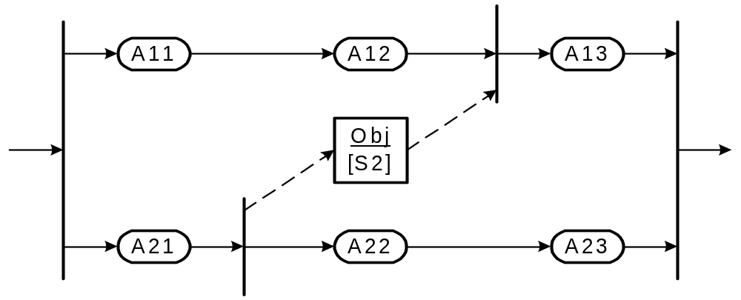
Convenience Features (Synch State)
Object flow states can be synch states

Slide 78
Convenience Features
Fork transitions can have guards.
Evaluate
Impact
Revise
Plan
[ priority = 1]
Register
Bug
Release
Fix
Fix
Bug
Test
Fix
Instead of doing this:
[ priority = 1]
Evaluate
Impact
Revise
Plan
Register
Bug
Release
Fix
[else]
Fix
Bug
Test
Fix
Notes:
Implementers of executing systems must take care that the join is aware that some or all the threads will not arrive. Modelers might want to attach a note to the join to remind readers of the same.

Slide 79
Convenience Features
Partitions are a grouping mechanism.
Swimlanes are the notation for partitions.
They do not provide domain-specific semantics.
Tools can generate swimlane presentation from domain-specific information without partitions.
Management
Evaluate
Impact
Revise
Plan
[ priority = 1]
Support
Register
Bug
Release
Fix
Engineering
Fix
Bug
Test
Fix

Slide 80
Convenience Features
Signal send icon
Wake Up
Signal
… translates to a transition with a send action.
Turn on Coffee Pot
Signal receipt icon
Get Cups
Coffee
Pot
Signal
Coffee Done
… translates to a wait state (a state with no action and a signal trigger event).
Drink Coffee
Notes:
Signal receipt is a natural way to model a wait state.
Dashed line notation is specifically for use with the signal icons.
Can you rotate icons when flow drawn horizontally?

Slide 81
When to Use Activity Diagrams
Use activity diagrams when the behavior you are modeling ...
  does not depend much on external events.
  mostly has steps that run to completion, rather than being interrupted by events.
  requires object/data flow between steps.
  is being constructed at a stage when you are more concerned with which activities happen, rather than which objects are responsible for them (except partitions possibly).

Slide 82
Activity Diagram Modeling Tips
Control flow and object flow are not separate. Both are modeled with state transitions.
Dashed object flow lines are also control flow.
You can mix state machine and control/object flow constructs on the same diagram (though you probably do not want to).

Slide 83
Activity Diagram Modeling Tips
Customer
Telesales
Accounting
Warehouse
From UML
User Guide:
Request
Return
Get Return
Number
Ship Item
Receive
Item
Item
[returned]
Restock
Item
Credit
Item
Account
[available]
Notes:
Diagram assumes that:
1) Receive Item and the OFS Item can be traversed in parallel. Same for Credit Account and Item OFS.
2) Restock item will not start until its Item input has arrived.
3) State machine can terminate with hanging Item OFS.
These are natural assumptions for an object flow language, but UML is state machine based.

Slide 84
Activity Modeling Tips
Customer
Telesales
Accounting
Warehouse
Request
Return
Get Return
Number
Ship Item
Item
Receive
[returned]
Item
Restock
Item
Credit
Item
Account
[available]

Slide 85
Activity Diagram Modeling Tips
Activity diagrams inherit from state machines the requirement for well-structured nesting of composite states.
This means you should either model as if composite states were there by matching all forks/decisions with a correspond join/merges …
… or check that the diagram can be translated to one that is well-nested.
This insures that diagram is executable under state machine semantics.

Slide 86
Activity Diagram Modeling Tips
Well-nested:
Notes:
Forks and joins are implicit composite states.

Slide 87
Activity Diagram Modeling Tips
Not well-nested:
Apply structured coding principles. (Be careful with goto’s!)

Slide 88
Activity Diagram Modeling Tips
Can be translated to well-nested
diagram on earlier slide:

Slide 89
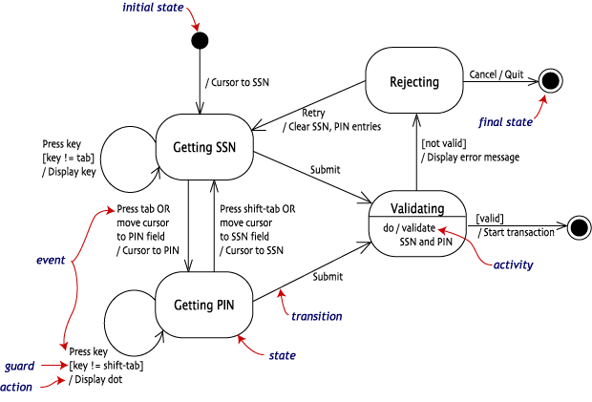
Example : Login of an online banking system

Slide 90
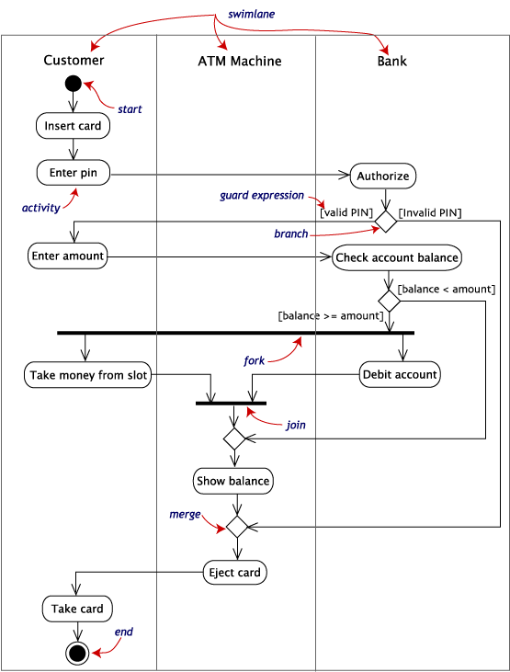
Activity
diagram
withdraw
money
(ATM)

Slide 91
Wrap Up: Activity Diagrams
Use Activity Diagrams for applications that are primarily control and data-driven, like business modeling …
… rather than event-driven applications like embedded systems.
Activity diagrams are a kind of state machine until UML 2.0 …
… so control and object/data flow do not have separate semantics.
UML 1.3 has new features for business modeling that increase power and convenience. Check it out and give feedback!

