Slide 1
Head First Python: Ch 5. Comprehending Data: Work that Data !
Aug 30, 2013
Inhoe Lee
Notes:
Hello everyone.
Thank you for attending this talk.
I’m Inhoe Lee.
What I’m gonna talk about today is Comprehending data

Slide 2
Outline
Coach Kelly needs your help
Sort in one of two ways
The trouble with time
Comprehending lists
Iterate to remove duplicates
Remove duplicates with sets
Your Python Toolbox
Notes:
I am gonna tell you about
sorting, comprehending lists, and two ways of removing duplicates

Slide 3
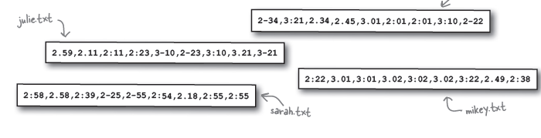
Coach Kelly needs your help
Coach needs a quick way to know the top three fastest times for each athlete
Notes:
Let’s say, coach is our old friend,
Coach needs a quick way to know the top three fastest times for each athlete
Can you help?
Sure you can
---next slide--

Slide 4
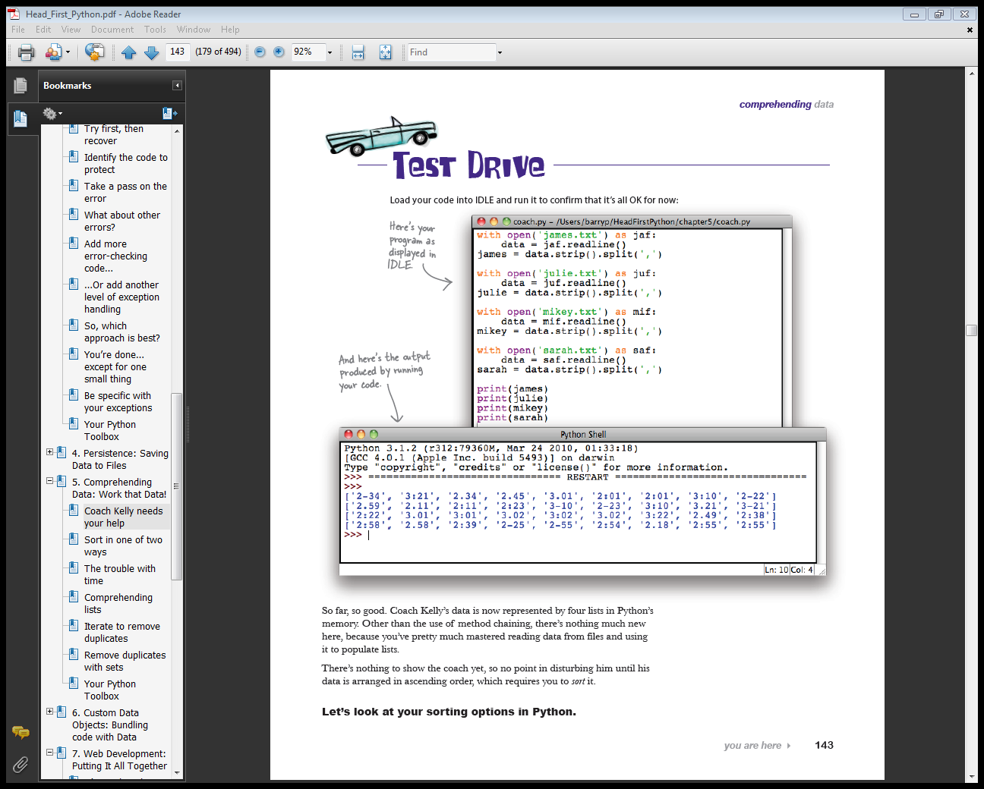
What you need to do
Open the file
Read the line of data
Convert the data
to a list
Display the four lists
on screen
Coach_1.py
Notes:
What you need to do is
Open each of the data files in turns,
Read line of data from the file, and
Convert the data to a list
Display the four lists on screen
Code is already given
It’s coach_1.py
Lets run this

Slide 5
Coach Kelly needs your help
Represented by four lists in Python’s memory
Require you to sort it
Notes:
So far, Coach Kelly’s data is now represented by four lists in Python’s memory.
There’s nothing to show the coach yet, so no point in disturbing him until his data is arranged in ascending order, which requires you to sort it.
But, his data is not arranged in ascending order, which requires you to sort it.
Let’s start with sorting options in Python.

Slide 6
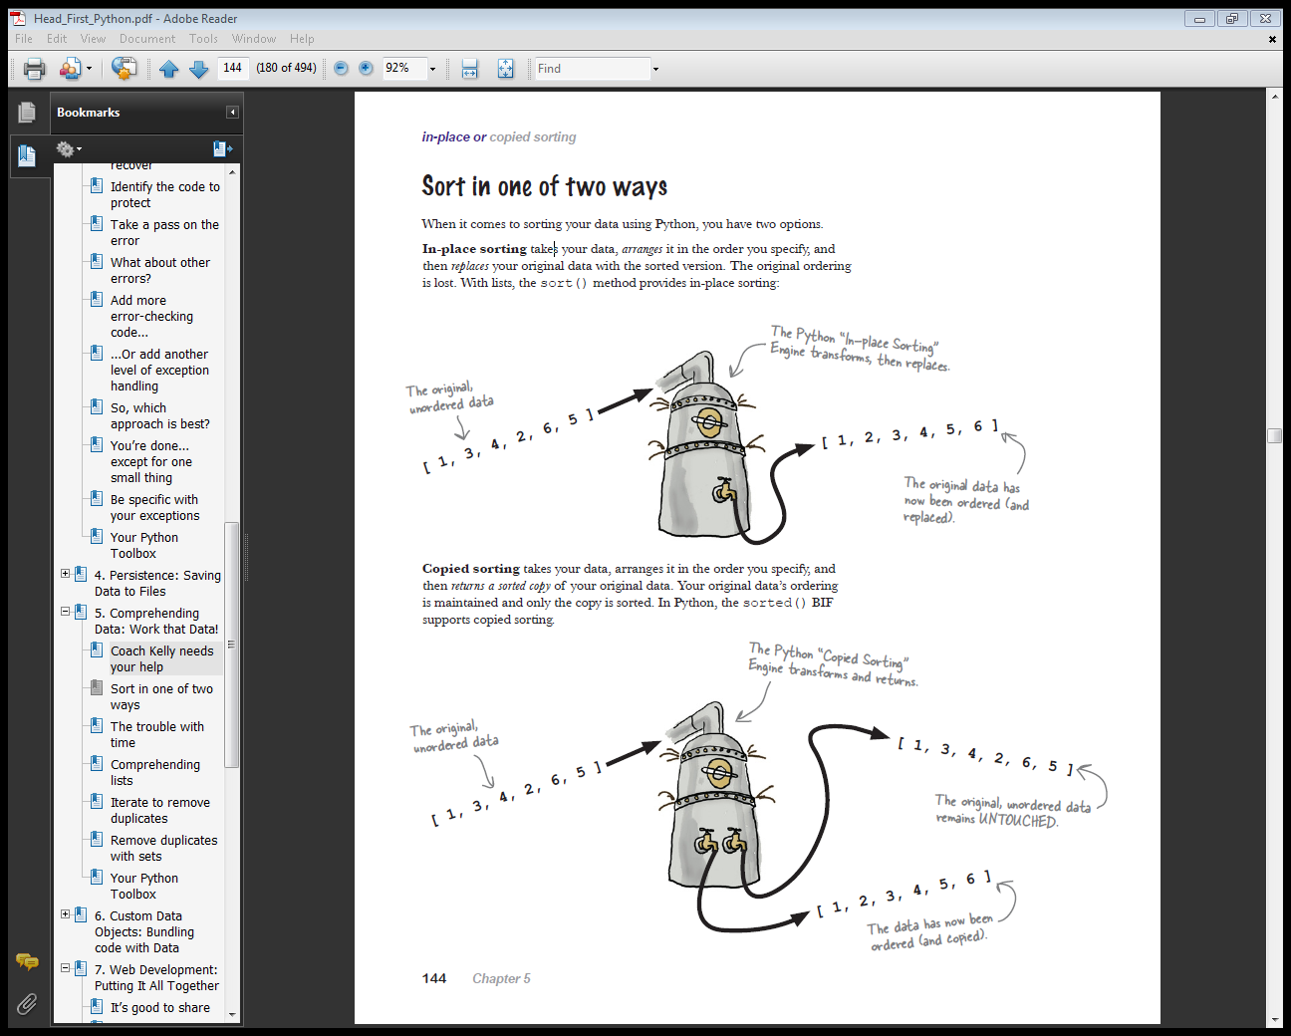
Sort in one of two ways
In-place sorting
Replace original data
Original ordering is lost
sort()
Copied sorting
Return a sorted copy of original data
Original data’s ordering is maintained
sorted()
Notes:
When it comes to sorting your data using Python, you have two options.
In-place, and copied sorting
In-place sorting takes your data, arranges it in the order you specify, and
then replaces your original data with the sorted version.
The original ordering is lost.
With lists, the sort() method provides in-place sorting:
Copied sorting takes your data, arranges it in the order you specify, and
then returns a sorted copy of your original data.
Your original data’s ordering is maintained and only the copy is sorted.
In Python, the sorted() method supports copied sorting.

Slide 7
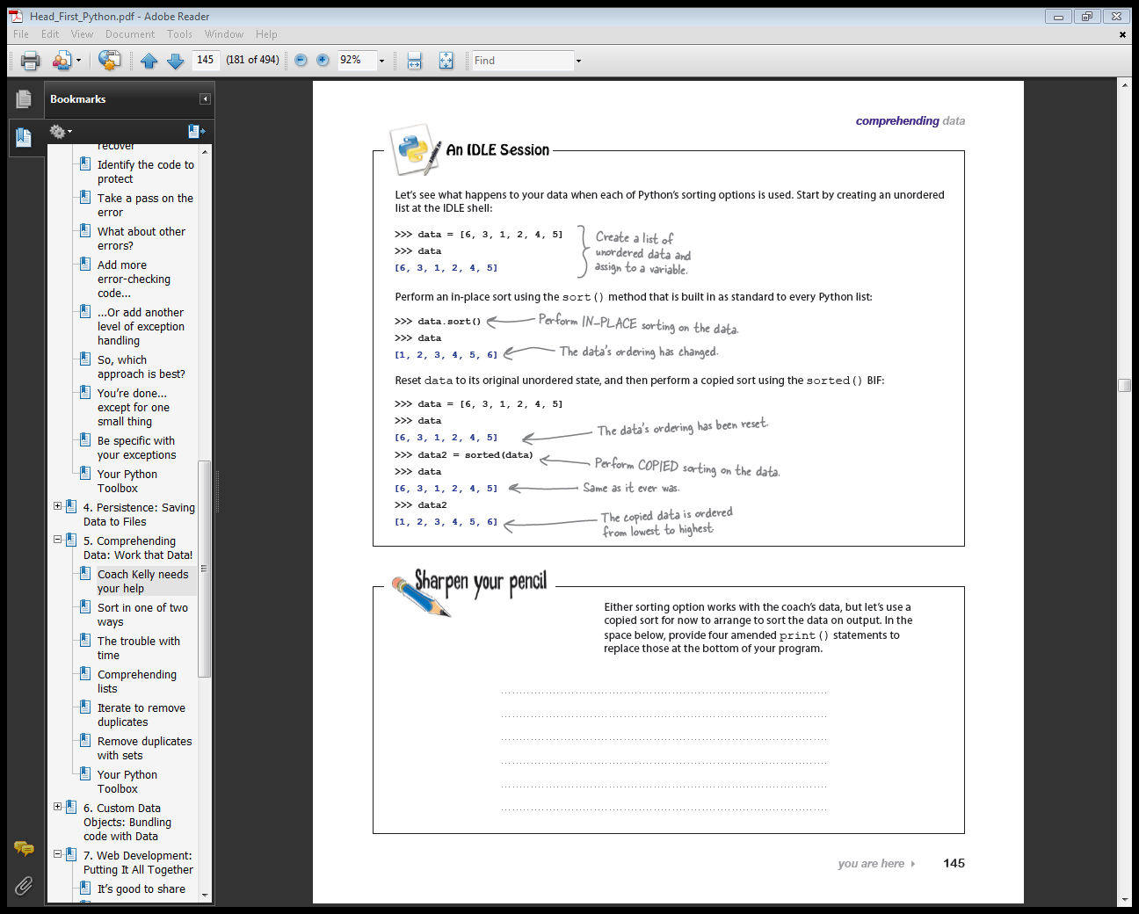
Practice
In-place sorting
Copied sorting
Notes:
Let’s see what happens to your data when each of Python’s sorting options is used.
Start by creating an unordered list at the IDLE shell:
Perform an in-place sort using the sort() method that is built in as standard to every Python list:
Reset data to its original unordered state, and then perform a copied sort using the sorted() BIF:

Slide 8
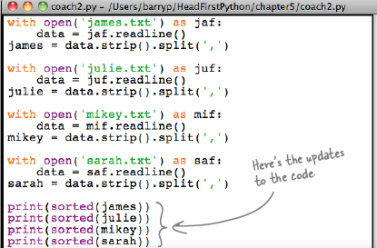
Sorting
Update the code
Coach_2.py
Notes:
So, Let’s update code,
It’s coach_2.py

Slide 9

Sorting
Result
Data values are now uniform
Periods, dashes, and colons
Need to fix data
Notes:
When you see the result,
it looks like your data values are not uniform.
Is the problem with all those
periods, dashes, and colons?
Yes. The minute and seconds separators are confusing Python’s sorting technology.

Slide 10
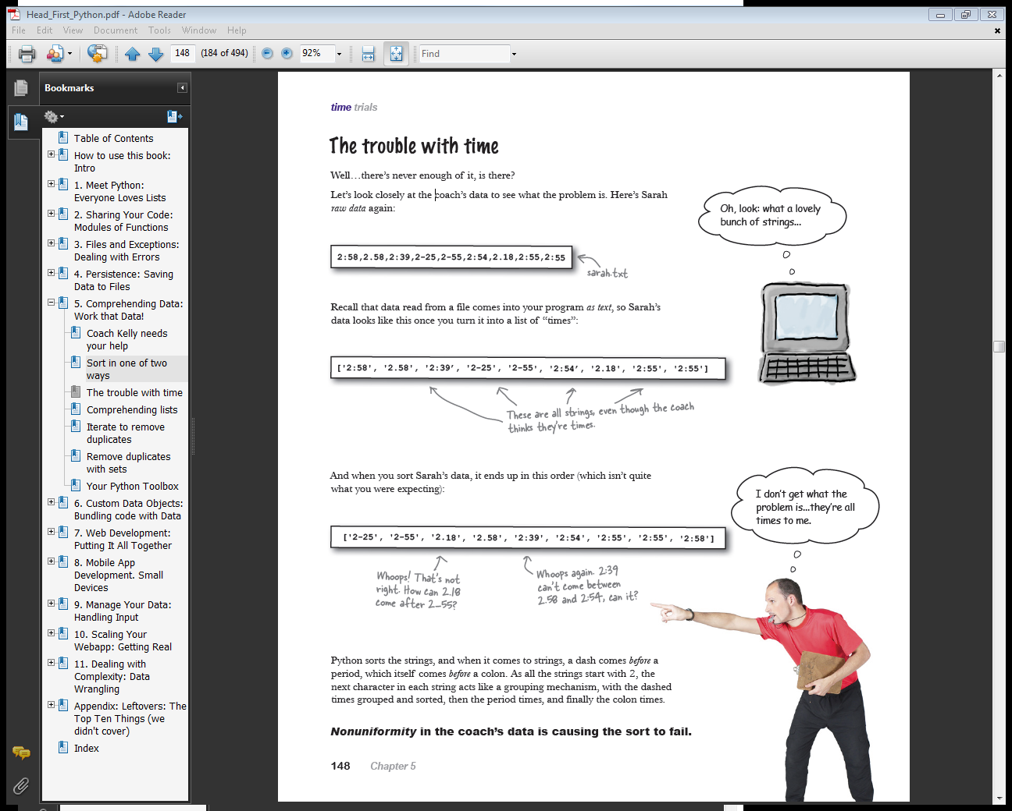
The trouble with time
Raw data
Read from file
After sorting
Notes:
Let’s look closely at the coach’s data to see what the problem is.
Here’s Sarah raw data again:
Recall that data read from a file comes into your program as text,
so Sarah’s data looks like this once you turn it into a list of “times”:
And when you sort Sarah’s data, it ends up in this order
Python sorts the strings, and when it comes to strings, a dash comes before a
period, which itself comes before a colon.
As all the strings start with 2, the next character in each string acts like a grouping mechanism, with the dashed times grouped and sorted, then the period times, and finally the colon times.
Non-uniformity in the coach’s data is causing the sort to fail.
So, as I said before, you need to fix it

Slide 11
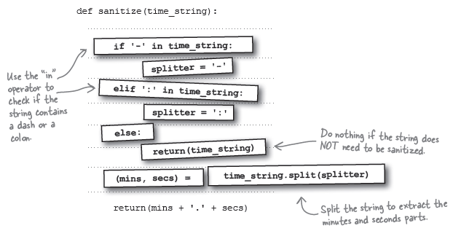
Sanitize
Sanitizing function
Notes:
Sanitize: 건전하게 보이도록 하다
Takes as input a string from each of the athlete’s lists.
The function then processes the string to replace any dashes or colons found with a period
and returns the sanitized string.

Slide 12
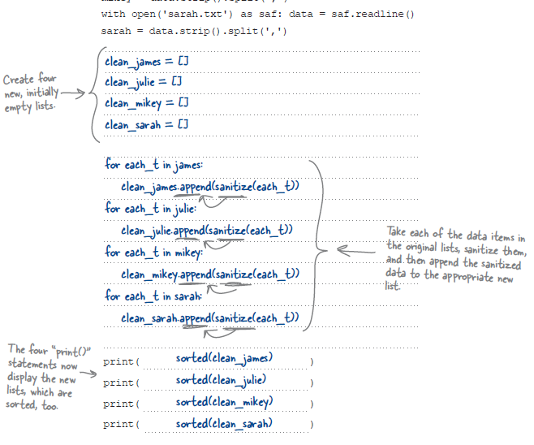
Sanitize
Coach_3.py
Notes:
So, open coach_3.py
And run it

Slide 13
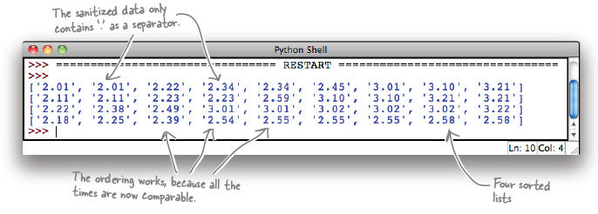
Sanitize
Output
Sorted, uniformly formatted
But, duplicated code
Notes:
sorting is now working as expected.
This output looks much better.
It’s taken a bit of work, but now the data from each of the four files is both
sorted and uniformly formatted.
By preprocessing your data before you sort it, you’ve helped ensure Python’s sorting technology performs correctly.
But, now Duplicated code is a problem

Slide 14
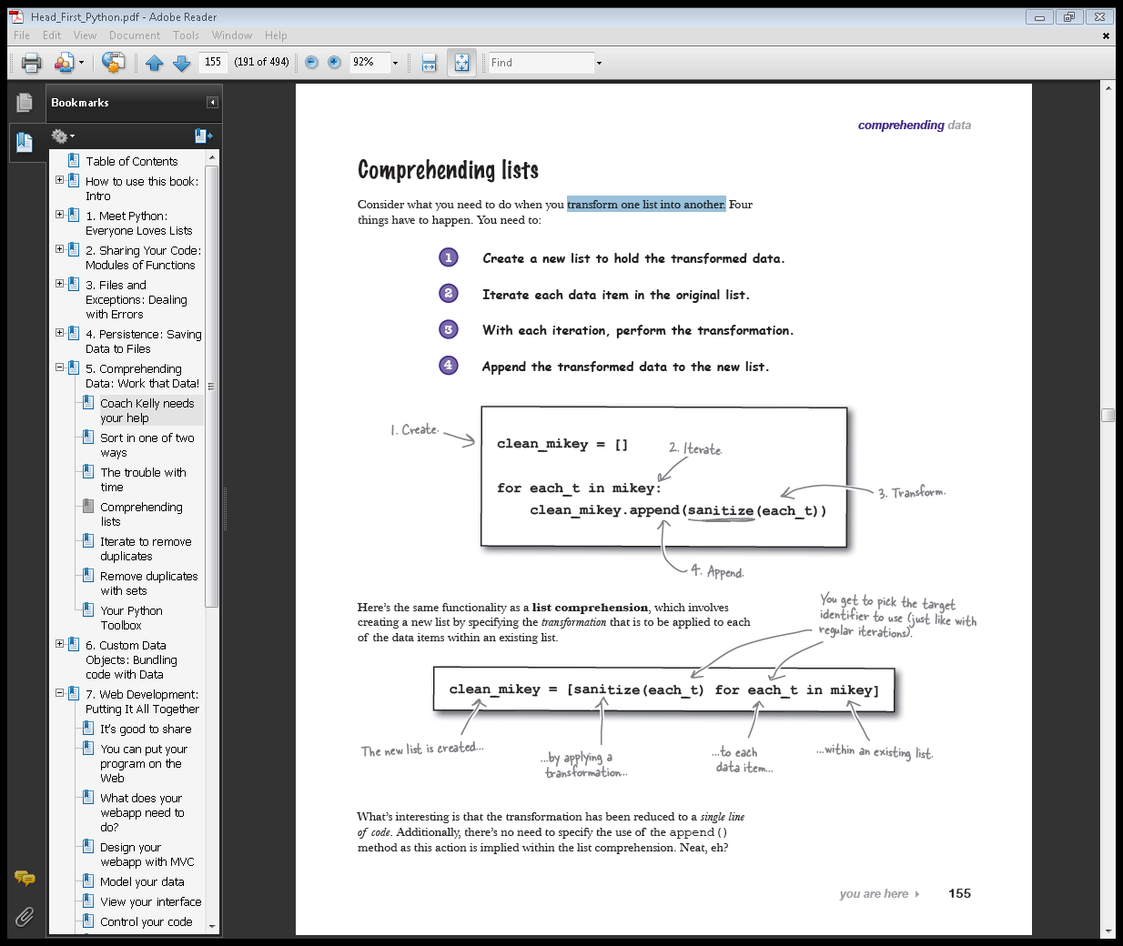
Comprehending lists
Transform one list into another
Notes:
Transforming lists is such a common requirement that Python provides a tool to make the transformation as painless as possible.
This tool is list comprehension.
And list comprehensions are designed to reduce the amount of code you need to write when transforming one list into another.

Slide 15
Comprehending lists
Notes:
What’s interesting is that the transformation has been reduced to a single line of code.
Additionally, there’s no need to specify the use of the append() method as this action is implied within the list comprehension.
Neat, eh?

Slide 16
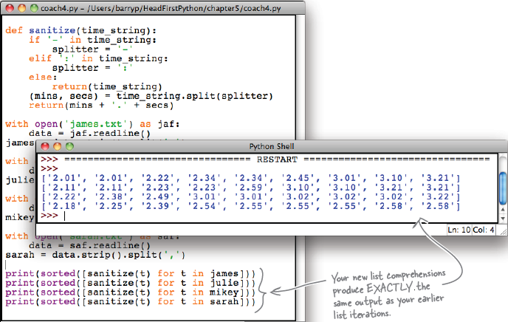
Comprehending lists
Coach_4.py
Notes:
producing the three fastest times for each
athlete

Slide 17
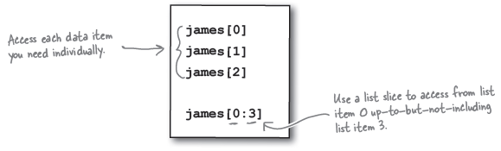
List slicing
List slice
What about removing duplicates from list?
Notes:
Accessing the first three data items from any list is easy.
Either specify each list item individually using the standard notation or use a list slice:

Slide 18
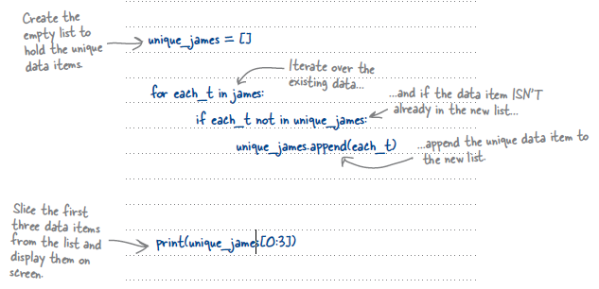
Iterate to remove duplicates
Notes:
Processing a list to remove duplicates is one area where a list comprehension
can’t help you, because duplicate removal is not a transformation; it’s more of
a filter. And a duplicate removal filter needs to examine the list being created
as it is being created, which is not possible with a list comprehension.
To meet this new requirement, you’ll need to revert to regular list iteration
code.

Slide 19
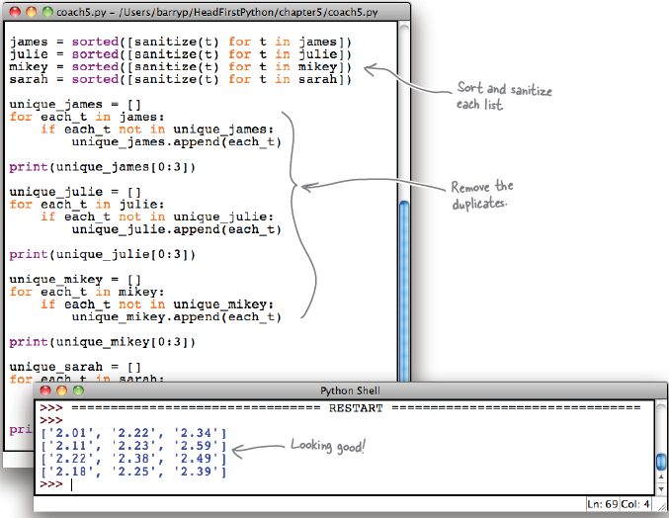
Iterate to remove duplicates
coach_5.py
Notes:
You are now displaying only the top three times for each athlete, and the
duplicates have been successfully removed.
The list iteration code is what you need in this instance.
There’s a little bit of duplication in your code, but it’s not too bad, is it?
The code that removes duplicates from your lists is itself
duplicated.
Wouldn't it be dreamy if there were a way to quickly and easily remove duplicates from an existing list?

Slide 20
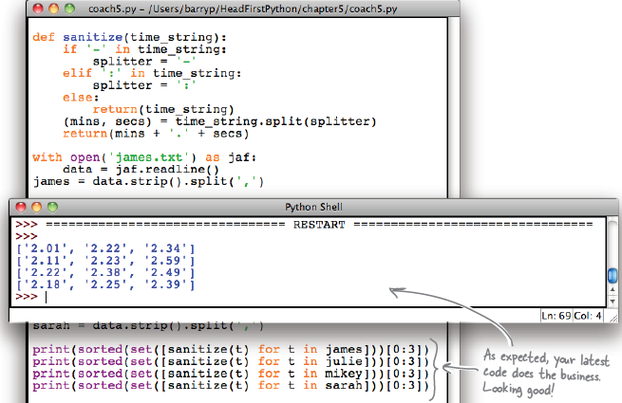
Remove duplicates with sets
Set removes duplicate automatically
Coach_6.py
Notes:
In addition to lists, Python also comes with the set data structure, which
behaves like the sets you learned all about in math class.
The overriding characteristics of sets in Python are that the data items in a set
are unordered and duplicates are not allowed. If you try to add a data item to a set
that already contains the data item, Python simply ignores it.
Create an empty set using the set() BIF, which is an example of a factory
function:
You’ve processed the coach’s data perfectly, while
taking advantage of the sorted() BIF, sets,
and list comprehensions. As you can imagine, you
can apply these techniques to many different
situations. You’re well on your way to becoming a
Python data-munging master!

Slide 21
Factory Function
Factory Function
make new data items of a particular type.
For instance, “set()”
In the real world, factories make things, hence the name.
Notes:
A factory function is used to make new data items of a particular type.
For instance, “set()” is a factory function because it makes a new set.
In the real world, factories make things, hence the name.

Slide 22
Your Python Toolbox
Sort()
In-place sorting
Sorted()
Copied sorting
Reverse=True
Arrange data in descending order
My_list[3:6]
Access from location3 up-to-but-not-including location6
Set()
Create a set
Notes:
That’s all I have to say for now
Thank you for coming

