Slide 1
Ontology Mapping Survey
April 6, 2012
Sengyu Rim
SNU IDB Lab.

Slide 2
Outline
Introduction
Background
Motivation
Proposed Solution
References

Slide 3
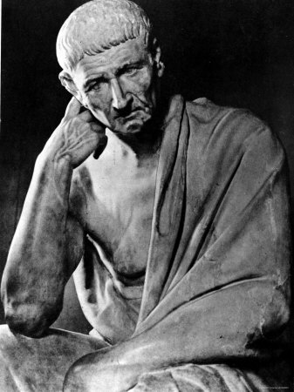
Introduction
Where does “Ontology” come from?
It relies on the philosophical discipline introduced by Aristotle^{[1]}
What is being?
What characteristics do all beings have in common?

Slide 4
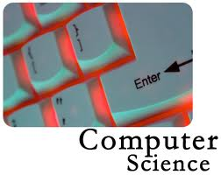
Introduction
What does “ontology” mean in computer science?
“an explicit specification of a conceptualisation”-Gruber,1993
Conceptualisation is an abstract and simplified view of the world , or domain of interest

Slide 5
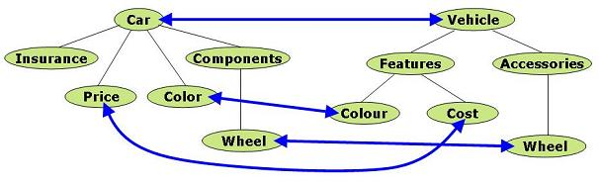
Introduction
Ontology Mapping^{[2]}
Given two ontologies O1 and O2, for each entity in O1 , we try to find a corresponding entity, which has the same intended meaning ,in O2
Semantic mapping(alignment) between ontologies is a necessary precondition when we use different ontologies

Slide 6
Outline
Introduction
Background
Motivation
Proposed Solution
References

Slide 7
Background
Categories of Ontology Mapping based on Choi et al^{[3]}
Mapping between an integrated global ontology and local ontology
Mapping between local ontologies
Mapping in ontology merge and alignment
Categories of Ontology Mapping based on Euzenat et al^{[9]}
Lexical: detecting similarities between labels of concepts
Structure: using the structure of the ontology
Background knowledge
Instance based mapping: using classified instance data

Slide 8
Background
Canonical process of ontology mapping^{[2]}
Feature engineering
Transform the initial representation into RDFS
Selection of next search
Choose a restricted subset of candidate concepts pairs to compute similarity
Similarity computation
Determine the similarity values of candidate mappings
Similarity aggregation
Aggregate different similarity values into a single aggregated one
Interpretation
uses the individual or aggregated similarity values to derive mappings
Iteration
Iteration is performed over the whole process

Slide 9
Background
Mapping process
Mapping table is returned after finishing all the steps
Iteration
6
Output
Input
Feature
Engineering
Search Step Selection
Similarity Computation
Similarity Aggregation
Inter-pretation
1
2
3
4
5

Slide 10
Background
Naïve Ontology Mapping(NOM)^{[4]}
Feature engineering
Transform the initial representation into RDFS
Search Step Selection
all entities of the first ontology are compared with all entities of the second ontology
Similarity Computation
similarity computation is done by using a wide range of similarity functions

Slide 11
Background
Naïve Ontology Mapping(NOM)
Similarity aggregation
assign the weight to individual similarity measure and sum the values
Interpretation
it applies a threshold to discard spurious evidence of similarity
Iteration
The first round uses only labels and string similarity
more sophisticated structural similarity measures for following rounds

Slide 12
Background
PROMPT^{[5]}
Feature Engineering
represent the ontologies in RDFS
Search Step Selection
Any pair is treated as a candidate mapping like NOM
Similarity Computation
The system determines the similarity based on whether entities have similar labels

Slide 13
Background
PROMPT
Similarity Aggregation
PROMPT uses only one similarity measure, aggregation is not necessary
Interpretation
PROMPT presents the pairs with a similarity above a defined threshold
Iteration
Iteration is done by in PROMPT to allow manual refinement

Slide 14
Background
GLUE^{[6]}
Feature Engineering
GLUE uses machine learning approach to classify the instances and concepts
Search Step Selection
GLUE checks every candidate mapping as mentioned
Similarity Computation, Similarity Aggregation, Interpretation
Similarity Estimator determines the similarity of two concepts based on the learnt rules
GLUE presents the pairs by using Relaxation Labelling
Iteration
Relaxation Labelling is repeated several times , but other steps are carried out once

Slide 15
Background
QOM^{[2]} –Quick Ontology Mapping
Feature Engineering
Transform ontologies into RDFS
Search Step Selection
lower the number of candidate mappings
Random: a simple approach to limit the number of candidate mappings
Label: only compare the entity pairs whose labels are near to each other in the sorted list
Hierarchy: compare from high level to low level
Similarity computation
restrict the range of costly features
Similarity aggregation, Interpretation, Iteration
Like NOM

Slide 16
Background
BLOOMS^{[7]}
Feature Engineering
Ontologies should be represented in RDFS
Search Step Selection
Any possible candidate pair
Similarity Computation
A bootstrapping approach utilizing the Wikipedia category hierarchy
BLOOMS constructs a forest for each matching candidate pair
Similarity aggregation
No aggregation
Interpretation
Presents pairs which are above threshold
Iteration
The process is executed once

Slide 17
Background
LOM(Lexicon-based Ontology Mapping Tool)^{[8]}
Feature Engineering
Ontologies should be represented in RDFS
Search Step Selection
All possible candidate pairs
Similarity Computation
Whole term matching
Word constituent matching
Synset matching
Type matching
Similarity aggregation
Assign weights to different measures
Interpretation, Iteration
Like NOM

Slide 18
Outline
Introduction
Background
Motivation
Proposed Solution
References

Slide 19






Motivation
Many works have addressed ontology mapping in the context of lexical(LOM), structural(NOM), background knowledge(GLUE)
Some more effort is needed in the realm of instance based ontology mapping
Lexical
Instance
B K
Structural

Slide 20
Motivation
Instances are the basic ground level components of an ontology, instantiation of a concept
The basic idea of instance-based mapping^{[9]}
The more significant the overlap of common instances of two concepts is, the more related these concepts are

Slide 21
Motivation
A general framework of instance based ontology mapping^{[9]}
Measures: we use similarity measures to order proposed mapping pairs according to the relatedness
Jaccard measures
Standard information-theory measures
Threshold
Mapping pairs above some threshold are returned
Hierarchy
Whether includes the instances of the descendants or not

Slide 22
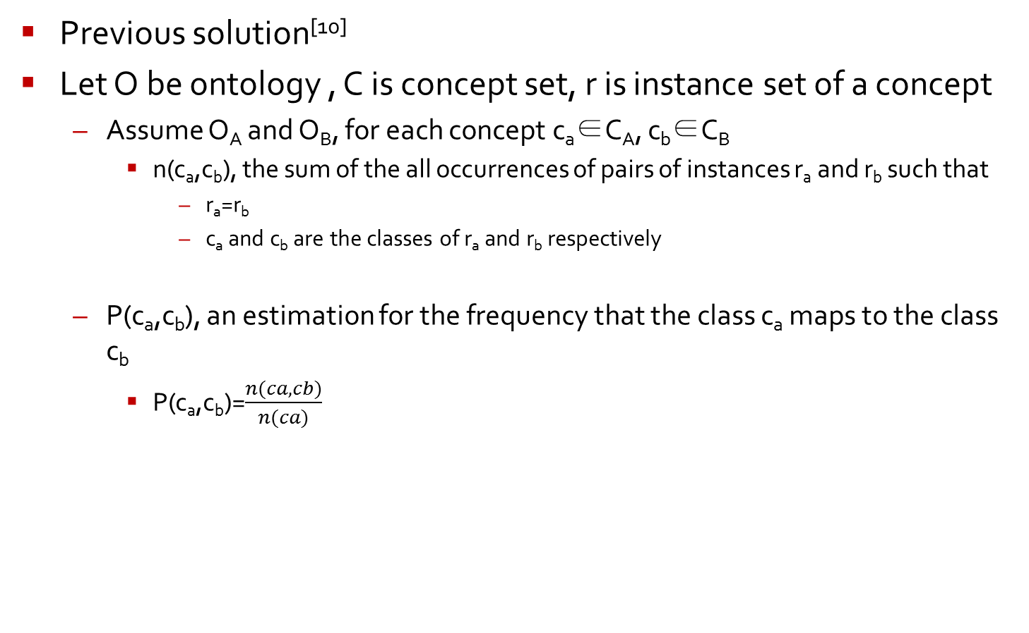
Motivation
Previous solution^{[10]}
Let O be ontology , C is concept set, r is instance set of a concept
Assume O_{A} and O_{B}, for each concept c_{a}∈C_{A}, c_{b}∈C_{B}
n(c_{a},c_{b}), the sum of the all occurrences of pairs of instances r_{a} and r_{b} such that
r_{a}=r_{b}
c_{a} and c_{b} are the classes of r_{a} and r_{b} respectively
P(c_{a},c_{b}), an estimation for the frequency that the class c_{a} maps to the class c_{b}
P(c_{a},c_{b})=$\frac{n(ca,cb)}{n(ca)}$

Slide 23
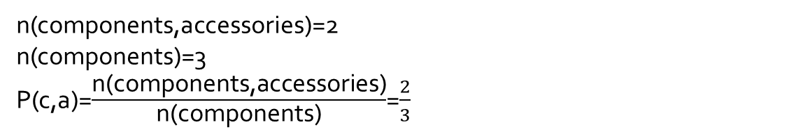
Motivation
example
Car
Vehicle
Insurance
Components
Car
Features
Accessories
Price
Color
Colour
Cost
Steering wheel
Spider handle
brake
wheel
seat
saddle
n(components,accessories)=2
n(components)=3
P(c,a)=$\frac{\text{n}\text{(}\text{components}\text{,}\text{accessories}\text{)}}{\text{n}\text{(}\text{components}\text{)}}$=$\frac{2}{3}$

Slide 24
Motivation
Problems
Strictly speaking, an ontology need not include any instances
If there are too few instances, the previous solution can not work well
Poorly utilization of the ontology structural information
Limited to the lexical comparison

Slide 25
Outline
Introduction
Background
Motivation
Proposed Solution
Reference

Slide 26
Proposed Solution
Main idea for extending the instance set
Extend the instance set by including the subconcepts and instances of descendants
car
Structure
Hatch
back
Compo-nents
sedan
Extended Instance Set (EIS)for car:
{structure,components,Hachback,sedan}

Slide 27
Proposed Solution
Main idea for combining structural information
Assign the weights to the instance sets based on different depths
Closer the instance set gets to the target concept, the greater weight it gets
Structure
Hatch
back
Compo-nents
sedan
depth 1
Steering wheel
wheel
depth 2
saddle
EIS for the depth 1 with weight a：
{components,Hachback,sedan}
EIS for the depth 2 with weight b： a>b
{Steering wheel, saddle, wheel}

Slide 28
Outline
Introduction
Background
Motivation
Proposed Solution
References

Slide 29
References
References
[1] Ontologies-Introduction and Overview
[2] QOM-Quick Ontology Mapping
[3]A Survey on Ontology Mapping
[4]Ontology mapping-an integrated approach
[5]The PROMPT suite: interactive tools for ontology merging and mapping
[6]Learning to match ontologies on the semantic web
[7]Ontology Alignment for linked open data
[8]LOM: A Lexical-based Ontology mapping tool
[9]An empirical study of instance-based ontology matching
[10]Instance-Based Ontology Mapping

Slide 30
Thank you!!!

