Slide 1
Support Vector Machines in R
Alexandros Karatzoglou, David Meyer, Kurt Hornik
Technische University Wien
Journal of Statistical Software, 2006
July 5, 2013
Hee-gook Jun

Slide 2
Outline
Introduction
Support Vector Machines
Data analysis
Conclusion

Slide 3
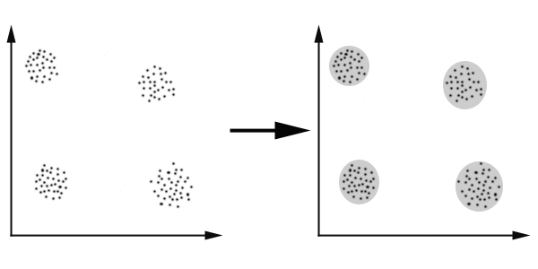
Clustering vs. Classification [1/3]
Clustering
Process of organizing objects into groups whose members are similar in some way
Hierarchical clustering, Bayesian approaches, ..

Slide 4
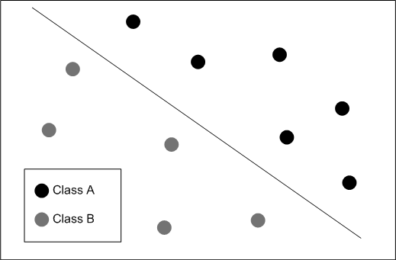
Clustering vs. Classification [2/3]
Classification
Predict group membership for data instances
Support vector machine, Decision tree, Neural networks,
K-nearest neighbors
New instance
Computed classifier
Classified into class A by classifier

Slide 5
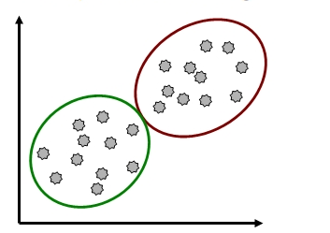
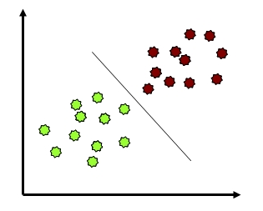
Clustering vs. Classification [3/3]
Clustering
grouping points that are close to each other
Classification
finding a rule that assigns labels to new points

Slide 6
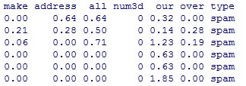
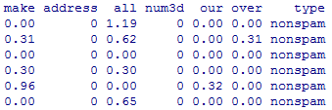
Supervised vs. Unsupervised learning [1/2]
Supervised learning
Given training data comprising examples of input vectors along with their corresponding target values (labels)
SVM is a supervised learning method

Slide 7
Supervised vs. Unsupervised learning [2/2]
Unsupervised learning
Given training data consists of a set of input vector without any corresponding target values
No target value in training data

Slide 8
Outline
Introduction
Support Vector Machines
Data analysis
Conclusion

Slide 9


Support Vector Machine
Two-class classification problem
Linear discriminant function for the classification problem
$$y\left(x\right)$$
X
$$y\left(x\right)=w^{T}x+b$$
X
O
X
X
X
O
X
O
O
X
O
O
O
O is spam, and X is nonspam

Slide 10
Goal
Select a decision boundary whose margin is maximized
y(x) decision boundary
X
X
O
X
X
X
O
X
O
O
X
O
O
Margin (smallest distance between decision boundary and any of the data points)
O

Slide 11
Problem
The nearest point for margin could be changed frequently
y(x) decision boundary
Nearest point after changing y(x)
X
X
O
X
X
X
O
X
O
O
X
O
O
Nearest point
O

Slide 12
Constrained Optimization
Consider the problem of finding the maximum of a function f(x)
Subject to a constraint relating x, g(x)
f(x)=1 f(x)=2 f(x)=3 f(x)=4….
g(x)

Slide 13



Constrained Optimization Form
Quadratic programming problem
f(x): Finding max margin → decision boundary
g(x): Subject to a constraint → margin boundary
$$\underset{w,b}{argmin}{\frac{1}{2}{\left\|w\right\|}^{2}}$$
$$\left(∵margin ∝\frac{y(x_{n}) }{\left\|w\right\|}\right)$$
$$subject to t_{n}\left(w^{T}x_{n}+b\right)≥1, n=1,…,N$$
$$\left(y\left(x_{n}\right)= w^{T}x_{n}+b\right)$$
y=0
y=-1 y=1
Support Vector!
margin boundary
decision
boundary
margin boundary

Slide 14
Features of SVM
Classification algorithm
Support Vector Machine

Slide 15
Transformation of function
Quadratic function
f(x): Find max margin (decision boundary)
g(x): constraint (margin boundary)
Lagrangian function
f(x) + g(x)
Dual representation
Primal problem ↔ Dual function
More solvable form

Slide 16
Non-seperable Data
Add penalty variable ‘ξ’
ξ>1
ξ=1
ξ=0

Slide 17

Nonlinear SVM
Φ function
Feature transform function Φ:$R^{d}→H$
Kernel Trick (alternative method)
Linearly seperable!

Slide 18



SVM Dimension [1/2]
3D Vector Space
$$y$$
$$x_{2}$$
$$x_{1}$$

Slide 19
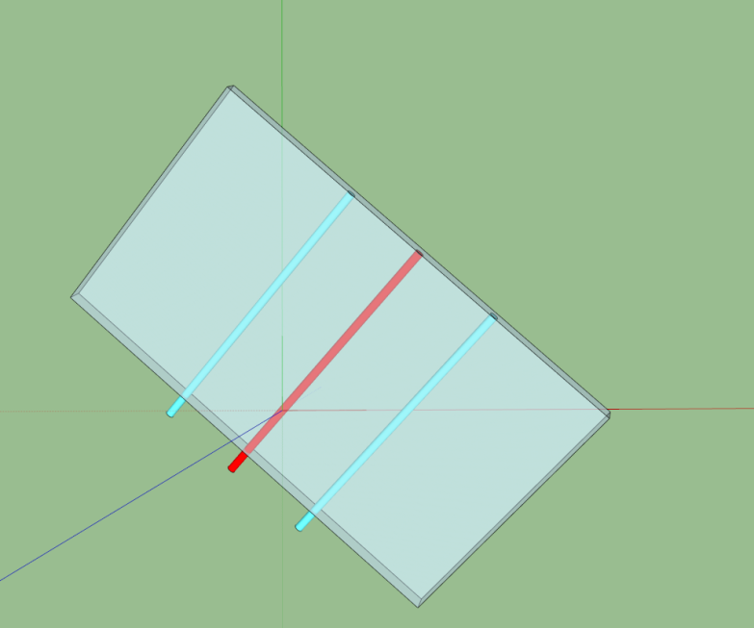
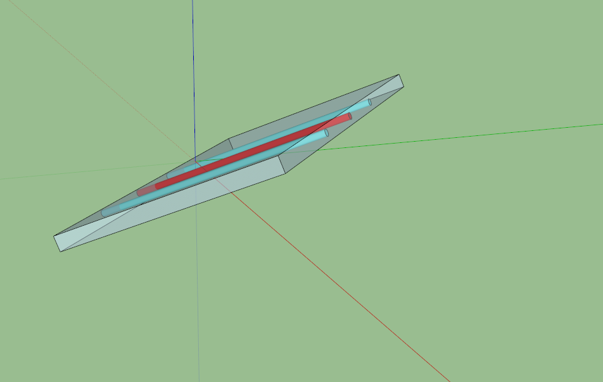
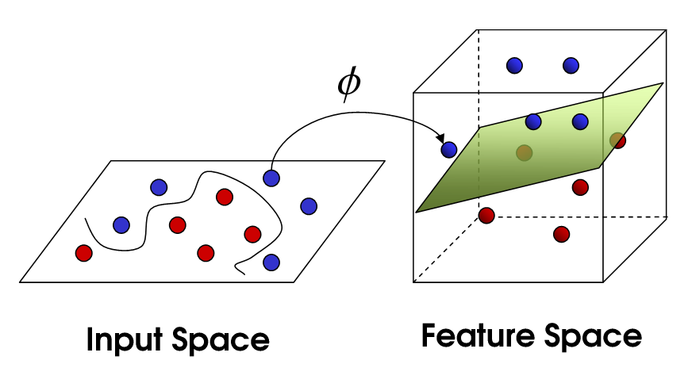





SVM Dimension [2/2]
$$x_{2}$$
$$y$$
$$x_{2}$$
$$x_{1}$$
$$x_{1}$$
$$y$$

Slide 20
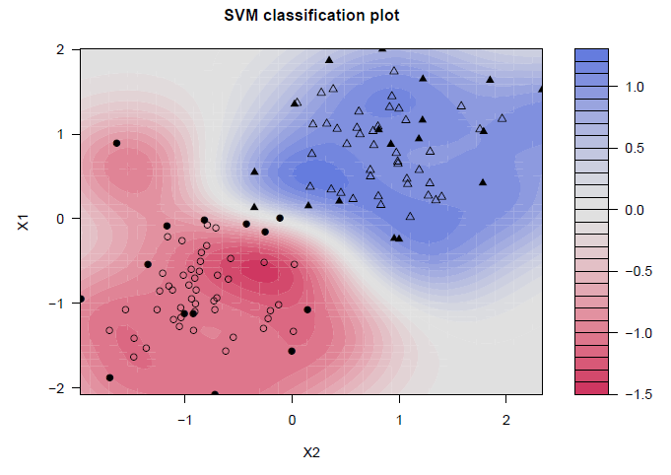
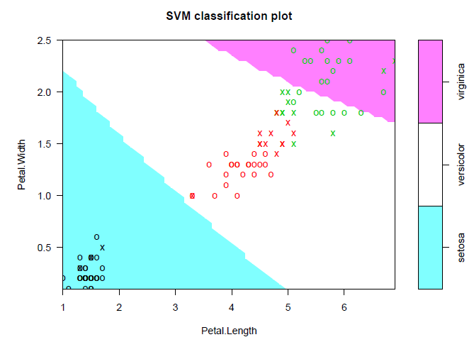
Data Analysis
A contour plot of the fitted decision values for a simple binary classification problem
SVM plot visualizing the iris data.

Slide 21
Conclusion
Support Vector Machine
Two-class classification problem
Quadric function → Lagrangian function → Dual function
Pros
Produce very accurate classifiers
Less overfitting, robust to noise
Cons
binary classifier
Computationally expensive

