Slide 1
Fine-grained Partitioning for Aggressive Data Skipping
Liwen Sun, Michael J. Franklin, Sanjay Krishnan, Reynold S. Xin†
UC Berkeley and †Databricks Inc.
VLDB 2014
March 17, 2015
Heymo Kou

Slide 2
Contents
Introduction
Overview
Workload Analysis
The Partitioning Problem
Feature-based Data Skipping
Discussion
Experimental Evaluation
Related Work & Conclusion

Slide 3
Introduction
Several ways tom improve data scan throughput
Memory caching
Parallelization
Data compression
Reduce the data access (Data skipping)
Increasing interest in reducing data access

Slide 4
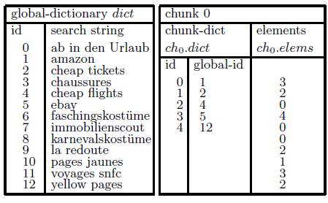
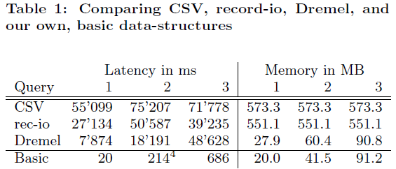
Recall Google’s PowerDrill

Slide 5
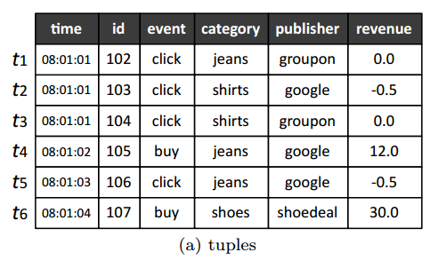
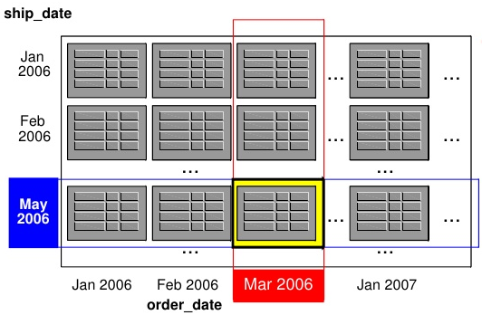
Logic difference
Traditionally, ranged partitioning
PowerDrill
Composite range partitioning
Skew Inevitable

Slide 6
Contributions
Feature Selection
Analyze frequent query features
Optimal Partitioning
Formulate Balanced MaxSkip partitioning problem
Scalability

Slide 7
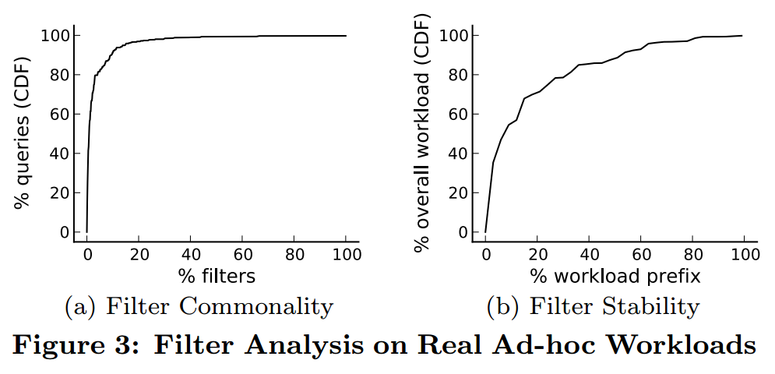
Overview Workload Assumptions
Filter Commonality
Only small set of filters are commonly used
Filter Stability
Future queries have occurred before

Slide 8
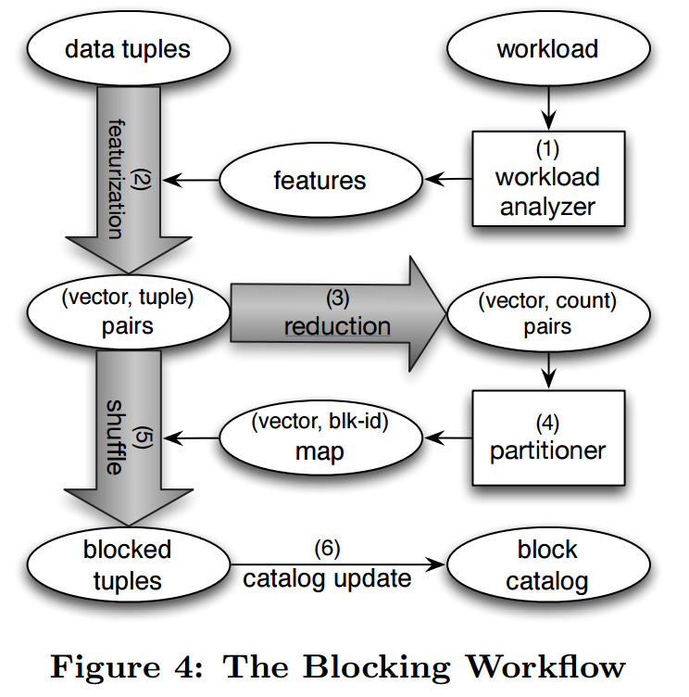
Overview Blocking Workflow
Workload Analyzer
Extract features
Featurization
Evaluate filters
tuple → (vector, tuple)
Reduction
Group by (vector, tuple)
Partitioner
Split data
Shuffle
Augment partitioned data
Catalog Update
Union vectors for each block

Slide 9
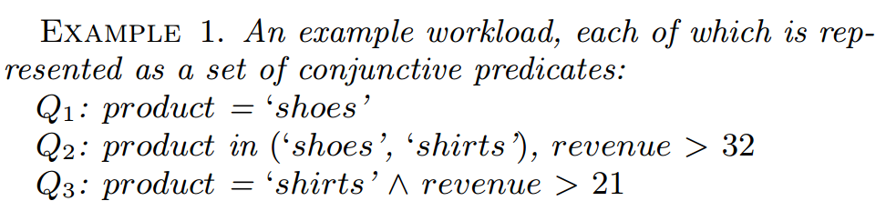
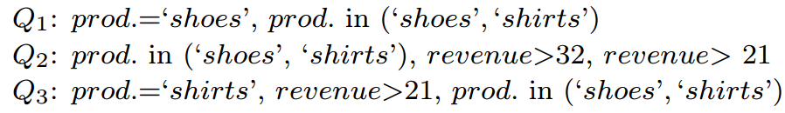
Workload Analysis
Goal : extract freatures from the query traces
Given
Predicate Augmentation
Reduce Redundancy

Slide 10

Partitioning Problem Problem Definition
Set of m features
Collection of m-dimensional bit vectors
Partitioning over V
Union vector of all vectors in P_{i}
Cost Function(sum of tuples that can be skipped)

Slide 11

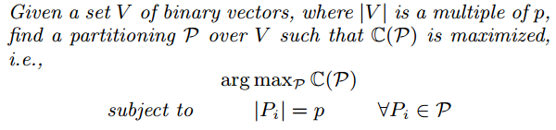
Partitioning Problem Balanced MaxSkip Partitioning
Cost Function over a partitioning
Problem 1 (Balanced MaxSkip Partitioning)
NP-hard using hypergraph bisection

Slide 12
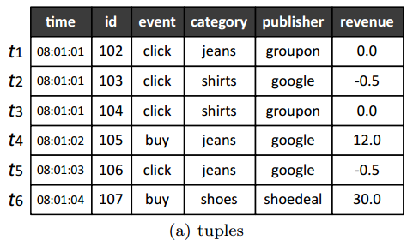
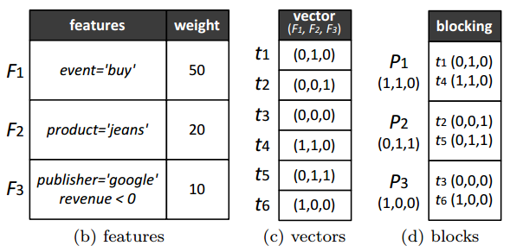
Partitioning Problem Example of Blocking

Slide 13
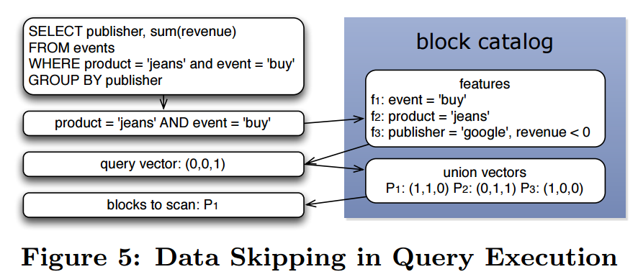
Feature-Based Data Skipping
Query Execution

Slide 14
Discussion
Data Update
Infrequent ad-hoc updates, batch-inserted, batch-deleted
Still fine-grained blocking partitions separately
Parameter Selection
Two key parameters in blocking process
numFeat : number of features
minSize : minimum number of tuples per block
Default Parameter
numFeat : < 50
MinSize : 64 – 128MB (which fits in HDFS block)

Slide 15
Experiment [1/3]
Environment
Amazon Spark EC2 cluster
25 m2.4xlarge instances
8 x 2.66 GHz CPU cores
64.8 GB RAM
2 x 840 GB disk storage
HDFS
Datasets
TPC-H benchmark data
TPC-H Skewed
Conviva
Anonymized user access log of video streams

Slide 16
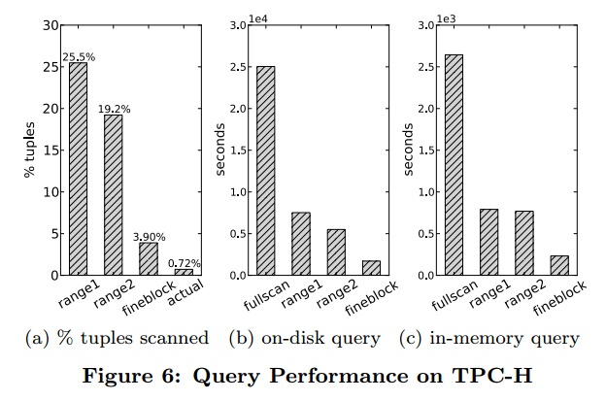
Experiment [2/3]
FullScan : disable data skipping
Range1 : Shark’s data skipping
Range2 : Composite range partitioning (PowerDrill)

Slide 17
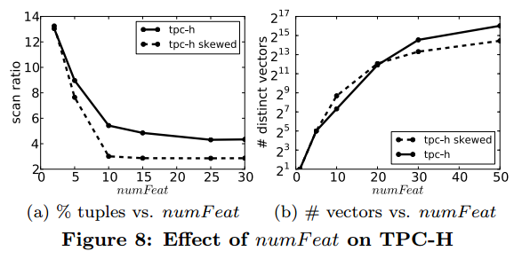
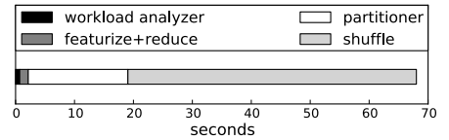
Experiment [3/3]
Effect of numFeat
Breakdown of blocking time

Slide 18
Conclusion
Fine-grained data blocking techniques
Partition data tuples into blocks
Data skipping reduce 5-7x less data access
2-5x improvement in query response time
Compared to range-based blocking techniques

