Slide 1

Session 21
Applying the Basic Statechart to the Case Study
Written by Thomas A. Pender
Published by Wiley Publishing, Inc.
October 27, 2011
Presented by Kang-Pyo Lee

Slide 2
Contents
Defining Entry and Exit Actions
Defining Send Events
Order of Events
Applying the Basic Statechart Diagram Notation to the Case Study

Slide 3
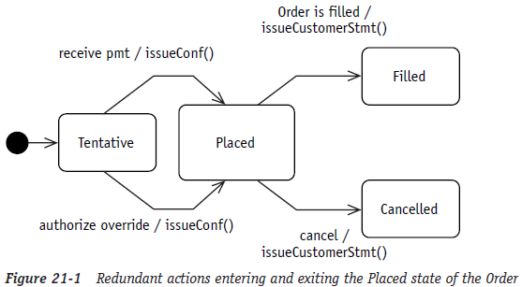
Defining Entry and Exit Actions (1/3)
Modeling state transitions often results in more than one event that changes the object to the same state
The UML offers two simplifications called entry & exit actions
Notes:
pmt: payment
Conf: confirmation

Slide 4
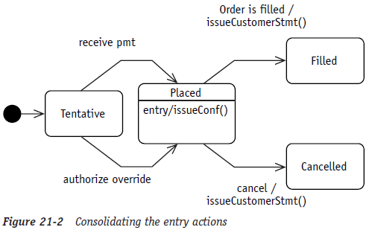
Defining Entry and Exit Actions (2/3)
Whenever an action must take place with every event that transitions to the same state, you can write the action(s) once as an entry action
  When the redundant action is replaced by the entry action, you can remove it from the individual event arrows
  This simplifies the diagram while preserving the same meaning
  You would read the diagram to say, “Every time you enter this state issue an order confirmation.”
Notes:
pmt: payment
Conf: confirmation

Slide 5
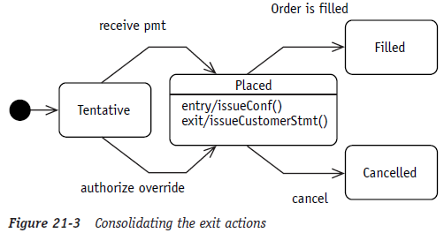
Defining Entry and Exit Actions (3/3)
The same simplification may be used for actions associated with events that leave a state with exit actions
  Modeled in the same manner as entry actions
Just remember that they may only be used when the action takes place every time you enter (for entry actions) or every time you exit (for exit actions) the state
Notes:
pmt: payment
Conf: confirmation
Stmt: statement

Slide 6
Contents
Defining Entry and Exit Actions
Defining Send Events
Order of Events
Applying the Basic Statechart Diagram Notation to the Case Study

Slide 7
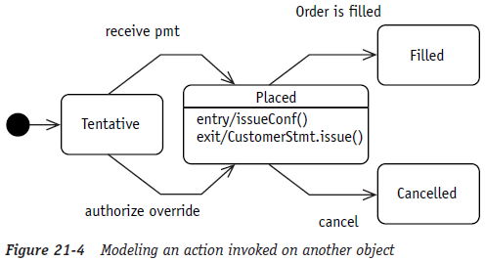
Defining Send Events
A send event is used when the object in the Statechart diagram needs to communicate with another object
An outgoing event must define the receiving object whether it is only one object or a broadcast to many objects
  Simply provide the object name followed by a period before the action expression
  This is often referred to as the dot notation

Slide 8
Contents
Defining Entry and Exit Actions
Defining Send Events
Order of Events
Applying the Basic Statechart Diagram Notation to the Case Study

Slide 9
Order of Events
When an event occurs, the order of execution runs like this:
  1. If an activity is in progress in the current state, interrupt it (gracefully if possible)
  2. Execute the exit action(s)
  3. Execute the actions associated with the event that started it all
  4. Execute the entry: action(s) of the new state
  5. Execute the activity or activities of the new state

Slide 10
Contents
Defining Entry and Exit Actions
Defining Send Events
Order of Events
Applying the Basic Statechart Diagram Notation to the Case Study

Slide 11
Applying the Basic Statechart Diagram Notation to the Case Study (1/7)
Inventory control: Problem statement
Products are first entered into our system when they are ordered using a purchase order (P.O.). Each product keeps a record of the originating P.O. (*1) When the product is received, it is placed into inventory by recording the location where it is placed. When the product is received, you have to update the P.O. to indicate that you have received the product. (*2)
When a product is sold, the product tracks the order to which it belongs. (*3) When a product is sold, it is also packed for shipping and the associated shipment is recorded. (*4) When the product is shipped, you need to record the shipper and the date it was picked up. (*5) Occasionally, a product is returned. In that case, you put the product back into inventory and record the location. (*6)

Slide 12
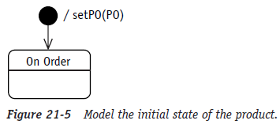
Applying the Basic Statechart Diagram Notation to the Case Study (2/7)
Constructing the Statechart diagram for the product object (*1)
  The initial state is On Order
  The action is to record the purchase order
  Notice that an action may be associated with the creation of the object

Slide 13
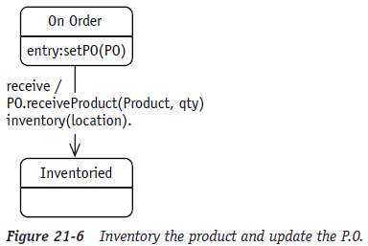
Applying the Basic Statechart Diagram Notation to the Case Study (3/7)
Constructing the Statechart diagram for the product object (*2)
  The transition from On Order to Inventoried is triggered by the receive event
  The associated actions are to update the purchase order object with the product and quantity received and update the product with the inventory location

Slide 14
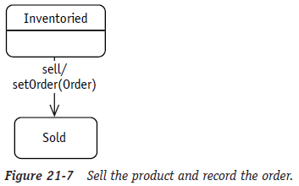
Applying the Basic Statechart Diagram Notation to the Case Study (4/7)
Constructing the Statechart diagram for the product object (*3)
  The sell event triggering the transition to the sold state and the action to record the Order that now holds the product

Slide 15
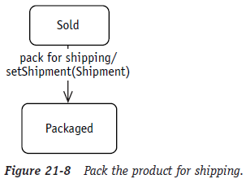
Applying the Basic Statechart Diagram Notation to the Case Study (5/7)
Constructing the Statechart diagram for the product object (*4)
  The event pack for shipping triggering the transition from sold to packaged
  The pack for shipping event also triggers the action to record the shipment

Slide 16
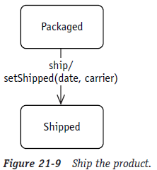
Applying the Basic Statechart Diagram Notation to the Case Study (6/7)
Constructing the Statechart diagram for the product object (*5)
  The ship event is the trigger
  The action is setShipped with the date and the carrier

Slide 17
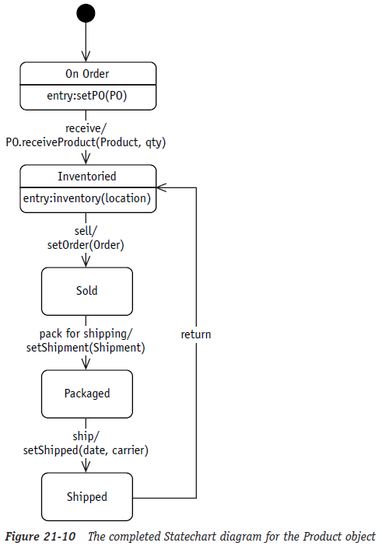
Applying the Basic Statechart Diagram Notation to the Case Study (7/7)
Constructing the Statechart diagram for the product object (*6)
  The return event requires us to record the
  inventory location
  The other incoming event also logs the
  inventory location

Slide 18
The End

