Slide 1
Comparative Study of Anomaly Detection Schemes in Network Intrusion Detection
Aleksandar Lazarevic, Aysel Ozgur
,Levent Ertoz, Jaideep Srivastava, Vipin Kumar
University of Minnesota, SDM, 2003 - SIAM
(679회 인용)
DongHyo Kim

Slide 2
Introduction (1)
Signature-based detection techniques
Widely deployed methods for detecting cyber attack
Detecting only previously known attacks corresponding signature
Signature database has to be manually revised for each new type of attack
Motivates intrusion detection techniques based on Data Mining
Intrusion detection techniques Based on Data Mining
1) Misuse detection
̶ Each instance in a dataset is labeled as normal or intrusion
̶ Able to automatically retrain intrusion detection models
̶ Accurately detect known attacks
̶ Drawback : Inability to detect novel, previously unseen attacks

Slide 3
Introduction (2)
Intrusion detection techniques Based on Data Mining
2) (Traditional) Anomaly detection
̶ Build models of normal data and detect deviations from the normal model
• Supervised Anomaly detection
☞ Detect new types of intrusions as deviations form normal usage
☞ Determine whether the test data belong to “normal” or not
• Unsupervised Anomaly detection
☞ Detecting anomalous behavior without using any knowledge
̶ However, both detection schemes suffer from a high rate of false alarm because of previously unseen (yet legitimate) system behaviors
♦ This paper focuses on a detailed comparative study of several anomaly detection schemes
♦ Several existing supervised and unsupervised anomaly detection schemes and their variations are evaluated

Slide 4
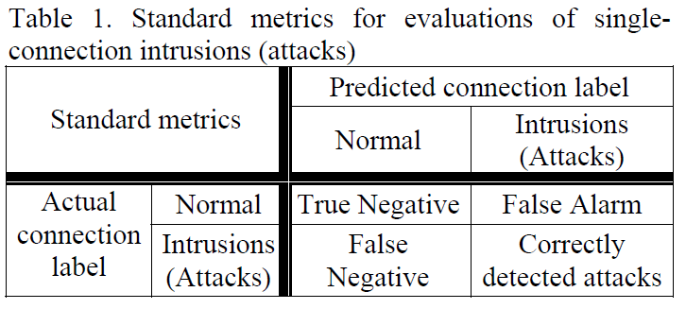
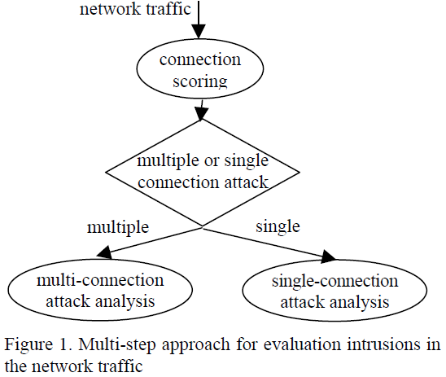
Evaluation of Intrusion Detection Systems (1)
Difficulty in IDS
Problematic to get high-quality data
Labeling requires enormous amount of time for many human experts
Need to measuring not only detection rate, but also the false alarm rate
Two types of attacks
̶ Detection rate
̶ False alarm rate
̶ Do not capture information about the number of connections

Slide 5
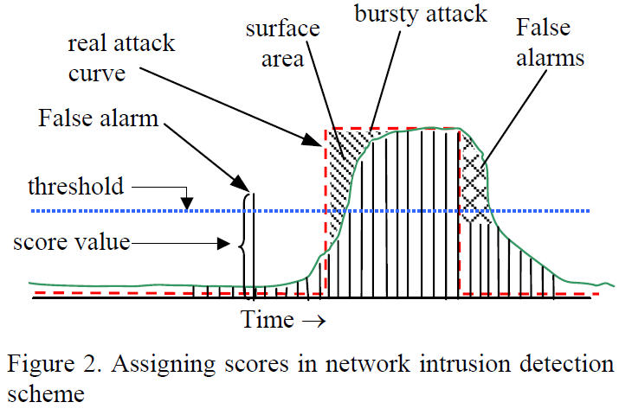
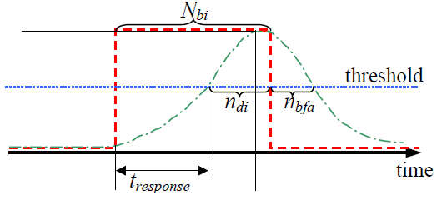
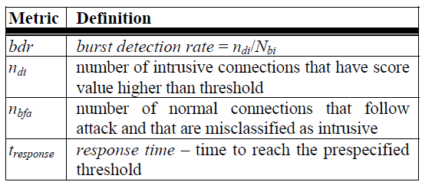
Evaluation of Intrusion Detection Systems (2)
Two types of attacks
1. Burst Detection rate 2. Response time

Slide 6
Anomaly Detection Techniques (1)
Outlier Detection Schemes for Anomaly Detection
Most anomaly detection algorithms require a set of purely normal data to train the model
Outlier may be defined as a data point which is very different from the rest of the data
Nearest Neighbor (NN) Approach
Outlier threshold : determine whether the point is an outlier or not
Threshold is based only on the training data and it is set to 2%
In order to compute the threshold, for all data points from training data distances to their nearest neighbors are computed and then sorted

Slide 7

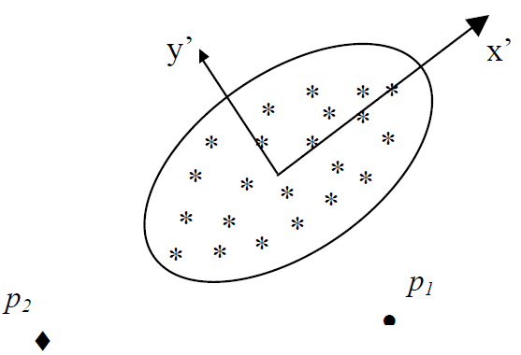
Anomaly Detection Techniques (2)
Mahalanobis-distance Based Outlier Detection
Training data corresponds to “normal behavior”
Compute the mean, standard deviation, covariance matrix of the normal data
All test data points that have distances to the mean of the training normal data greater than the threshold are detected as outliers

Slide 8
Anomaly Detection Techniques (3)
Density Based Local Outliers (LOF approach)
Assigning to each data example a degree of being outlier (LOF)
1. For each data example O compute k-distance and k-distance neighborhood
2. Compute reachability distance for each data example O with respect to data example p as : reach-dist(O,p) = max{k-distance(p), d(O,p)}
d(O,p) : distance from data example O to data example p
3. Compute local reachability density of data example O
(local reachability : inverse of the average reachability distance based on the MinPts NN of data example O)
4. Compute the LOF of data example O (local outlier factor : Average of the ratios of the local reachability density of example O and local reachability density of O’s MinPts NN)

Slide 9
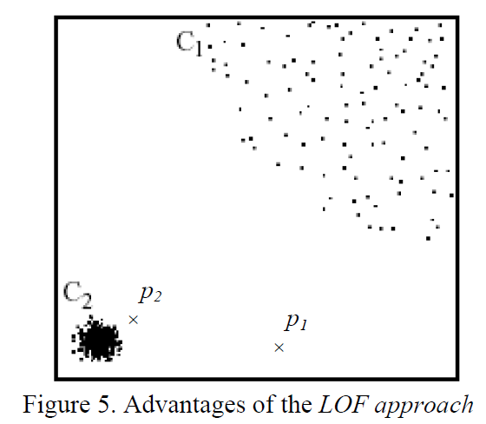
Anomaly Detection Techniques (3)
Density Based Local Outliers (LOF approach)
Unsupervised Support Vector Machines
Attempts to separate the entire set of training data from the origin
Finding a small region where most data lies and label data points in this region as one class
RBF kernel with smaller variance : High detection rate but very high false alarm rate

Slide 10
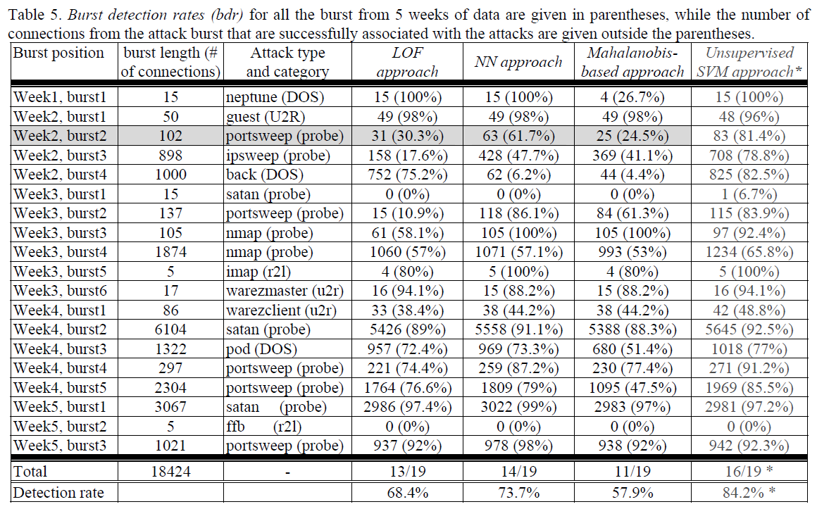
Experiments (1)

Slide 11
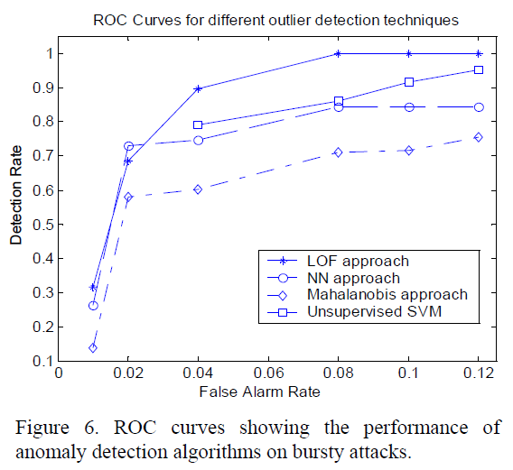
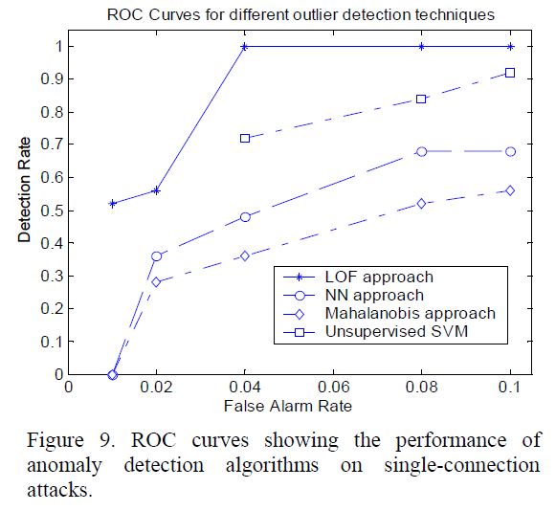
Experiments (2)

Slide 12
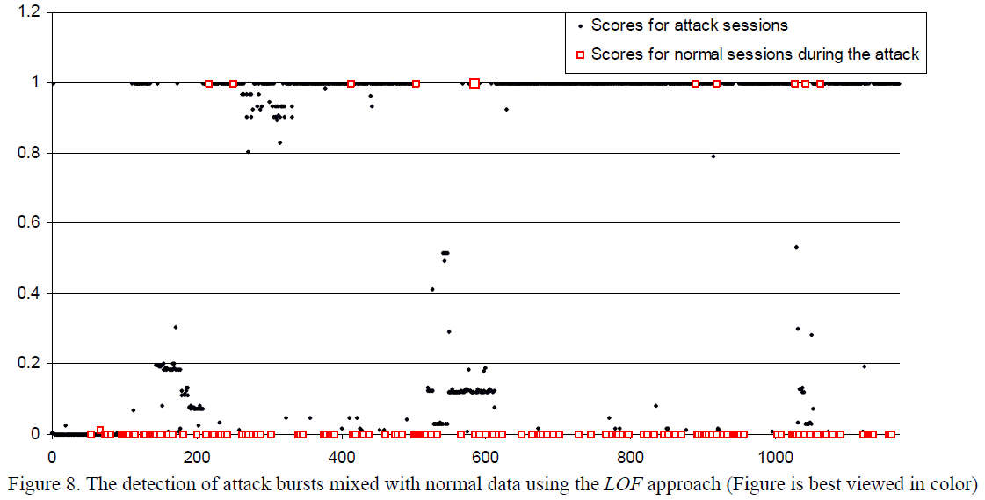
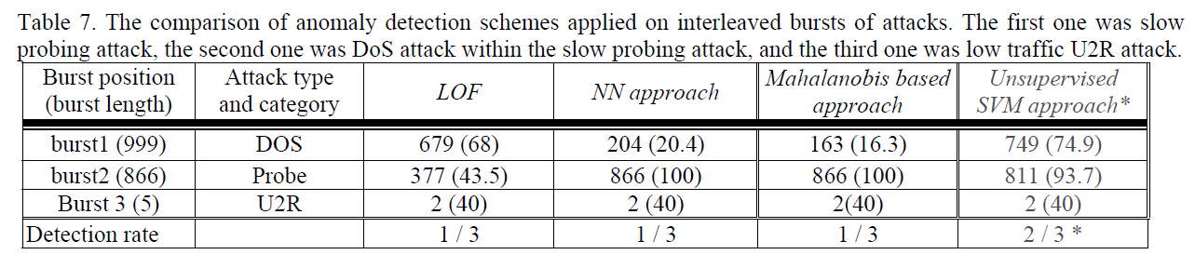
Experiments (3)

Slide 13
(Network) Traffic Anomaly Detection Using K-Means Clustering
Gerhard Munz, Sa Li, Georg Carle
University of Tuebingen, Germany
GI/ITG Workshop MMBnet, 2007
(124회 인용)
DongHyo Kim

Slide 14
Introduction
Network-based IDS(Intrusion detection systems)
Searches network monitoring data for harmful packets or packet flows
Presenting a novel flow-based anomaly detection scheme based on the K-mean clustering algorithm (Generating additional clusters for anomalous traffic)
Goal : Identify time intervals showing anomalous traffic behavior
Processing steps
Training data containing flow records of both normal and anomalous traffic are transformed into feature datasets
Datasets are divided into different clusters for normal and anomalous traffic using the K-means clustering algorithm
Resulting cluster centroids are deployed for fast detection of anomalies in new monitoring data

Slide 15
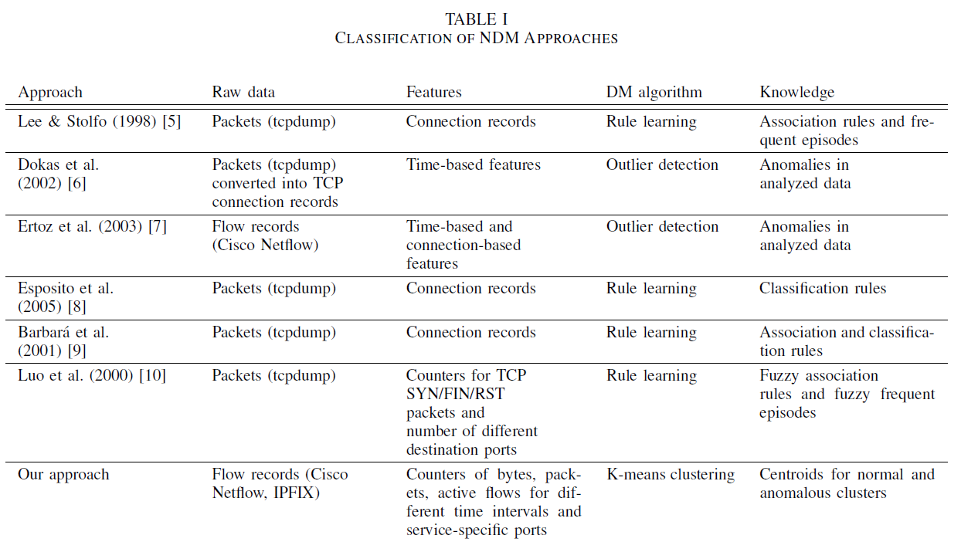
Network Data Mining

Slide 16
Raw Data and Extracted Features (1)
Cisco Netflow flow records
Protocol type
Source IP address, Destination IP address
Source port, Destination port
Statistical information
Transforming Raw data
Classifying transport protocol and predefined port number
• Normal traffic looks very different depending on the service or application
• Motiv. : Applying K-means separately for different services (protocol, port)
• Flow records don’t fit into any of the predefined service classes => default class
Aggregating flow records for equally spaced time intervals

Slide 17
Raw Data and Extracted Features (2)
Transformed dataset
Each dataset contains the following features
• Total number of packets sent from and to the given port in the considered time interval
• Total number of bytes sent from and to the given port in the considered time interval • Number of different source-destination pairs matching the given service-specific port and protocol and being observed in the considered time interval
Idea : The number of packets and bytes allows detecting anomalies in traffic volume, while the third features helps detecting port scans, distributed attacks

Slide 18
K-means Clustering (1)
K-means Clustering algorithm
Define the number of clusters K
Initialize the K cluster centroids
Iterate over all objects and compute the distances to the centroids of all clusters Assign each object to the cluster with the nearest centroid
Recalculate the centroids of both modified clusters
Repeat step 3~4 until the centroids do not change anymore
Training datasets without being labeled
Assumption that normal and anomalous traffic form different clusters in the feature space
Clustering individually for the predefined services identified by (protocol, port) pair
Default class that cover the remaining flows distinguished by the protocol value only

Slide 19

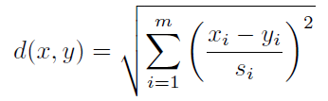
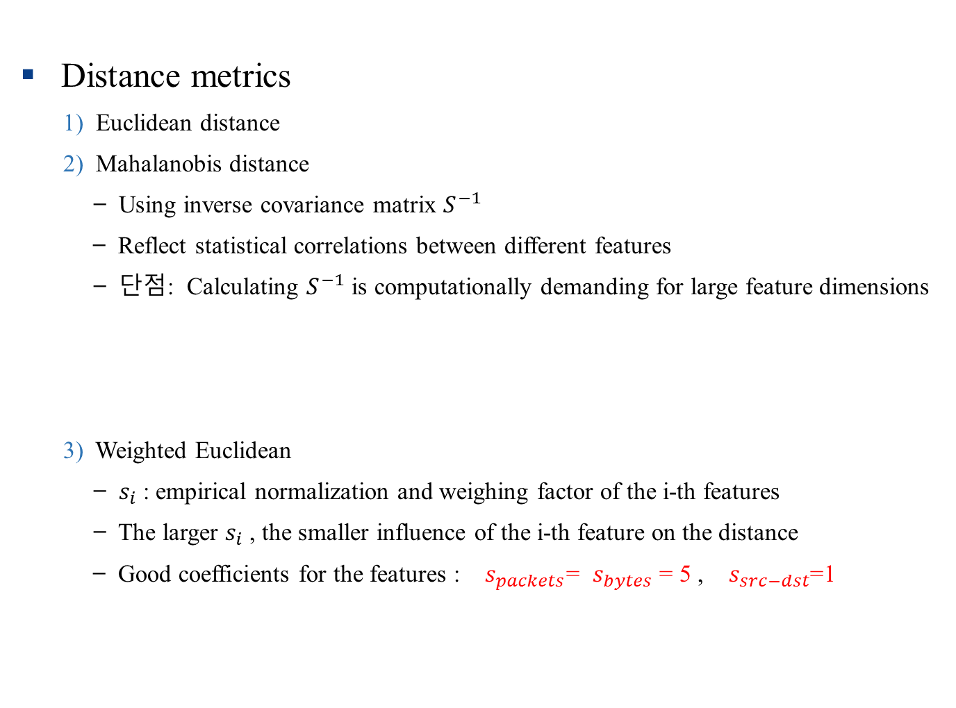
K-means Clustering (2)
Distance metrics
1) Euclidean distance
2) Mahalanobis distance
̶ Using inverse covariance matrix $S^{−1}$
̶ Reflect statistical correlations between different features
̶ 단점: Calculating $S^{−1}$ is computationally demanding for large feature dimensions
3) Weighted Euclidean
̶ $s_{i}$: empirical normalization and weighing factor of the i-th features
̶ The larger $s_{i}$, the smaller influence of the i-th feature on the distance
̶ Good coefficients for the features : $s_{packets}$= $s_{bytes}$ = 5 , $s_{src−dst}$=1

Slide 20
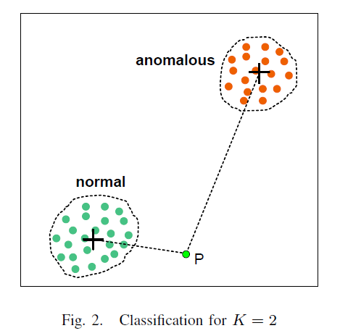
K-means Clustering (3)
̶ 전체 서비스를 포함하는 데이터셋에서 K-means 를 돌리지 않고, 각 서비스마다 K=2인 k-means 클러스터링을 함으로써 정확도와 성능 모두 향상시킴
̶ Input traffic class are calculated using the weighted Euclidean distance
̶ 강점 : Detecting known kinds of anomalies
̶ 약점 : Detecting new anomalies

Slide 21
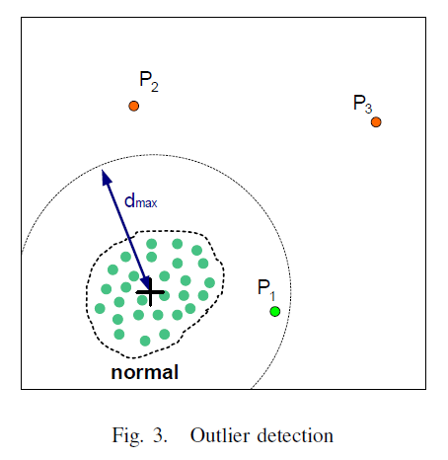
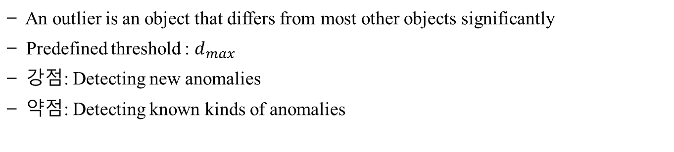
K-means Clustering (4)
̶ An outlier is an object that differs from most other objects significantly
̶ Predefined threshold : $d_{max}$
̶ 강점: Detecting new anomalies
̶ 약점: Detecting known kinds of anomalies

Slide 22
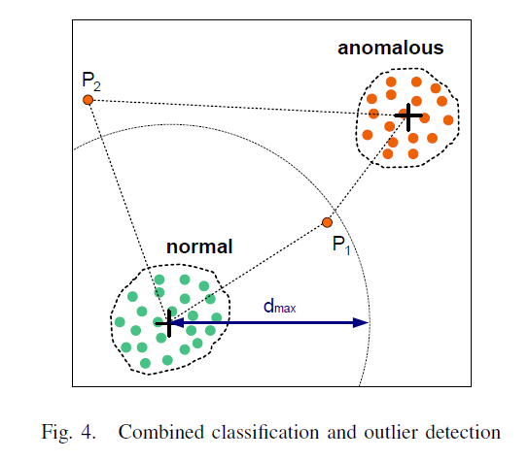
K-means Clustering (5)
̶ Combined way in order to overcome the limitations of each previous method
̶ Anomaly object : if it is closer to anomalous cluster or
if its distance to normal cluster centroid is larger than threshold
̶ Relatively more accurate in detecting known kinds and new anomalies

Slide 23
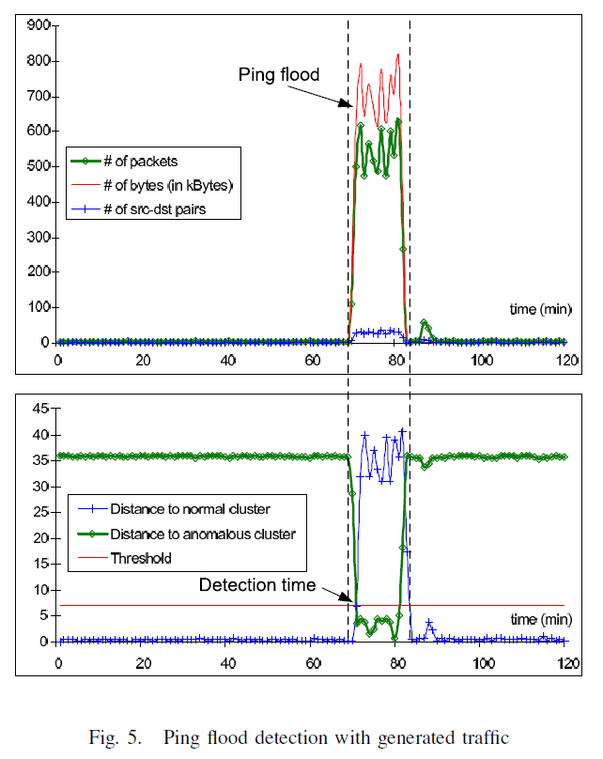

Experimental Results
Environments
Generating traffic in a local testbed
Played back tcpdump traces in a real network
Ping flood starts at t = 70 min
Evaluation
Evaluating the capability to detect port scans and DoS attack
Anomaly detected at t = 71 ~ 84 min
Threshold $d_{max}$ = 7

