Slide 1
No Title, yet
Hyunwoo Kim
SNU IDB Lab.
September 11, 2008

Slide 2
Contents
Introduction
Motivation
Related Work
Our Approach
Evaluation
Conclusion

Slide 3
Introduction [/]
Tagging
  Action of adding keywords to objects
Tags
  Meaningful descriptors of the objects
  To organize and index contents
  Useful with multimedia objects
    – little or no textual context

Slide 4

Motivation [/]
Tropical_Blue_Ocean.jpg

Slide 5
Introduction [/]
Image search and video search
We can only use the title of multimedia to find
Tags will help the search result
It will be helpful not only multimedia contents also text based contents

Slide 6
Motivation [/]
Tropical_Blue_Ocean.jpg
Tags: Blue Ocean, Hawaii,
Waikiki

Slide 7
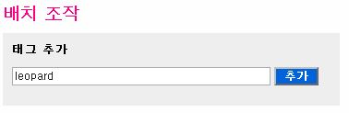
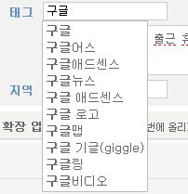
Motivation [/]
Flickr
Tistory

Slide 8
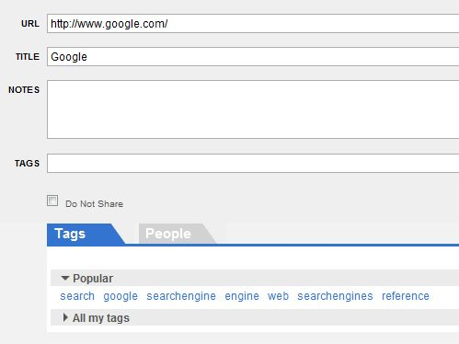
Motivation [/]
Delicious

Slide 9
Related Work [/]
Flickr Tag Recommendation based on Collective Knowledge, WWW2008
  How we can assist user in the tagging phase
  Recommending tags that can be added to the photo
  Tag co-occurrence
  Tag aggregation and ranking

Slide 10
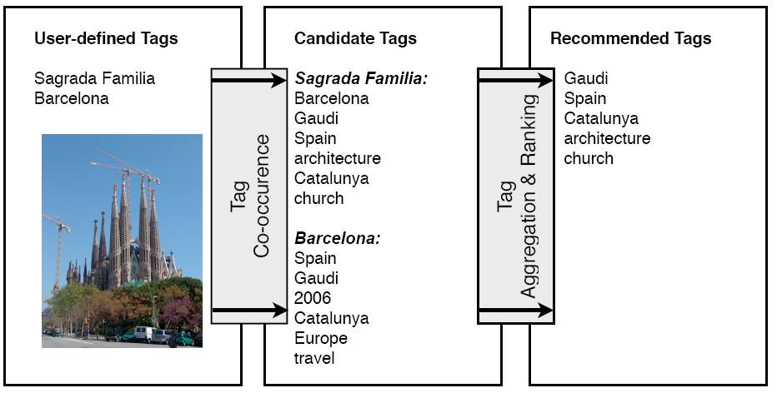
Related Work [/]

Slide 11
Related Work [/]
Personalized Tag Recommendations via Tagging and Content-based Similarity Metrics, ICWSM 2007
  Tag recommendation in social bookmarking sites
  Users add too few tags
  Content-based method
  Tagging-based method

Slide 12
Related Work [/]
The similarity between URL₁ and URL₂ is defined by
  Word frequency vector of the URL contents in content-based method
  Common tag frequency vector of the URL in tagging-based method
The weight of a tag is sum of similarities of the URL that contains the tag

Slide 13
Related Work [/]
Information Retrieval in Folksonomies: Search and Ranking, ESWC 2006
  FolkRank
  Similar to PageRank of Google
  FolkRank make a set of related users and resources for a given tag

Slide 14
Related Work [/]
Tag Recommendations in Folksonomies, PKDD2007
A proposal of Community-based Folksonomy with RDF Metadata, ISWC 2005
A Collaborative Tagging System for Personalized Recommendation in B2C Electronic Commerce
Tag-aware Recommender Systems by Fusion of Collaborative Filtering Algorithms, SAC2008
Towards the Semantic Web: Collaborative Tag Suggestions

