Slide 1
Chapter 9 – Neural Nets
Data Mining for Business Intelligence
Shmueli, Patel & Bruce
© Galit Shmueli and Peter Bruce 2008

Slide 2
Basic Idea
Combine input information in a complex & flexible neural net “model”
Model “coefficients” are continually tweaked in an iterative process
The network’s interim performance in classification and prediction informs successive tweaks

Slide 3
Network Structure
Multiple layers
  Input layer (raw observations)
  Hidden layers
  Output layer
Nodes
Weights (like coefficients, subject to iterative adjustment)
Bias values (also like coefficients, subject to iterative adjustment)

Slide 4
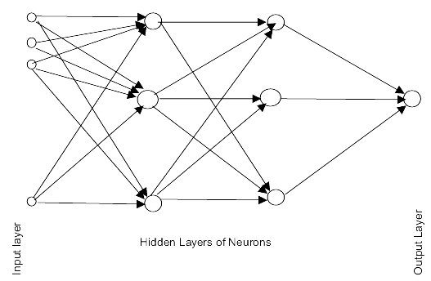
Schematic Diagram

Slide 5
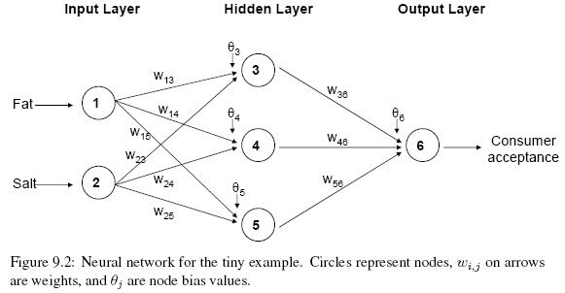
Example – Using fat & salt content to predict consumer acceptance of cheese

Slide 6
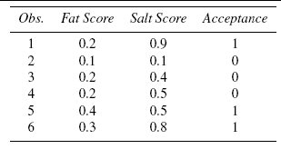
Example - Data

Slide 7
Moving Through the Network

Slide 8
The Input Layer
For input layer, input = output
E.g., for record #1:
  Fat input = output = 0.2
  Salt input = output = 0.9
Output of input layer = input into hidden layer

Slide 9

The Hidden Layer
In this example, it has 3 nodes
Each node receives as input the output of all input nodes
Output of each hidden node is a function of the weighted sum of inputs

Slide 10
The Weights
g HAS TO be a nonlinear function such as Logistic Function, otherwise …
The weights θ (theta) and w are typically initialized to random values in the range -0.05 to +0.05
Equivalent to a model with random prediction (in other words, no predictive value)
These initial weights are used in the first round of training

Slide 11
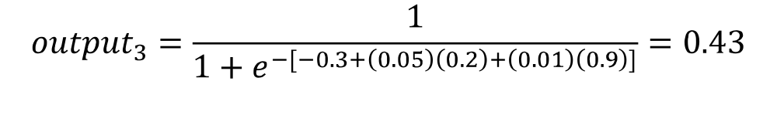
Output of Node 3 if g is a Logistic Function

Slide 12
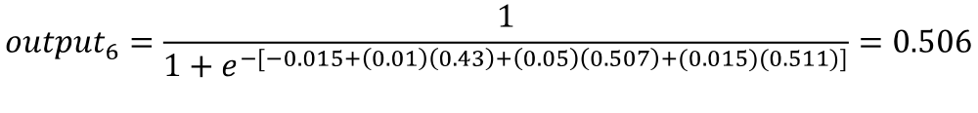
Output Layer
The output of the last hidden layer becomes input for the output layer
Uses same function as above, i.e. a function g of the weighted average

Slide 13
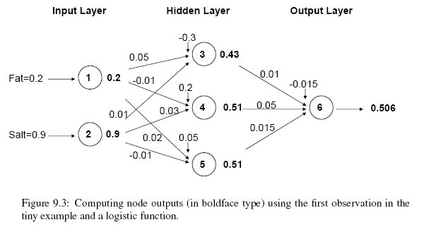
The output node

Slide 14
Mapping the output to a classification
Output = 0.506
If cutoff for a “1” is 0.5, then we classify as “1”

Slide 15

Relation to Linear Regression
A net with a single output node and no hidden layers, where g is the identity function, takes the same form as a linear regression model

Slide 16
Relation to Logistic Regression
A net with a single output node and no hidden layers, where g is the identity (?) function, takes the same form as a logistic regression model

Slide 17
Training the Model

Slide 18
Preprocessing Steps
Continuous variables
  Scale variables to 0-1
Categorical variables
  If equidistant categories, map to equidistant interval points in 0-1 range
  Otherwise, create dummy variables
    1 of N coding vs binary coding
Transform (e.g., log) skewed variables

Slide 19
Back Propagation (“back-prop”)
Goal: Find weights that yield best predictions or smallest output errors’ squared sum
The Sum of square error (SSE) is a differentiable function of w and theta given data
Gradient Descent method is employed to minimize it which results in “Backprop”
  w is updated in the direction of the opposite of Gradient ~ 1 dim example
This method finds local minimum, not global

Slide 20
Errors are back-propagated
The process we described above is repeated for all records
  At each record, compare prediction to actual
  Difference is the error for the output node
  Error is propagated back and distributed to all the hidden nodes and used to update their weights
More specifically, …

Slide 21
Back Propagation (“back-prop”)
Output from output node k:
Error associated with that node:
Note: this is like ordinary error, multiplied by a correction factor

Slide 22
Why It Works
Big errors lead to big changes in weights
Small errors leave weights relatively unchanged
Over thousands of updates, a given weight keeps changing until the error associated with that weight is negligible, at which point weights change little

Slide 23

Error is Used to Update Weights
l = constant between 0 and 1, reflects the “learning rate”.
The larger the quicker, but more likely to jump over the global minimum

Slide 24
Case Updating
Weights are updated after each record is run through the network
Completion of all records through the network is one epoch (also called sweep or iteration)
After one epoch is completed, return to first record and repeat the process

Slide 25
Online vs Batch Updating
The algorithm shown before is NOT exactly Gradient Descent, but an approximation or called online learning
Batch learning is exactly following GD
  All records in the training set are fed to the network before updating takes place
  In this case, the error used for updating is the sum of all errors from all records

Slide 26
Common Criteria to Stop the Updating
When weights change very little from one iteration to the next
When the misclassification rate reaches a required threshold
When a limit on runs is reached

Slide 27
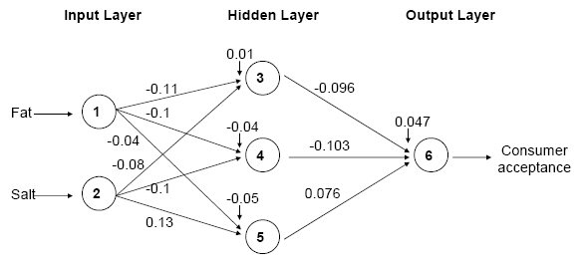
Fat/Salt Example: Final Weights

Slide 28
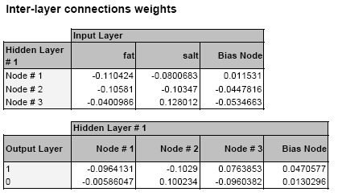
XLMiner Output: Final Weights
Note: XLMiner uses two output nodes (P[1] and P[0]); diagrams show just one output node (P[1])

Slide 29
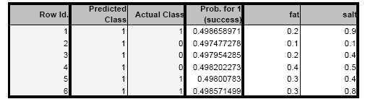
XLMiner: Final Classifications

Slide 30
Other than Back-prop?
Backprop results from applying Gradient Descent on Sum of Square Error
What if other optimization algorithms applied?
  No problem, could be faster
  Conjugate Gradient
  Newton’s (use of second derivative or Hessian matrix)
  Levenberg Marquadt, a variant of Newton’s
Of course, none of the above finds global minimum

Slide 31
Avoiding Overfitting
With sufficient hidden nodes and iterations, neural net can virtually fit any training data!! (cf. full grown tree)
This “universal approximating” property can easily lead to overfitting
To avoid overfitting:
Track error in validation data
Limit iterations
Limit complexity of network

Slide 32
User Inputs

Slide 33
Specify Network Architecture
Number of hidden layers
  Most popular – one hidden layer
Number of nodes in hidden layer(s)
  More nodes capture complexity, but increase chances of overfit
Number of output nodes
  For classification, one node per class (in binary case can also use one)
  For numerical prediction use one

Slide 34
Network Architecture, cont.
“Learning Rate”
  Low values “downweight” the new information from errors at each iteration
  This slows learning, but reduces tendency to overfit to local structure
“Momentum”
  High values keep weights changing in same direction as previous iteration
  Likewise, this helps avoid overfitting to local structure, but also slows learning

Slide 35
Advantages
Good predictive ability
Can capture complex relationships
No need to specify a model

Slide 36
Disadvantages
Considered a “black box” prediction machine, with no insight into relationships between predictors and outcome
No variable-selection mechanism included, so you have to do it yourself carefully
Bigger computational requirements if there are many variables (additional variables dramatically increase the number of weights to calculate)

Slide 37
Summary
Neural networks can be used for classification and prediction
Can capture a very flexible/complicated relationship between the outcome and a set of predictors
The network “learns” and updates its model iteratively as more data are fed into it
Good predictive performance
“Black box” in nature and large amounts of data required

