Slide 1
Mathematical View of PageRank & HITs
Apr 6, 2012
Heegook Jun

Slide 2
Outline
Introduction
Google’s PageRank
HITs
Conclusion
Discussion

Slide 3
Introduction
Idea: mine hyperlink information in the Web
Assumptions
Links often connect related pages
A link between pages is a recommendation
Query-independent ordering
Using link counts as simple measures of popularity

Slide 4
PageRank
PageRank
두 웹 페이지 사이의 Markov Random Walk를 Random Surfing으로 구현
높은 PageRank는 어떤 query에 대해서든 관련 있을 가능성이 높다
Assumption
Link가 걸려있는 페이지는 유사한 주제를 다루고 있다

Slide 5
PageRank Algorithm
Imagine a browser doing a random walk on web pages:
Start at a random page
At each step, follow one of the n links on that page, each with 1/n probability
Do this repeatedly. Use the “long-term visit rate” as the page’s score

Slide 6

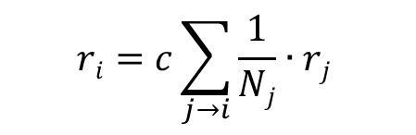
PageRank
PageRank
$$ri=c\sum_{j→i}{\frac{1}{Nj}∙rj}$$
r₁ = 10
r₄ = $\frac{1}{2}$ ∙ 10 + $\frac{1}{3}$∙ 30 + $\frac{1}{2}\text{∙}$ 40
r₂ = 30
r₃ = 40

Slide 7


PageRank: Linear Algebra
P = ($\frac{1}{Nj}$)
1
2
j 1 2 3 4
i
1 2
3
4
0 $\frac{1}{1}$ 0 0
0 0 $\frac{1}{1}$ 0
$\frac{1}{2}$ 0 0 $\frac{1}{2}$
0 0 0 0
4
3

Slide 8
PageRank: Linear Algebra

Slide 9
PageRank: Linear Algebra
r = P^{T} ∙ y
i
j

Slide 10
PageRank: Linear Algebra
r = (P ∙ P)^{T} ∙ y
i
j

Slide 11
PageRank: Linear Algebra
r = (P∙P∙P)^{T} ∙ y
i
j

Slide 12
PageRank: Linear Algebra
For all page’s rank: y = (0, 0, 1, .., 0, 0) → u = (1, 1, 1, .. , 1, 1)
Summation
r = I ∙ u
+ P^{T} ∙ u
+ ( P ∙ P )^{T} ∙ u
+ ( P ∙ P ∙ P )^{T} ∙ u …
By Von Neumann Diffusion Kernel
r = ( (I – P) ^{T} )⁻¹ ∙ u
Recursive expression: r_{i} = P ^{T} ∙ r_{i-1}

Slide 13
Rank Sink Problem
Unreachable!
j
i

Slide 14
Rank Sink Problem
There is no out edge!
j
i

Slide 15

Random Surfer Model
The random surfer simply keeps clicking on successive links at random.

Slide 16
Random Surfer Model
If a real web surfer ever gets into a small loop of web pages, it is unlikely that the surfer will continue in the loop forever.
j
i

Slide 17
Random Surfer Model
Instead, the surfer will jump to some other page.
j
i
i

Slide 18
Random Surfer Model
Apply random surfer model
Damping factor 0 ≤ α < 1 ( google uses α = 0.85 )
r_{i} = P ^{T} r_{i-1}
r_{i} = α P ^{T} r_{i-1} + ( 1 – α ) r_{i-1}

Slide 19
Example
U = { 'http://www.aaa.com‘,
'http://www.bbb.com‘,
'http://www.ccc.com‘,
'http://www.ddd.com‘,
'http://www.eee.com‘,
'http://www.fff.com‘ }
a
d
b
c
f
e

Slide 20
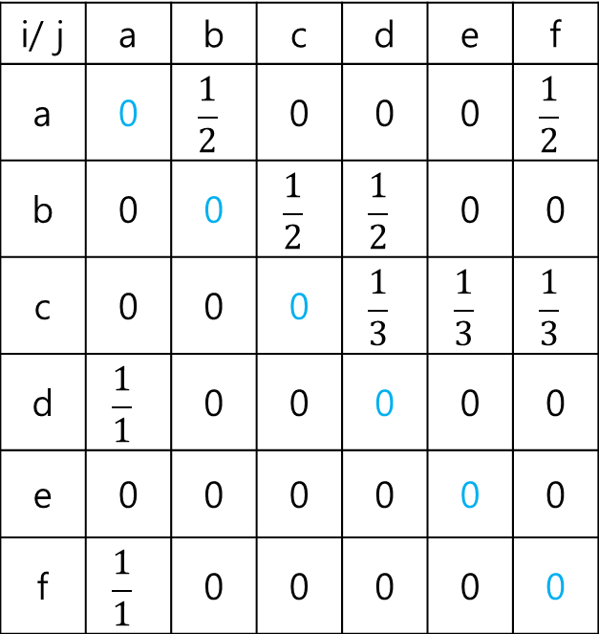
Example
P
a
d
i/ j | a | b | c | d | e | f
a | 0 | $$\frac{1}{2}$$ | 0 | 0 | 0 | $$\frac{1}{2}$$
b | 0 | 0 | $$\frac{1}{2}$$ | $$\frac{1}{2}$$ | 0 | 0
c | 0 | 0 | 0 | $$\frac{1}{3}$$ | $$\frac{1}{3}$$ | $$\frac{1}{3}$$
d | $$\frac{1}{1}$$ | 0 | 0 | 0 | 0 | 0
e | 0 | 0 | 0 | 0 | 0 | 0
f | $$\frac{1}{1}$$ | 0 | 0 | 0 | 0 | 0
b
c
f
e

Slide 21
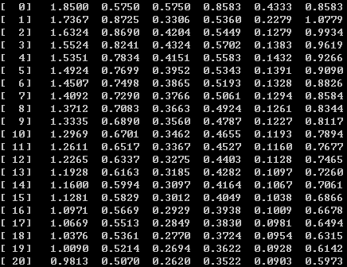
Example
r_{i} = α P ^{T} r_{i-1} + ( 1 – α ) r_{i-1}
r_{i} = 0.85 ∙ P ^{T} r_{i-1} + 0.15 ∙ r_{i-1}

Slide 22
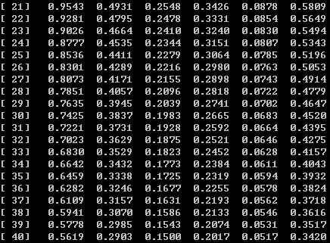
Example
r_{i} = α P ^{T} r_{i-1} + ( 1 – α ) r_{i-1}
r_{i} = 0.85 ∙ P ^{T} r_{i-1} + 0.15 ∙ r_{i-1}

Slide 23
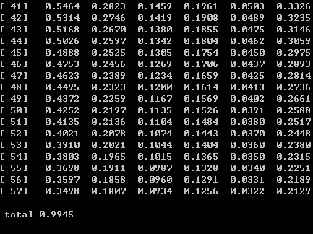
Example
r_{i} = α P ^{T} r_{i-1} + ( 1 – α ) r_{i-1}
r_{i} = 0.85 ∙ P ^{T} r_{i-1} + 0.15 ∙ r_{i-1}

Slide 24

Example
a | 0.3498
b | 0.1807
c | 0.0934
d | 0.1256
e | 0.0322
f | 0.2129
$$\sum_{i∈U}{ri}=1$$

Slide 25
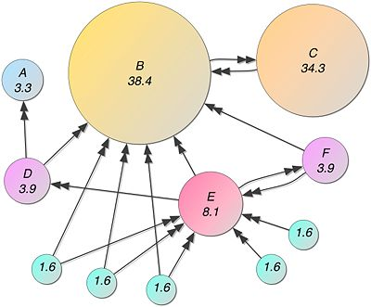
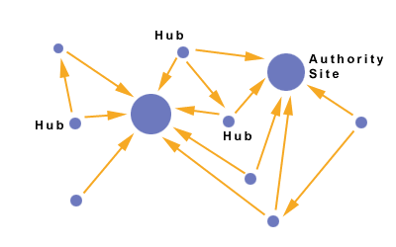
HITs (Hyperlink Induced Topic Search)
PageRank
HITs

Slide 26
HITs (Hyperlink Induced Topic Search)
Authoritative Sources in a Hyperlinked Environment
Jon M. Kleinberg, Journal of ACM, 1999
Uses hubs and authorities to define a recursive relationship between web pages
An authority is a page that many hubs link to
A hub is a page that links to many authoriites

Slide 27
HITs (Hyperlink Induced Topic Search)
The basic idea:
A page is a good authoritative page with respect to a given query if it is referenced (i.e., pointed to) by many (good hub) pages that are related to the query.
A page is a good hub page with respect to a given query if it points to many good authoritative pages with respect to the query.
Good authoritative pages (authorities) and good hub pages (hubs) reinforce each other.

Slide 28


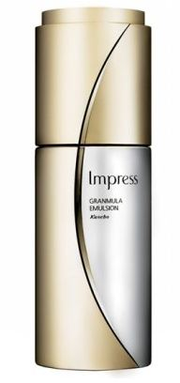
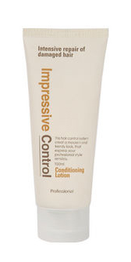

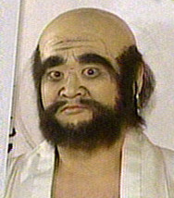


Example: Authority
A
B
Authority

Slide 29

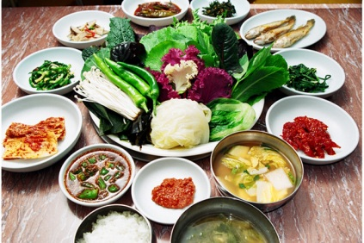
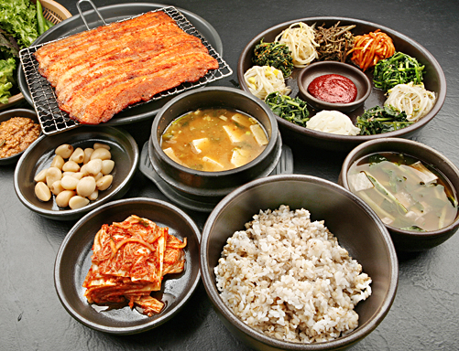
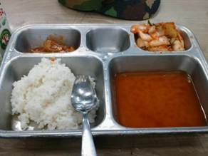

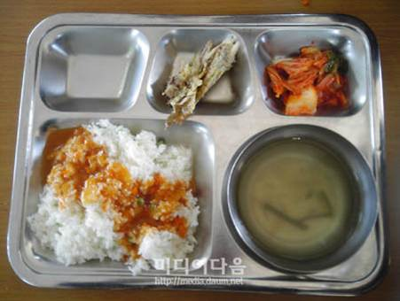
Example: Hub
A
Hub
B
Notes:
맛집Site

Slide 30



HITs Algorithm
Operation I: for each page p:
a(p) = Σ h(q)
q: (q, p)∈E
q₁
q₂
p
q₃
Hubs
Authority

Slide 31

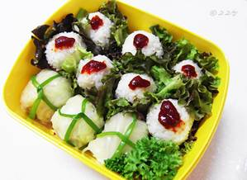
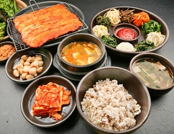
HITs Algorithm
Operation O: for each page p:
h(p) = Σ a(q)
q: (p, q)∈E
q₁
p
q₂
q₃
Hubs
Authority

Slide 32
HITs: Linear Algebra
Matrix representation of operations I and O
A: Adjacency matrix of Subgraph
h_{i}: vector of hub scores after i iterations
a_{i}: the vector of authority scores after i iterations
Operation I : a_{i} = A^{T} h_{i-1}
Operation O: h_{i} = A a_{i}
= A^{T} ∙ A a_{i-1}
= ( A^{T} ∙ A )^{i} a₀
= A ∙ A^{T} h_{i-1}
= ( A ∙ A^{T} )^{i} h₀

Slide 33


HITs: Linear Algebra
Authority Score : a_{i} = ( A^{T} ∙ A ) a_{i-1}
Hub Score : h_{i} = ( A ∙ A^{T} ) h_{i-1}
After each iteration of applying operations, normalize all authority and hub scores
Repeat until the scores for each page converge
the convergence is guaranteed
$$a\left( p \right)= \frac{a( p )}{\sqrt{\sum_{q ∈V}{\left[ a\left( q \right)\right]2}}}$$
$$h\left( p \right)= \frac{h( p )}{\sqrt{\sum_{q ∈V}{\left[ h\left( q \right)\right]2}}}$$

Slide 34
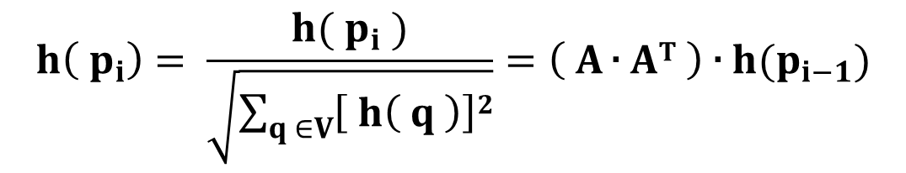
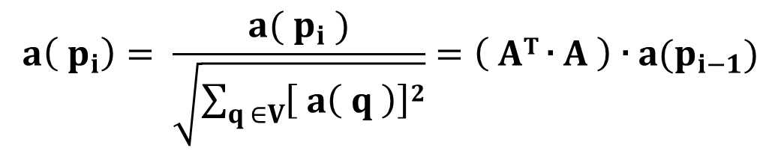
HITs: Linear Algebra
Authority Score
Hub Score
$$a\left( p_{i}\right)= \frac{a( p_{i} )}{\sqrt{\sum_{q ∈V}{\left[ a\left( q \right)\right]2}}}=\left( AT \text{∙} A \right) \text{∙} a(p_{i−1})$$
$$h\left( p_{i}\right)= \frac{h( p_{i} )}{\sqrt{\sum_{q ∈V}{\left[ h\left( q \right)\right]2}}}=\left( A \text{∙} AT \right) \text{∙} h(p_{i−1})$$

Slide 35
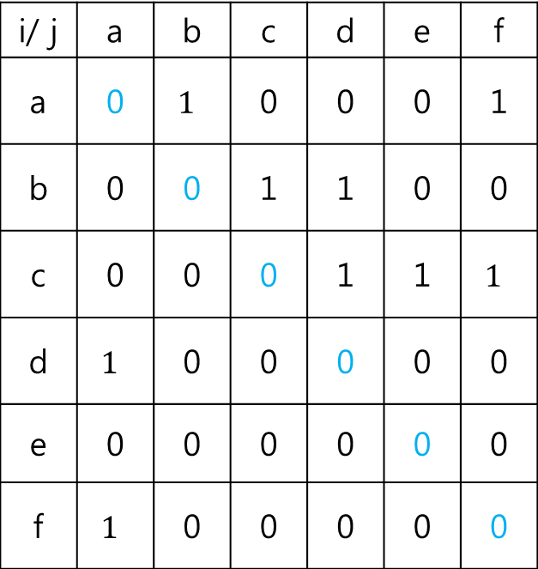
Example
a
d
i/ j | a | b | c | d | e | f
a | 0 | $$1$$ | 0 | 0 | 0 | 1
b | 0 | 0 | 1 | 1 | 0 | 0
c | 0 | 0 | 0 | 1 | 1 | $$1$$
d | $$1$$ | 0 | 0 | 0 | 0 | 0
e | 0 | 0 | 0 | 0 | 0 | 0
f | $$1$$ | 0 | 0 | 0 | 0 | 0
b
c
f
e

Slide 36
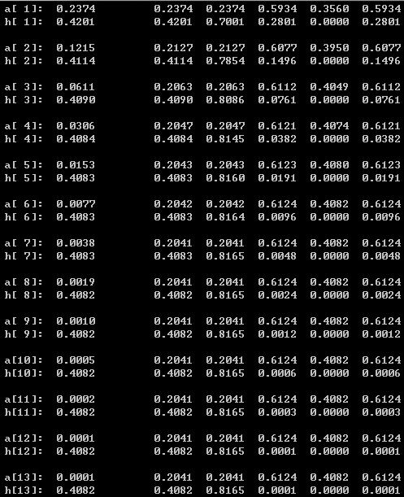
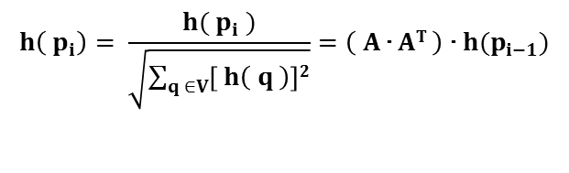
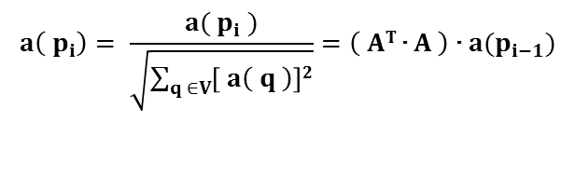
Example
Authority Score
Hub Score
$$a\left( p_{i}\right)= \frac{a( p_{i} )}{\sqrt{\sum_{q ∈V}{\left[ a\left( q \right)\right]2}}}=\left( AT \text{∙} A \right) \text{∙} a(p_{i−1})$$
$$h\left( p_{i}\right)= \frac{h( p_{i} )}{\sqrt{\sum_{q ∈V}{\left[ h\left( q \right)\right]2}}}=\left( A \text{∙} AT \right) \text{∙} h(p_{i−1})$$

Slide 37
Example
Authority Score
Hub Score
$$a\left( p_{i}\right)= \frac{a( p_{i} )}{\sqrt{\sum_{q ∈V}{\left[ a\left( q \right)\right]2}}}=\left( AT \text{∙} A \right) \text{∙} a(p_{i−1})$$
$$h\left( p_{i}\right)= \frac{h( p_{i} )}{\sqrt{\sum_{q ∈V}{\left[ h\left( q \right)\right]2}}}=\left( A \text{∙} AT \right) \text{∙} h(p_{i−1})$$

Slide 38
Example
a | 0.0001
b | 0.2041
c | 0.2041
d | 0.6124
e | 0.4082
f | 0.6124

Slide 39
Example
a | 0.4082
b | 0.4082
c | 0.8165
d | 0.0001
e | 0.0000
f | 0.0001

Slide 40
Example
a
d
b
c
f
e

Slide 41
Conclusion
PageRank와 HITs는 Hyperlink를 활용해 Ranking Method를 구현
PageRank 는 Markov Random Walk로 Random Surfing를 구현
세상에 존재하는 모든 다른 페이지들과의 유사도의 합
HITs는 Authority와 Hub 지수를 사용해 Link간 관계를 분석
Linear Algebra를 활용해 단순한 형태로 알고리즘을 구현하기 쉽다

Slide 42
Discussion
Strong point
공간 안에서 데이터의 geometry가 왜곡된 상황에서도 올바르게 문서간 거리를 구할 수 있다
쿼리 독립적. 어떤 쿼리가 오더라도 자신의 페이지와 다른 모든 페이지들 간의 유사성을 계산한다
Weak point
주제와 동떨어진 쿼리가 오더라도 높은 Rank를 줄 수가 있다
Link 관계를 악용해 랭킹을 올릴 수 있는 방법이 존재

Slide 43
References
Jon M. Kleinberg, Authoritative Sources in a Hyperlinked Environment, Journal of ACM, 1999
Ayman Farahat Et al, Authority Rankings from HITS, PageRank, and SALSA: Existence, Uniqueness, and Effect of Initialization, SIAM J. Scientific Computing, 2006
Wikipedia, http://en.wikipedia.org/wiki/HITS_algorithm#Normalization
The Stanford Natural Language Processing Group, http://nlp.stanford.edu/IR-book/html/htmledition/hubs-and-authorities-1.html
Dept of Mathematics, Cornell Univ, http://www.math.cornell.edu/~mec/Winter2009/RalucaRemus/Lecture4/lecture4.html

Slide 44
Thank you

