Slide 1
Introduction to NoSQL
27 Sep 2013
SNU IDB Lab.
Min Sup Lee

Slide 2
Outline
NoSQL: Why
What is the problem with RDBMS’s?
Cap Theorem
Some NoSQL Use Cases
List of NoSQL Databases

Slide 3
NoSQL: Why
“Not Only SQL” – NoSQL
ACID doesn’t scale well
Web apps have different needs
Scalability & elasticity (at low cost!)
High availability
Flexible schemas / semi-structured data
Geographic distribution (multiple datacenters)

Slide 4

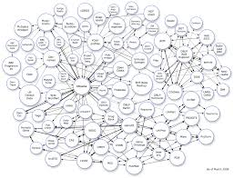
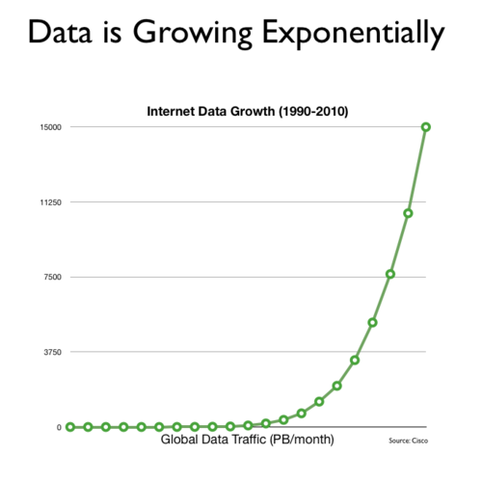
NoSQL: Why
New Trends
Connectivity
Cloud Computing
Big Data
Concurrency
Diversity

Slide 5
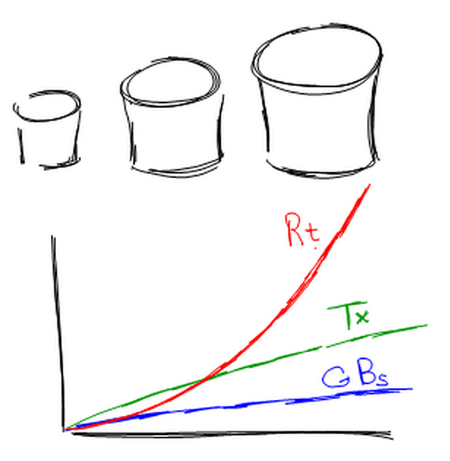
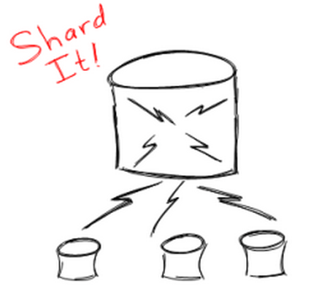
What is the problem with RDBMS’s?
The growth in database transactions and volumes
Large impact on response time
Need Database Sharding
Takes large databases and breaks them into smaller databases

Slide 6
What is the problem with RDBMS’s?
ACID properties are always desirable in RDBMS
But what about:
Latency
Partition Tolerance
High Availability

Slide 7
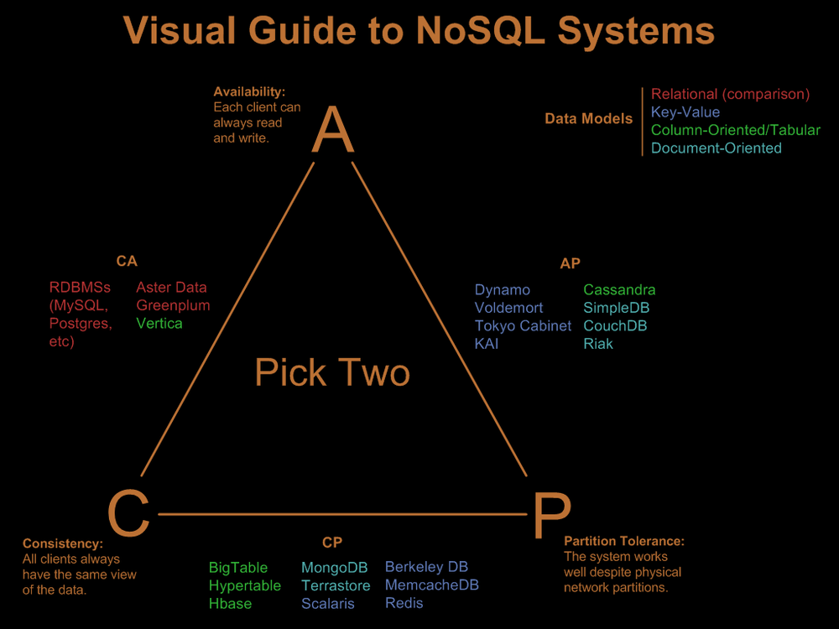
Cap Theorem
Consistency
Each client always has the same view of the data
Availability
All clients can always read and write
Partition tolerance
The system works well across physical network partitions

Slide 8
Some NoSQL Use Cases
Massive data volumes
Massively distributed architecture required to store the data
Google, Amazon, Yahoo, Facebook
Extreme query workload
Impossible to efficiently do joins at that scale with an RDBMS
Schema evolution
Schema flexibility is not trivial at large scale
Schema changes can be gradually introduced with NoSQL

Slide 9








List of NoSQL Databases
Wide column store / Column families
Document store
Key value / Tuple store
Graph Databases

