Slide 1
RDFPath: Path Query Processing on Large RDF Graph with MapReduce
Martin Przyjaciel-Zablocki et al.
University of Freiburg
ESWC 2011
24 May 2013
SNU IDB Lab.
Min Sup Lee

Slide 2
Outline
Introduction
RDFPath
Evaluation
Conclusion and Discussion

Slide 3
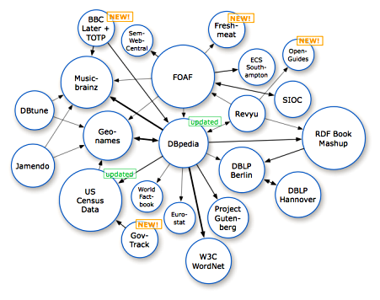
Introduction Semantic Web and RDF
Semantic web
Amount of semantic data increase steadily
Semantic web data is typically represented as a RDF graph
RDF (Resource Description Framework)
The most prominent standards
Storing and representing data
Management of large RDF graphs
Non-trivial task
Single machine approaches are challenged

Slide 4
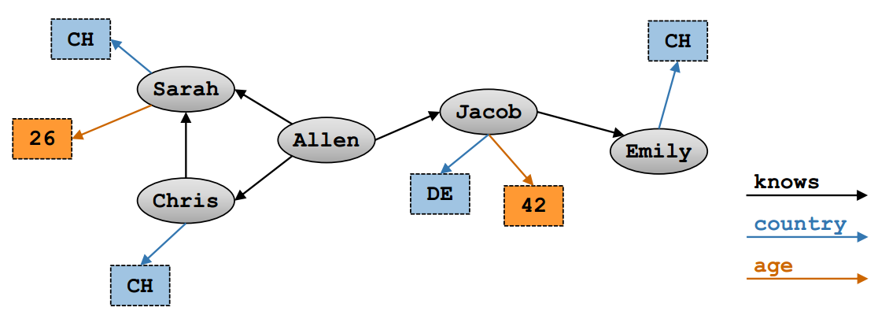
Introduction Expressions of RDF
RDF data and RDF graph
RDF data set consists of a set of RDF triples
<subject, predicate, object>
Subject | Predicate | Object
Allen | Knows | Jacob
Allen | Knows | Chirs
Allen | Knows | Sarah
Sarah | Country | CH
Sarah | Age | 26
Chris | Country | CH
Chirs | Knows | Sarah
Jacob | Country | DE
Jacob | Age | 42
Jacob | Knows | Emily
Emily | Country | CH

Slide 5
Introduction RDF Query Processing
SPARQL Query Processing
SELECT ?X WHERE{
Allen Knows ?X }
Subject | Predicate | Object
Allen | Knows | Jacob
Allen | Knows | Chirs
Allen | Knows | Sarah
Sarah | Country | CH
Sarah | Age | 26
Chris | Country | CH
Chirs | Knows | Sarah
Jacob | Country | DE
Jacob | Age | 42
Jacob | Knows | Emily
Emily | Country | CH
Allen | Knows | Jacob
Allen | Knows | Chirs
Allen | Knows | Sarah
Jacob
Chirs
Sarah

Slide 6
Introduction RDF Query Processing
SPARQL Query Join Processing
SELECT ?X WHERE{
Allen Knows ?X
?X Country CH }
Subject | Predicate | Object
Allen | Knows | Jacob
Allen | Knows | Chirs
Allen | Knows | Sarah
Sarah | Country | CH
Sarah | Age | 26
Chris | Country | CH
Chirs | Knows | Sarah
Jacob | Country | DE
Jacob | Age | 42
Jacob | Knows | Emily
Emily | Country | CH
Allen | Knows | Jacob
Allen | Knows | Chirs
Allen | Knows | Sarah
Sarah | Country | CH
Chris | Country | CH
Emily | Country | CH
Sarah
Chris

Slide 7

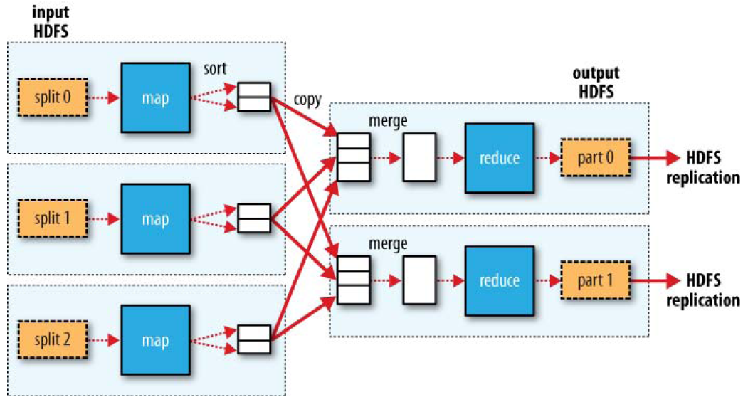

Introduction MapReduce Framework
MapReduce
Runs on off-the-shelf hardware
Shows desirable scaling properties
New computing nodes can easily be added
Hadoop
High fault tolerance and reliability
Provide an implementation of MapReduce programming model

Slide 8
Introduction MapReduce Framework
MapReduce Join
SELECT ?X WHERE{
Allen Knows ?X
?X Country CH }
Map
[Machine 1]
Allen | Knows | Jacob
Allen | Knows | Chirs
Allen | Knows | Sarah
Sarah | Country | CH
S | P | O
Allen | Knows | Jacob
Allen | Knows | Chirs
Allen | Knows | Sarah
Sarah | Country | CH
Sarah | Age | 26
Chris | Country | CH
Chirs | Knows | Sarah
Jacob | Country | DE
Jacob | Age | 42
Jacob | Knows | Emily
Emily | Country | CH
Reduce
[Machine 1]
Allen | Knows | Jacob
Emily | Country | CH
[Machine 2]
Sarah | Age | 26
Chris | Country | CH
Chirs | Knows | Sarah
Jacob | Country | DE
[Machine 2]
Allen | Knows | Chirs
Chris
Sarah
Chris | Country | CH
[Machine 3]
[Machine 3]
Jacob | Age | 42
Jacob | Knows | Emily
Emily | Country | CH
Allen | Knows | Sarah
Sarah | Country | CH

Slide 9
Introduction RDFPath
RDFPath
A declarative path query language for RDF
Natural mapping to the MapReduce
Supports more diverse and powerful features than SPARQL 1.0
▶
Allen :: knows [country=equals(“CH”)]
▶
Results
Allen (knows) Chris [coutry=“CH”]
Allen (knows) Sarah [coutry=“CH”]
Notes:
Semantic web data는 RDF로 표현된다. 그런데 Large RDF 그래프나 데이터는 한대의 머신으로 manage하기 힘들다.
RDFPath는 기존의 Query language보다 직관적이고 MapReduce에 적용하기 좋은 Query language 이다.
그러므로 편리하게 사용할 수 있고, MapReduce를 사용함으로써 size에 대한 고민도 해결하겠다! 라는 의미

Slide 10
Outline
Introduction
RDFPath
Evaluation
Conclusion and Discussion

Slide 11
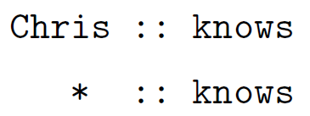
RDFPath
RDFPath
Navigational queries on RDF graphs
Composed by a sequence of location steps
Every location step is mapped to one Mapreduce job
The result of a query is a set of paths
Start Node
The first part of a RDFPath query
Separated by “::” from the rest of the query
The symbol “*” indicates an arbitrary start node where every subject

Slide 12
RDFPath RDFPath By Example
Location Step
The basic navigational component
Specifying the next edge to follow in the query evaluation process
Allen :: knows > knows > age
Allen :: knows (2) > age
Allen :: *
Result
Allen (knows) Jacob (knows) Emily ??
Allen (knows) Chris (knows) Sarah (age) 26

Slide 13
RDFPath RDFPath By Example
Filter
Specified within any location step using square brackets
equals(), prefix(), suffix(), min(), max()
Allen :: knows > age [min(30)] [max(60)]
Allen (knows) Sarah (age) 26
Allen (knows) Jacob (age) 42
Allen :: * > * [equals(‘Emily’)]
Allen (knows) Jacob (knows) Emily

Slide 14
RDFPath RDFPath By Example
Bounded search
Between the start node and all reachable nodes
(*2), (*3)…
Allen :: knows (*2)
Allen (knows) Jacob
Allen (knows) Jacob (knows) Emily
Allen (knows) Chris
Allen (knows) Sarah

Slide 15
RDFPath RDFPath By Example
Aggregation Function
Counts the number of resulting paths
count(), sum(), avg(), min() and max()
Allen :: *.count()
3
Allen :: knows > age.avg()
34

Slide 16
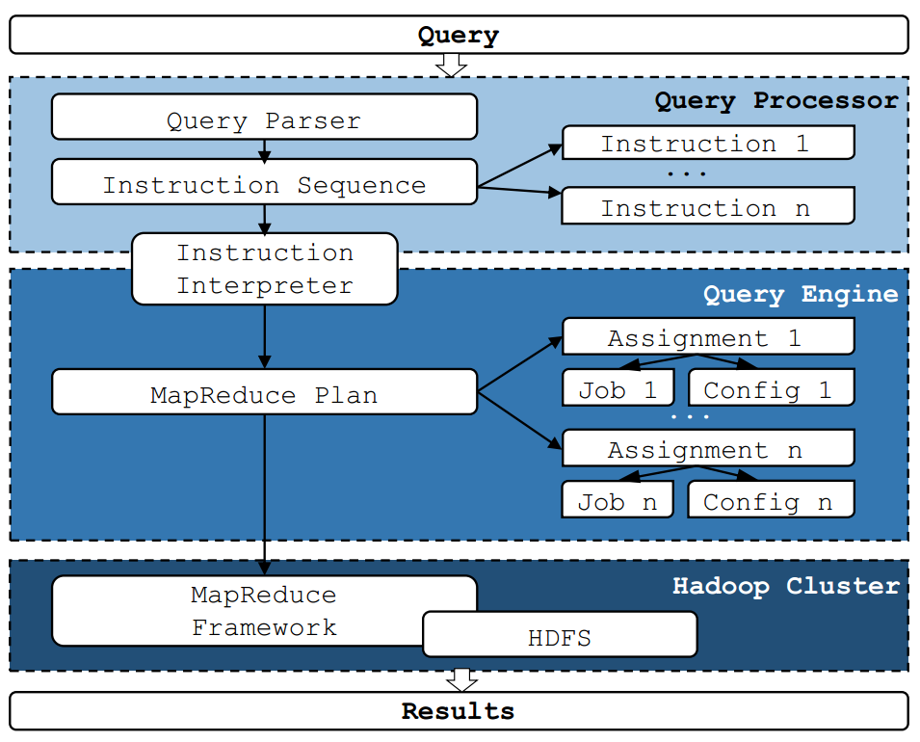
RDFPath Query Processing
Parses the query
Generates a general execution plan
Filter, join or aggregation function
MapReduce plan
Encapsulates the MapReduce job with a job configuration
Runs the MapReduce jobs

Slide 17
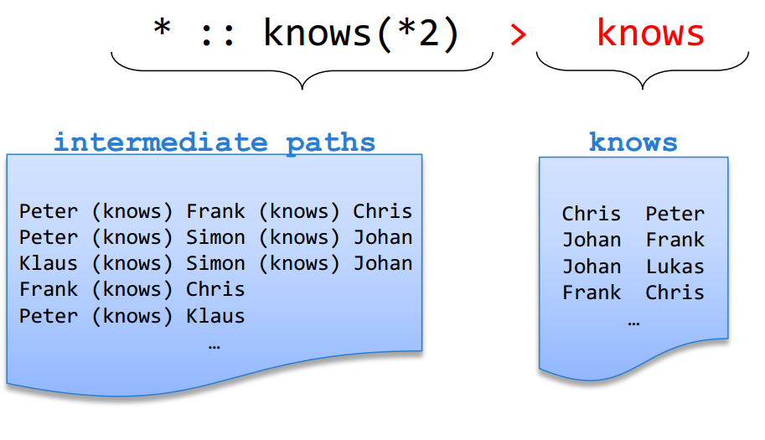
RDFPath MapReduce Join
Mapping to MapReduce jobs
Map task
Tagging intermediate paths and knows partition for join
Applying filter condition
Reduce task
Perform Join and store resulting paths back to HDFS
Join
Join keys

Slide 18
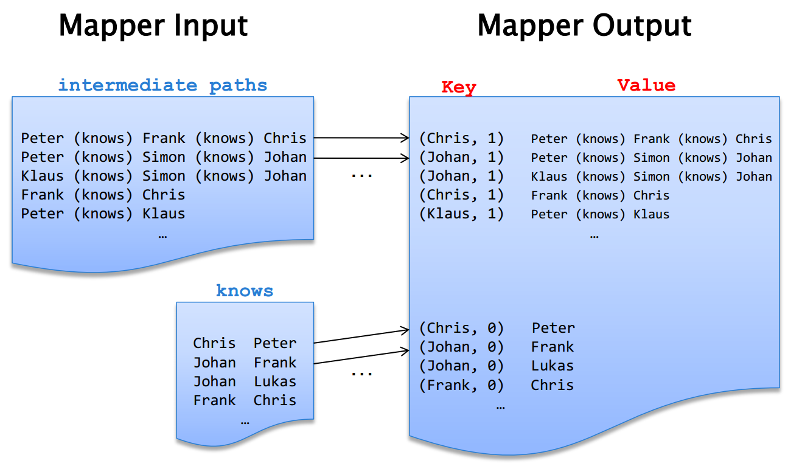
RDFPath MapReduce Join
Mapping to MapReduce jobs
Join keys

Slide 19
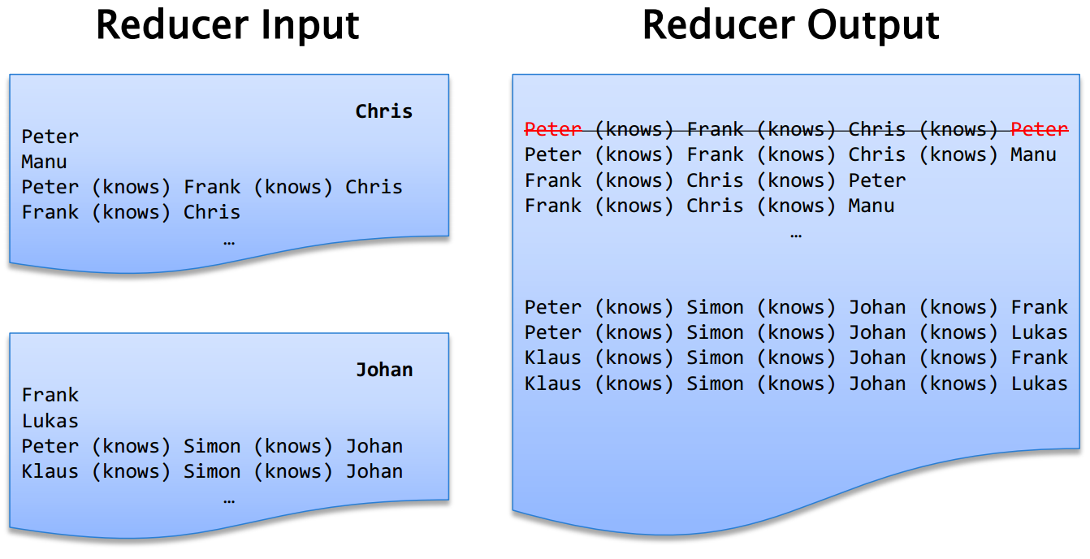
RDFPath MapReduce Join
Mapping to MapReduce jobs
* :: knows (*2) > knows

Slide 20
Outline
Introduction
RDFPath
Evaluation
Conclusion and Discussion

Slide 21
Evaluation
Environment setup
Cluster of 10 machines (Dual Core 3GHz, 4GB RAM, 1TB HDD)
Cloudera’s Distribution for Hadoop 3 Beta (CDH3)
Defalult configuration with with 9 reducers (one per HDD)
Two different data sources
Artificial data produced by the SP2Bench generator
1.6 billion RDF triples
Real world data from the online music service Last.fm
225 million RDF triples

Slide 22
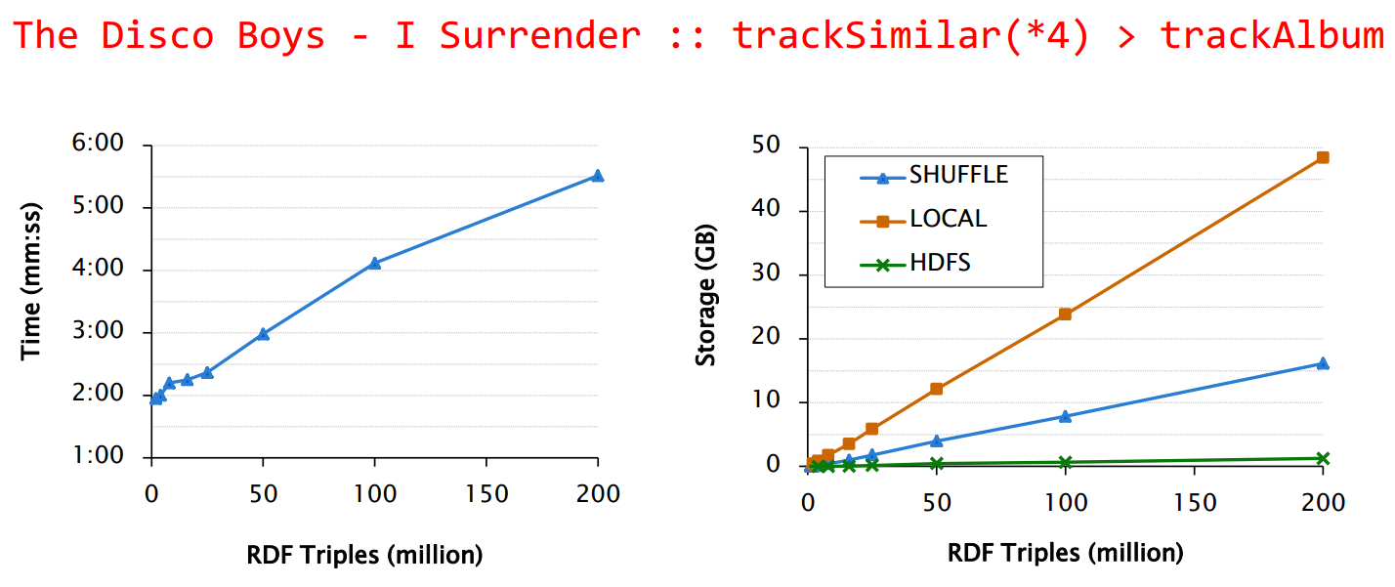
Evaluation
Query 1
From online music service
Determines the album name for all similar tracks

Slide 23
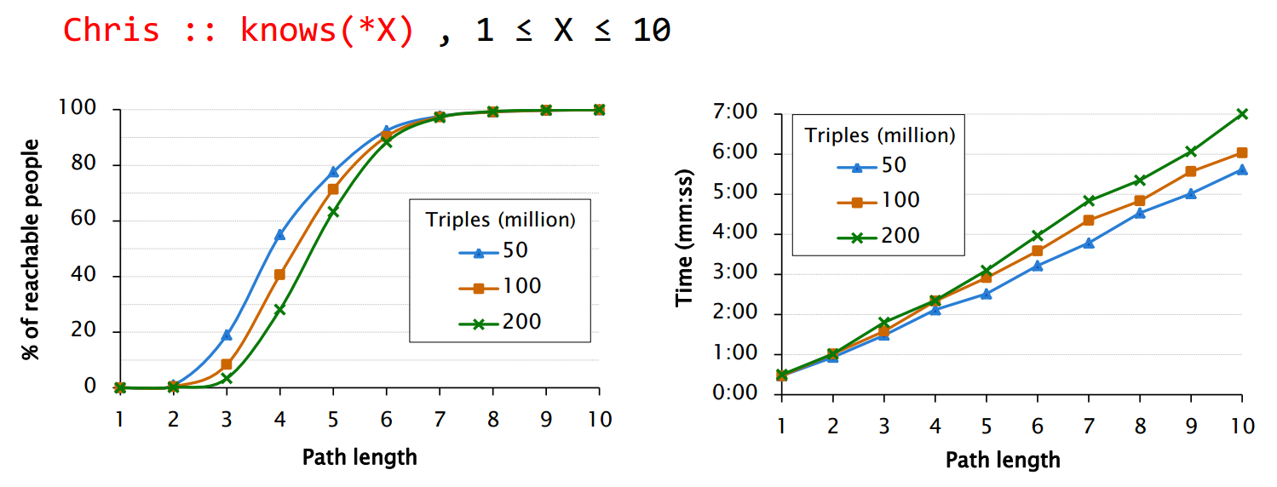
Evaluation
Query 3
The artificial data produced by the SP2Bench generator
Determines the friends of Chris reached by following an increasing number of edge
Corresponds to the six degrees of separation paradigm

Slide 24
Outline
Introduction
RDFPath
Evaluation
Conclusion and Discussion

Slide 25
Conclusion and Discussion
Conclusion
Intuitive syntax for path queries
Effective execution strategy using MapReduce
Discussion
Strong points
An expressive RDF path query language geared towards casual users
Scaling properties of the MapReduce Framework
Weak points
Incomplete description of Query processing with Mapreduce
Need comparisons with other RDF Query Languages

Slide 26
Thank you

