Slide 1
Dirichlet Distribution
M. Farrow, MAS3301 Bayesian Statistics, Newcastle University. 2013.
B. A. Frigyik, A. Kapila, and M. a R. Gupta. Introduction to the Dirichlet Distribution and Related Processes, University of Washington Department of Electrical Engineering, 2012.
Feb 26, 2015
Hee-Gook Jun

Slide 2
Outline
Bernoulli Distribution
Binomial Distribution
Multinomial Distribution
Beta Distribution
Dirichlet Distribution

Slide 3
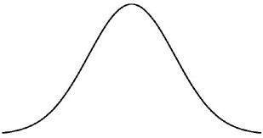





Distribution Function vs. Linear Function
$$f\left(x\right)=ax+b$$
Distribution function
Random variable: x
Parameter: a, b
Linear function
Variable: x
Constant: a, b
Binomial dist. function: $X\sim B\left(p\right)=f(x;p)$
Gaussian dist. function: $X\sim N\left(μ,σ^{2}\right)=f(x;μ$,$σ^{2}$)
$μ$↓ $σ^{2}$↑
$μ$ ↑ $σ^{2}$ ↓

Slide 4
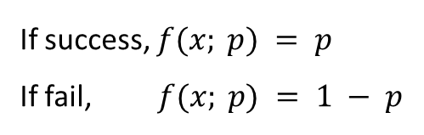





Bernoulli Distribution
Random variable: X = {0,1}
Parameter: 0 < p < 1
Sample space (support): x $∈$ {0,1}
$$(when p is 0.5)$$
0.5
pmf
If success, $f(x; p) = p$
If fail, $f(x; p) = 1 − p$
0
1
$$f(x; p) = p^{x}{(1−p)}^{1−x}$$
cdf
$$\left\{\begin{matrix}0 for x<0 \\ 1−p for 0≤x≤1 \\ 1 for x ≥1 \end{matrix}\right.$$
F$\left(x;p\right)=P\left(X≤x\right)=$
1
0
0
1

Slide 5

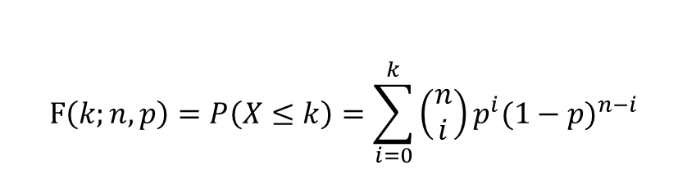

Binomial Distribution
Random variable: X = # of successes in n trials
Parameter
n: # of trials
p: success probability in each trial
Sample space: x $∈$ {0,…,n}
pmf
$$f\left(x;n, p\right)=P\left(X=x\right)=\left(\begin{matrix}n \\ x\end{matrix}\right)p^{x}{(1−p)}^{n−x}$$
$$F\left(k;n,p\right)=P\left(X≤k\right)=\sum_{i=0}^{k}{\left(\begin{matrix}n \\ i\end{matrix}\right)p^{i}{(1−p)}^{n−i}}$$
cdf
$$X_{1},X_{2},…,X_{n}\sim Ber\left(θ\right) ⇔ Y\sim Bin\left(n,θ\right)$$
Notes:
cdf에서 수식 헷갈릴거 같아 x대신 k 씀. 의미는 그대로임

Slide 6
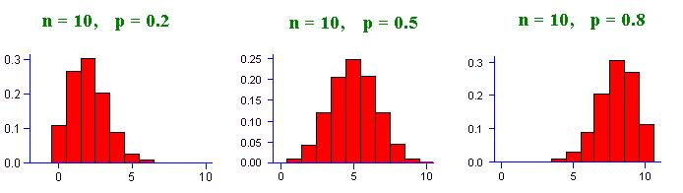
Binomial Distribution: the parameter
Distribution’s shape is changed by the p
p < 0.5 skewed left
p = 0.5 symmetric
p > 0.5 skewed right
p 마다 pdf 형태 달라진다 → p 도 분포 가질 수 있다!
Notes:
http://www.marin.edu/~npsomas/Normal_Binomial.htm

Slide 7



Beta Distribution: distribution of probability
Beta dist. provide a family of conjugate prior probability distributions in Bayesian inference
The domain of the beta dist. can be viewed as a probability, and in fact beta dist. is often used to describe the distribution of a probability value p
$$X\sim Bin\left(n,p\right) \text{P} \sim Beta(α,β)$$
$$X\sim Bin\left(n,θ\right) \text{Θ} \sim Beta(α,β)$$
$$f\left(x; n,θ\right) f(θ; α,β)$$

Slide 8
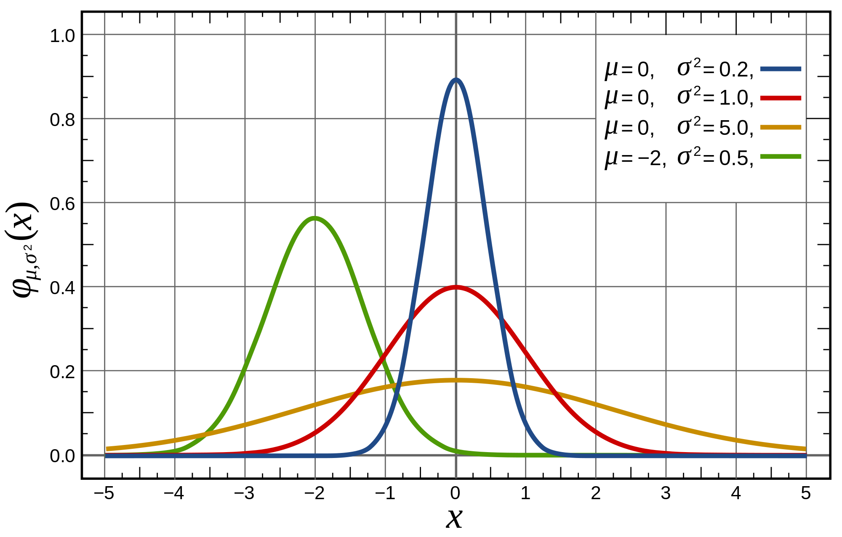
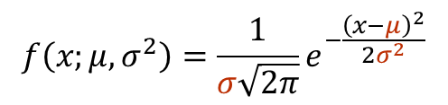
Parameters of Gaussian Distribution
$$f\left(x;μ,σ^{2}\right)=\frac{1}{σ\sqrt{2π}}e^{−\frac{{\left(x−μ\right)}^{2}}{2σ^{2}}}$$
Notes:
http://ajourneyintodatascience.com/normal-distribution/

Slide 9
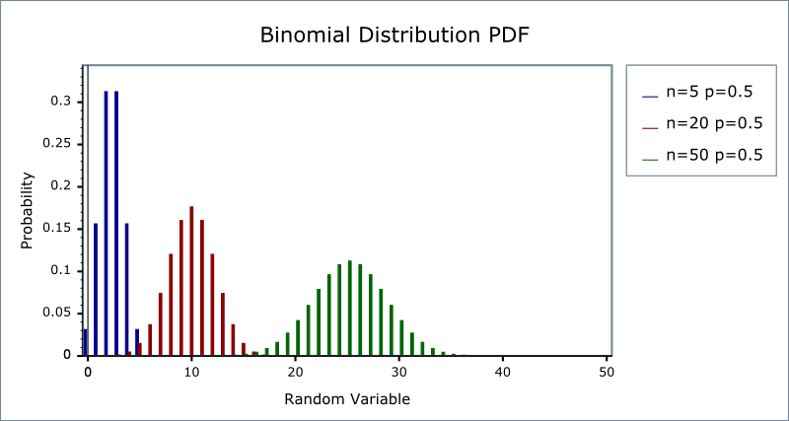
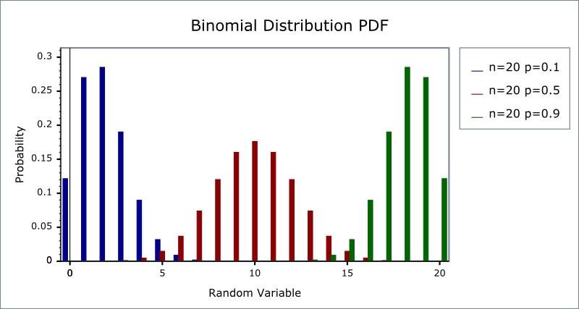

Parameters of Binomial Distribution
$$f\left(x;n, p\right)=\left(\begin{matrix}n \\ x\end{matrix}\right)p^{x}{(1−p)}^{n−x}$$
Notes:
http://www.boost.org/doc/libs/1_41_0/libs/math/doc/sf_and_dist/html/math_toolkit/dist/dist_ref/dists/binomial_dist.html

Slide 10
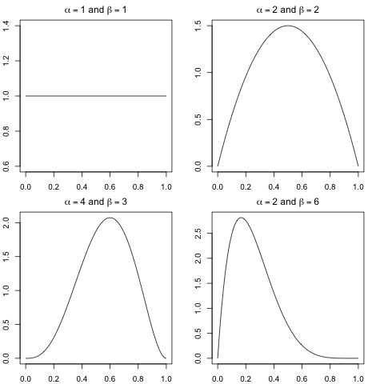

Parameters of Beta Distribution
$$\text{Θ} \sim Beta(α,β)$$
Notes:
http://www.mailund.dk/index.php/2009/08/09/

Slide 11


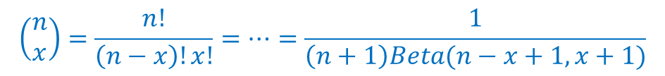

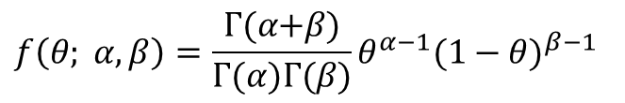
Beta Distribution: Gamma Function and Beta Function
Gamma function
Extension of the factorial function
$\text{Γ}\text{(}n\text{)}\text{ = (}\text{n}\text{−1)!}$
Beta function
Binomial coefficient after adjusting indices
$Beta\left(a, b\right)=\frac{\text{Γ}\text{(}\text{a}\text{)}\text{Γ}\text{(}\text{b}\text{)}}{\text{Γ}\text{(}\text{a}+\text{b}\text{)} }$
$$f\left(θ; α,β\right)=\frac{\text{Γ}\text{(}α\text{+}β\text{)}}{\text{Γ}\text{(}α\text{)}\text{Γ}\text{(}β\text{)}}θ^{α−1}{(1−θ)}^{β−1}$$
$$\text{Θ} \sim Beta(α,β)$$
$$\left(\begin{matrix}n \\ x\end{matrix}\right)p^{x}{(1−p)}^{n−x}$$
$$\left(\begin{matrix}n \\ x\end{matrix}\right)=\frac{n!}{\left(n−x\right)!x!}=…=\frac{1}{\left(n+1\right)Beta(n−x+1,x+1)}$$

Slide 12
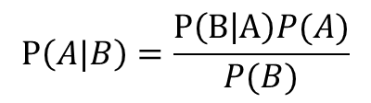

Bayesian inference
Posterior probability
Consequence of two antecedents
Prior probability
Likelihood function
$$P\left(A|B\right)=\frac{P\left(B | A\right)P(A)}{P(B)}$$
posterior
likelihood x prior
$$p\left(θ|x\right) ∝ p\left(x | θ\right)×p(θ)$$

Slide 13



Bayesian inference: Intuition
What we want to know
What we should know
Background knowledge
$$p\left(θ|x\right)$$
posterior
$$p\left(θ|x\right) = p\left(x | θ\right) p(θ)$$
likelihood x prior
$$p\left(θ|x\right) = p\left(x | θ\right) p(θ)$$
Maximum Likelihood
Assumption

Slide 14


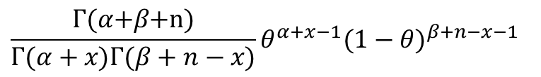
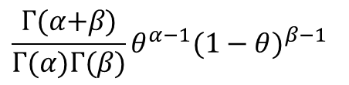
Conjugate prior for a binomial likelihood
Conjugate prior
Posterior distributions are in the same family as the prior probability distribution
Beta distribution
Conjugate prior for the binomial dist. for binomial likelihood
$$p\left(θ|x\right) ∝ p\left(x | θ\right)p(θ)$$
likelihood (Binomial Dist.)
prior (Beta Dist.)
$$\left(\begin{matrix}n \\ x\end{matrix}\right)θ^{x}{(1−θ)}^{n−x}$$
$$\frac{\text{Γ}\text{(}α\text{+}β\text{)}}{\text{Γ}\text{(}α\text{)}\text{Γ}\text{(}β\text{)}}θ^{α−1}{(1−θ)}^{β−1}$$
$$\frac{\text{Γ}\text{(}α\text{+}β\text{+}\text{n}\text{)}}{\text{Γ}\text{(}α+x\text{)}\text{Γ}\text{(}β+n−x\text{)}}θ^{α+x−1}{(1−θ)}^{β+n−x−1}$$
Posterior (Beta Dist.)

Slide 15


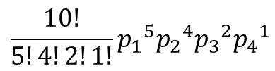


Binomial Distribution vs. Multinomial Distribution
Multinomial dist. is a generalization of the binomial dist.
Binomial distribution
$$f\left(x;n, p\right)=\left(\begin{matrix}n \\ x\end{matrix}\right)p^{x}{(1−p)}^{n−x}$$
T F T T F F F T F T
$$\left(\begin{matrix}10 \\ 5\end{matrix}\right)p^{5}{(1−p)}^{10−5}$$
Multinomial distribution
$f\left(x_{1},{…,x}_{k};n,p_{1},{…,p}_{k}\right)=\frac{n!}{x_{1}!{…x}_{k}!}{p_{1}}^{x_{1}}$…${p_{k}}^{x_{k}}$
$$⇧ ⇩ ⇧ ⇧ ⇩ ⇦ ⇧ ⇩ ⇨ ⇧ ⇦ ⇩$$
$$\frac{10!}{5!4!2!1!}{p_{1}}^{5}{p_{2}}^{4}{p_{3}}^{2}{p_{4}}^{1}$$

Slide 16




Beta Distribution vs. Dirichlet Distribution
Dirichlet dist. is a multivariate generalization of the Beta dist.
Very often used as prior distributions in Bayesian Statistics
Conjugate prior of the Multinomial dist.
$$X\sim Bin\left(n,θ\right)$$
$$\text{Θ} \sim Beta(α,β)$$
$$X_{1},…,X_{k}\sim Multi\left(n,θ_{1},…,θ_{k}\right)$$
$${\text{Θ}}_{1} ,…,{\text{Θ}}_{k}\sim Dir\left(α_{1},…,α_{k}\right)$$

Slide 17
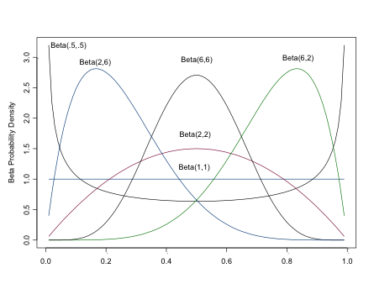
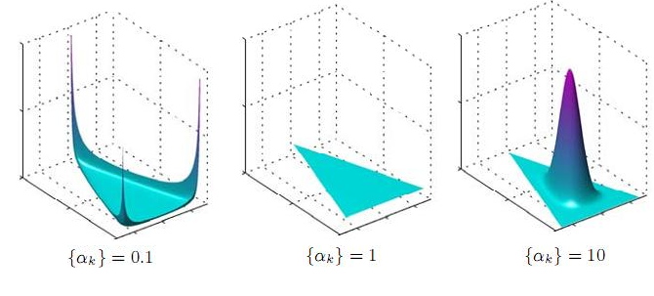
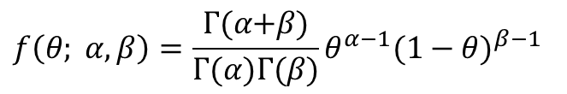

Beta Distribution vs. Dirichlet Distribution Cont.
$$f\left(θ; α,β\right)=\frac{\text{Γ}\text{(}α\text{+}β\text{)}}{\text{Γ}\text{(}α\text{)}\text{Γ}\text{(}β\text{)}}θ^{α−1}{(1−θ)}^{β−1}$$
Beta distribution
Dirichlet distribution
$f\left(θ_{1},{…,θ}_{k};α_{1},{…,α}_{k}\right)=\frac{\text{Γ}\text{(}α_{1}\text{+}…+α_{k}\text{)}}{\text{Γ}\text{(}α_{1}\text{)}\text{...}\text{Γ}\text{(}α_{k}\text{)}}{θ_{1}}^{α_{1}}$…${θ_{k}}^{α_{k}}$
Beta
Dirichlet
Notes:
http://www.columbia.edu/~cjd11/charles_dimaggio/DIRE/styled-4/styled-11/code-4/
http://www.52nlp.cn/lda-math-%E8%AE%A4%E8%AF%86betadirichlet%E5%88%86%E5%B8%833/dirichlet-distribution

