Slide 1
Information Retrieval in Trust-Enhanced Document Networks
Klaus Stein and Claudia Hess
Laboratory for Semantic Information Technology Bamberg University
European Web Mining Forum(EMWF) 2005, and Knowledge Discovery and Ontologies(KDO) 2005
Aug 8, 2012
Hee-gook Jun

Slide 2
Outline
Introduction
Document Reference Network based Ranking
A second Source of Information: The Author Trust Network
Trust-based Visibility: A Two-Layer Approach
Conclusion

Slide 3
Web Mining Categories
Web mining is used to discover the content of the Web*
Web Mining
Web Content Mining
Web Structure Mining
Web Usage Mining

Slide 4
Web Content Mining vs. Web Structure Mining
Web Content Mining
Discovery of useful information from web content
Analyze web content directly
Web Structure Mining
Discovers relationships between web pages by analyzing web structures
Analyze references(links) between documents
Compute the visibility(rank score) based on link analysis

Slide 5
Search Engine
Information gathering
Collect data as much as possible
Information selection
Select subset of pages with query
Information ranking
Give ranked pages to user

Slide 6
Basic Idea
Important web page
Cited by many other important pages
Visibility(PageRank Score)
Depends on the number of references
Visibility of the referencing documents
But it ignores the semantics of the reference!

Slide 7

Counter Example: A Scientific Paper
Cite another one because the author finds it useful
But also if the author disagrees
wants to give an opposite point of view
agree
disagree

Slide 8
Our approach
Current problem
Search engine can’t understand the semantics of a reference
Author trust network
Reincorporate link semantics by using a second resource
Personalization of rankings based on user’s trust

Slide 9
Outline
Introduction
Document Reference Network based Ranking
A second Source of Information: The Author Trust Network
Trust-based Visibility: A Two-Layer Approach
Conclusion

Slide 10
Citation influence (Pinski and Narin, 1976)
Compute the importance of a scientific journal
By using the weighted sum of the ranks of the journals
vis₄₃ = vf₄₂(p₁₁, p₂₃, p₂₇)
p₃₃
p₄₅
p₂₇
p₁₁
p₄₂
p₇₆
p₂₃
p₅₈
p₃₀

Slide 11
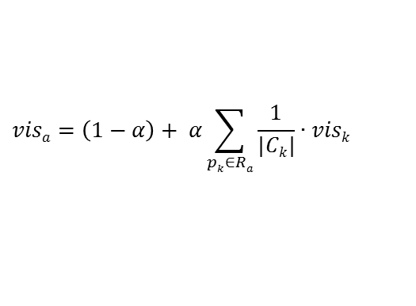
PageRank (S. Brin and L. Page, 1998)
Slightly modified version of citation influence algorithm
It works best for networks with cyclic reference structures
$$visa=\left(1−α\right)+ α\sum_{pk∈Ra}{\frac{1}{|Ck|}∙visk}$$
P_{k}
P_{a}

Slide 12
Outline
Introduction
Document Reference Network based Ranking
A second Source of Information: The Author Trust Network
Trust-based Visibility: A Two-Layer Approach
Conclusion

Slide 13
The Author Trust Network
A trusts B
C distrusts D
A
C
E
B
D
p₃₃
p₄₅
p₂₇
p₁₁
p₄₂
p₇₆
p₂₃
p₅₈
p₃₀

Slide 14
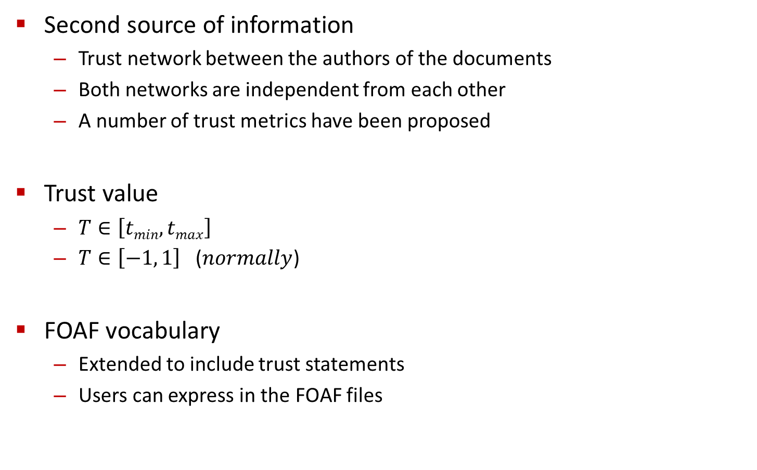
The Author Trust Network
Second source of information
Trust network between the authors of the documents
Both networks are independent from each other
A number of trust metrics have been proposed
Trust value
$T∈\left[tmin, tmax\right]$
$T∈\left[−1, 1\right]$ ($normally$)
FOAF vocabulary
Extended to include trust statements
Users can express in the FOAF files

Slide 15
Outline
Introduction
Document Reference Network based Ranking
A second Source of Information: The Author Trust Network
Trust-based Visibility: A Two-Layer Approach
Conclusion

Slide 16

Weighted PageRank
Trust-aware visibility function
PageRank + trust weight
Trust value scope [-1, 1] → mapping to [0, 1]
0.3
0.7
20
0.5
P_{a}
$$visa=\left(1−α\right)+ α(\frac{1.2}{1.8}∙10 + \frac{0.5}{1.5}∙20)$$
1.2
10
P_{k}
0.6

Slide 17
Controversial References
Assumption
Controversially referenced papers are the most interesting papers
In contrast to the weighted PageRank
T_{min} = -1, T_{max} = 1 → squared value
P_{a}
P_{a}

Slide 18
Conclusion
Author trust network
Reincorporate link semantics by using a second resource
Personalization of rankings based on user’s trust
Utilize negative trust value
Controversial references

Slide 19
Discussion
Strong points
Reincorporate link semantics by using author trust network
Weak points
Additional management overhead
New link attribute “nofollow”

Slide 20
Thank you

