Slide 1
Computing Semantic Similarity Using Ontologies
Rajesh Thiagarajan, Geetha Manjunath, and Markus Stumptner
HP Laboratories
ISWC 2008
December 28, 2011
Sengyu Rim
SNU IDB Lab.

Slide 2
Outline
Introduction
Background
Solution
Evaluation and Results
Conclusion
Discussion

Slide 3

Introduction
Similarity: relatedness of two entities
recommendation
search
targeted ads
usages

Slide 4
Introduction
Bag-of-words(BOW) format is used in IR to represent the entities
Set of weighted terms
Cosine similarity measure has been widely applied to similarity measurement using BOW
Motivation
Cosine similarity measure using BOW only depends on direct overlapping
Polysemy(apple, jaguar)
Synonymy(glad, happy)

Slide 5

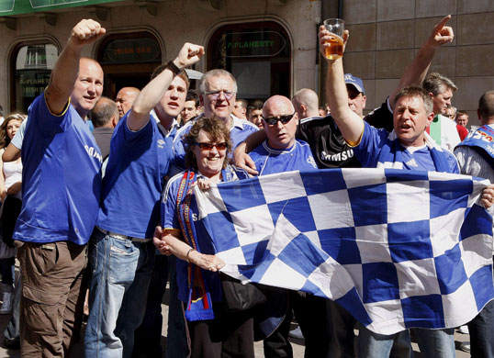
Introduction
Motivation
VS
（Manchester United ∩ Chelsea）=∅
ONTOLOGY!
BUT
We are all premier league fans!

Slide 6
Introduction
We extended the notion of semantic similarity considering the relationships
Spreading is the process of including additional related terms by referring to an ontology such as Wordnet and Wikipedia

Slide 7
Outline
Introduction
Background
Solution
Evaluation and Results
Conclusion
Discussion

Slide 8

Background
Bag-of –words(BOW)
An entity is represented by a set of pairs <t_{i} , w_{i}>
t_{i} is a term that describes the entity, w_{i} is the weight of the term
Cosine similarity measure
is the vector representation of an entity e_{j}
Euclidean length
of an entity e_{j} is

Slide 9
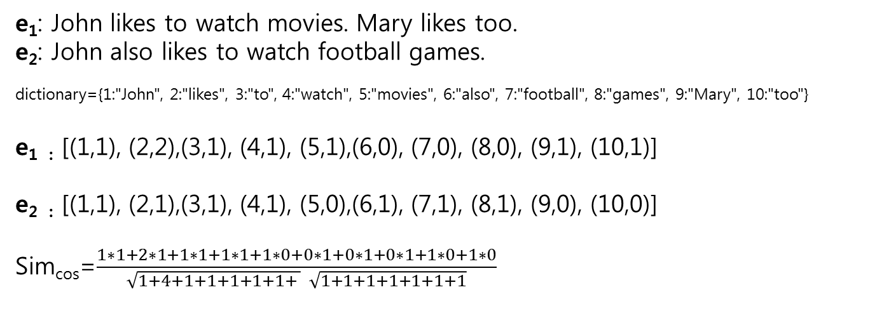
Background
Example of BOW
e₁: John likes to watch movies. Mary likes too.
e₂: John also likes to watch football games.
dictionary={1:"John", 2:"likes", 3:"to", 4:"watch", 5:"movies", 6:"also", 7:"football", 8:"games", 9:"Mary", 10:"too"}
e_{1 :} [(1,1), (2,2),(3,1), (4,1), (5,1),(6,0), (7,0), (8,0), (9,1), (10,1)]
e_{2 :} [(1,1), (2,1),(3,1), (4,1), (5,0),(6,1), (7,1), (8,1), (9,0), (10,0)]
Sim_{cos}=$\frac{1∗1+2∗1+1∗1+1∗1+1∗0+0∗1+0∗1+0∗1+1∗0+1∗0}{\sqrt{1+4+1+1+1+1+1+ } \sqrt{1+1+1+1+1+1+1}}$

Slide 10
Outline
Introduction
Background
Solution
Evaluation and Results
Conclusion
Discussion

Slide 11
Solution
Spreading: the process of including the terms that are related to the original terms in an entity’s description(ED) by referring to an ontology
Example: compute the similarity of the following EDs
e₁ = {<google, 1.0>} e₂= {<yahoo, 2.0>}
e’₁ = {<google, 1.0>, <internet search engines, 0.5>}
e’₂= {<yahoo, 2.0>, <internet search engines, 1.0>}
Spreading by referring to
Wiki parent category relationship

Slide 12
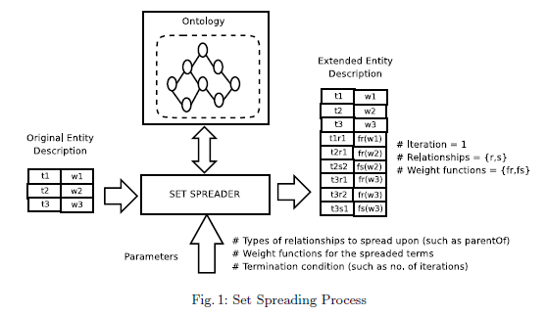
Solution
Set spreading: the process of extending an ED such that the related terms which are determined with respect to an ontology

Slide 13
Solution
Similarity computation using set spreading
Apply the cosine similarity technique to compute similarity between the extended BOWs
Main steps
Compute similarity between original two Eds
Spread the two EDs if none of the termination conditions are not met else go to Step 5
Compute cosine similarity between the two extended Eds
Go to STEP 2
Compute the mean of the similarity values computed in all the iterations
Return the mean similarity value

Slide 14
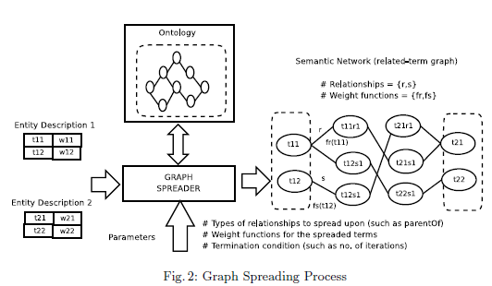
Solution
Graph spreading: the process where terms from two Eds and the related terms build into a graph representation(semantic network)

Slide 15
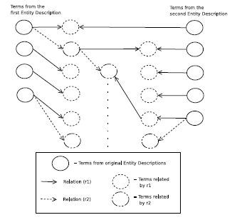
Solution
Similarity computation using graph spreading
Semantic network can be transformed into bipartite graph by omitting the intermediate related nodes

Slide 16
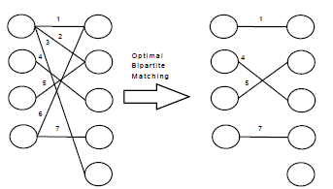
Solution
Similarity computation using graph spreading
Optimize the bipartite graph by using Hungarian Algorithm
G’=<V,E’> ，E’⊆ E such that is optimal

Slide 17


Solution
Similarity computation using graph spreading
Weight normalization
W¹²=w_{i}¹∪w_{j}²
W^{12’}=w_{i}^{1’}∪w_{j}^{2’} ={ w11’,…, w_{i}^{1’} , w_{i}^{2’}, …, w_{j}^{2’} }
w_{l}^{k}’ = $\frac{wlk}{max⁡(W{12}^{})}$
Aggregate path distance
Euler path distance

Slide 18
Solution
Similarity computation using graph spreading
Similarity measures: Given two entities ed1 and ed2 the similarity using aggregate path distance is

Slide 19
Outline
Introduction
Background
Solution
Evaluation and Results
Conclusion
Discussion

Slide 20
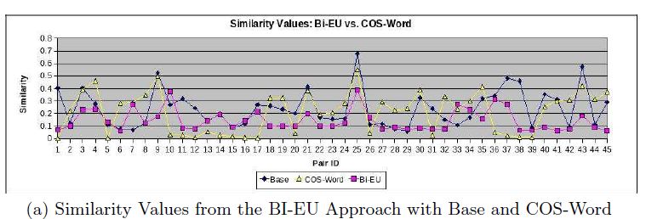
Evaluation and Results
We use user profile matching scenario as a platform to evaluate the similarity
Base: the similarity measure derived from the user judgements
COS-Word: cosine similarity measure between words in word profiles
Bi-EU: similarity measure after graph spreading

Slide 21
Evaluation and Results
Results
BI-EU approach outperforms in comparison to other 2 approaches
The reason for the poor performance of COS-Word is the absence of common words

Slide 22
Outline
Introduction
Background
Solution
Evaluation and Results
Conclusion
Discussion

Slide 23
Conclusion
We presented a number of computation measures that utilizes spreading
Improvements in accuracy
Future work
Take the hierarchical information into account
Automatically determine the ontology to be used for spreading

Slide 24
Outline
Introduction
Background
Solution
Evaluation and Results
Conclusion
Discussion

Slide 25
Discussion
Strong point
Improvements in accuracy of semantic similarity measure
The utilization of ontology
Weak point
Not a very novel idea from current point
May be because it was published more than 3 years ago

Slide 26
Thank you!!!

