Slide 1
Practical RDF Chapter 6. Creating an RDF Vocabulary
Shelley Powers, O’Reilly
SNU IDB Lab.
Somin Kim

Slide 2
Outline
Introduction
Defining the vocabulary : Business and Scope
Defining the vocabulary : Element
Formalizing the vocabulary with RDFS
Integrating the Dublin Core

Slide 3
Introduction
How RDF Vocabularies Differ from XML
RDF
A way of recording information about resources
Serialized using XML
Specific business domain
Directly within XML
Define the concept of “class” and “property”
Ex) “Source is a property of Term”
The source element is processed as a property of Term

Slide 4
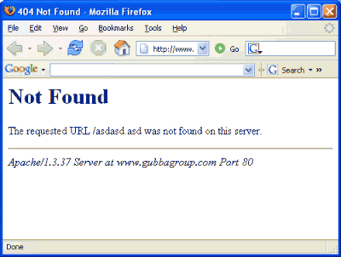
Defining the Vocabulary : Business and Scope(1/2)
Problem with maturing web site
404 page not found
Page missing
Content’s been deleted or moved
The linking site made a mistake with
the link
Aging content that isn’t deleted
Users could be halfway through reading it only to realize that it talks about something that has been obsolete for years

Slide 5
Defining the Vocabulary : Business and Scope(2/2)
Content management systems help with creating, posting, and managing the original contents, but don’t help provide information about the context or the resource
Such as FrontPage, Vignette, and others
Meta tags can be attached
Copyright information, keywords, authorship
Expectancy of the resource of its move history
Reasons for move
Provide information
Useful for humans
Usable by automated process

Slide 6
Defining the Vocabulary : Elements (1/8) The PostCon Domain Elements
RDF-capable
Describe the major entities and properties
Describe how these entities are related to one another
PostCon
What is the content’s bio
What is the content’s relevancy
What is the content’s history of movement
What are the content’s related resources
If the resource no longer exists, are there replacement
What are the presentation characteristics of the content

Slide 7
Defining the Vocabulary : Elements (2/8) Postcon System domain
PostCon system domain elements and their properties
Element | Property | Description
Content | Unique Content ID | To identify content
 | Biography | Content biographical information
 | Relevancy | Relevancy of content
 | History | History of content movement
 | Presentation | Content type and presentation
 | Related | Related content

Slide 8
Defining the Vocabulary : Elements (3/8) Prototyping the Vocabulary
When creating a new vocabulary
Define the URI for the vocabulary
Ex) http://burningbird.net/postcon/elements/1.0
Determining what the URI of the web resource is
Ex) http://burningbird.net/articles/monster1.htm
<?xml version=“1.0”?>
<rdf:RDF
xml:rdf=http://www.w3.org/1999/02/22-rdf-syntax-ns#
xml:pstcn=http:///burningburd.net/postcon/elements/1.0/
xml:base=http://burningbird.net/articles/>
<rdf:Description rdf:about=“monster1.htm”>
<pstcn:bio />
<pstn:relevancy />
<pstcn:presentaion />
<pstcn:history />
<pstcn:related />
</rdf:Description>
</rdf:RDF>
First cut of PostCon vocabulary

Slide 9
Defining the Vocabulary : Elements (4/8) The Graph of our PostCon Example
http://www.burningbird.net/postcon/elements/1.0/resource
http://www.w3c.org/1999/02/22-rdf-syntax-ns#type
http://burningbird.net/postcon/elements/1.0/bio
http://burningbird.net/articles/monster1.htm
http://burningbird.net/postcon/elements/1.0/relevancy
http://burningbird.net/postcon/elements/ 1.0/presentation
http://burningbird.net/postcon/elements/1.0/history
http://burningbird.net/postcon/elements/1.0/related

Slide 10
Defining the Vocabulary : Elements (5/8) Adding Repeating Values
Web resource can move many times
More than one recommended resource
Use the same predicate in multiple statement
Ex) <pstcn : related rdf:resource=“monster2.htm” />
<pstcn : related rdf:resource=“monster3.htm” />
<pstcn : related rdf:resource=“monster4.htm” />
Three related resource for entity being defined
No order to resources

Slide 11
Defining the Vocabulary : Elements (6/8) Adding a Container
Container
A group of related items : infinite number of items
Seq, Bag or Alt
Web site movement are related to one another
By date and time
Infinite numbers of movements are possible
The best fit is Seq
Ex)
<pstcn : history>
<rdf:Seq>
<rdf:_1 rdf:resource=“http://www.yasd.com/dynaearth/monster1.htm” />
<rdf:_2 rdf:resource=http://www.dynamicearth.com/articles/monster1.htm />
<rdf:_3 rdf:resource=http://burningbird.net/articles/monster1.htm />
<rdf:Seq>
</pstcn:history>

Slide 12
Defining the Vocabulary : Elements (7/8) The Graph of model defined
http://www.burningbird.net/postcon/elements/1.0/resource
http://www.w3c.org/1999/02/22-rdf-syntax-ns#type
http://www.w3.org/1999/02/22-rdf-syntax-ns#type
http://burningbird.net/postcon/elements/1.0/bio
Genid:6405
http://burningbird.net/postcon/elements/ 1.0/relevancy
http://burningbird.net/articles/monster1.htm
http://burningbird.net/postcon/elements/ 1.0/presentation
http://burningbird.net/postcon/elements/1.0/history
http://burningbird.net/postcon/elements/1.0/related

Slide 13
Defining the Vocabulary : Elements (8/8) Adding in a Value
How the value is treated
Rdf:value work for pstcn:requires
References the actual value of the predicate
Ex)
<pstcn:presentation rdf:parseType=“Resource”>
<pstcn:requires rdf:parseType=“Resource”>
<pstcn:type>stylesheet</pstcn:type>
<rdf:value>http://burningbird.net/de.css<rdf:value>
</pstcn:requires>
<pstcn:requires rdf:parseType=“Resource”>
<pstcn:type>logo</pstcn:type>
<rdf:value>http://burningbird.net/mm/dynamicearth.jpg<rdf:value>
</pstcn:requires>
</pstcn:presentation>

Slide 14
Formalizing the Vocabulary with RDFS(1/3)
RDFS
Define which vocabulary elements are classes and properties
Define the range for each property
Class
Equivalent to a relational data model entity
Any item
Rdf:Description block with an associated rdf:type
Ex) Movement, Resource

Slide 15
Formalizing the Vocabulary with RDFS(2/3)
Defining the vocabulary classes (Ex. Resource)
Subclass of the RDF Resource type
Human-readable label is Web Resource
Comments provide a brief description
<rdfs:Class rdf:about=“http://burningbird.net/postcon/elements/1.0/Resource”>
<rdfs:isDefinedBy rdf:resource=“http://burningbird.net/postcon/elements/1.0/”>
<rdfs:subClass rdf:resource=“http://www.w3.org/2000/01/rdf-schema#Resource/”>
<rdfs:label xml:lang=“en”> Web Resource </rdfs:label>
<rdfs:comment xml:lang=“en”>
Web resource managed with PostCon System
</rdfs:comment>
</rdfs:class>

Slide 16
Formalizing the Vocabulary with RDFS(3/3)
Defining the Properties (Ex. Type)
Type element has a range that determines the type of value
Literal : element contains literal values
<rdfs:Property rdf:about=“http://burningbird.net/postcon/elements/1.0/type”>
<rdfs:isDefinedBy rdf:resource=“http://burningbird.net/postcon/elements/1.0/”>
<rdfs:label xml:lang=“en”>Resource Type</rdfs:label>
<rdfs:comment >Type of Required Resource </rdfs:comment>
<rdfs:range rdf:resource=“http://www.w3.org/2000/01/rdf-schema#Literal/”>
</rdfs:Property>

Slide 17
Intergrating the Dublin Core (1/4)
Dublin Core
Open forum engaged in metadata standards
purpose
Metadata model : be used intelligently
More efficient and intelligent resource search
MetaData Element set
Ex) title : a name given to the resource
creator : an entity responsible for making the content of the resource
subject : the topic of the content of the resource

Slide 18
Integrating the Dublin Core (2/4) Dublin Core in RDF/XML
Namespace for elements
http://purl.org/dc/elements/1.1/
Ex)
<rdfs:Property rdf:about=“http://purl.org/dc/elements/1.1/title”>
<rdfs:label xml:lang=“en-US”> Title </rdfs:label>
<rdfs:comment xml:lang=“en-US”> A name given to the resource. </rdfs:comment>
<dc:description xml:lang=“en-US”> Typically, a title will be a name by which the resource
is formally known. </dc:description>
<rdfs:isDefinedBy rdf:resource=“http://purl.org/dc/elements/1.1/”>
<dcterms:issued> 1999-07-02 </dcterms:issued>
</rdfs:Property>

Slide 19
Integrating the Dublin Core (3/4) Mixing Vocabularies
Replace the PostCon attributes with DC elements
Pstcn : title
dc: title
Pstcn : author
dc: creator
Pstcn : owner
dc: publisher

Slide 20
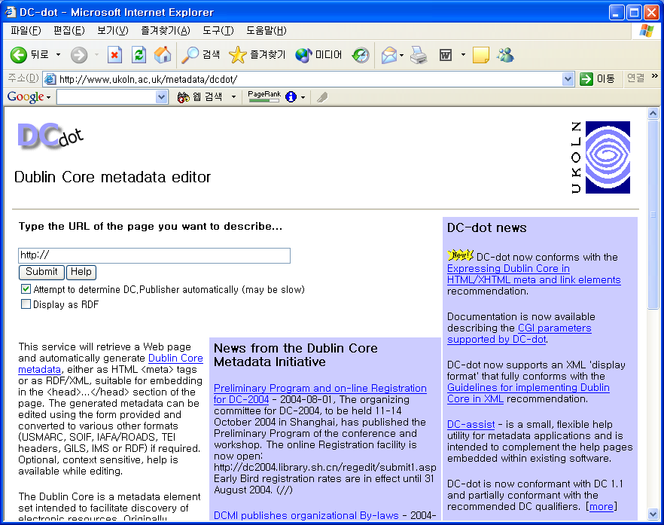
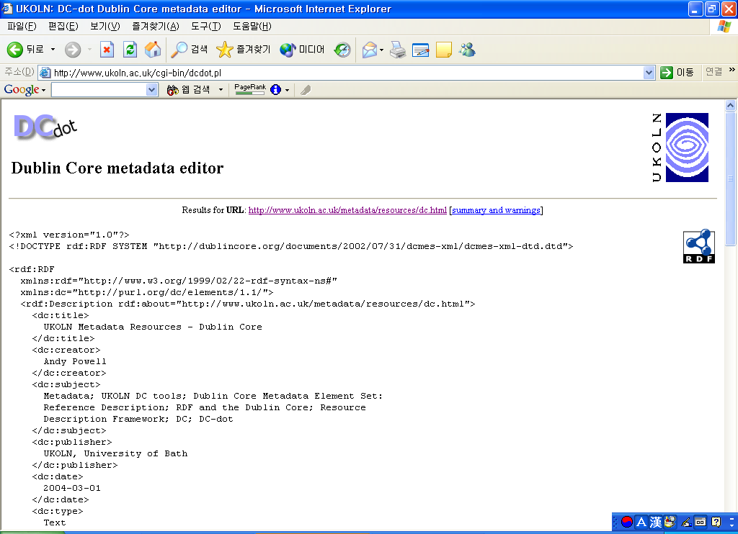
Integrating the Dublin Core (4/4) Using DC-dot to Generate DC RDF

