Slide 1
Modeling Relationship Strength in Online Social Networks
Rongjing Xiang, Jennifer Neville, Monica Rogati
WWW 2010
18 May 2012
Presented by Jee-bum Park

Slide 2
Outline
Introduction
Latent Variable Model
Experiments
Conclusion
Discussion

Slide 3


Introduction
Researchers have found that relational ties can improve behavior prediction in tasks such as fraud detection and viral marketing
Much of this past work has focused on social networks with binary relational ties
These binary indicators provide only a coarse indication of the nature of the relationship
friend or not

Slide 4
Introduction
The real-world social networks often contain both strong and weak ties
Strong ties = Close friends
Weak ties = Acquaintances
Fortunately, online social networks often consist of more than just a record of social network ties
User profile
User interaction
Close friend
Acquaintance

Slide 5
Introduction
Interaction data has been used to predict relationship strength*
This work only considered two levels of relationship strength, namely weak and strong relationships
Focused on supervised learning methods, which requires human annotation of link strength
We focus instead on developing a richer model that can represent the full spectrum of relationship strength, from weak to strong
We propose an unsupervised method to infer a continuous-valued relationship strength for links
* I. Kahanda and J. Neville. Using transactional information to predict link strength in online social networks. ICWSM, 2009.
E. Gilbert and K. Karahalios. Predicting tie strength with social media. CHI, 2009.

Slide 6
Outline
Introduction
Latent Variable Model
Experiments
Conclusion
Discussion

Slide 7
Latent Variable Model
Two key assumptions
The theory of homophily
The relationship strength directly impacts frequency of online interactions between a pair of users
The homophily principle postulates that people tend to form ties with other people who have similar characteristics
Such profile attributes include, for instance, the schools and companies, online groups that they joined, the geographic locations, etc.
The stronger the relationship, the higher likelihood that a certain type of interaction will take place between the pair of users

Slide 8
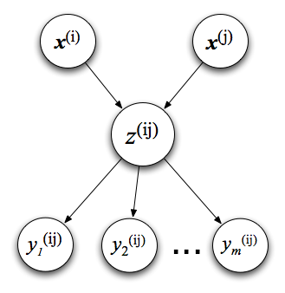
Latent Variable Model
Profile similarity
Interaction activity
Latent variable model
The profile vector of user i
The occurrences of m different interactions considered between i and j
The latent relationship strength between i and j

Slide 9
Outline
Introduction
Latent Variable Model
Experiments
Conclusion
Discussion

Slide 10
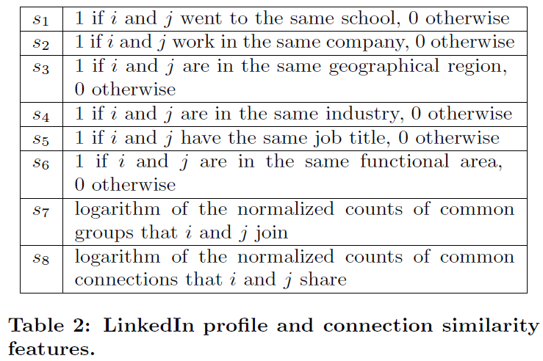
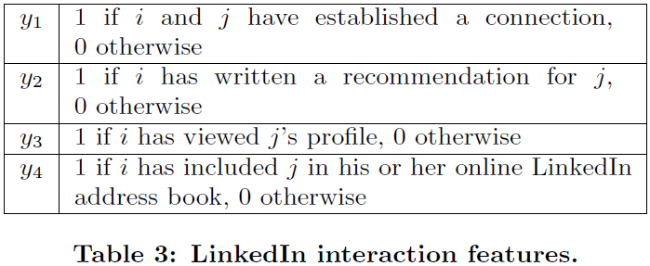
Experiments
LinkedIn data
Randomly selected 100 LinkedIn users as seed nodes
Up to two links away in the connection graph
100,000 pairs

Slide 11
Experiments
The recommendation of people related to specific users
Similarity features
Job
Functional area
Geographical region
Comparing the rankings using relationship strength to several alternative rankings
Recommendation links
Profile-view links
Address-book links
Connection links
Interaction count
Profile similarity

Slide 12
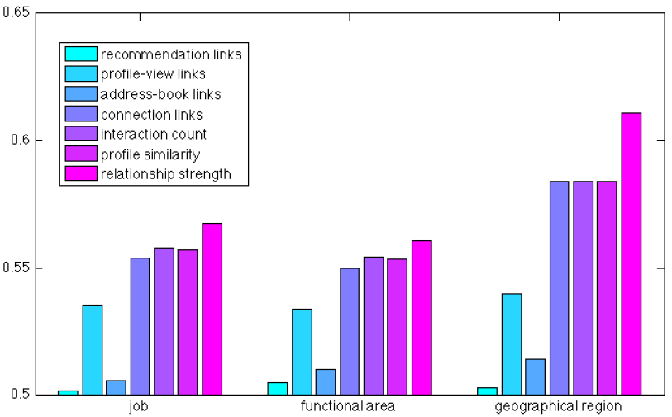
Experiments
The area under the ROC curve

Slide 13
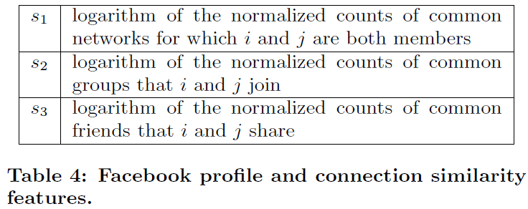
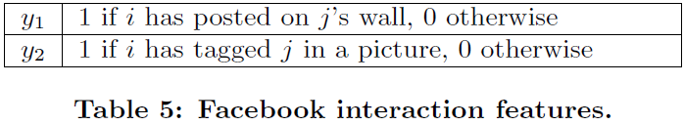
Experiments
Facebook data
Randomly selected five public Purdue Facebook users as seed nodes
Considered all nodes within three hops of the seed nodes
4500 nodes, 144,712 pairs

Slide 14
Experiments
Applying the weighted graph formed from relationship strength in a number of collective classification tasks
Gender
Relationship status
Political views
Religious views
Classification using the relationship strength graph is compared with the four observed Facebook graphs
Friendship graph
Top-friend graph
Profile-similarity graph
Interaction-count graph

Slide 15
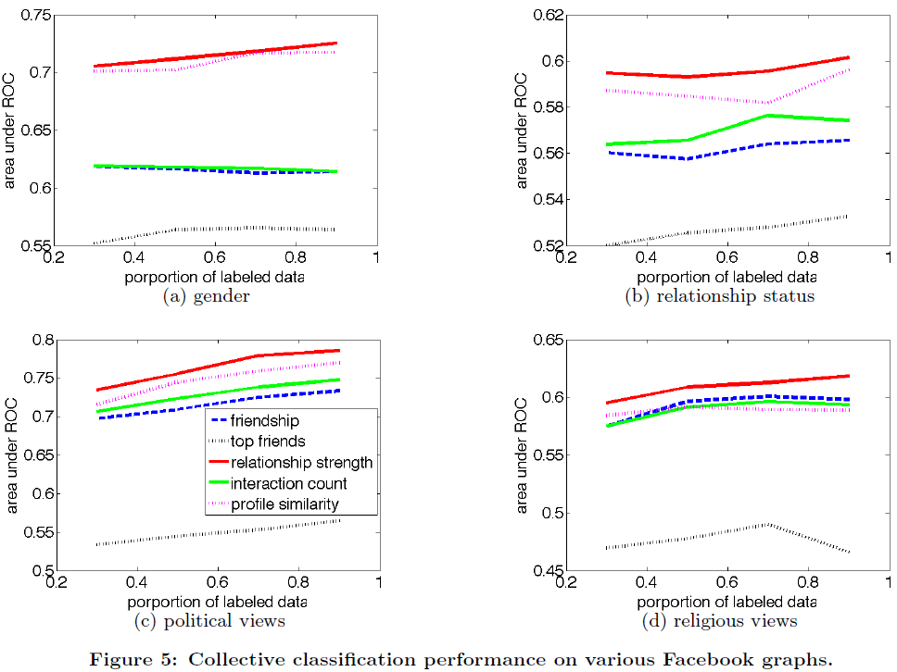
Experiments

Slide 16
Outline
Introduction
Latent Variable Model
Experiments
Conclusion
Discussion

Slide 17
Conclusion
Proposed a latent variable model for the task of relationship strength estimation in online social networks
The weighted graph formed by the estimated relationship strengths gives better classification performance than the graphs formed from various aspects of the raw data

Slide 18
Outline
Introduction
Latent Variable Model
Experiments
Conclusion
Discussion

Slide 19
Discussion
Robust and scalable model
The paper is generally well written and easy to follow
Got insights about evaluation techniques for recommendation and classification using various social graphs
Autocorrelation
AUC; the area under the ROC curve

Slide 20
Thank You!
Any Questions or Comments?

