Slide 1
Tagging Might not be Slower than Filing in Folders
K. Voit, K. Andrews, and W. Slany
Graz University of Technology, Austria
CHI Extended Abstract 2012
20 June 2012
Hyunwoo Kim

Slide 2
Outline
Introduction
Related Work
Tagstore and TagTrees
Evaluation
Conclusion
Discussion

Slide 3
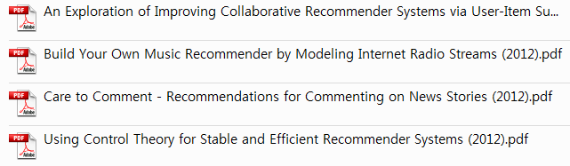
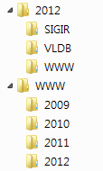

Introduction
Filing in folders
WWW 2012 papers

Slide 4
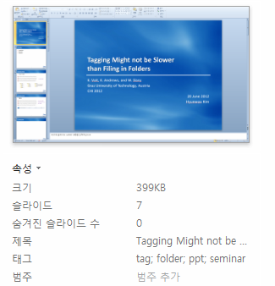
Introduction
Tagging
WWW, 2012, papers,
Recommendation, Music,
News, Radio

Slide 5
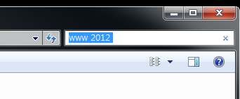
Introduction
Information access methods
Navigation (or browsing) methods
No change from the 1960s
Search (or teleporting) methods

Slide 6

Introduction
Tagstore
A new software framework
For testing issues related to tagging files and folders on the local hard disk

Slide 7
Outline
Introduction
Related Work
Tagstore and TagTrees
Evaluation
Conclusion
Discussion

Slide 8
Related Work
Tagging vs. on a desk without any computer [Pak, Cognitive Technology 2007]
Organizing by assigning tags was significantly faster
A serious drawback is that a non-standard interface (web form) was used
Hotmail vs. Google [Civan, American Society for Information Science and Technology 2008]
Web interfaces (folders) and Google Gmail (tagging)
No significant differences were found in re-finding performance
Tagging vs. folder structures [Ma, CHI 2009]
No significant differences
New Google Gmail interface [Rodden, CHI 2010]
Labels and a limited form of folders
No comparative evaluation

Slide 9
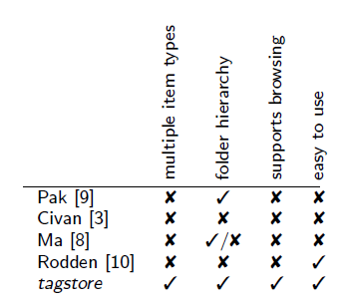
Related Work
Issues
Most studies organized only one specific item type
Not allowing a browsing/navigation process at all
Neglecting the essential aspect of hierarchy
No tag completion mechanism
Overview of systems used in related studies

Slide 10
Outline
Introduction
Related Work
Tagstore and TagTrees
Evaluation
Conclusion
Discussion

Slide 11
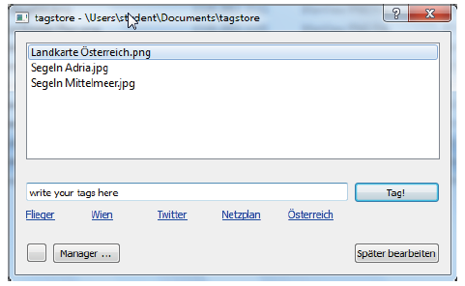


Tagstore and TagTrees
Tagstore Framework
File
Tagstore
storage
User

Slide 12
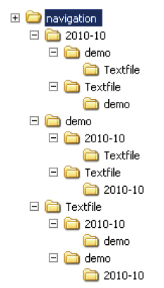

Tagstore and TagTrees
A sample tagstore TagTree
A single item tagged with the three tags 2010-10, demo, and Textfile

Slide 13
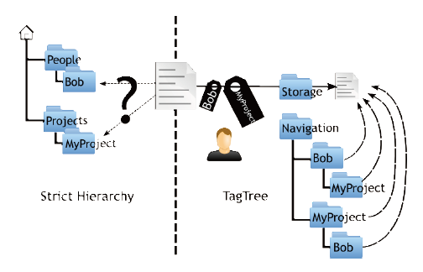
Tagstore and TagTrees
Folder hierarch and TagTree concept
Using an example file Bobs_ideas_about_MyProject.txt

Slide 14
Outline
Introduction
Related Work
Tagstore and TagTrees
Evaluation
Conclusion
Discussion

Slide 15

Evaluation
Formal experiment
Folder
Tagging
Familiarization
Break
Tagging
Folder
18 test persons
Storing
Folder
Tagging
Experiment
Interview
Tagging
Folder
Re-find

Slide 16
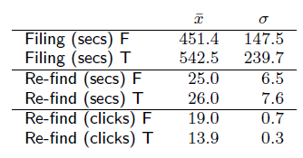
Evaluation
Feedback questionnaire results
78% of TPs preferred tagstore over hierarchy of folders
Both storing and re-finding items with tagstore was faster
Tagstore supports users better than traditional folders
Objective measures
Mean and standard deviation of the results for all TPs
folder hierarchies (F) and tagging(T)

Slide 17
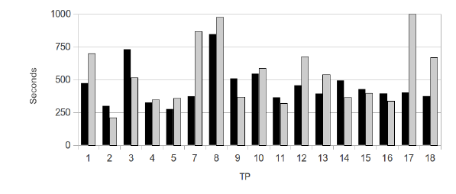
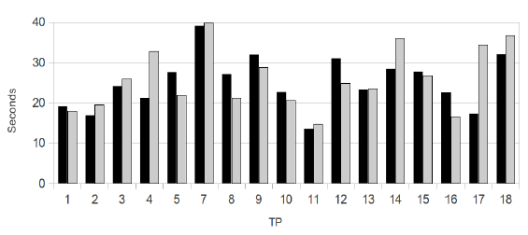
Evaluation
Objective measures
Slower TPs might dilute a clearer result
A distinct sub-group comprised of the fastest TPs
Filing performance into
folder hierarchy (black) and tagstore (grey)
Re-finding performance within
folder hierarchy (black) and tagstore (grey)

Slide 18
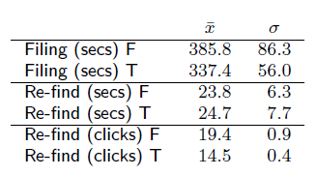
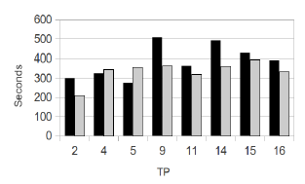
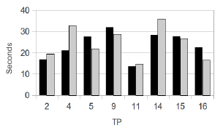
Evaluation
Fast performers
Used more file moving actions when filing into folder hierarchies
Used fewer tags within tagstore
Were distracted much less
Did not re-inspect the test items that often
Used much less file move actions to file into tagstore
Results for the fast performers
Filing and re-finding performance

Slide 19
Outline
Introduction
Related Work
Tagstore and TagTrees
Evaluation
Conclusion
Discussion

Slide 20
Conclusion
Tagstore
A new software framework
Studies of filing and re-finding in hierarchies compared to within tagging systems
A fairer experimental setup
In a future experiment
The advantages of tagstore might become even more apparent

Slide 21
Outline
Introduction
Related Work
Tagstore and TagTrees
Evaluation
Conclusion
Discussion

Slide 22
Discussion
Strong points
Comparing tagging mechanisms to organizing information in folder hierarchies
A fairer experiment
Weak points
No significant results

Slide 23
Thank You

