Slide 1
Storage and Retrieval of Large RDF Graph Using Hadoop and MapReduce
Mohammad Farhan Husain, Pankil Doshi,
Latifur Khan, Bhavani Thuraisingham
University of Texas at Dallas
CloudCom 2009
24 April 2014
SNU IDB Lab.
Inhoe Lee
Notes:
계산이론특강에서 발표하는 20개 논문 중에 한 개로
박근수 교수님이 중요하다고 한 논문이기에 준비해보았습니다.

Slide 2
Outline
Introduction
Proposed Architecture
File Organization
MapReduce Framework
The DetermineJobs Algorithm
Result
Conclusion

Slide 3
Introduction
Scalability is a major issue
Storing huge number of RDF triples and the ability to efficiently query them is a challenging problem
Hadoop is a distributed file system
High fault tolerance and reliability
Implementation of MapReduce programming model
MapReduce
Google uses it for web indexing, data storage, social networking
Notes:
Scalability: System can handle addition of large number of users, data, tasks etc. without affecting its performance significantly
provides high fault tolerance and reliability
provides an implementation of MapReduce programming model

Slide 4
Introduction
Current semantic web frameworks Jena
Do not scale well
Run on single machine
Cannot handle huge amount of triples
Only 10 million triples in a Jena in-memory model running in a machine having 2 GB of main memory
Notes:
could load only 10 million

Slide 5
Introduction
RDF Query Processing
Where does he live who teaches ADB in Spring 2014?
bkmoon
Teaches
Lives in
ADB
Seoul
SELECT ?Y WHERE{
?X <http://cse.snu.ac.kr/Spring2014>“ADB” .
?X <http://www.live.or.kr/livesIn> ?Y
}

Slide 6
Introduction
Devise a schema to store RDF data in Hadoop
Lehigh University Benchmark (LUBM) data
Devise an algorithm
Determine the number of jobs
Determine their sequence and inputs

Slide 7
Outline
Introduction
Proposed Architecture
File Organization
MapReduce Framework
The DetermineJobs Algorithm
Result
Conclusion

Slide 8
File Organization
To minimize the amount of space
Replace the common prefixes in URIs with much smaller prefix string
Separate prefix file
No caching in Hadoop
SPARQL query needs reading files from HDFS -> high latency
Organization of files
Determine the files need to search in for a SPARQL query
Fraction of entire data set -> execution much faster
Notes:
This reduces the space required by the data by a significant amount

Slide 9
File Organization
Naïve model
Do not store the data in a single file
Not suitable for MapReduce framework
A file is the smallest unit of input to a MapReduce job in Hadoop
S | P | O
YG | Type | Chair
YG | worksFor | CS
CS | subOrganizationOf | SNU
CS | Type | Dept.
SNU | Type | Univ.
EE | Type | Dept.
A | worksFor | EE
B | worksFor | MA
C | worksFor | CB
A | Type | Chair
B | Type | Professor
C | Type | Professor
. | . | .
. | . | .

Slide 10
File Organization
Predicate Split (PS)
Divide the data according to the predicates
P(worksFor)
YG | C.S.
A | C.S.
B | E.E.
C | C.B.
S | P | O
YG | Type | Chair
YG | worksFor | C.S.
CS | subOrganizationOf | SNU
CS | Type | Dept.
SNU | Type | Univ.
EE | Type | Dept.
A | worksFor | C.S.
B | worksFor | E.E.
C | worksFor | C.B.
A | Type | Professor
B | Type | Chair
C | Type | Professor
. | . | .
. | . | .
P(subOrganizationOf)
CS | SNU
P(type)
YG | Chair
C.S. | Dept.
SNU | Univ.
E.E. | Dept.
A | Professor
B | Professor
C | Professor

Slide 11
File Organization
Predicate Object Split (POS)
P(worksFor)
YG | C.S.
A | C.S.
B | E.E.
C | C.B.
Reduce the execution time
Reduce the amount of space
70.42% space gain after PS steps
PO(type.Chair.)
YG | Chair
P(subOrganizationOf)
CS | SNU
PO(type.Univ.)
SNU | Univ.
P(type)
YG | Chair
C.S. | Dept.
SNU | Univ.
E.E. | Dept.
A | Professor
B | Professor
C | Professor
PO(type.Dept.)
C.S. | Dept.
E.E. | Dept.
PO(type.Professor)
A | Professor
B | Professor
C | Professor
11

Slide 12
Outline
Introduction
Proposed Architecture
File Organization
MapReduce Framework
The DetermineJobs Algorithm
Result
Conclusion

Slide 13
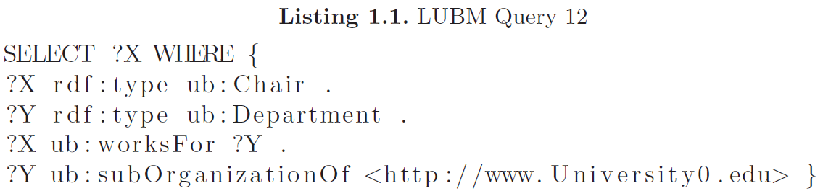
The DetermineJobs Algorithm
Naïve model
S | P | O
A | type | Chair
B | type | Chair
CS | type | Department
EE | type | Department
A | worksFor | CS
B | worksFor | EE
CS | subOrganizationOf | www.University0.edu
EE | subOrganizationOf | SNU
. | . | .
. | . | .
A
Need three join operations

Slide 14
The DetermineJobs Algorithm
Devised Algorithm 1
①
②
③
④
1
X
2
Y
4
Y
3
X,Y
Notes:
Algorithm 1 which determines the number of jobs needed
|V | is equal to the number of triple patterns in Q.
edge e if and only if their corresponding triple patterns share at least one variable
Each edge represents as many joins as the number of variables it has in its label.
Hence, total number of joins present in the graph is the total number of variables mentioned in the labels of all edges

Slide 15
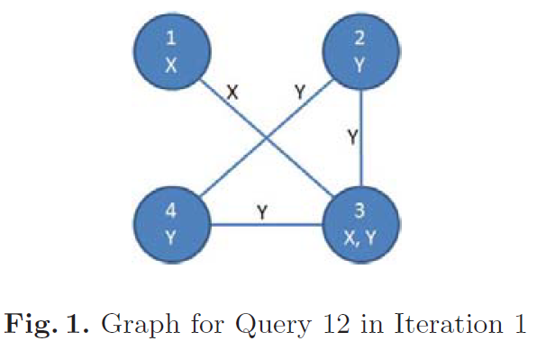
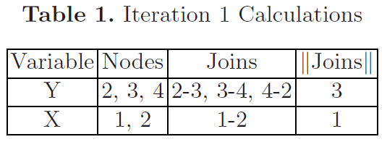
The DetermineJobs Algorithm
Devised Algorithm 1
3
3
Sort the variables in descending order according to the number of joins
Notes:
Algorithm 1 which determines the number of jobs needed
|V | is equal to the number of triple patterns in Q.
edge e if and only if their corresponding triple patterns share at least one variable
Each edge represents as many joins as the number of variables it has in its label.
Hence, total number of joins present in the graph is the total number of variables mentioned in the labels of all edges

Slide 16
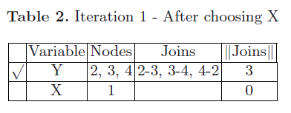
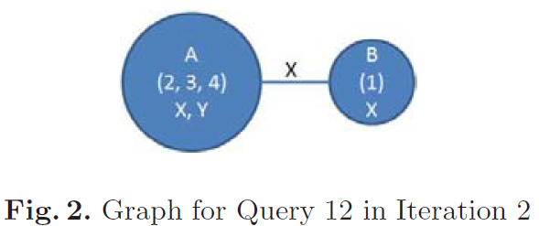
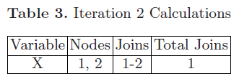
The DetermineJobs Algorithm
Nodes 2, 3 and 4 collapse and form a single node
Calculates the number of joins still left in the graph
Determine that no more job is need
Return the job collection
Notes:
total 1 join

Slide 17
The DetermineJobs Algorithm
Nodes 2, 3 and 4 collapse and form a single node
Calculates the number of joins still left in the graph
Determine that no more job is need
Return the job collection
CS | type | Department
EE | type | Department
A | worksFor | CS
B | worksFor | EE
CS | subOrganizationOf | www.University0.edu
CS
CS | type | Department
A | worksFor | CS
CS | subOrganizationOf | www.University0.edu

Slide 18
Outline
Introduction
Proposed Architecture
MapReduce Framework
The DetermineJobs Algorithm
Result
Conclusion

Slide 19
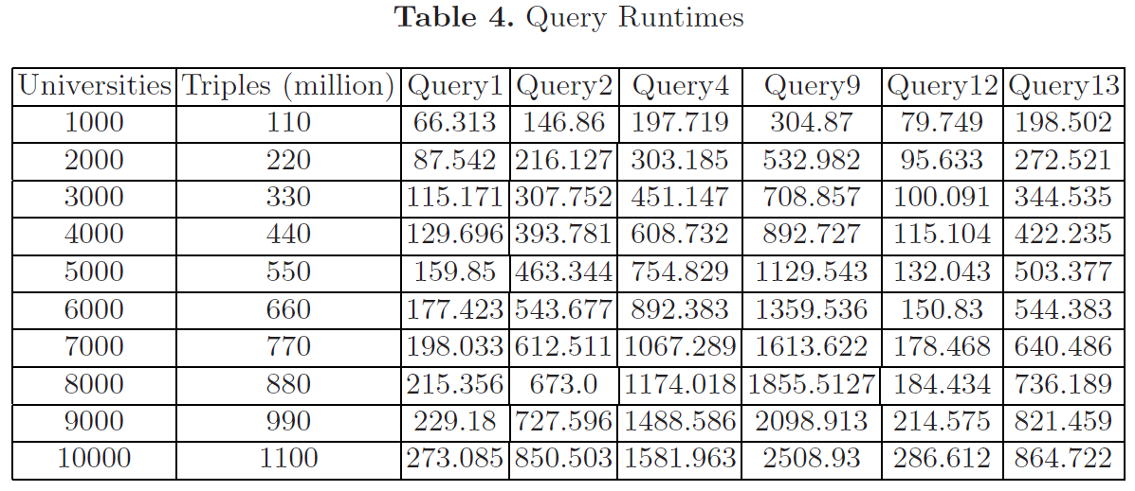
Result
Q. 1: Only one join
Q. 2: Three times more triple patterns than Q. 1
Q. 4: One less triple pattern than Q. 2 and
inferencing to bind 1 triple pattern
Q. 9 and 12: Also require inferencing
Q. 13: Has an Inverse property
Notes:
query answering times in sec
As expected, as the number of triples increased, the time to answer a query also increased
Q2, it does not take thrice the time of query 1 answering time because of our storage schema.

Slide 20
Result
10000 universities dataset has ten times triples than 1000 universities
For Q. 1,
Increase by 4.12 times
For Q. 9,
Increase by 8.23 times
Still less than the increase in dataset size

Slide 21
Outline
Introduction
Proposed Architecture
MapReduce Framework
Result
Conclusion

Slide 22
Conclusion
Devised efficient file organization
Made the algorithm which determines the number of jobs, sequence and inputs
Weak points
Lack of comparison with the result on previous framework

Slide 23
Thank you

