Slide 1
Head First Python: Ch 1. Everyone loves lists
Aug 22, 2013
Hee-gook Jun
Notes:
Welcome to the Chap 1 of the head first Python
In this presentation, we’re going to be talking about how you can use list data type and how you can express basic programming syntax in Python

Slide 2
Outline
Create simple Python lists
Lists are like arrays
Add more data to your list
Work with your list data
For loops work with lists of any size
Store lists within lists
Check a list for a list
Complex data is hard to process
Handle many levels of nested lists
Don’t repeat code; create a function
Create a function in Python
Recursion to the rescue!
Your Python Toolbox

Slide 3
Create simple Python lists
1 Convert each of the names into strings by surrounding the data with quotes
2 Separate each of the list items from the next with a comma
3 Surround the list of items with opening and closing square brackets
4 Assign the list to an identifier (movies in the preceding code) using the assignment operator (=)
It does not need to declare data type in Python
movies = ["The Holy Grail", "The Life of Brian", "The Meaning of Life"]
Notes:
Now the first thing I want to talk about is Python lists

Slide 4
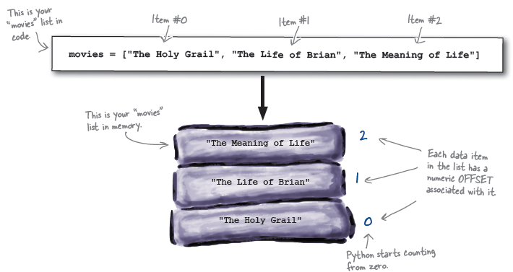
Lists are like arrays
Access list data using the square bracket notation
print(movies[1])

Slide 5
Exercises
cast = ["Cleese", 'Palin', 'Jones', "Idle"]
print(cast)
print(len(cast))
print(cast[1])
cast.append("Gilliam") # add a single data item
print(cast)
cast.pop() # remove data from the end of the list
print(cast)
cast.extend(["Gilliam", "Chapman"]) # add a collection of data items to the end of the list
print(cast)
cast.remove("Chapman") # remove a specific data item from the list
print(cast)
cast.insert(0, "Chapman") # add a data item before a specific slot location
print(cast)

Slide 6
Add more data to your list
Python lists can contain data of mixed type
["The Holy Grail", 1975, "The Life of Brian", 1979, "The Meaning of Life", 1983]
movies = ["The Holy Grail", "The Life of Brian", "The Meaning of Life"]
movies.insert(1, 1975)
movies.insert(3, 1979)
movies.append(1983)
movies = ["The Holy Grail", 1975,"The Life of Brian", 1979,"The Meaning of Life", 1983]

Slide 7
Work with your list data
# When you use “while”, you have to worry about state information that requires you to employ a counting identifier
count = 0
while count < len(movies):
print(movies[count])
count = count+1
# When you use “for”, the Phthon interpreter worries about the state information for you
for each_item in movies:
print(each_item)
# Indented code is called as “suite”

Slide 8
Store lists within lists
Lists can hold collections of anything including other lists
movies = ["The Holy Grail", 1975, "Terry Jones & Terry Gilliam", 91,
["Graham Chapman",
["Michael Palin", "John Cleese", "Terry Gilliam", "Eric Idle", "Terry Jones"]
]
]
print(movies[4][1][3])
# The “for” loop prints each item of the outer loop only
for each_item in movies:
print(each_item)

Slide 9
Check a list for a list
Each time you process an item in your list, you need to check to see if the item is another list
If the item is a list, you need to process the nested list before processing the next item in your outer list
# Ask if “each_item” is a list
for each_item in movies:
if isinstance(each_item, list):
for nested_item in each_item:
print(nested_item)
else:
print(each_item)
# But it cannot print nested list of nested list

Slide 10
Complex data is hard to process
# Ask if “each_item” is a list
for each_item in movies:
if isinstance(each_item, list):
for nested_item in each_item:
print(nested_item)
else:
print(each_item)
movies = ["The Holy Grail", 1975, "Terry Jones & Terry Gilliam", 91,
["Graham Chapman",
["Michael Palin", "John Cleese", "Terry Gilliam", "Eric Idle", "Terry Jones"]
]
]

Slide 11
Handle many levels of nested lists
The solution is to add more code to handle the additionally nested list
for each_item in movies:
if isinstance(each_item, list):
for nested_item in each_item:
if isinstance(nested_item, list):
for deeper_item in nested_item:
print(deeper_item)
else:
print(nested_item)
else:
print(each_item)
# But overly complex code is rarely a good thing

Slide 12
Don’t repeat code; create function
This code contains a lot of repeated code
for each_item in movies:
if isinstance(each_item, list):
for nested_item in each_item:
if isinstance(nested_item, list):
for deeper_item in nested_item:
print(deeper_item)
else:
print(nested_item)
else:
print(each_item)

Slide 13
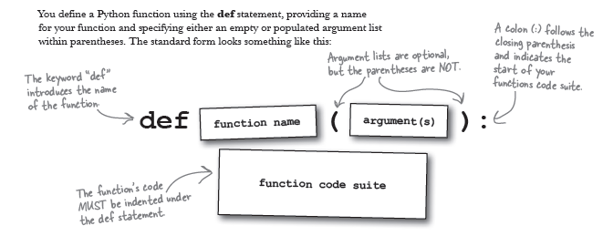
Create a function in Python
A Function in Python is a named suite of code, which can also take an optional list of arguments if required

Slide 14
Recursion to the rescue!
Take advantage of function and recursion
To solve the code complexity problems that had crept into the earlier list-processing code
def print_lol(the_list):
for each_item in the_list:
if isinstance(each_item, list):
print_lol(each_item)
else:
print(each_item)
print_lol(movies)

Slide 15
Terminology
Python philosophy: “Batteries included”
A way of referring to the fact that Python comes with most everything you’ll need to get going quickly and productively
Python let you do most things well, without having to rely on code from third parties to get going
e.g.) Many BIFs: isinstance()..
BIF
a built-in function
print(), isinstance(), ..
Suite
a block of Python code, which is indented to indicate grouping

