Slide 1
CREAM: Semantic annotation system
May 24, 2013
Hee-gook Jun

Slide 2
References
[1] From manual to semi-automatic semantic annotation: about ontology-based
text annotation tools
COLING 2000 (Semantic Annotation and Intelligent Content)
M. Erdmann, A. Maedche, H.-P. Schnurr, S. Staab
[2] CREAM: creating relational metadata with a component-based, ontology-
driven annotation framework
K-CAP 2001 (Knowledge capture)
Siegfried Handschuh, Steffen Staab, Alexander Maedche
[3] Authoring and annotation of web pages in CREAM
WWW 2002
Siegfried Handschuh, Steffen Staab
[4] S-CREAM - Semi-automatic CREAtion of Metadata
EKAW 2002 (Knowledge Engineering and Knowledge Management. Ontologies and the Semantic Web)
Siegfried Handschuh, Steffen Staab, Fabio Ciravegna
University of Karlsruhe, Karlsruhe, Germany

Slide 3
Outline
Web Annotations
Manual Annotation
CREAM: Ontology-driven annotation framework
S-CREAM: Semi-automatic CREation of Metadata
Conclusion
Discussion

Slide 4

Web Annotations
Statements by an author about a Web document
External to the documents
Stored in one or more annotation servers
Annotation server should be able to
consult the annotations with a given document
add their own annotations
Tools: Annotea, SHOE, Ont-O-Mat

Slide 5
Architecture of Annotea
Browser/Editor
Annotation Servers
Get RDF
Web document
RDF database
Annotations
Store RDF

Slide 6

Manual Annotation [1]
KA2 initiative
The main source of information for the KA portal stems from distributed web pages maintained by members of the KA community
Editor
aslkdfjlksjdfafdasdjflkjsdlkfjlaskdjflkjaslkdfjlasjdfkadfklsjafsasfasdfsafasdfdasfdsfasdf
Docs
Annotated
Docs
Annotator
Crawler
Knowledge Base
Ontology

Slide 7
Manual Annotation [1]: Problems
Syntax errors and typos of ontological entities
False references
Lack of deep domain knowledge

Slide 8
Inference-supported Annotation [1]
CREAM
Integrates the ontology and the knowledge base into the editing evnironment
Editor
aslkdfjlksjdfafdasdjflkjsdlkfjlaskdjflkjaslkdfjlasjdfkadfklsjafsasfasdfsafasdfdasfdsfasdf
Docs
Annotated
Docs
Annotator
Crawler
Knowledge Base
Ontology

Slide 9
Inference-supported Annotation [1]
CREAM
Integrates the ontology and the knowledge base into the editing evnironment
Annotator
Docs
Annotated
Docs
aslkdfjlksjdfafdasdjflkjsdlkfjlaskdjflkjaslkdfjlasjdfkadfklsjafsasfasdfsafasdfdasfdsfasdf
Crawler
Knowledge Base

Slide 10

CREAM: Ontology-driven annotation framework [2]
Basic idea: Avoid error-prone and syntactic mistakes
Challenges
Consistency
Proper Reference
Avoid Redundancy
Relational Metadata
Maintenance
Ease of Use
Efficiency

Slide 11
CREAM: Architecture [2]
Document Viewer and Ontology Guidance
Browsing Knowledge database
Document management
Avoid duplicate annotations and existing semantic annotations
Annotation Inference Server
Reasons on crawled and newly annotated ontology instances
Information Extraction

Slide 12
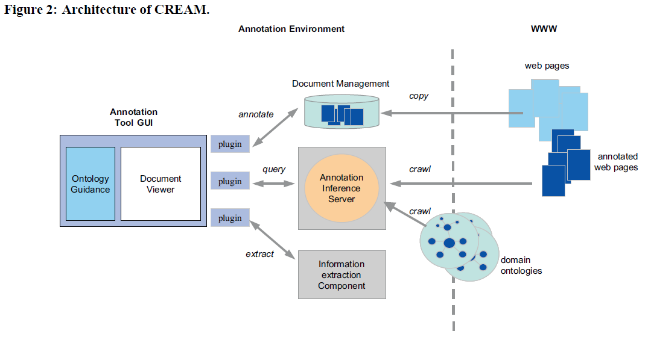
CREAM: Architecture [2]
Ont-O-Mat: the implementation of CREAM framework

Slide 13
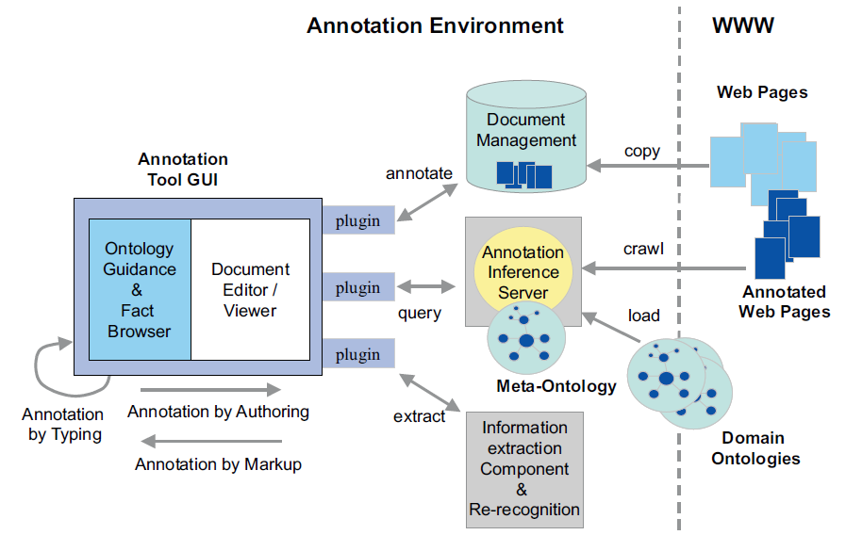
CREAM: Meta Ontology [3]
Define the ontology rather independently of the purpose of creation of metadata by web and annotation

Slide 14
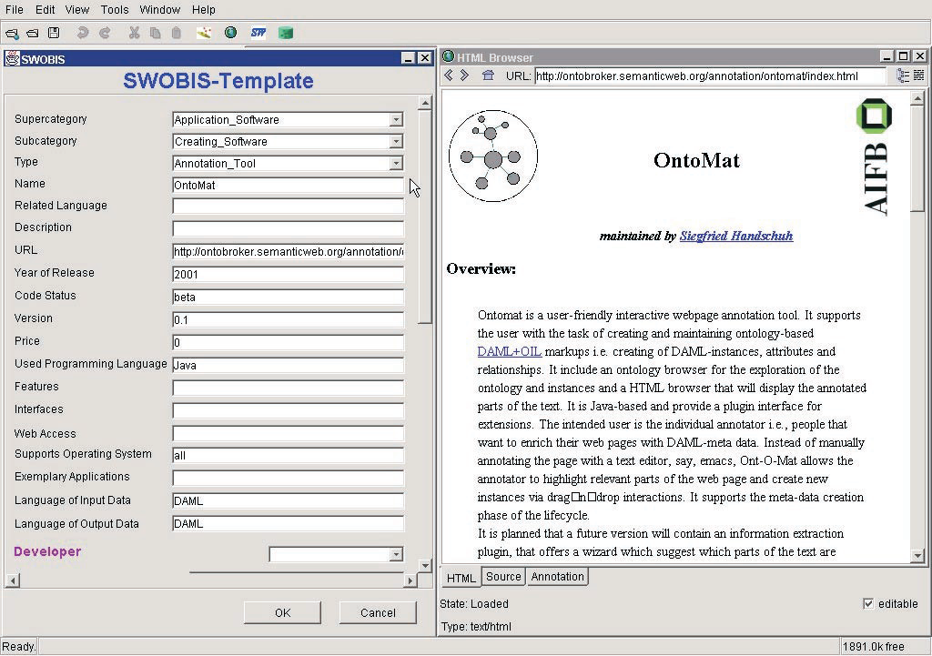
CREAM: Annotation by Typing [3]
Working almost exclusively within the ontology guidance/fact browser
<A onto=“O:C”></A> where O is instance(or global URI) and C is Concept

Slide 15
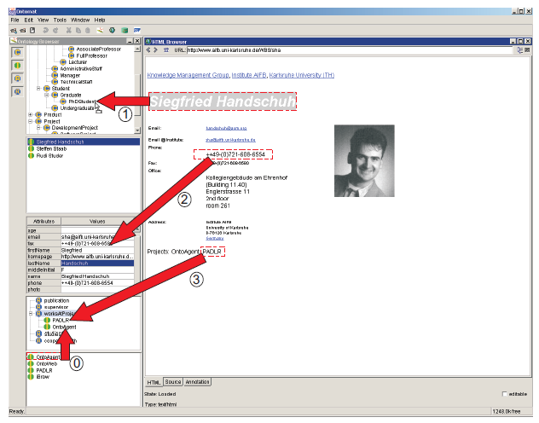
CREAM: Annotation by Markup [3]
Reuse of data from the document editor/viewer in the ontology guidance/fact browser

Slide 16
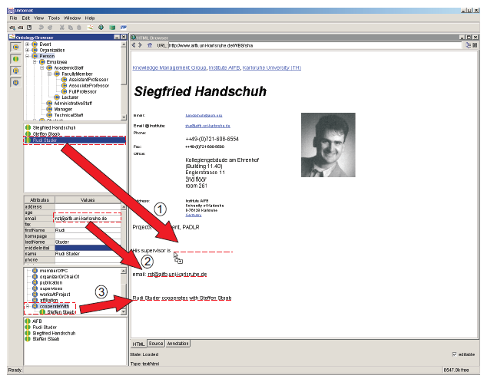
CREAM: Annotation by Authoring [3]
Reuse of data from the fact browser in the document editor.

Slide 17
S-CREAM: Semi-automatic CREation of Metadata [4]
Aligns conceptual markup
From Tag-like annotation to structured annotation
Discourse representation
Thing
Tagged output
Docs
DR

Slide 18
S-CREAM
Ont-O-Mat and Amilcare
Producing XML tagged document
Zwei Linden instOf Hotel
Zwei Linden is located at Dobbertin
Dobbertin instOf City
Zwei Linden has room single room 1
<hotel>Zwei Linden</hotel>
<city>Dobbertin</city>
<singleroom>Single room</singleroom>

Slide 19
Conclusion
Comprehensive framework for creating annotations
Ontology guidance/fact browser
Document management system
Meta ontology
Inference service
Information extraction
The foundation of the future semantic web

Slide 20
Discussion
Strong point
Referenced paper
Providing an annotation tool
Weak point
Not well-organized paper
Legacy ontology model (DAML +OIL)

