Slide 1

Session 25
Modeling the Static View:
The Component Diagram
Written by Thomas A. Pender
Published by Wiley Publishing, Inc.
October 27, 2011
Presented by Hyewon Lim

Slide 2
Contents
Explaining the Component Diagram
Defining the Notation for Components and Component Dependencies
Building a Component Diagram for the Case Study
Mapping the Logical Design to the Physical Implementation

Slide 3
Explaining the Component Diagram (1/5)
The next step is to define the physical implementation
Three problems of the physical implementaion
  The software
  The hardware
  The integration of the two
Notes:
Folder icon 으로 표시.

Slide 4
Explaining the Component Diagram (2/5)
Component diagram
  Models the physical implementation of the software
    C.f., Class diagrams describe the organization and intent of the s/w design
  To define software modules and their relationships to one another
Deployment diagram
  Models the physical architecture of the hardware
Combined
  Model the integration and distribution of the software across the hardware implementation
Notes:
Folder icon 으로 표시.

Slide 5
Explaining the Component Diagram (3/5)
Each component is a chunk of code
  That resides in memory on a piece of hardware
Each component must define an interface
  Which allows other components to communicate with that component
The interface and the internal implementation of the component are encapsulated in the classes that make up the component

Slide 6
Explaining the Component Diagram (4/5)
The UML groups components into three broad categories
  Deployment components
    Which are required to run the system
  Work product components
    Including models, source code and data files used to create deployment components
  Execution components
    Which are components created while running the application

Slide 7
Explaining the Component Diagram (5/5)
Components may depend on one another
  i.e., .exe may require access to .dll
  i.e., A client application may depend on a server side application
Components may depend on classes
  i.e., To compile an executable file, we may need to supply the source classes
Given the key elements, component, component interface, and dependencies, we can describe the physical implementation of the system in terms of the s/w modules and the relationship among them

Slide 8
Contents
Explaining the Component Diagram
Defining the Notation for Components and Component Dependencies
Building a Component Diagram for the Case Study
Mapping the Logical Design to the Physical Implementation

Slide 9
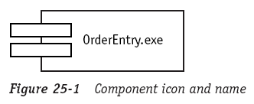
Defining the Notation for Components and Component Dependencies (1/5)
A component icon
  A rectangle with two small rectangles centered on the left edge
  The name is placed inside the icon

Slide 10
Defining the Notation for Components and Component Dependencies (2/5)
Component stereotypes
  Provide visual clues to the role that component plays in the implementation
Some common component stereotypes include
<<executable>> | A component that runs on a processor
<<library>> | A set of resources referenced by an executable during runtime
<<table>> | A database component accessed by an executable
<<file>> | Typically represents data or source code
<<document>> | A document such as a page inserted into a Web page

Slide 11
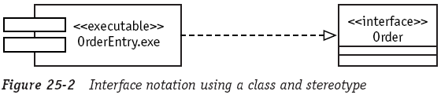
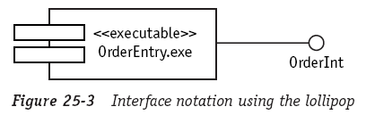
Defining the Notation for Components and Component Dependencies (3/5)
Component interfaces
  Modeled in either of two ways
    Use a class with the <<interface>> and a realization arrow
    Use a “lollipop” with a solid line (more common)

Slide 12
Defining the Notation for Components and Component Dependencies (4/5)
Component interfaces
  The interface should already have been defined in the Class diagram
    The interface implemented by a component is actually implemented by the classes within the component
  A component may implement as many interfaces as it requires
    The number and exact type of interfaces are dictated by the classes implemented by the component

Slide 13
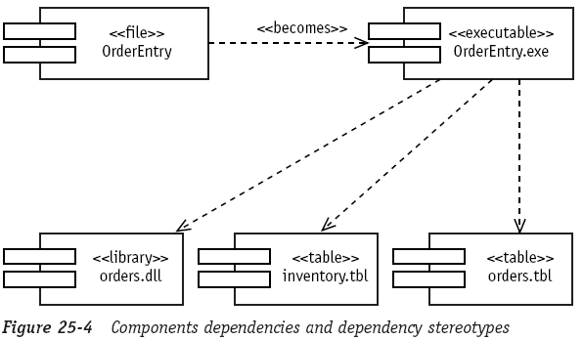
Defining the Notation for Components and Component Dependencies (5/5)
Component dependencies
  Draw with the dashed arrow
Notes:
Session 24의 package dependencies랑 비슷함.
stereotype 써주고….
Figure 25-4:
<< becomes >> 는 OrderEntry file이 runtime에 OrderEntry.exe 실행파일이 된다는 것을 의미함.
OrderEntry.exe가 실행될 때는 아래의 세 가지 dll이 필요함.

Slide 14
Contents
Explaining the Component Diagram
Defining the Notation for Components and Component Dependencies
Building a Component Diagram for the Case Study
Mapping the Logical Design to the Physical Implementation

Slide 15
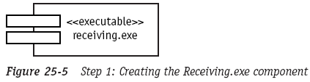
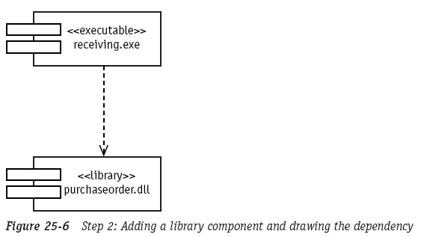
Building a Component Diagram for the Case Study (1/3)
Model the Receiving application
  Create the Receiving.exe component
  Adds library component and draws a dependency

Slide 16
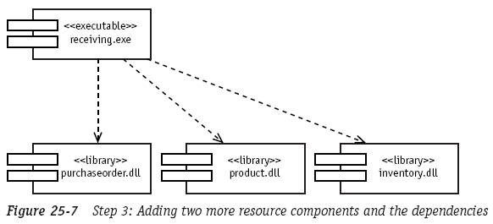
Building a Component Diagram for the Case Study (2/3)
Model the Receiving application
  Adds two more resource components and the dependency

Slide 17
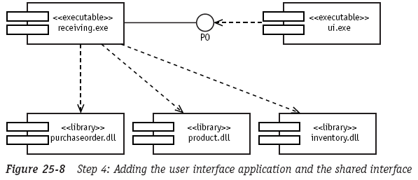
Building a Component Diagram for the Case Study (3/3)
Model the Receiving application
  Adds the client application that manages the user interface

Slide 18
Contents
Explaining the Component Diagram
Defining the Notation for Components and Component Dependencies
Building a Component Diagram for the Case Study
Mapping the Logical Design to the Physical Implementation

Slide 19
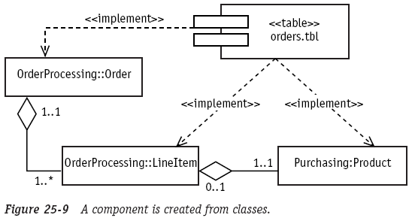
Mapping the Logical Design to the Physical Implementation (1/3)
Making components from classes involves choices about
how to assemble these classes into cohesive units
The interfaces of the classes in the component make up the interface to the component
Notes:
Figure 25-9: database table component인 orders.tbl이 ‘주문’을 정의하는 Order, LineItem, Product 세 클래스들을 implement함.

Slide 20
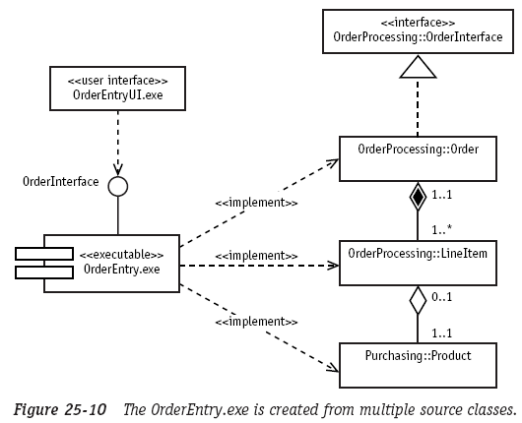
Mapping the Logical Design to the Physical Implementation (2/3)
The main program in an application may implement some or
all of the key classes in the logical model
  Compile the classes together into a single executable

Slide 21
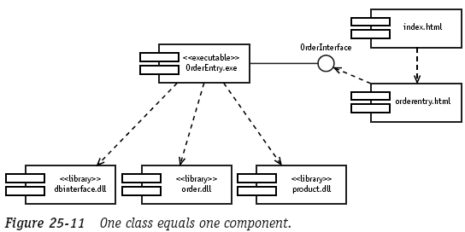
Mapping the Logical Design to the Physical Implementation (3/3)
A component consists of a single class implemented as an executable file, library, table, or document
Components can be organized into packages just like other diagrams and model elements
  Can be very helpful when managing application distribution
Notes:
OrderEntry.exe가 여러 classes들을 complie하지 않고, 대신 individual class들을 위한 library component들을 참조한다.

Slide 22
The End

