Slide 1
Analysis and Improvement of Map-Reduce Data Distribution in Read Mapping Applications
A. Espinosa, P. Hernandez, J.C. Moure, J. Protasio, and A. Ripoll
Universitat Autonoma de Barcelona
Journal of Supercomputing, 2012
12 Apr 2013
Taewhi Lee

Slide 2
Outline
Bioinformatics: “Read Mapping” Problem
MAQ (Mapping and Assembly with Quality) Algorithm
MapReduce (Slides by Yongho Ha in 2011 H3 conf., KTH)
Existing MapReduce MAQ Implementation
Optimizing MapReduce Mapping Application
Experimental Results
Conclusions

Slide 3
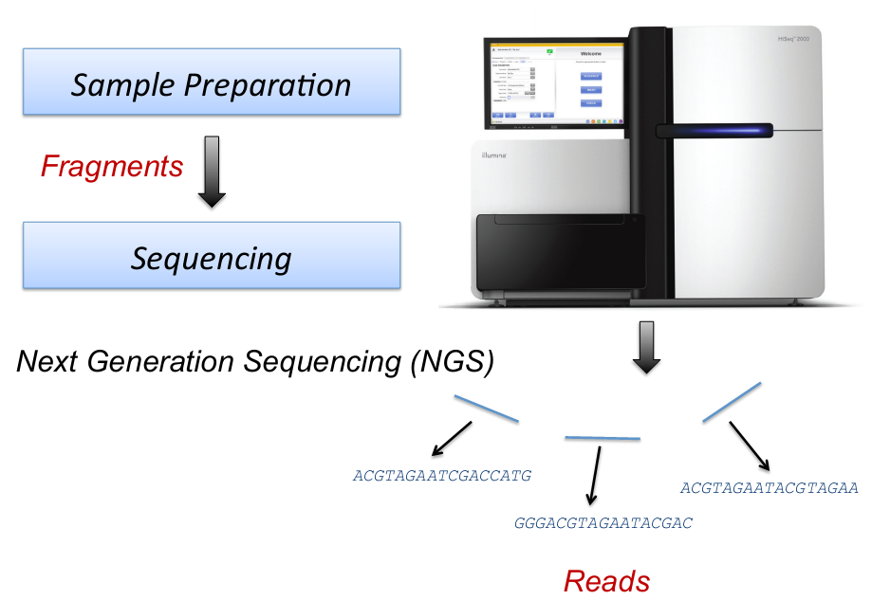
Bioinformatics: “Read Mapping” Problem
Huge amounts of short reads are aligned onto a reference genome
Read: fragment sequences to align
Reference genome: a representative example of a species’ set of genes
Motivation: high sequence similarity usually implies significant functional or structural similarity

Slide 4
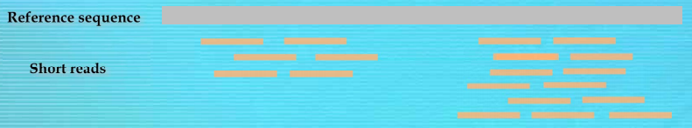
Challenges in “Read Mapping” Problem
Data size
Huge amount of sequencing data
Large size of vertebrate genomes (e.g., Human with > 3GB)
Accuracy
Reads have sequencing errors
Reference genome has repetitive elements
How can we efficiently align the reads to the reference genome?
➔ MAQ (Mapping and Assembly with Quality) algorithm with MapReduce

Slide 5
Outline
Bioinformatics: “Read Mapping” Problem
MAQ (Mapping and Assembly with Quality) Algorithm
MapReduce (Slides by Yongho Ha in 2011 H3 conf., KTH)
Existing MapReduce MAQ Implementation
Optimizing MapReduce Mapping Application
Experimental Results
Conclusions

Slide 6
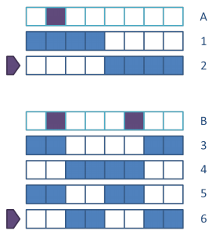
MAQ Algorithm: Key Insight [Li et al., Genome Research’08]
If a read in its correct position to the reference genome has one mismatch, then partitioning that read into two makes sure one part is still exactly matched
For 2 mismatches, it is possible to create 6 templates (patterns)

Slide 7
MAQ Algorithm [Li et al., Genome Research’08]
1. Build a hash table to store and index the short reads (first 28 bases)
Hash table
keys
read 1
h(r1)
read 2
h(r2)
read 3
read 4
h(r3) h(r4)
h(r4)+1
read 5
h(r5)

Slide 8
MAQ Algorithm [Li et al., Genome Research’08]
2. Scan the reference genome to identify hits with 28-bases window
scan genome
6 patterns of the subsequences
hash table (x6)
candidate
reads

Slide 9
Outline
Bioinformatics: “Read Mapping” Problem
MAQ (Mapping and Assembly with Quality) Algorithm
MapReduce (Slides by Yongho Ha in 2011 H3 conf., KTH)
Existing MapReduce MAQ Implementation
Optimizing MapReduce Mapping Application
Experimental Results
Conclusions

Slide 10
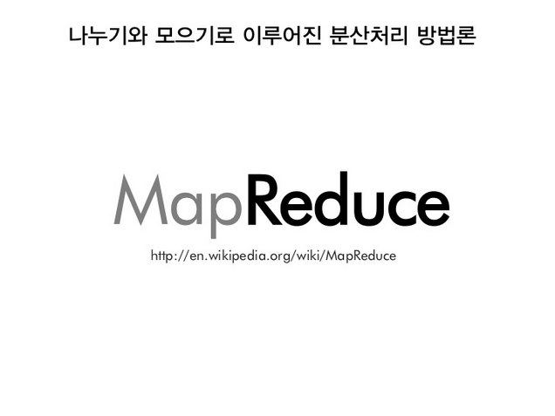

Slide 11
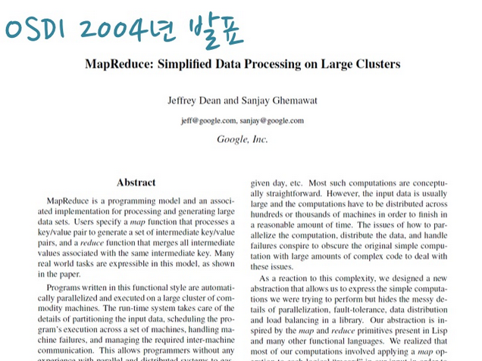

Slide 12
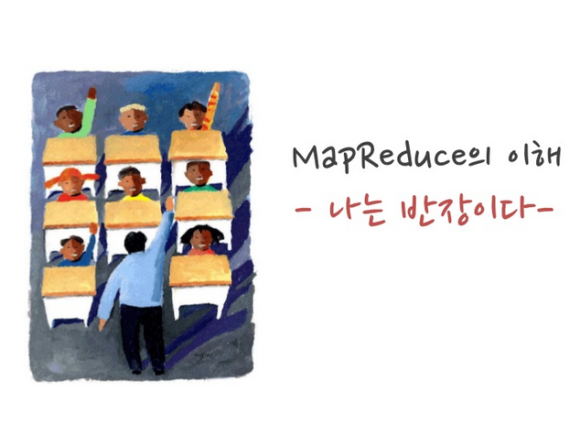

Slide 13


Slide 14


Slide 15
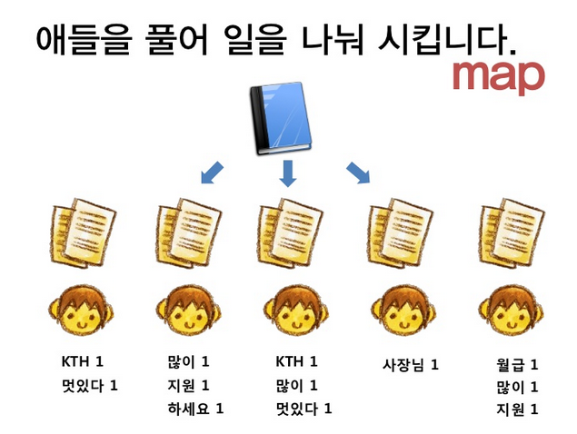

Slide 16
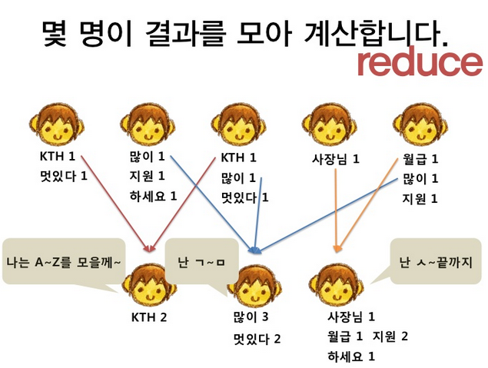

Slide 17
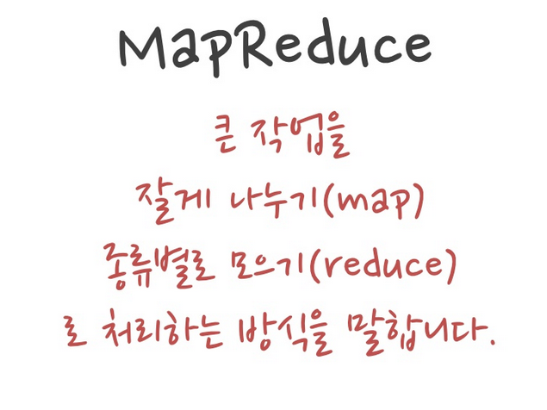

Slide 18
MapReduce Framework [Dean and Ghemawat, OSDI ’04]
MapReduce: a programming model for large-scale data processing
Input / output: a set of key/value pairs
Simple programming interface: map and reduce
Automatic data distribution and process communication
Distributed tasks work on their local partition of the input data
map(k1, v1) → list(k2, v2)
reduce(k2, list(v2)) → list(v2)
: remote I/O
Map
sort
: local I/O
Input
merge
Output
Reduce
Split 0
Map
Split 1
Part 0
Split 2
Part 1
…
Reduce
Map
DFS
DFS

Slide 19
Outline
Bioinformatics: “Read Mapping” Problem
MAQ (Mapping and Assembly with Quality) Algorithm
MapReduce (Slides by Yongho Ha in 2011 H3 conf., KTH)
Existing MapReduce MAQ Implementation
Optimizing MapReduce Mapping Application
Experimental Results
Conclusions

Slide 20
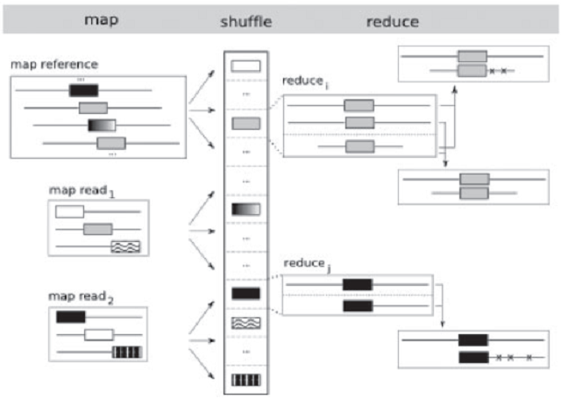
Existing Read Mapping Applications with MapReduce
“Sequence read centric” strategy (similar to repartition join)

Slide 21
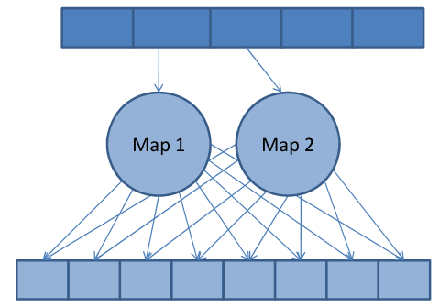
Map Task Operation
Map task
Apply templates to read input
Generate several hash keys that have to be matched
All generated key/value records are sent to reducers to be compared with the whole set of the sequences ➔ high network I/O cost
“Scatter” map task design

Slide 22
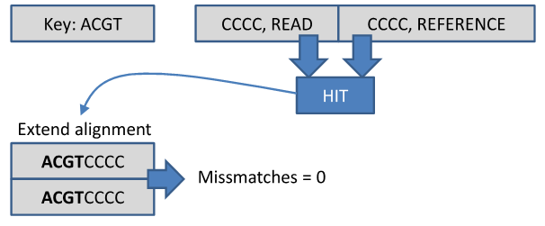
Reduce Task Operation
Reduce task
For each hit, find the number of mismatches and compute quality values

Slide 23
Outline
Bioinformatics: “Read Mapping” Problem
MAQ (Mapping and Assembly with Quality) Algorithm
MapReduce (Slides by Yongho Ha in 2011 H3 conf., KTH)
Existing MapReduce MAQ Implementation
Optimizing MapReduce Mapping Application
Experimental Results
Conclusions

Slide 24
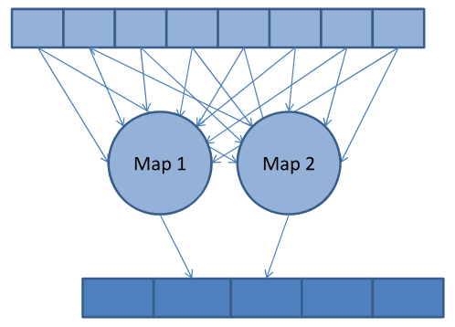
Optimization: “Gather” Map Task Design
Problems of “Scatter” map task design
Intensive use of local disk writes for storing map output
Overload of communications to send map output to reducers
Cost of sorting and merging the intermediate output
Solution: map-side filtering using combiner functions
Combiner: a function run before sending map output to reducers (usually repeat reduce function in map phase)
“Gather” map task design

Slide 25
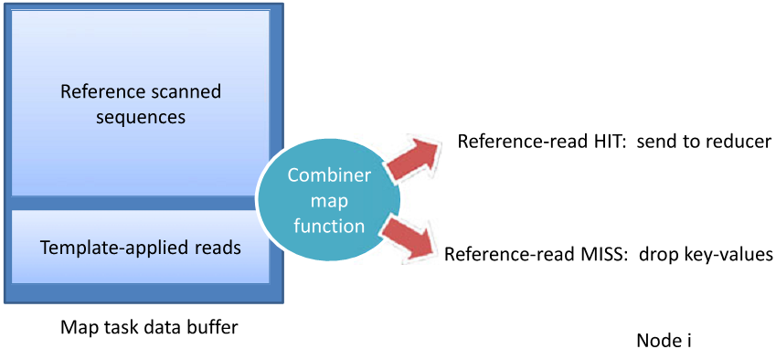
Map Task Operation with Combiner
1. All map tasks have an identical local copy of the whole reference genome
2. Each map task receives its own piece of the short reads
3. Map task generates hash keys from the reads and the reference genome
4. Combiner function is called at the end of map tasks to only keep local hits

Slide 26
Hadoop Configurations
Storing reference genome locally
Use Hadoop distributed-cache: automatic distribution to all map tasks
Allocating memory for sequence hits
io.sort.mb: The total amount of buffer memory to use while sorting files
100MB → Large enough to store all local intermediate values generated by map
io.sort.record.percent: The percentage of io.sort.mb dedicated to tracking record boundaries
Affects the maximum number of records collected before the collection thread must block
5% → 30% - to allow a larger number of records
io.sort.spill.percent: The soft limit in either the buffer or record collection buffers
Once reached, a thread will begin to spill the contents to disk in the background
80% → 99% - to avoid spilling to disk

Slide 27
Outline
Bioinformatics: “Read Mapping” Problem
MAQ (Mapping and Assembly with Quality) Algorithm
MapReduce (Slides by Yongho Ha in 2011 H3 conf., KTH)
Existing MapReduce MAQ Implementation
Optimizing MapReduce Mapping Application
Experimental Results
Conclusions

Slide 28
Experimental Settings
Test data
Read: 1, 3, 5, and 7M Illumina/Solexa sequencing reads (36-bases long)
Reference genome: full human genome (2.87GB), chromosome 1 (247MB), and chromosome 22 (49.7MB)
Allowing up to 2 mismatches
Test cluster
25 IBM JS20 blade nodes with dual PowerPC 970MP processor
4GB main memory
7.3 TB running GPFS file system version 3.1
Gigabit Ethernet network
Linux 2.6.16.60, Hadoop 0.20.1

Slide 29
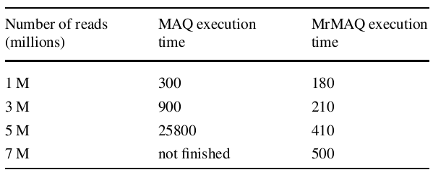
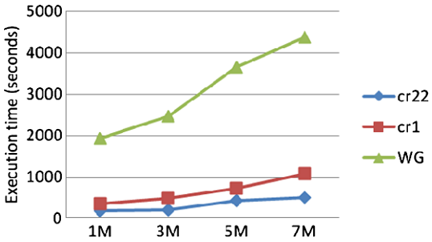
Comparison of Original MAQ vs. MrMAQ
Original MAQ vs. MrMAQ
Chromosome 22
MrMAQ with increasing data set sizes

Slide 30
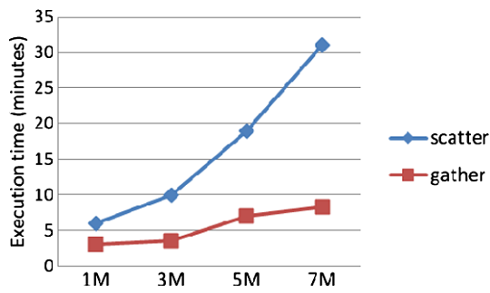
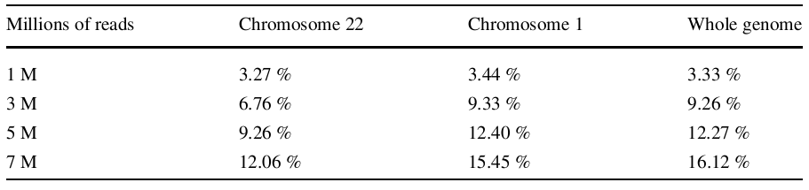
Comparison of “Scatter” vs. “Gather”
Execution times
Chromosome 22
Percentage of Data Filtered in Map Phase by Combiner function

Slide 31
Outline
Bioinformatics: “Read Mapping” Problem
MAQ (Mapping and Assembly with Quality) Algorithm
MapReduce (Slides by Yongho Ha in 2011 H3 conf., KTH)
Existing MapReduce MAQ Implementation
Optimizing MapReduce Mapping Application
Experimental Results
Conclusions

Slide 32
Conclusions
Describe some performance implications of scatter design, the most common pattern of sequence alignment MapReduce applications
Suggest a method to redesign scatter to gather MapReduce applications
Propose a list of Hadoop performance optimization specific for sequence alignment MapReduce applications

Slide 33
Thank You!
Any questions or comments?

