Slide 1
How Useful are Your Comments? Analyzing and Predicting YouTube Comments and Comment Ratings
Stefan Siersdorfer, Sergiu Chelaru, Wolfgang Nejdl, Jose San Pedro
WWW’10
19 June 2015
Hyewon Lim

Slide 2
Outline
Introduction
Data
Sentiment Analysis of Rated Comments
Predicting Comment Ratings
Comment Ratings and Polarizing YouTube Content
Category Dependencies of Ratings
Conclusion and Future Work

Slide 3
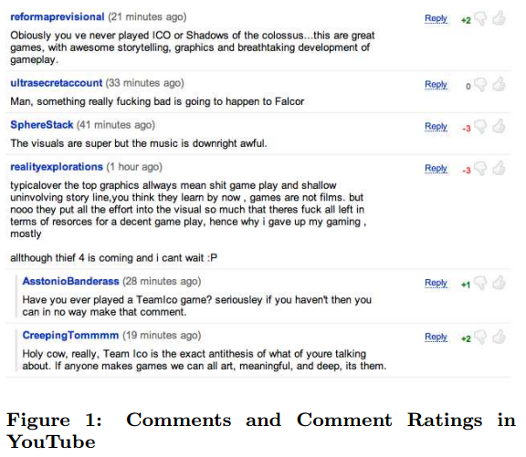
Introduction
YouTube
Traffic: >20% of the web total and 10% of the whole internet
60% of the videos watched on-line
Social tools on YouTube
Filter relevant opinions
Skip offensive or inappropriate comment

Slide 4
Introduction
Can we predict the community feedback for comments?
Is there a connection between sentiment and comment ratings?
Can comment ratings be an indicator for polarizing content?
Do comment ratings and sentiment depend on the topic of the discussed content?

Slide 5
Outline
Introduction
Data
Sentiment Analysis of Rated Comments
Predicting Comment Ratings
Comment Ratings and Polarizing YouTube Content
Category Dependencies of Ratings
Conclusion and Future Work

Slide 6
Data
Collect 756 keyword queries
From Google’s Zeitgeist archive (2001 - 2007)
Remove inappropriate queries (e.g., “windows update”)
Collect information for each video (2009)
The first 500 comments
With authors, timestamps, and comment ratings
Metadata
Title, tags, category, description, upload date, and statistics
Statistics: overall number of comments, views, and star ratings
Final size
67,290 videos
About 6.1 million comments

Slide 7
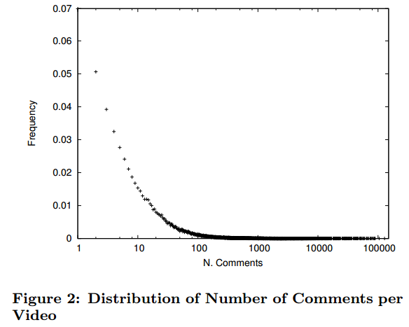
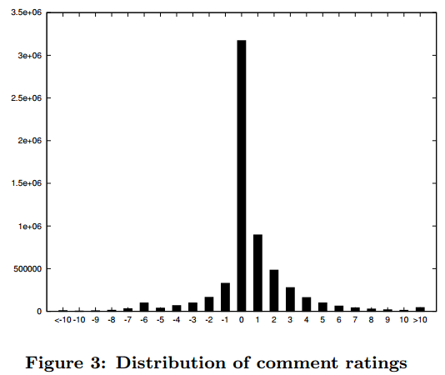
Data

Slide 8

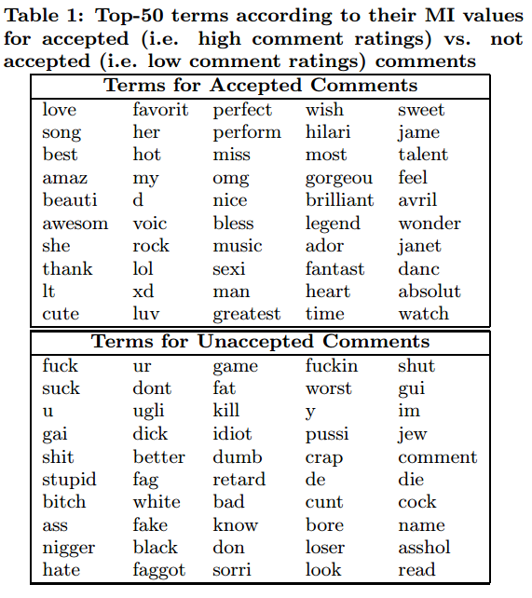

Data
Preliminary term analysis
Compute a ranked list of terms using Mutual Information measure
High community acceptance: > $×5$
Low community acceptance: > $×5$

Slide 9
Outline
Introduction
Data
Sentiment Analysis of Rated Comments
Predicting Comment Ratings
Comment Ratings and Polarizing YouTube Content
Category Dependencies of Ratings
Conclusion and Future Work

Slide 10
Sentiment Analysis of Rated Comments
Do comment language and sentiment have an influence on comment rating?
WordNet
Thesaurus containing textual descriptions of terms and relationships between terms
SentiWordNet
A lexical resource built on top of WordNet
A triple of senti values (pos, neg, obj)
e.g., good = (0.875, 0.0, 0.125), ill = (0.25, 0.375, 0.375)
Vehicle
Car
Automobile

Slide 11
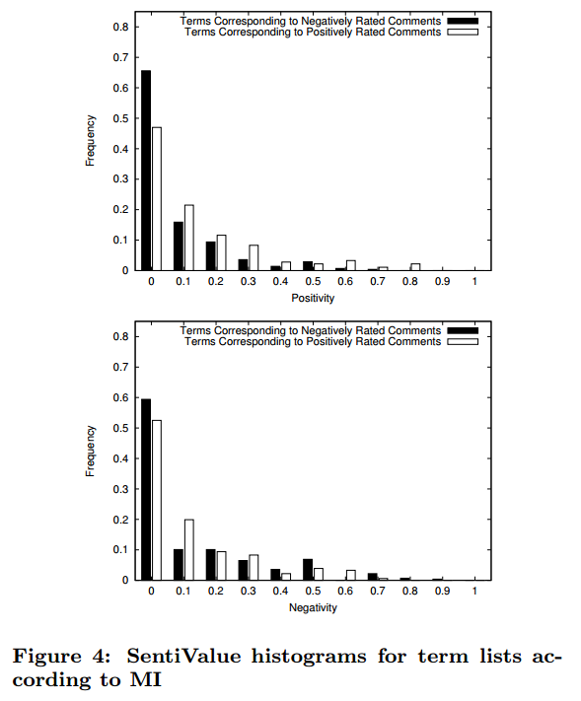
Sentiment Analysis of Rated Comments
SentiWordNet-based analysis of terms
The terms corresponding to negatively rated comments towards higher negative sentivalue assignments

Slide 12
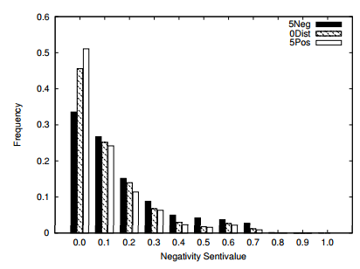
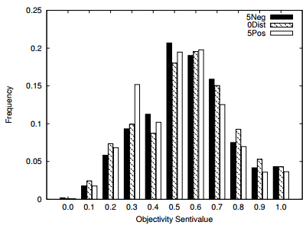
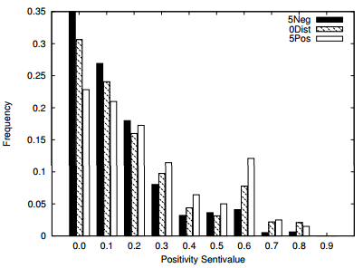
Sentiment Analysis of Rated Comments
Sentiment analysis of ratings
Intuition
The choice of terms provoke strong reactions of approval or denial ◻ therefore determine the final rating score
0Dist
5Neg
5Pos
-5
0
5

Slide 13
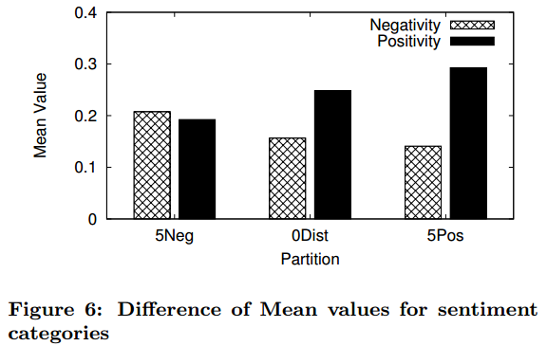
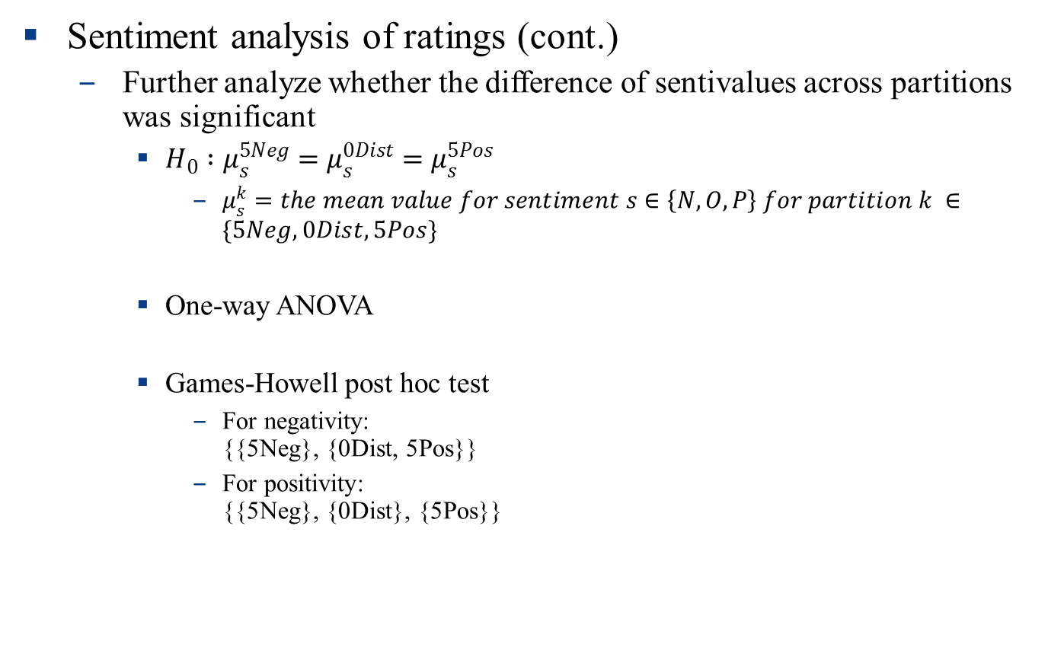
Sentiment Analysis of Rated Comments
Sentiment analysis of ratings (cont.)
Further analyze whether the difference of sentivalues across partitions was significant
$H_{0} :μ_{s}^{5Neg}=μ_{s}^{0Dist}=μ_{s}^{5Pos}$
$μ_{s}^{k}=the mean value for sentiment s∈\left\{N, O, P\right\} for partition k ∈\{5Neg, 0Dist, 5Pos\}$
One-way ANOVA
Games-Howell post hoc test
For negativity: {{5Neg}, {0Dist, 5Pos}}
For positivity: {{5Neg}, {0Dist}, {5Pos}}

Slide 14
Outline
Introduction
Data
Sentiment Analysis of Rated Comments
Predicting Comment Ratings
Comment Ratings and Polarizing YouTube Content
Category Dependencies of Ratings
Conclusion and Future Work

Slide 15
Predicting Comment Ratings
Can we predict community acceptance?
Categorize comments as likely to obtain a high overall rating or not
Term-based representations of comments
Support vector machine classification
Consideration
Different levels of restrictiveness (distinct threshold)
Above/below +2/-2, +5/-5, and +7/-7
Different amounts of randomly chosen training comments (accepted/unaccepted)
T = 1000, 10000, 50000, 200000

Slide 16
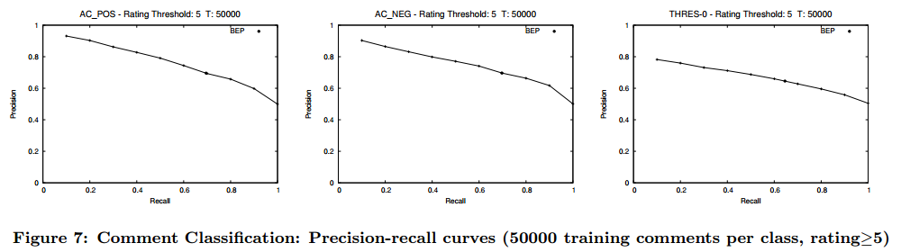
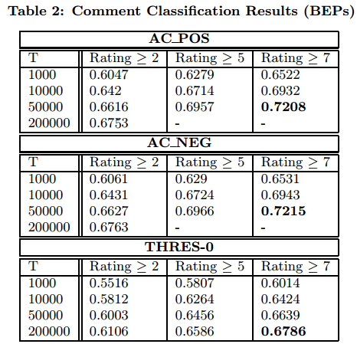
Predicting Comment Ratings

Slide 17
Outline
Introduction
Data
Sentiment Analysis of Rated Comments
Predicting Comment Ratings
Comment Ratings and Polarizing YouTube Content
Category Dependencies of Ratings
Conclusion and Future Work

Slide 18
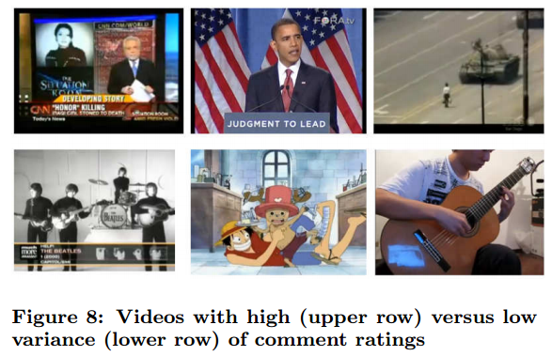
Comment Ratings and Polarizing YouTube Comment
Variance of comment ratings as indicator for polarizing videos
User evaluation
Sort top- and bottom-50 videos by their variance
Put 100 videos into random order
Evaluated by 5 users on a 3-point Likert scale
3: polarizing, 1: rather neutral, 2: in between
Mean user rating for videos on top: 2.085 / bottom: 1.25
⇨ Polarizing videos tend to trigger more diverse comment rating behavior

Slide 19
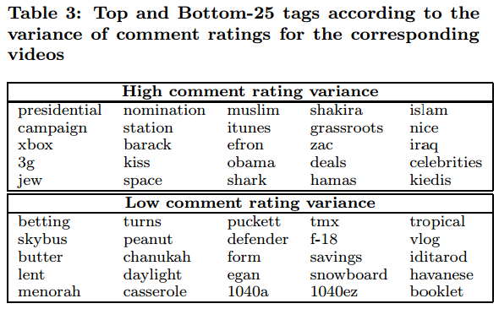
Comment Ratings and Polarizing YouTube Comment
Variance of comment ratings as indicator for polarizing topics
1,413 tags occurring in at least 50 videos
User evaluation
Mean user rating for tags in the top-100: 1.53/ bottom-100: 1.16
⇨ Tags corresponding to polarizing topics tend to be connected to more diverse comment rating behavior

Slide 20
Outline
Introduction
Data
Sentiment Analysis of Rated Comments
Predicting Comment Ratings
Comment Ratings and Polarizing YouTube Content
Category Dependencies of Ratings
Conclusion and Future Work

Slide 21


Category Dependencies of Ratings
News & Politics
Sports
Science
Comments? Discussions? Feedback?

Slide 22
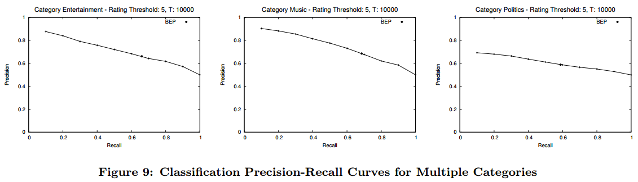
Category Dependencies of Ratings
Classification

Slide 23
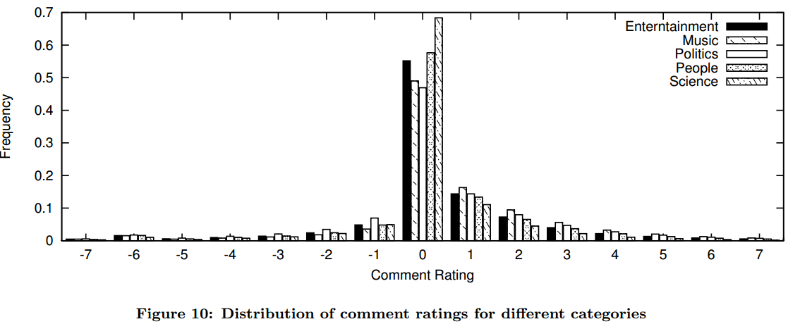
Category Dependencies of Ratings
Analysis of comment ratings for different categories
Intuition
Some topics are more prone to generate intense discussions than others
Science video: a majority of 0-scored comments
Politics video: more negatively / Music video: more positively

Slide 24
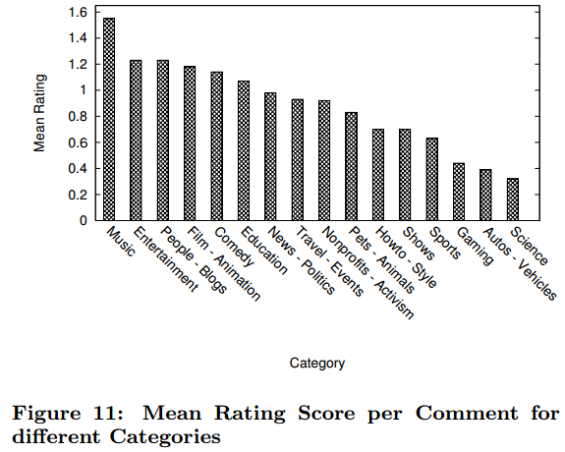
Category Dependencies of Ratings
Analysis of comment ratings for different categories (cont.)
Intuition
Some topics are more prone to generate intense discussions than others

Slide 25
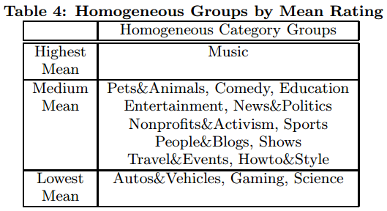
Category Dependencies of Ratings
Analysis of comment ratings for different categories (cont.)
Further analyze whether the rating score difference across categories was significant
One-way ANOVA / Games-Howell post hoc test

Slide 26
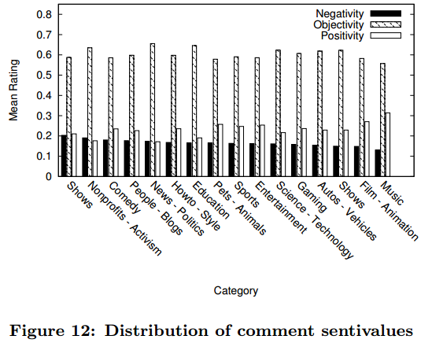

Category Dependencies of Ratings
Sentivalues in categories
Find a dependency of sentivalues for different categories
$H_{0} :μ_{r}^{K, i}=μ_{r}^{K, j}, ∀i, j, K∈\left\{N, O, P\right\}$
One-way ANOVA
→ User generated comments tend to differ widely across different categories, and therefore the quality of classification models gets affected

Slide 27
Outline
Introduction
Data
Sentiment Analysis of Rated Comments
Predicting Comment Ratings
Comment Ratings and Polarizing YouTube Content
Category Dependencies of Ratings
Conclusion and Future Work

Slide 28
Conclusion and Future Work
In-depth analysis of YouTube comments
Different aspects of comment ratings for the YouTube platform
Automatically determining the community acceptance of comments
Rating behavior can be often connected to polarizing topics and content
Future work
Temporal aspects
Additional stylistic and linguistic features
User relationships
Techniques for aggregating information obtained from comments and ratings
Application
Comment search

