Slide 1
Interactive Group Suggesting for Twitter
Zhonghua Qu, Yang Liu
The University of Texas at Dallas
ACL 2011
February 1 2012
Presented by Somin Kim

Slide 2
Contents
Introduction
Interactive Group Detection
Data
Experiment
Conclusion
Discussion

Slide 3

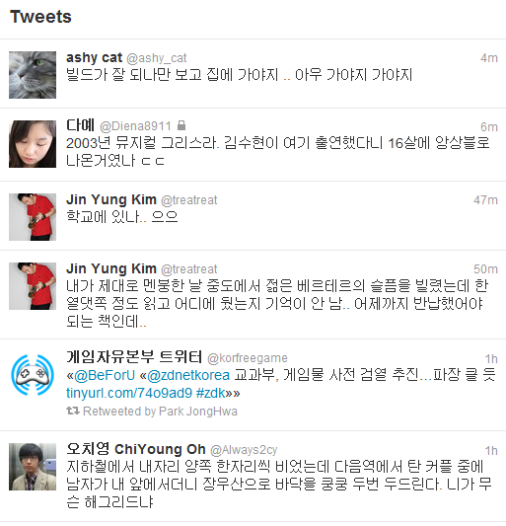
Introduction
A twitter user can “follow” other users to get their latest updates
19 million active users follow 80 other users on average
Twitter service displays “tweets” in the order of their timestamps

Slide 4
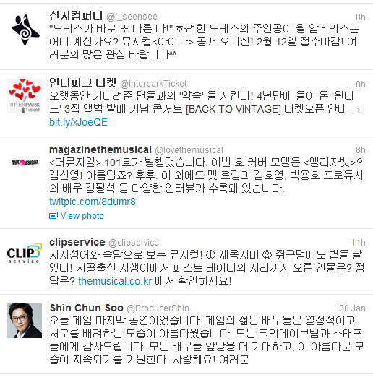
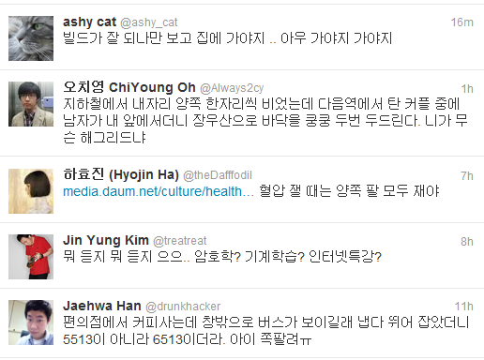
Introduction
(cont.)
But “following” list starts to consist of Twitter accounts for different purpose
Twitter does not have an effective user grouping mechanism
The only way to create group is to create “lists” of users in Twitter manually by selecting each individual user
“Social information” to find real-life friend groups may work well
“Textual information” to find topic-based groups may work well

Slide 5
Contents
Introduction
Interactive Group Detection
Data
Experiment
Conclusion
Discussion

Slide 6
Interactive Group Detection
The general structure of the system
Seed Users & Target Users
Textual Sub-System
Sub-System
Selector
Social Sub-System
Ranks
……

Slide 7













Interactive Group Detection
The general structure of the system (cont.)
Seed user | Target user |  | Ranking

Slide 8
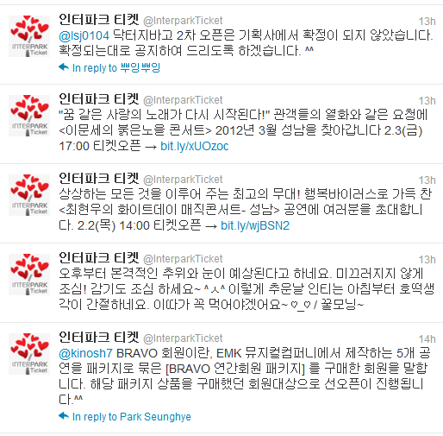
Interactive Group Detection
Tweet based sub-system
User groups are modeled using the textual information contained in their tweets
We merge all the tweets from a user to form a larger document

Slide 9
Interactive Group Detection
Tweet based sub-system (cont.)
Bag-of-word model
A simple assumption used in natural language processing and information retrieval
A text (such as a sentence or a document) is represented as an unordered collection of words, disregarding grammar and even word order
In the beginning God created the heaven and the earth. And the earth was without form, and void; and darkness was upon the face of the deep. And the Spirit of God moved upon the face of the waters. And God said, Let there be light: and there was light.
In the beginning God created the heaven and the earth. And the earth was without form, and void; and darkness was upon the face of the deep. And the Spirit of God moved upon the face of the waters. And God said, Let there be light: and there was light.
Word | Count
beginning | 1
earth | 2
God | 3

Slide 10
Interactive Group Detection
Tweet based sub-system (cont.)
LDA : Latent Dirichlet Allocation
If we observe words collected into documents
Each document is a mixture of a small number of various topics
Each word’s creation is attributable to one of the document’s topic
Topic distribution is assumed to have a Dirichlet prior

Slide 11
Interactive Group Detection
Tweet based sub-system (cont.)
LDA (cont.)
For example, an LDA model might have topics that classified as CAT and DOG
α : the parameter of the Dirichlet prior on the per-document topic distributions
β : the parameter of the Dirichlet prior on the per-topic word distribution
θ_{i} : the topic distribution for document i
φ_{k} : the word distribution for topic k
z_{ij} : the topic for the jth word in document i
w_{ij} : the specific word
Corpus
φ | CAT | DOG
w1 (meow) | 0.7 | 0.1
w2 (kitten) | 0.9 | 0.1
w3 (bark) | 0.1 | 0.8
w4 (puppy) | 0.2 | 0.9
w5 (animal) | 0.6 | 0.6
d1
d3
β
d2
d4
Corpus
d1
1st word
CAT
kitten
2nd word
CAT
θ | CAT | DOG
d1 | 0.7 | 0.3
d2 | 0.4 | 0.6
d3 | 0.5 | 0.5
d4 | 0.8 | 0.2
meow
α
…

Slide 12
Interactive Group Detection
Tweet based sub-system (cont.)
LDA (cont.)
Bag-of-topic vector
Corpus
d1
1st word
CAT
kitten
θ | topic1 | topic2
d1 | 0.7 | 0.3
d2 | 0.4 | 0.6
d3 | 0.5 | 0.5
d4 | 0.8 | 0.2
2nd word
CAT
meow
Similarity
between d1 and d3
α
β
…

Slide 13


Interactive Group Detection
Tweet based sub-system (cont.)
Given a group of seed users, we want to find target users that are similar to the seeds in terms of their tweet content
Similarity between one target user and a seed group
Centroid
We calculate the centroid of seeds, then use the similarity between centroid and the target user
Average
We calculate the similarity between the target and each individual seed user, then take the average
Similarity functions
Cosine similarity
Inverse Euclidean distance

Slide 14
Interactive Group Detection
Friend based sub-system
Social information in Twitter
“following” relation
It is directed relation(unlike other social network sites like Facebook or MySpace)
We only consider bi-directional following relation
“mention”
It happens when someone refers to another Twitter user in their tweets
Usually it happens in replies and retweets
We used the count of bi-directional friends and mentions between a target user and the seed group as the score of ranking

Slide 15
Interactive Group Detection
Group type detection
The first component is to determine which sub-system to use to suggest user groups
If a sub-system is a good match, then it will rank the users in the seed group higher than others not in the seed
Seed
Target
Friend
T2
S1
T3
T7
T5
T1
T6
T4
T2
T4
S1
S2
T1
T3
S3
T5
T7
Tweet
T6
T6
T1
T4
T7
T5
S1
T2
T2

Slide 16
Contents
Introduction
Interactive Group Detection
Data
Experiment
Conclusion
Discussion

Slide 17
Data
We use lists created by twitter users as the reference friend group in testing and evaluation
Excluded users that
Have less than 20 or more than 150 friends
Do not have a qualified list (more than 20 and less than 200 list members)
Do not use English in their tweets
87 lists from 12 users
1,383 friends information
180,296 tweets
584,339 friend-of-friend information
65,329 mentions

Slide 18
Contents
Introduction
Interactive Group Detection
Data
Experiment
Conclusion
Discussion

Slide 19
Experiment
We evaluate the performance of each sub-system and then use group type detection algorithm to adaptively combine the systems
For each user group, we randomly take out some users from the list and use as seed candidate
The target user consists of the rest of the list members and other “friends” that the list creator has
For each group, we run the experiment 10 times using randomly selected seeds
We calculate the mean average precision (MAP) score with the rank position of the list members

Slide 20
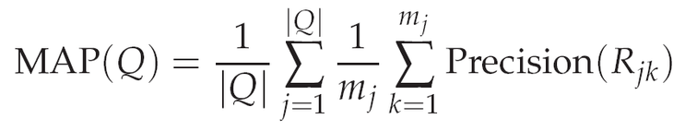

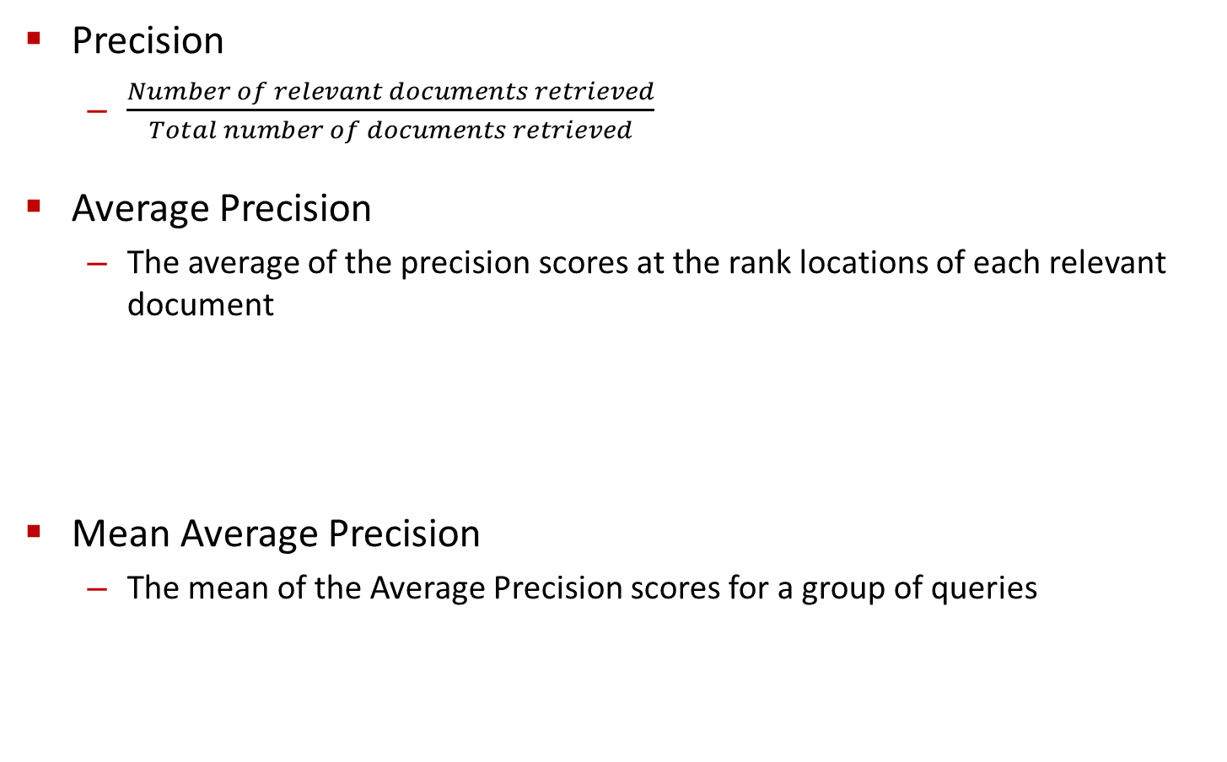

Experiment
Precision
$\frac{Number of relevant documents retrieved}{Total number of documents retrieved}$
Average Precision
The average of the precision scores at the rank locations of each relevant document
Mean Average Precision
The mean of the Average Precision scores for a group of queries
$\frac{1}{3} ∙$ $\left(\frac{1}{1}+ \frac{2}{3}+ \frac{3}{5}\right)$ $≈0.76$
$\frac{1}{3} ∙$ $\left(\frac{1}{2}+ \frac{2}{3}+ \frac{3}{4}\right)$ $≈0.64$
AP

Slide 21
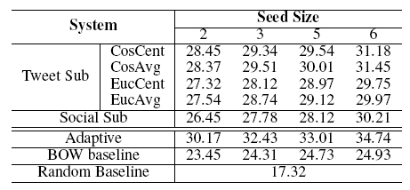
Experiment
Ranking results using different systems
In general using a larger seed group improves performance
Since more information can be obtained from the group
The “CosAvg” scheme achieves the best results among Tweet based sub-systems
After the automatic sub-system selection, we observe increased performance
The two information sources used to build sub-systems can appropriately capture the group characteristics

Slide 22
Contents
Introduction
Interactive Group Detection
Data
Experiment
Conclusion
Discussion

Slide 23
Conclusion
We have proposed an interactive group creation system for Twitter users to organize their “followings”
Two sub systems, based on tweet text and social information respectively
Group type detection procedure
By using different systems adaptively, better performance can be achieved
Future work
Use negative seeds
Add more sophisticated sub-systems

Slide 24
Contents
Introduction
Interactive Group Detection
Data
Experiment
Conclusion
Discussion

Slide 25
Discussion
Strong point
Novel idea
Appropriate using of different information
Weak point
Simple methods
Need more detailed evaluation
How about
Combining different sub-systems?
Applying threshold to ranking ?
Recommending group name?

