Slide 1
Component & Deployment Diagram
© copyright 2001 SNU OOPSLA Lab.

Slide 2
Contents
Implementation Diagrams
Component Diagram
Deployment Diagram
Implementation Modeling

Slide 3
Implementation Diagrams
Show aspects of model implementation, including source code structure and run-time implementation structure
Kinds
  component diagram
  deployment diagram

Slide 4
Component Diagram
Shows the organizations and dependencies among software components
Components include
  source code components
  binary code components
  executable components

Slide 5
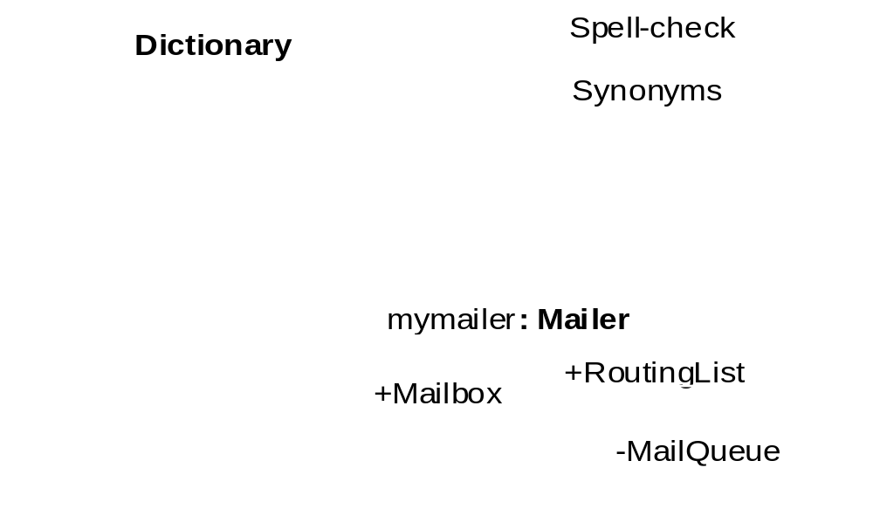
Components

Slide 6
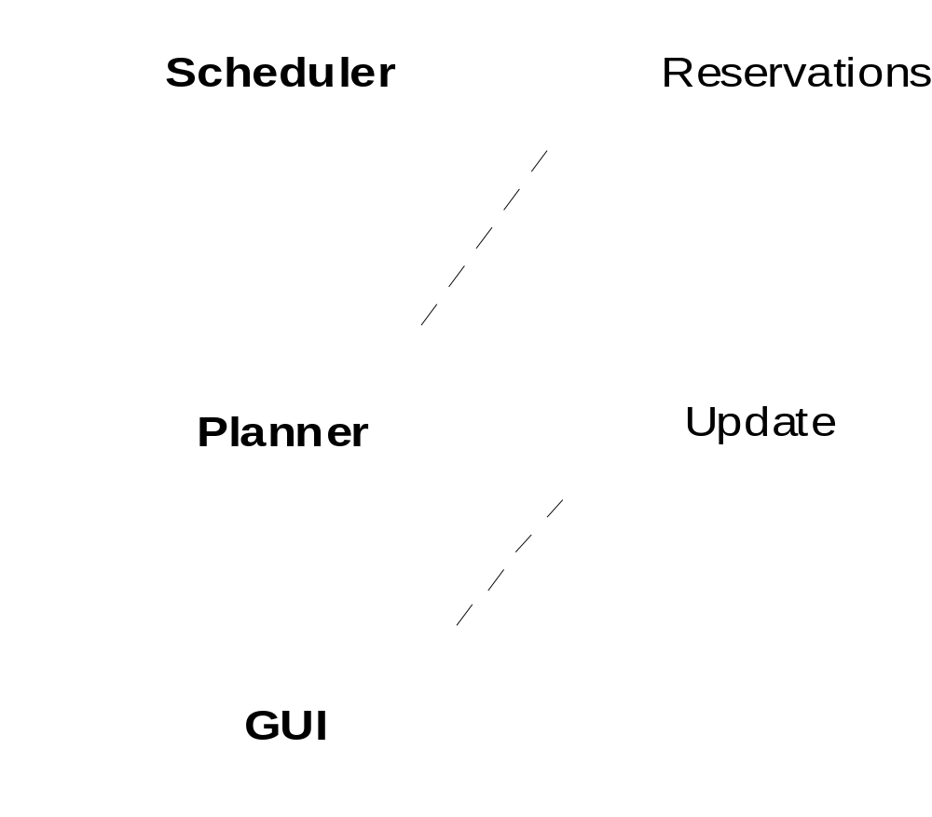
Component Diagram

Slide 7
Deployment Diagram
Shows the configuration of run-time processing elements and the software components, processes and objects that live on them
Deployment diagrams may be used to show which components may run on which nodes

Slide 8
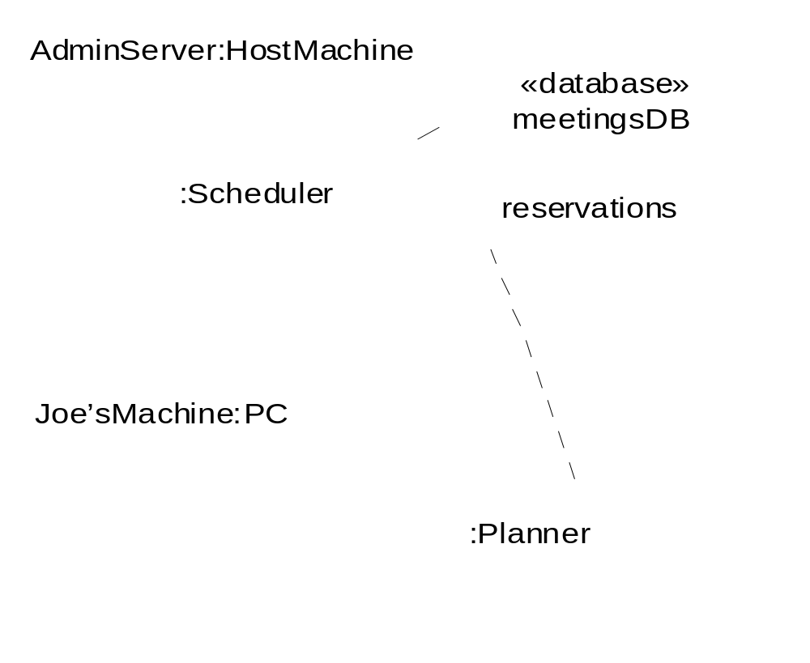
Deployment Diagram

Slide 9
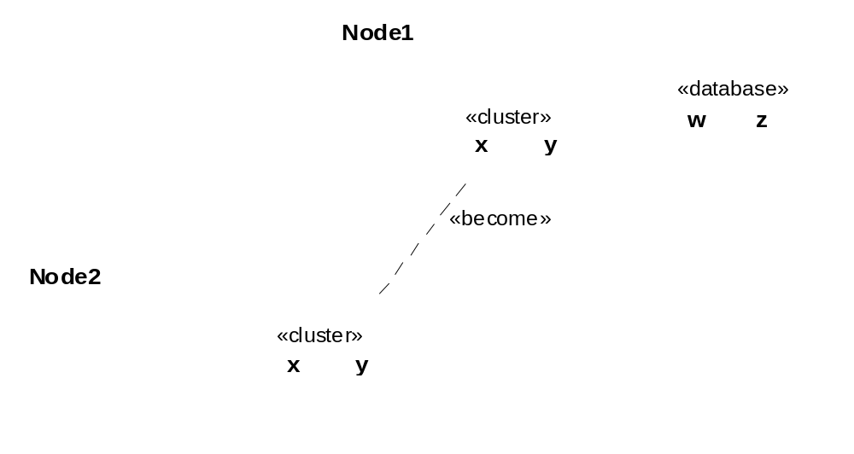
Deployment Diagram (cont’d)

Slide 10
When to model structure
Adopt an opportunistic top-down+bottom-up approach to modeling structure
  Specify the top-level structure using “architecturally significant” classifiers and model management constructs (packages, models, subsystems; see Tutorial 3)
  Specify lower-level structure as you discover detail re classifiers and relationships
If you understand your domain well you can frequently start with structural modeling; otherwise
  If you start with use case modeling (as with a use-case driven method) make sure that your structural model is consistent with your use cases
  If you start with role modeling (as with a collaboration-driven method) make sure that your structural model is consistent with your collaborations

Slide 11
Structural Modeling Tips
Define a “skeleton” (or “backbone”) that can be extended and refined as you learn more about your domain.
Focus on using basic constructs well; add advanced constructs and/or notation only as required.
Defer implementation concerns until late in the modeling process.
Structural diagrams should
  emphasize a particular aspect of the structural model
  contain classifiers at the same level of abstraction
Large numbers of classifiers should be organized into packages

Slide 12
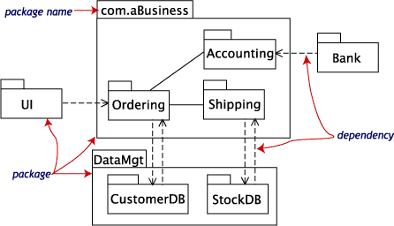
Example : Package Diagram of Business Model

Slide 13
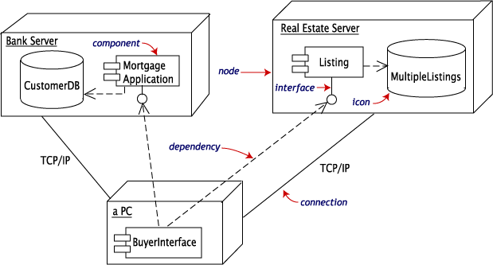
Example : Deployment Diagram
In transaction

Slide 14
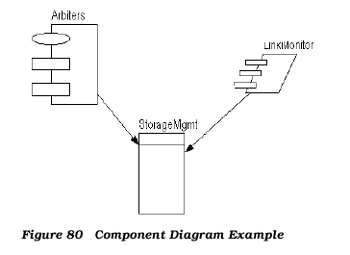
Example : Rational Rose Component Diagram

Slide 15
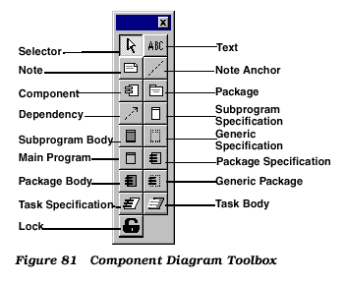
Example : Rational Rose Component Tool

Slide 16
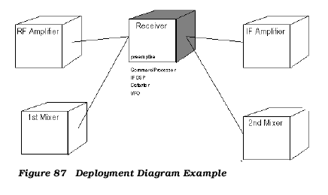
Example : Rational Rose Deployment Diagram

Slide 17
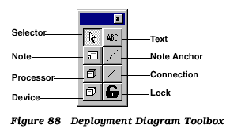
Example : Rational Rose Deployment Tool

