Slide 1
Chapter 4 – Evaluating Classification & Predictive Performance
Data Mining for Business Intelligence
Shmueli, Patel & Bruce
© Galit Shmueli and Peter Bruce 2008

Slide 2
Why Evaluate?
Multiple methods are available to classify or predict
For each method, multiple choices are available for settings
To choose best model, need to assess each model’s performance

Slide 3
Accuracy Measures (Classification)

Slide 4
Misclassification error
Error = classifying a record as belonging to one class when it belongs to another class.
Error rate = percent of misclassified records out of the total records in the validation data

Slide 5
Naïve Rule
Naïve rule: classify all records as belonging to the most prevalent class
Often used as benchmark: we hope to do better than that
Exception: when goal is to identify high-value but rare outcomes, we may do well by doing worse than the naïve rule (see “lift” – later)

Slide 6
Separation of Records
“High separation of records” means that using predictor variables attains low error
“Low separation of records” means that using predictor variables does not improve much on naïve rule

Slide 7
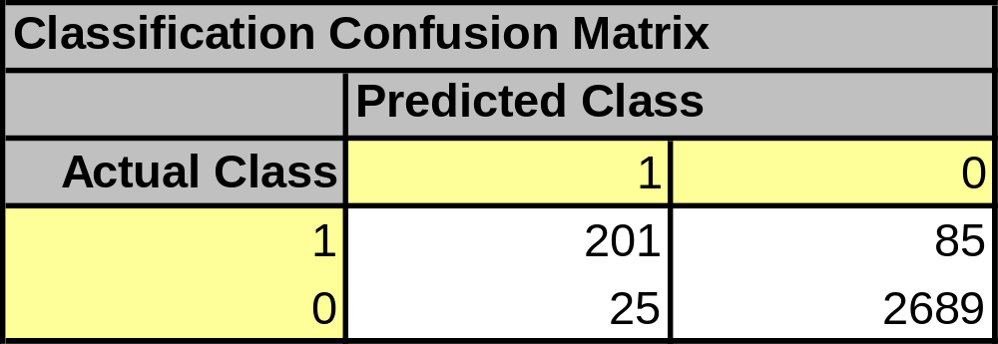
Confusion Matrix
201 1’s correctly classified as “1”
85 1’s incorrectly classified as “0”
25 0’s incorrectly classified as “1”
2689 0’s correctly classified as “0”

Slide 8
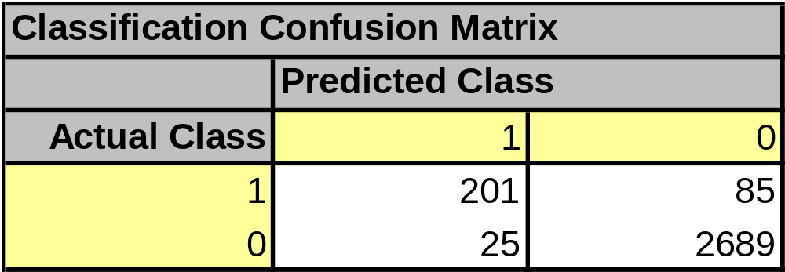
Error Rate
Overall error rate = (25+85)/3000 = 3.67%
Accuracy = 1 – err = (201+2689) = 96.33%
If multiple classes, error rate is:
  (sum of misclassified records)/(total records)

Slide 9
Cutoff for classification
Most DM algorithms classify via a 2-step process:
For each record,
  Compute probability of belonging to class “1”
  Compare to cutoff value, and classify accordingly
Default cutoff value is 0.50
  If >= 0.50, classify as “1”
  If < 0.50, classify as “0”
Can use different cutoff values
Typically, error rate is lowest for cutoff = 0.50

Slide 10
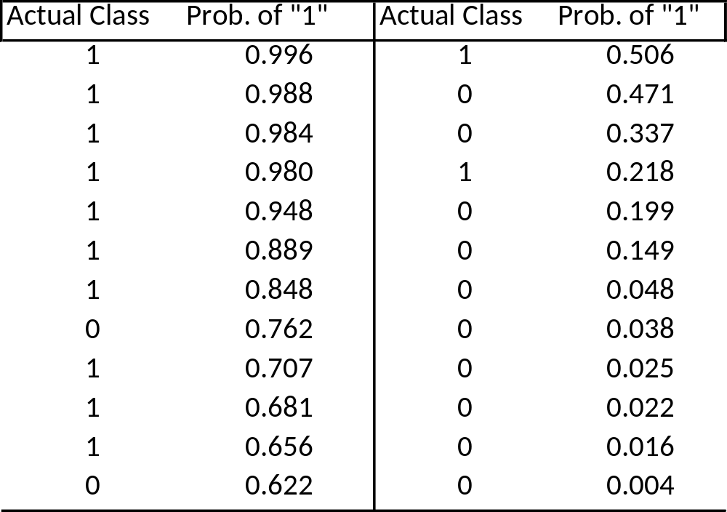
Cutoff Table
If cutoff is 0.50: eleven records are classified as “1”
If cutoff is 0.80: seven records are classified as “1”

Slide 11
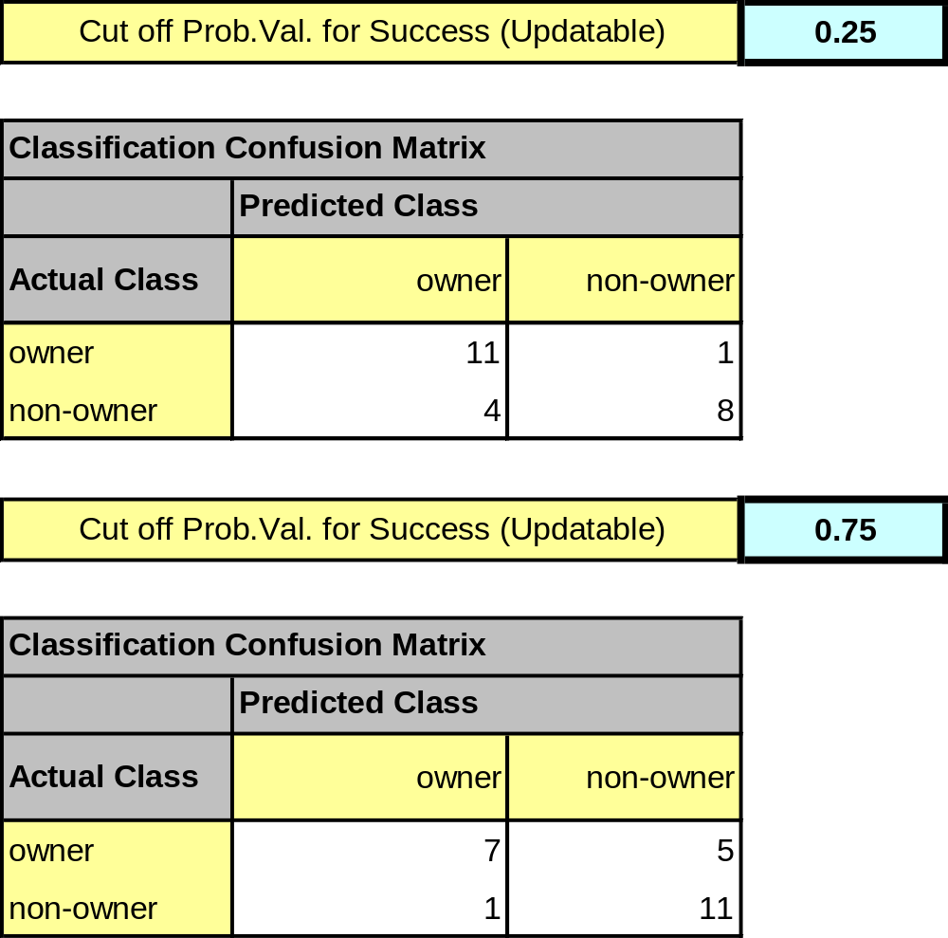
Confusion Matrix for Different Cutoffs

Slide 12
Lift

Slide 13
When One Class is More Important
In many cases it is more important to identify members of one class
  Tax fraud
  Credit default
  Response to promotional offer
  Detecting electronic network intrusion
  Predicting delayed flights
In such cases, we are willing to tolerate greater overall error, in return for better identifying the important class for further attention

Slide 14
Alternate Accuracy Measures
If “0” is the important class,
Sensitivity = % of “0” class correctly classified
Specificity = % of “1” class correctly classified
False positive rate = % of predicted “0’s” that were not “0’s”
False negative rate = % of predicted “1’s” that were not “1’s”
  Note: because “0,” not “1,” is the important class, the use of the terms “positive” and “negative” is counterintuitive.

Slide 15
Lift and Decile Charts: Goal
Useful for assessing performance in terms of identifying the most important class
Helps evaluate, e.g.,
  How many tax records to examine
  How many loans to grant
  How many customers to mail offer to

Slide 16
Lift and Decile Charts – Cont.
Compare performance of DM model to “no model, pick randomly”
Measures ability of DM model to identify the important class, relative to its average prevalence
Charts give explicit assessment of results over a large number of cutoffs

Slide 17
Lift and Decile Charts: How to Use
Compare lift to “no model” baseline
  In lift chart: compare step function to straight line
  In decile chart compare to ratio of 1

Slide 18
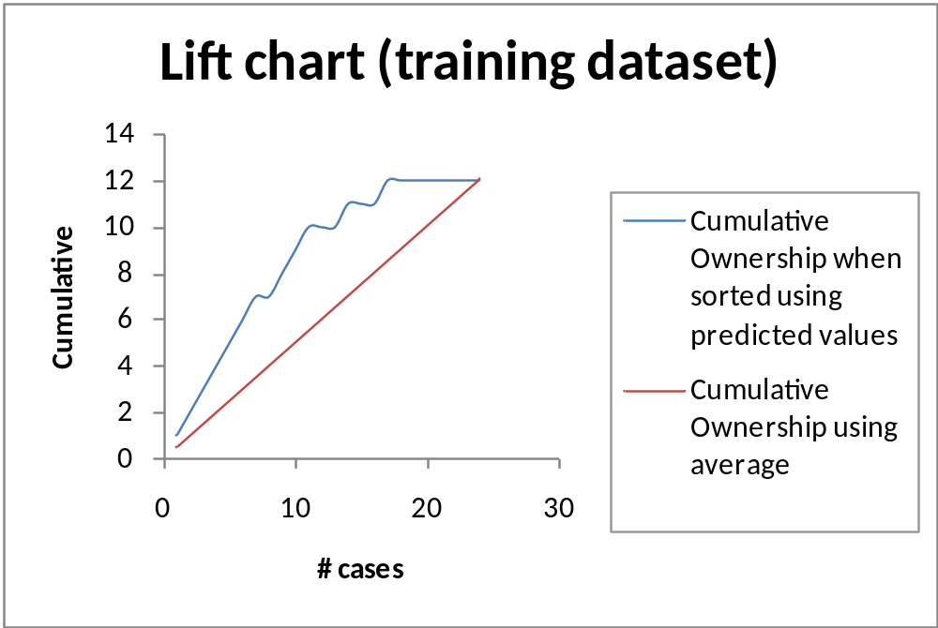
Lift Chart – cumulative performance
After examining (e.g.,) 10 cases (x-axis), 9 owners (y-axis) have been correctly ID’d

Slide 19
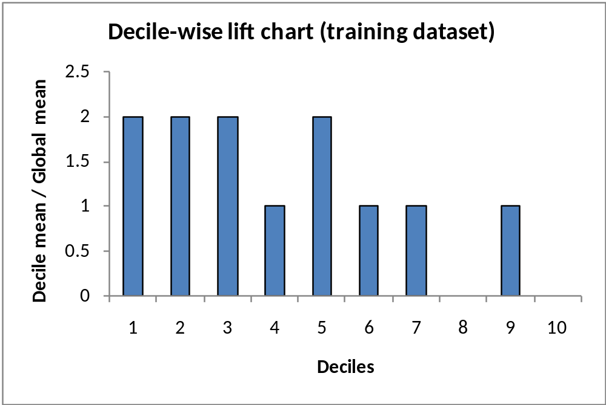
Decile Chart
In “most probable” (top) decile, model is twice as likely to ID the important class (compared to avg. prevalence)

Slide 20
Lift Charts: How to Compute
Using the model’s classifications, sort records from most likely to least likely members of the important class
Compute lift: Accumulate the correctly classified “important class” records (Y axis) and compare to number of total records (X axis)

Slide 21
Lift vs. Decile Charts
Both embody concept of “moving down” through the records, starting with the most probable
Decile chart does this in decile chunks of data
  Y axis shows ratio of decile mean to overall mean
Lift chart shows continuous cumulative results
  Y axis shows the number of important class records identified

Slide 22
Asymmetric Costs

Slide 23
Misclassification Costs May Differ
The cost of making a misclassification error may be higher for one class than the other(s)
Looked at another way, the benefit of making a correct classification may be higher for one class than the other(s)

Slide 24
Example – Response to Promotional Offer
Suppose we send an offer to 1000 people, with 1% average response rate (“1” = response, “0” = nonresponse)
“Naïve rule” (classify everyone as “0”) has error rate of 1% (seems good)
Using DM we can correctly classify eight 1’s as 1’s
  It comes at the cost of misclassifying twenty 0’s as 1’s and two 0’s as 1’s.

Slide 25
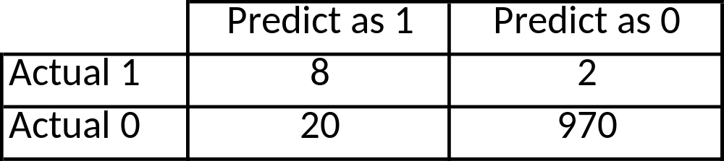
The Confusion Matrix
Error rate = (2+20) = 2.2% (higher than naïve rate)

Slide 26
Introducing Costs & Benefits
Suppose:
profit from a “1” is $10
Cost of sending offer is $1
Then:
Under naïve rule, all are classified as “0” so no offers are sent: no cost, no profit
Under DM predictions, 28 offers are sent.
  8 respond with profit of $10 each
  20 fail to respond, cost $1 each
  972 receive nothing (no cost, no profit)
Net profit = $60

Slide 27
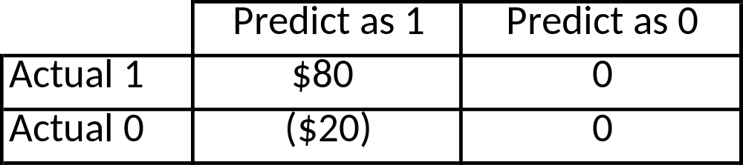
Profit Matrix

Slide 28
Lift (again)
Adding costs to the mix, as above, does not change the actual classifications
Better: Use the lift curve and change the cutoff value for “1” to maximize profit

Slide 29
Generalize to Cost Ratio
Sometimes actual costs and benefits are hard to estimate
Need to express everything in terms of costs (i.e. cost of misclassification per record)
Goal is to minimize the average cost per record
A good practical substitute for individual costs is the ratio of misclassification costs (e,g,, “misclassifying fraudulent firms is 5 times worse than misclassifying solvent firms”)

Slide 30
Minimizing Cost Ratio
q₁ = cost of misclassifying an actual “1”,
q₀ = cost of misclassifying an actual “0”
Minimizing the cost ratio q₁/q₀ is identical to
minimizing the average cost per record
Software* may provide option for user to specify cost ratio
*Currently unavailable in XLMiner

Slide 31
Note: Opportunity costs
As we see, best to convert everything to costs, as opposed to a mix of costs and benefits
E.g., instead of “benefit from sale” refer to “opportunity cost of lost sale”
Leads to same decisions, but referring only to costs allows greater applicability

Slide 32
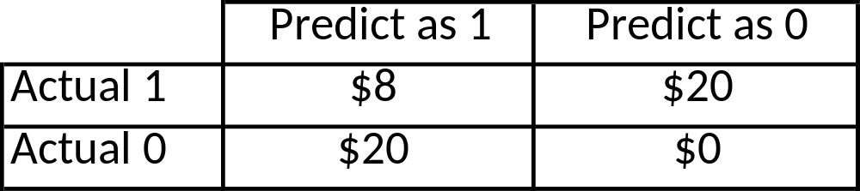
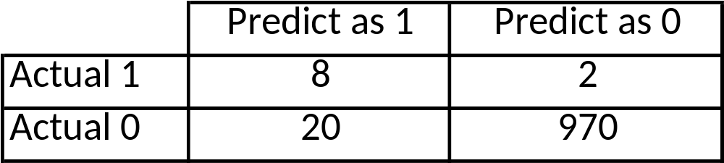
Cost Matrix
(inc. opportunity costs)
Recall original confusion matrix (profit from a “1” = $10, cost of sending offer = $1):

Slide 33
Multiple Classes
For m classes, confusion matrix has m rows and m columns
Theoretically, there are m(m-1) misclassification costs, since any case could be misclassified in m-1 ways
Practically too many to work with
In decision-making context, though, such complexity rarely arises – one class is usually of primary interest

Slide 34
Adding Cost/Benefit to Lift Curve
Sort records in descending probability of success
For each case, record cost/benefit of actual outcome
Also record cumulative cost/benefit
Plot all records
  X-axis is index number (1 for 1st case, n for n^{th} case)
  Y-axis is cumulative cost/benefit
  Reference line from origin to y_{n} ( y_{n} = total net benefit)

Slide 35
Lift Curve May Go Negative
If total net benefit from all cases is negative, reference line will have negative slope
Nonetheless, goal is still to use cutoff to select the point where net benefit is at a maximum

Slide 36
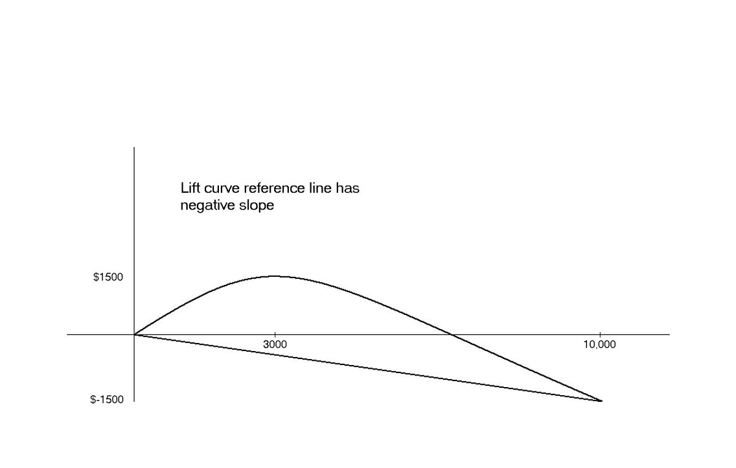
Negative slope to reference curve

Slide 37
Oversampling and Asymmetric Costs

Slide 38
Rare Cases
Asymmetric costs/benefits typically go hand in hand with presence of rare but important class
  Responder to mailing
  Someone who commits fraud
  Debt defaulter
Often we oversample rare cases to give model more information to work with
Typically use 50% “1” and 50% “0” for training

Slide 39
Example
Following graphs show optimal classification under three scenarios:
  assuming equal costs of misclassification
  assuming that misclassifying “o” is five times the cost of misclassifying “x”
  Oversampling scheme allowing DM methods to incorporate asymmetric costs

Slide 40
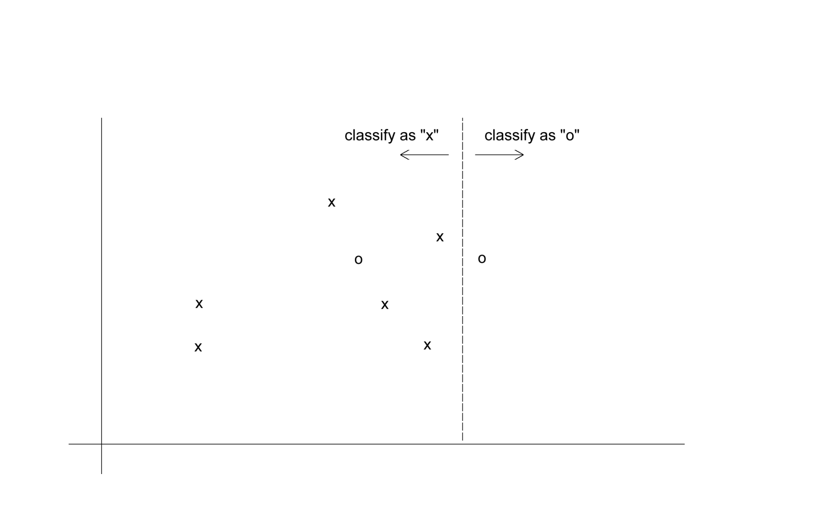
Classification: Equal Costs

Slide 41
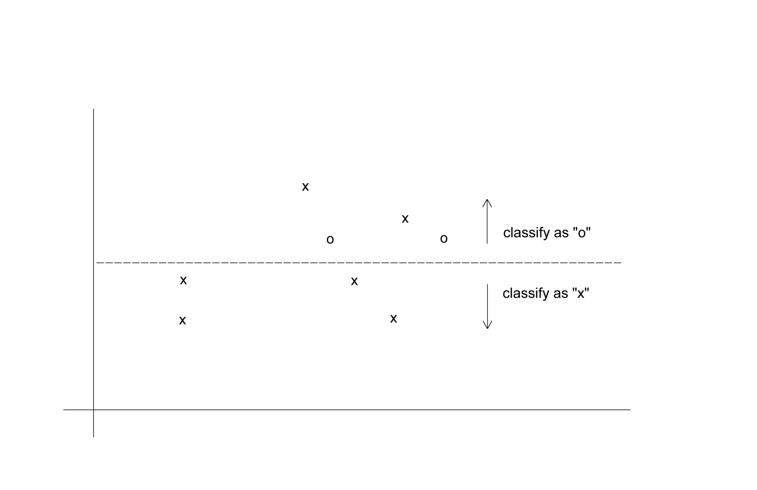
Classification: Unequal Costs

Slide 42
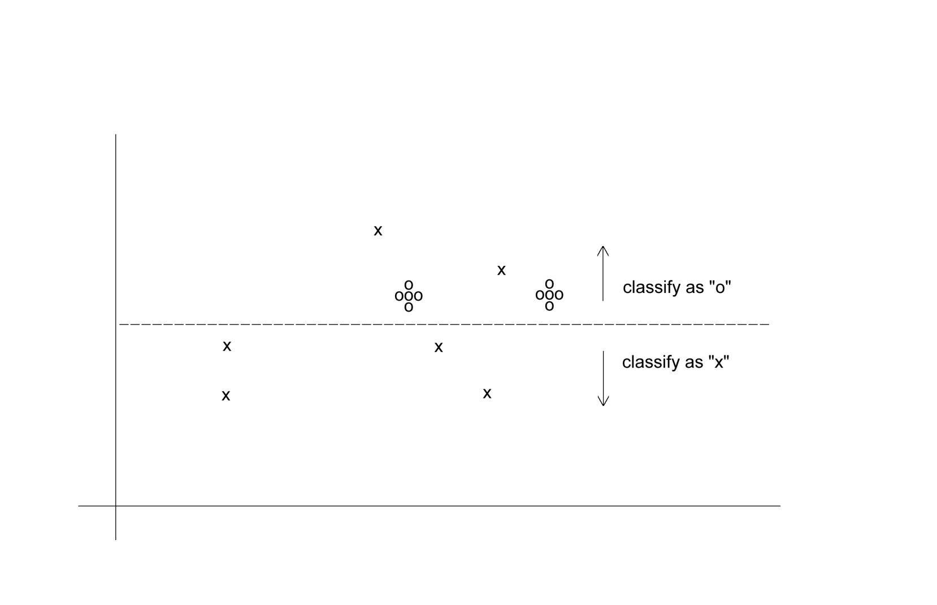
Oversampling Scheme
Oversample “o” to appropriately weight misclassification costs

Slide 43
An Oversampling Procedure
Separate the responders (rare) from non-responders
Randomly assign half the responders to the training sample, plus equal number of non-responders
Remaining responders go to validation sample
Add non-responders to validation data, to maintain original ratio of responders to non-responders
Randomly take test set (if needed) from validation

Slide 44
Classification Using Triage
Take into account a gray area in making classification decisions
Instead of classifying as C₁ or C₂, we classify as
  C₁
  C₂
  Can’t say
The third category might receive special human review

Slide 45
Evaluating Predictive Performance

Slide 46
Measuring Predictive error
Not the same as “goodness-of-fit”
We want to know how well the model predicts new data, not how well it fits the data it was trained with
Key component of most measures is difference between actual y and predicted y (“error”)

Slide 47
Some measures of error
MAE or MAD: mean absolute error (deviation)
  Gives an idea of the magnitude of errors
Average error
  Gives an idea of systematic over- or under-prediction
MAPE: mean absolute percentage error
RMSE (root-mean-squared-error): square the errors, find their average, take the square root
Total SSE: total sum of squared errors

Slide 48
Lift Chart for Predictive Error
Similar to lift chart for classification, except…
Y axis is cumulative value of numeric target variable (e.g. revenue), instead of cumulative count of “responses”

Slide 49
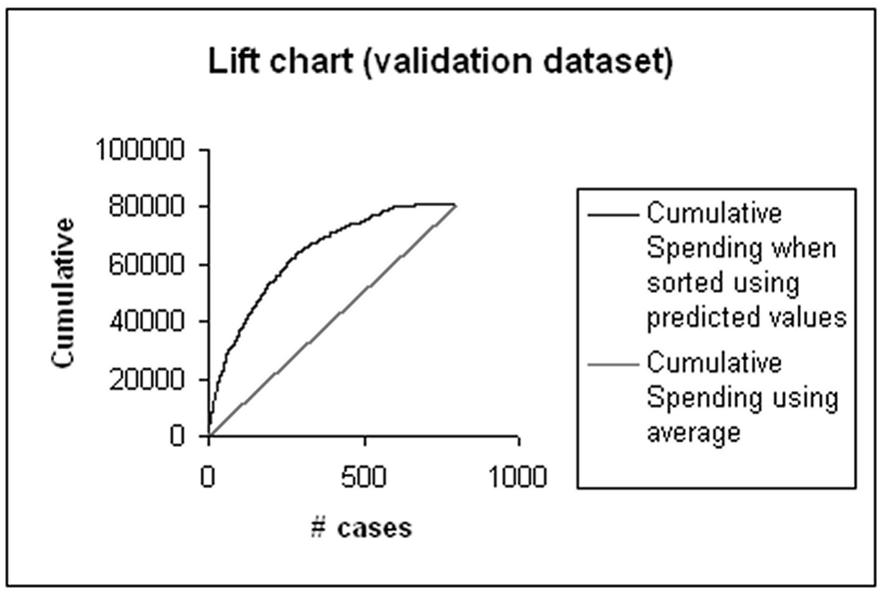
Lift chart example – spending

Slide 50
Summary
Evaluation metrics are important for comparing across DM models, for choosing the right configuration of a specific DM model, and for comparing to the baseline
Major metrics: confusion matrix, error rate, predictive error
Other metrics when
  one class is more important
  asymmetric costs
When important class is rare, use oversampling
In all cases, metrics computed from validation data

