Slide 1
Spark Streaming
Dongjun Lee
16 December 2016

Slide 2
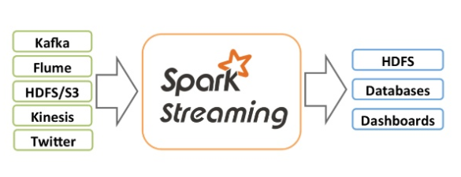
Overview
Spark streaming is an extension of Spark API
Scalable, high-throughput, fault tolerant stream processing of live data streams
Data can be ingested from many sources (Kafka, Flume, TCP sockets ..)
Can be processed using complex algorithms expressed with high-level functions (ex. Map, reduce, join, window)
Processed data can be pushed out to filesystems or databases.
Can apply Spark’s machine learning and graph processing algorithms on data stream

Slide 3
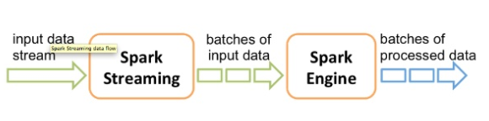
Overview
How internally it works
Receives live input data streams and divides the data into batches
Then processed by the Spark engine to generate the final stream of results in batches.
Dstream
Spark streaming provides a high-level abstraction called discretized stream(Dstream)
Represents a continuous stream of data
Can be created either from data or by applying high-level operations on other Dstreams
Internally Dstream is represented as a sequence of RDDs
Notes:
Like RDD’s transformation and action

Slide 4
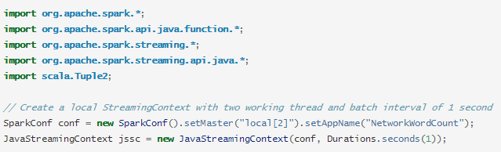
A Quick Example
Simple Spark Streaming program example
Count the number of words in text data received from a data server listening on a TCP socket.
First, we create a JavaStreamingContext object.
Main entry point for all streaming functionality.
Create a local StreamingContext with two execution threads, and a batch interval of 1 second.

Slide 5
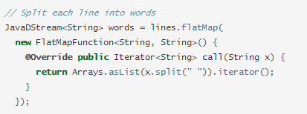
A Quick Example (cont.)
Create a Dstream that represents streaming data
Each record in this stream is a line of text, then we want to split the lines by space into words.
flatMap is DStream operation that creates a new DStream by generating multiple new records from each record in the source DStream

Slide 6
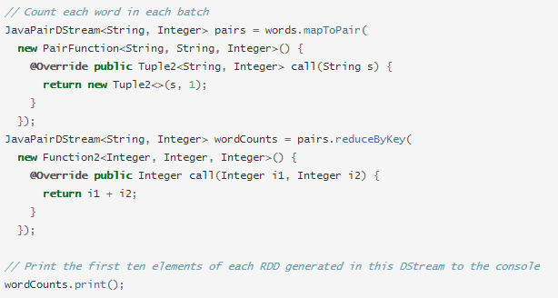
A Quick Example (cont.)
Next, we count these words
The words Dstream is mapped to a Dstream of (word, 1) pairs.
Then it is reduced to get the frequency of words in each batch of data

Slide 7

A Quick Example (cont.)
To start the processing after all the transformations have been setup, we finally call start method

Slide 8
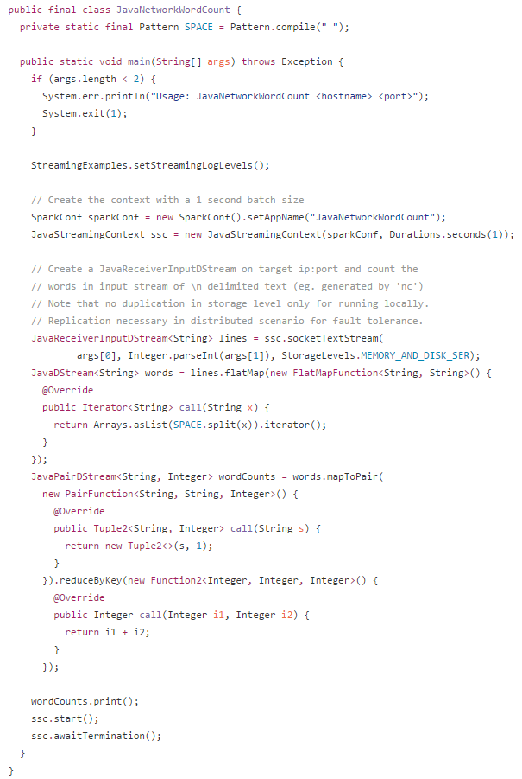

Slide 9
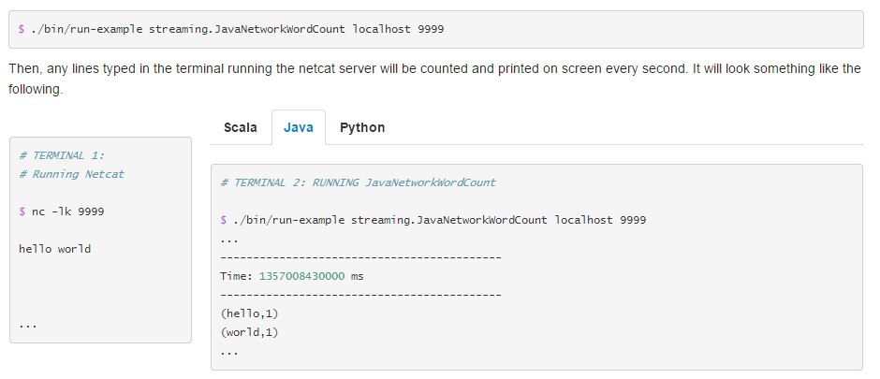
A Quick Example (cont.)
How to run the example
Using NetCat as a data server

Slide 10
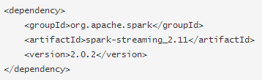
Basic Concepts - Linking
Spark streaming is available through Maven central.
Add the following dependency to your Maven project.
What is Maven?
Project management and comprehension tool.
Can manage a project’s build, reporting and documentation from a central piece of information. (pom.xml)

Slide 11
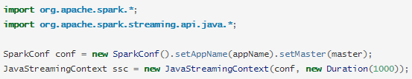
Basic Concepts – Initializing StreamingContext
A JavaStreamingContext object can be created from a SparkConf object
appName parameter is a name for your application to show on the cluster UI
master is a Spark, Mesos, or YARN cluster URL
Notes:
appName parameter is a name for your application to show on the cluster UI.

Slide 12
Basic Concepts – More about StreamingContext
After a context is defined, you have to do the following.
1. Define the input sources by creating input DStreams.
2. Define the streaming computations by applying transformation and output operations to DStreams.
3. Start receiving data and processing it using streamingContext.start()
4. Wait for the processing to be stopped (manually or due to any error) using streamingContext.awaitTermination().
5. The processing can be manually stopped using streamingContext.stop().
Points to remember
Once a context has been started, no new streaming computations can be set up or added to it.
Once a context has been stopped, it cannot be restarted.
Only one StreamingContext can be active in a JVM at the same time.
A SparkContext can be re-used to create multiple StreamingContexts, as long as the previous StreamingContext is stopped (without stopping the SparkContext) before the next StreamingContext is created.

Slide 13
Input DStreams and Receivers
Basic Sources
File Streams : For reading data from files on any file system compatible with the HDFS API (HDFS, S3, NFS etc.)
Queue of RDDs as a Stream : For testing a Spark Streaming application with test data, one can also create a DStream based on a queue of RDDs
Advanced Sources (with external non-Spark libraries)
Kafka
Flume
Kinesis
Custom Sources
Input Dstreams can also be created out of custom data sources.
All you have to do is implement a user-defined receiver that can receive data from the custom sources and push it into Spark

Slide 14
For next seminar
Transformations on Dstreams
How the data from the input Dstream to be modified.
Similar to “transformations” for RDDs
Output Operations on Dstreams
How Dstream’s data to be pushed out to external systems (like a database or file systems)
Similar to “actions” for RDDs
Some design patterns
MLlib Operations (May be in next next seminar)
Deploying Applications
Monitoring Applications
Performance Tuning (May be in next next seminar)
About Paper if you want!
System architecture, features, performance etc.

