Slide 1

Session 15
Applying the Activity Diagram to the Case Study
Written by Thomas A. Pender
Published by Wiley Publishing, Inc.
October 20, 2011
Presented by Jee-bum Park

Slide 2
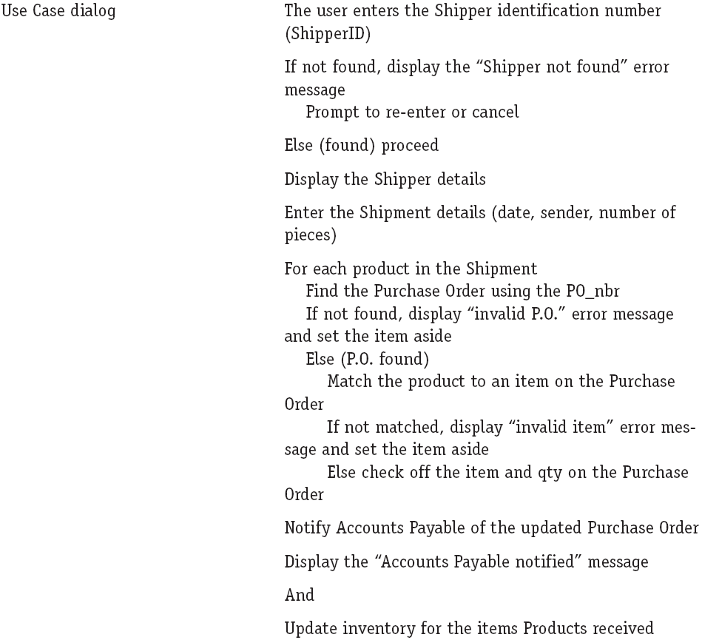
Building an Activity Diagram for the Case Study (1/12)
One way to proceed with the Activity diagram is
  To follow the Use Case narrative

Slide 3
Building an Activity Diagram for the Case Study (2/12)
First, identify the pre-conditions
  The pre-conditions must be tested before you allow the Use Case to execute

Slide 4
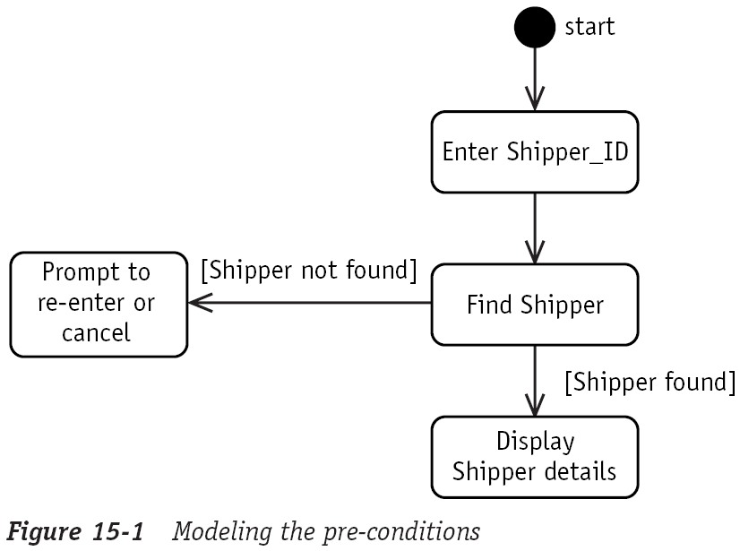
Building an Activity Diagram for the Case Study (3/12)
First, identify the pre-conditions
  The pre-conditions must be tested before you allow the Use Case to execute

Slide 5
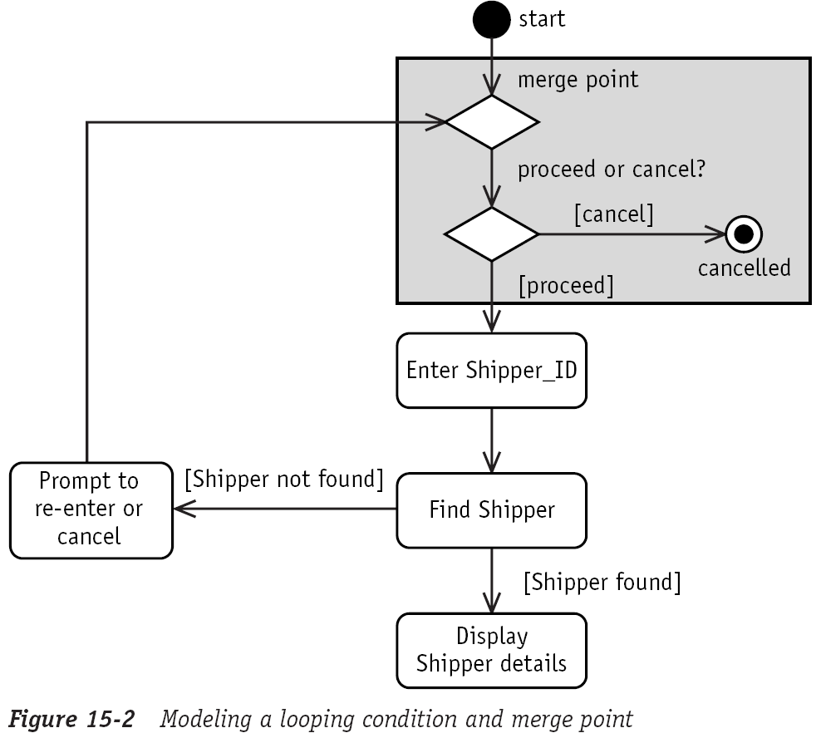
Building an Activity Diagram for the Case Study (4/12)
First, identify the pre-conditions
  To make a re-enter flow, you need to loop back to the beginning and offer them a choice

Slide 6
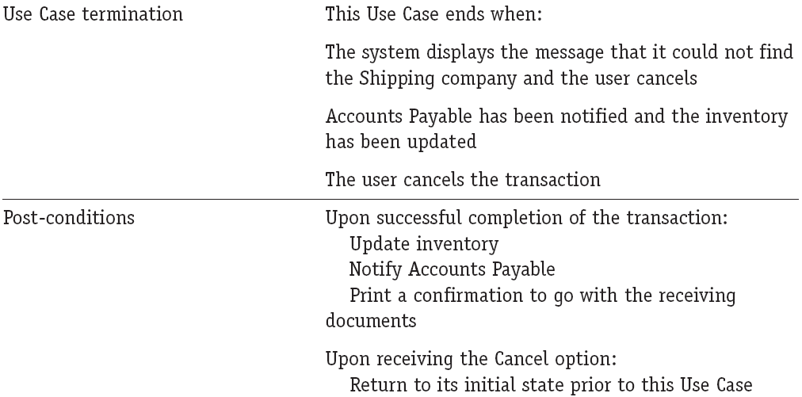
Building an Activity Diagram for the Case Study (5/12)
Next identify the post-conditions and terminations

Slide 7
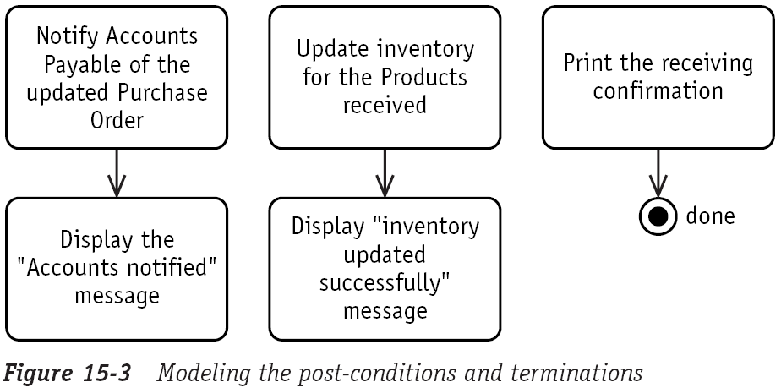
Building an Activity Diagram for the Case Study (6/12)
Next identify the post-conditions and terminations

Slide 8
Building an Activity Diagram for the Case Study (7/12)
Next, you need to set up for each loop with a decision diamond

Slide 9
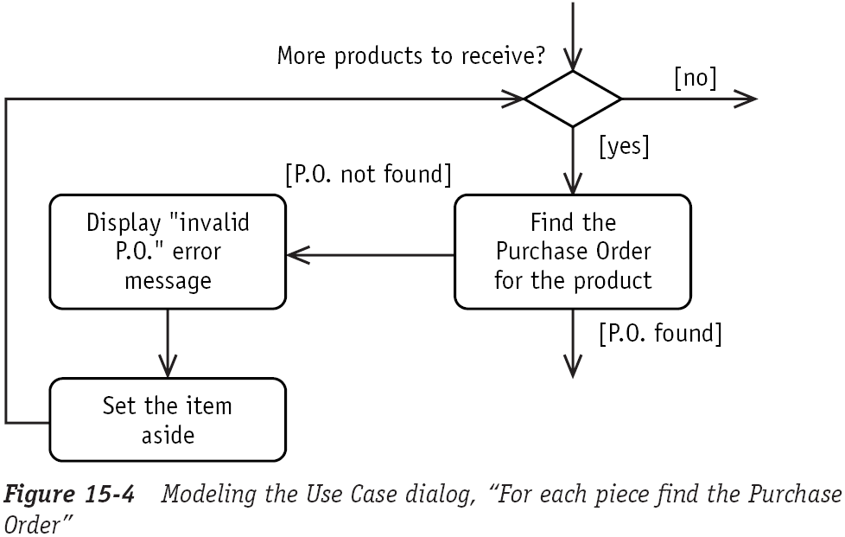
Building an Activity Diagram for the Case Study (8/12)
Next, you need to set up for each loop with a decision diamond

Slide 10
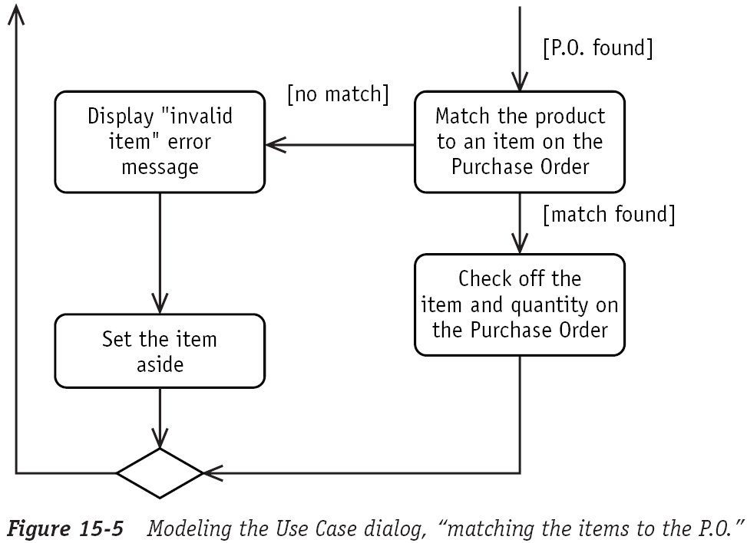
Building an Activity Diagram for the Case Study (9/12)
Loop back to the more products to receive decision

Slide 11
Building an Activity Diagram for the Case Study (10/12)
Concurrency opportunity

Slide 12
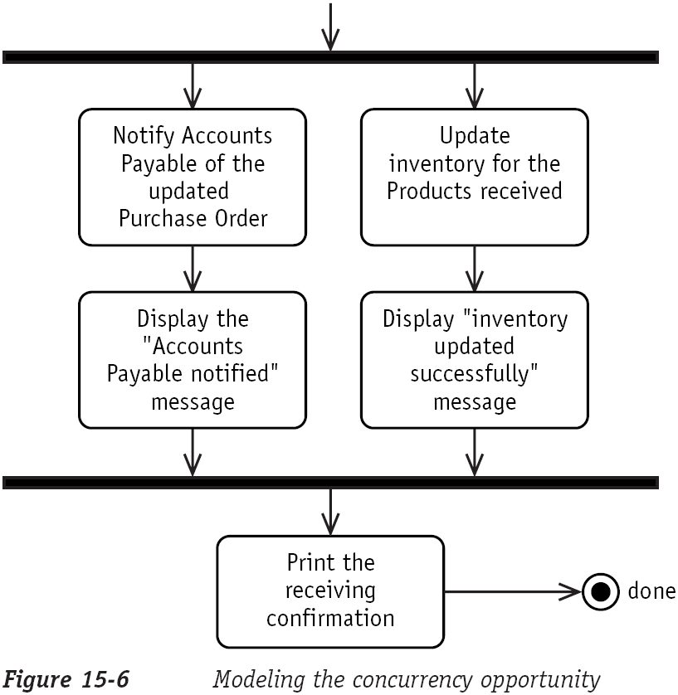
Building an Activity Diagram for the Case Study (11/12)
Concurrency opportunity

Slide 13
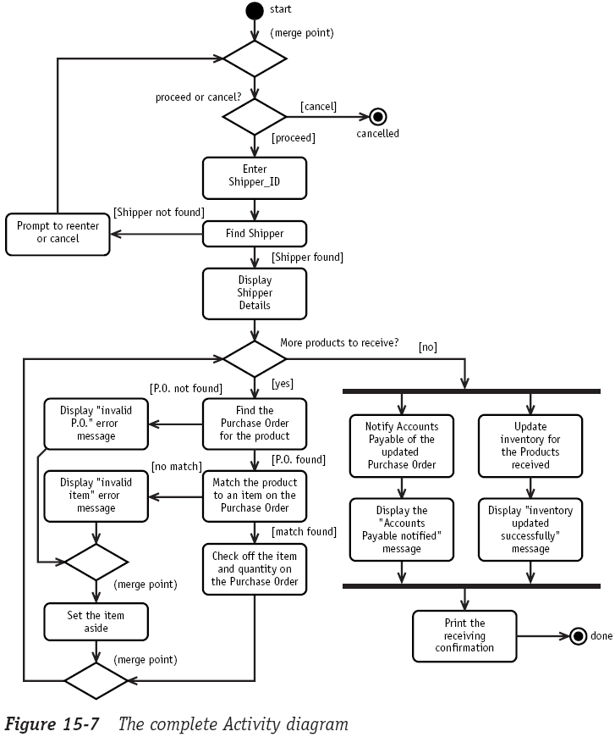

Building an Activity Diagram for the Case Study (12/12)

Slide 14
The End

