Slide 1

Session 20
Modeling the Dynamic View:
The Statechart Diagram
Written by Thomas A. Pender
Published by Wiley Publishing, Inc.
October 20, 2011
Presented by So-min Kim

Slide 2
Contents
Describing the Purpose and Function of the Statechart
Diagram
Defining the Fundamental Notation for a Statechart Diagram
Building a Statechart Diagram
Defining Internal Events and Activities

Slide 3
Describing the Purpose and Function of the Statechart Diagram (1/2)
Statechart diagram
  It models the life of a single object
  Two elements
    A state is the condition of the object
    An event triggers a change in state, a transition
      An action is a behavior triggered by an event
      The behavior actually makes the changes to the attribute values that redefine the state of the object

Slide 4
Describing the Purpose and Function of the Statechart Diagram (2/2)
Sequence diagram vs Statechart diagram
  Sequence diagram
    Sequence diagram models the interactions between objects
    The scope is a single scenario
  Statechart diagram
    Statechart diagram models the effect that these interactions have on the internal makeup of the object
    The scope is the entire life of an object

Slide 5
Contents
Describing the Purpose and Function of the Statechart
Diagram
Defining the Fundamental Notation for a Statechart Diagram
Building a Statechart Diagram
Defining Internal Events and Activities

Slide 6
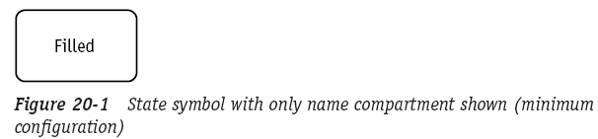
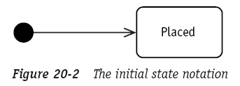
Defining the Fundamental Notation for a Statechart Diagram (1/3)
A state is modeled as a rounded rectangle with the state name inside
The initial state of an object is modeled as a solid dot with an arrow pointing to the first state

Slide 7
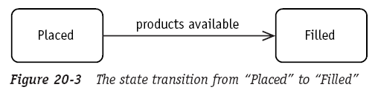
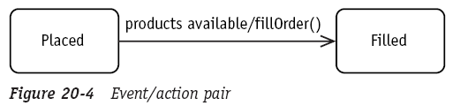
Defining the Fundamental Notation for a Statechart Diagram (2/3)
An event is a line style arrow connecting one state to another state
To model an action, place a forward slash after the event name followed by the name of the action

Slide 8
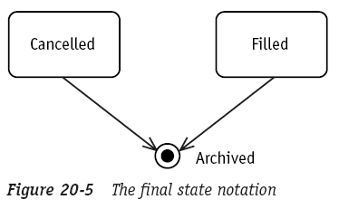
Defining the Fundamental Notation for a Statechart Diagram (3/3)
An object may reach a final state from which it may not return to an active state

Slide 9
Contents
Describing the Purpose and Function of the Statechart
Diagram
Defining the Fundamental Notation for a Statechart Diagram
Building a Statechart Diagram
Defining Internal Events and Activities

Slide 10
Building a Statechart Diagram (1/6)
Problem statement
We track current customer status to help avoid uncollectable receivables and identify customers worthy of preferred treatment. All customers are initially set up as prospects, but when they place their first order, they are considered to be active.
If a customer doesn’t pay an invoice on time, he is placed on probation. If he does pay on time and has ordered more than $10,000 in the previous six months, he warrants preferred status. Preferred status may be changed only if the customer is late on two or more payments. Then he returns to active status rather than probation, giving him the benefit of the doubt based on his preferred history.

Slide 11
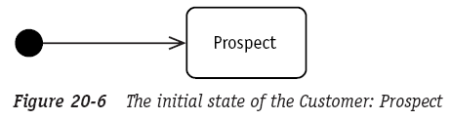
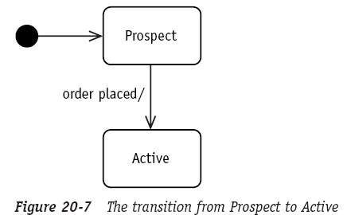
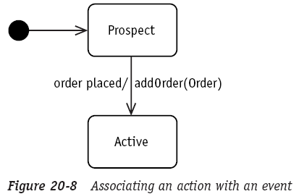
Building a Statechart Diagram (2/6)
Statechart Diagram

Slide 12
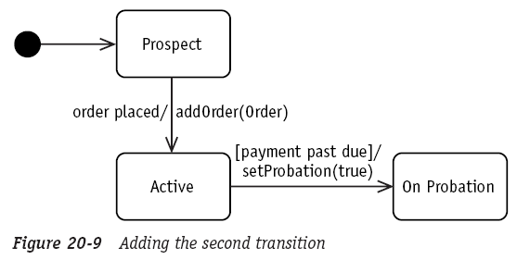
Building a Statechart Diagram (3/6)
Statechart Diagram (cont.)

Slide 13
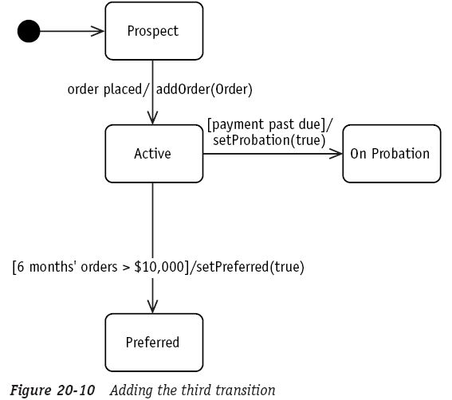
Building a Statechart Diagram (4/6)
Statechart Diagram (cont.)

Slide 14
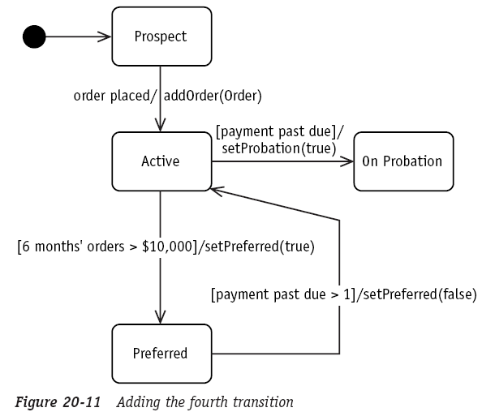
Building a Statechart Diagram (5/6)
Statechart Diagram (cont.)

Slide 15
Building a Statechart Diagram (6/6)
The process of building a Statechart
  1. Model the initial state.
  2. Identify the event(s) that change the object from the initial state to some other state
  3. Name the new state
  4. Draw the transition from the first state to the second
    Label the transition arrow with the event that triggers the transition
  5. Identify the action(s) associated with the event and that actually change the object attributes
    Add the action after the event name and preceded by a forward slash
  6. Continue the process with each new event until all events have been accounted for
  7. If there is a state from which the object can never leave, convert this state to the final state notation

Slide 16
Contents
Describing the Purpose and Function of the Statechart
Diagram
Defining the Fundamental Notation for a Statechart Diagram
Building a Statechart Diagram
Defining Internal Events and Activities

Slide 17
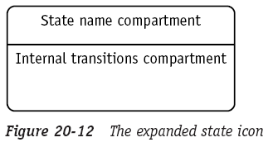
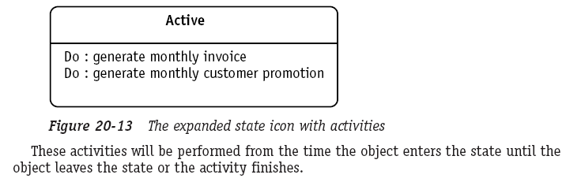
Defining Internal Events and Activities (1/1)
The state icon can be expanded to reveal what the object can do while it is in a given state
  The internal transitions comparment contains information about actions and activities specific to that data
    Activities are processes performed within a state
      Activities may be interrupted because they do not affect the state of the object
      To model activities, use the keyword “Do:”
    Actions alters the state
      You must not interrupt actions

Slide 18
The End

