Slide 1
Chapter 6: Formal Relational Query Languages

Slide 2
Database System Concepts
Chapter 1: Introduction
Part 1: Relational databases
  Chapter 2: Introduction to the Relational Model
  Chapter 3: Introduction to SQL
  Chapter 4: Intermediate SQL
  Chapter 5: Advanced SQL
  Chapter 6: Formal Relational Query Languages
Part 2: Database Design
  Chapter 7: Database Design: The E-R Approach
  Chapter 8: Relational Database Design
  Chapter 9: Application Design
Part 3: Data storage and querying
  Chapter 10: Storage and File Structure
  Chapter 11: Indexing and Hashing
  Chapter 12: Query Processing
  Chapter 13: Query Optimization
Part 4: Transaction management
  Chapter 14: Transactions
  Chapter 15: Concurrency control
  Chapter 16: Recovery System
Part 5: System Architecture
  Chapter 17: Database System Architectures
  Chapter 18: Parallel Databases
  Chapter 19: Distributed Databases
Part 6: Data Warehousing, Mining, and IR
  Chapter 20: Data Mining
  Chapter 21: Information Retrieval
Part 7: Specialty Databases
  Chapter 22: Object-Based Databases
  Chapter 23: XML
Part 8: Advanced Topics
  Chapter 24: Advanced Application Development
  Chapter 25: Advanced Data Types
  Chapter 26: Advanced Transaction Processing
Part 9: Case studies
  Chapter 27: PostgreSQL
  Chapter 28: Oracle
  Chapter 29: IBM DB2 Universal Database
  Chapter 30: Microsoft SQL Server
Online Appendices
  Appendix A: Detailed University Schema
  Appendix B: Advanced Relational Database Model
  Appendix C: Other Relational Query Languages
  Appendix D: Network Model
  Appendix E: Hierarchical Model

Slide 3
Chapter 6: Formal Relational Query Languages
6.1 Relational Algebra
6.2 Tuple Relational Calculus
6.3 Domain Relational Calculus
Formal Theory behind SQL!!!

Slide 4
Relational Algebra
Procedural language (Language Specifying What to Retrieve, not How to Retrieve)
Six basic operators
  select: σ
  project: ∏
  union: ∪
  set difference: –
  Cartesian product: x
  rename: ρ
The operators take one or two relations as inputs and produce a new relation as a result.

Slide 5

Select Operation σ – Example
Relation r
σ_{A=B ^ D > 5} (r)

Slide 6
Select Operation σ
Notation: σ _{p}(r) (where p is called the selection predicate)
Defined as:
σ_{p}(r) = {t | t ∈ r and p(t)}
Where p is a formula in propositional calculus consisting of terms connected by : ∧ (and), ∨ (or), ¬ (not)
Each term is one of: (<attribute>) op ( <attribute> or <constant> )
where op is one of: =, ≠, >, ≥. <. ≤
Example of selection:
σ _{dept_name=“Physics”} (instructor)

Slide 7

Project Operation ∏ – Example
Relation r:
∏_{A,C} (r)

Slide 8

Project Operation ∏
Notation:
where A₁, A₂ are attribute names and r is a relation name.
The result is defined as the relation of k columns obtained by erasing the columns that are not listed
Duplicate rows removed from result, since relations are sets
Example: To eliminate the dept_name attribute of instructor
∏_{ID, name, salary} (instructor)

Slide 9
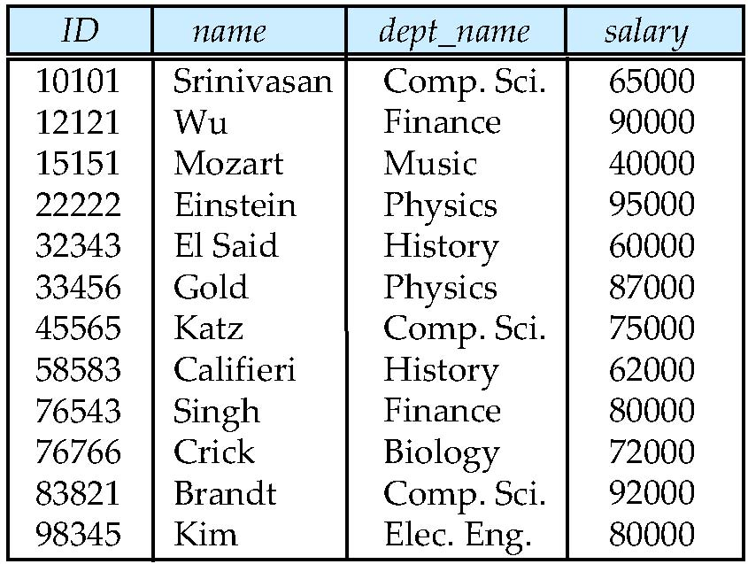
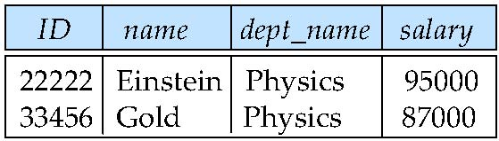
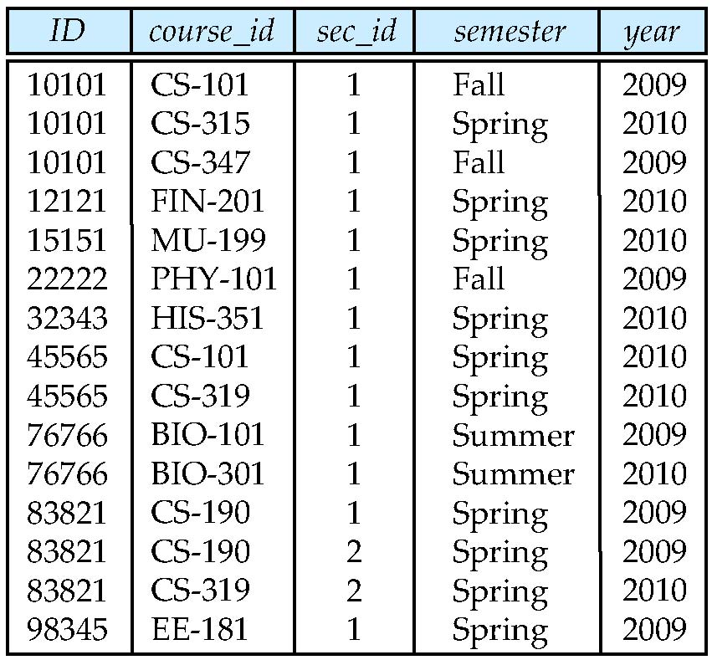
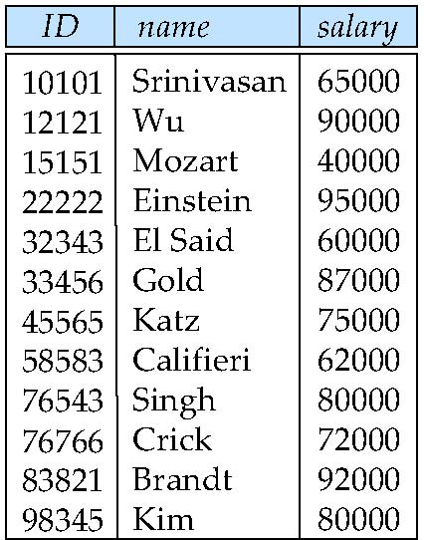
Figure 6.07: The Teaches relation
Figure 6.01: The Instructor relation
Figure 6.02: The result of applying a selection predicate dept_name = “Physics”
Figure 6.03: The result of applying projection with ID, name, salary to
Instructor relation

Slide 10
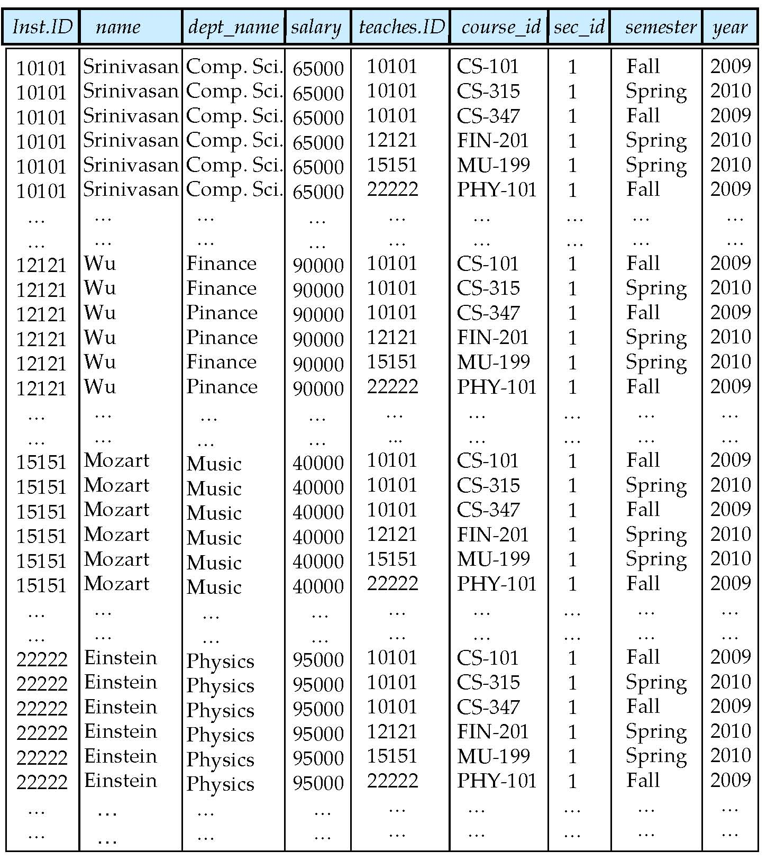
Figure 6.08: The result of instructor X teaches

Slide 11
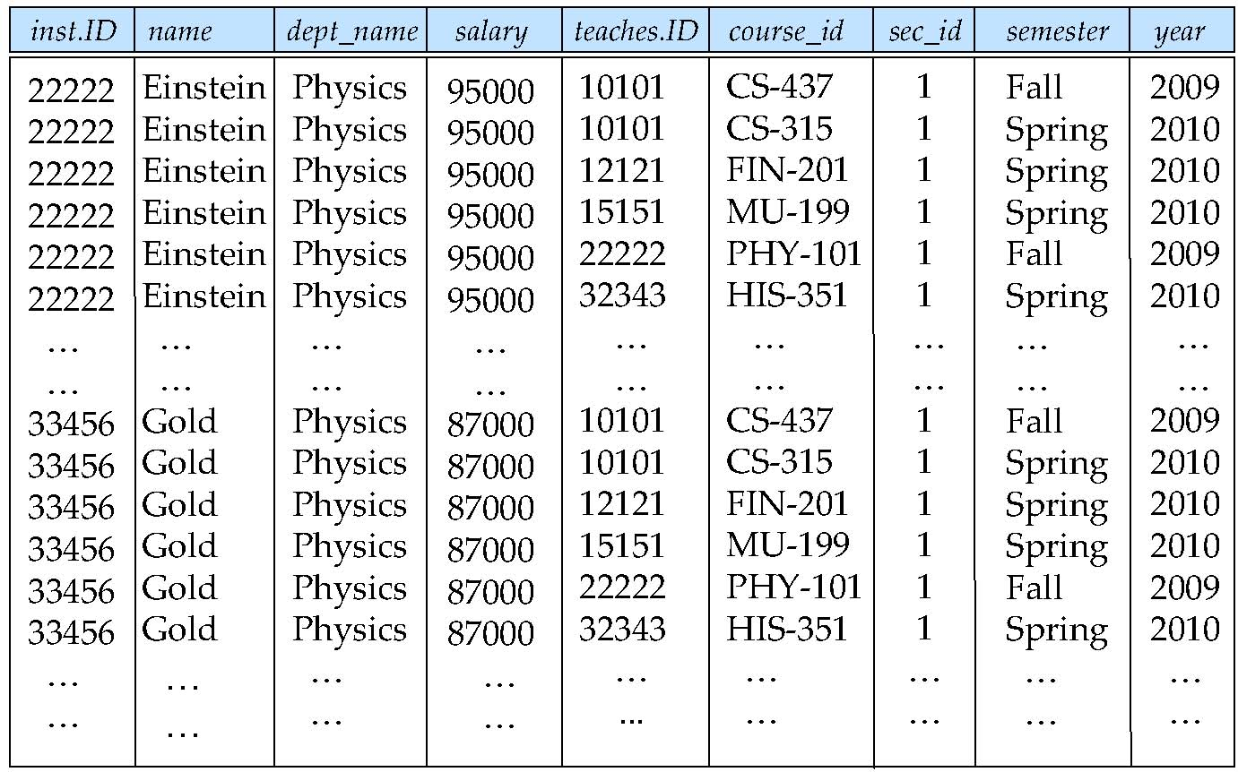
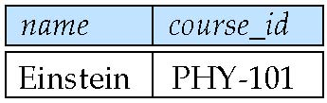
Figure 6.09: The Result of applying a selection predicate dept_name = “Physics” to instructor X teaches
Figure 6.10:

Slide 12

Union Operation ∪ – Example
Relations r, s:
r ∪ s:

Slide 13
Union Operation ∪
Notation: r ∪ s
Defined as:
r ∪ s = {t | t ∈ r or t ∈ s}
For r ∪ s to be valid.
1. r, s must have the same arity (same number of attributes)
2. The attribute domains must be compatible (example: 2nd column
of r deals with the same type of values as does the 2nd column of s)
Example: to find all courses taught in the Fall 2009 semester, or in the Spring 2010 semester, or in both
∏_{course_id} (σ _{semester=“Fall” Λ year=2009} (section)) ∪
∏_{course_id} (σ _{semester=“Spring” Λ year=2010} (section))

Slide 14

Set difference (–) of two relations
Relations r, s:
r – s:

Slide 15
Set Difference (–) Operation
Notation r – s
Defined as:
r – s = {t | t ∈ r and t ∉ s}
Set differences must be taken between compatible relations.
  r and s must have the same arity
  attribute domains of r and s must be compatible
Eg: to find all courses taught in the Fall 2009 semester, but not in the Spring 2010 semester
∏_{course_id} (σ _{semester=“Fall” Λ year=2009} (section)) −
∏_{course_id} (σ _{semester=“Spring” Λ year=2010} (section))

Slide 16

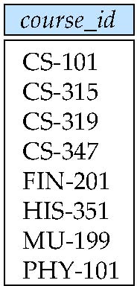
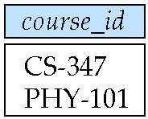
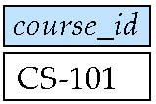
Figure 6.04: The section relation
Figure 6.05: Courses offered in either Fall 2009, Spring 2010 or both semesters
Figure 6.06: Courses offered in either Fall 2009, but not in Spring 2010 semesters
Figure 6.13: Courses offered in both the Fall 2009 and Spring 2010 semesters

Slide 17


Cartesian-Product (X) Operation – Example
Relations r, s:
r x s:
Can build expressions using multiple operations
Example: σ_{A=C}(r x s)

Slide 18
Cartesian-Product Operation
Notation r x s
Defined as:
r x s = {t q | t ∈ r and q ∈ s}
Assume that attributes of r(R) and s(S) are disjoint. (That is, R ∩ S = ∅).
If attributes of r(R) and s(S) are not disjoint, then renaming must be used.

Slide 19

Rename Operation
Allows us to name, and therefore to refer to, the results of relational-algebra expressions.
Allows us to refer to a relation by more than one name.
Example:
ρ _{x} (E)
returns the expression E under the name X
If a relational-algebra expression E has arity n, then
returns the result of expression E under the name X, and with the attributes renamed to A₁ , A₂ , …., A_{n} .

Slide 20
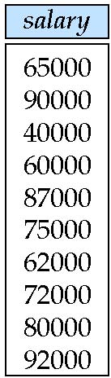
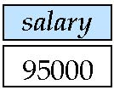
Example Query with Renaming ρ
Find the largest salary in the university
  Step 1: find instructor salaries that are less than some other instructor salary (i.e. not maximum)
      using a copy of instructor under a new name d
    ∏_{instructor.salary} (σ _{instructor.salary < d.salary} (instructor x ρ_{d} (instructor)))
  Step 2: Find the largest salary
    ∏_{salary} (instructor) –
    ∏_{instructor.salary} (σ _{instructor.salary < d,salary} (instructor x ρ_{d} (instructor)))
Figure 6.01: The Instructor relation
Figure 6.11: 누군가의 salary보다는 적은 salary
Figure 6.12: The highest salary

Slide 21
Example Queries with selection commutativity
Find the names of all instructors in the Physics department, along with the course_id of all courses they have taught
  Query 1
  ∏_{instructor.ID,course_id} (σ_{dept_name=“Physics”} ( σ _{instructor.ID=teaches.ID} (instructor x teaches)))
  Query 2
  ∏_{instructor.ID,course_id} (σ_{instructor.ID=teaches.ID} ( σ _{dept_name=“Physics”} (instructor) x teaches))

Slide 22
Formal Definition
A basic expression in the relational algebra consists of either one of the following:
  A relation in the database
  A constant relation
Let E₁ and E₂ be relational-algebra expressions; the following are all relational-algebra expressions:
  E₁ ∪ E₂
  E₁ – E₂
  E₁ x E₂
  σ_{p} (E₁), P is a predicate on attributes in E₁
  ∏_{s}(E₁), S is a list consisting of some of the attributes in E₁
  ρ _{x} (E₁), x is the new name for the result of E₁

Slide 23
Additional Operations
We define additional operations that do not add any power to the relational algebra, but that simplify common queries.
Set intersection
Natural join
Assignment
Outer join

Slide 24

Set-Intersection (∩) Operation
Notation: r ∩ s
Defined as: r ∩ s = { t | t ∈ r and t ∈ s }
Assume:
  r, s have the same arity
  attributes of r and s are compatible
Note: r ∩ s = r – (r – s)
Relation r, s:
r ∩ s

Slide 25
Natural-Join ( ) Operation
Notation: r s
Let r and s be relations on schemas R and S respectively.
Then, r s is a relation on schema R ∪ S obtained as follows:
  Consider each pair of tuples t_{r} from r and t_{s} from s.
  If t_{r} and t_{s} have the same value on each of the attributes in R ∩ S,
  add a tuple t to the result, where
    t has the same value as t_{r} on r
    t has the same value as t_{s} on s
Example:
  R = (A, B, C, D)
  S = (E, B, D)
  Result schema = (A, B, C, D, E)
  r s is defined as:
  ∏_{r.A, r.B, r.C, r.D, s.E} (σ_{r.B = s.B ∧ r.D = s.D} (r x s))

Slide 26

Natural Join Example
Relations r, s:
r s

Slide 27
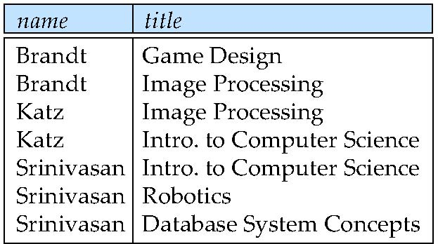
Natural Join and Theta Join
Find the names of all instructors in the Comp. Sci. department together with the course titles of all the courses that the instructors teach
  ∏ _{name, title} (σ _{dept_name=“Comp. Sci.”} (instructor teaches course))
Natural join is associative
  (instructor teaches) course is equivalent to
  instructor (teaches course)
Natural join is commutative
  instruct teaches is equivalent to teaches instructor
The theta join operation r _{θ} s is defined as
  r _{θ} s = σ_{θ} (r x s)
  Theta _{θ} is a selection predicate
Figure 6.16

Slide 28

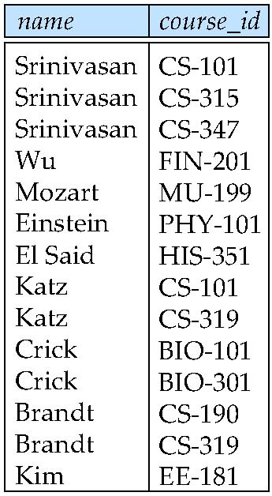
Figure 6.14: Natural Join of the instructor relation and the teaches relation
Figure 6.15: Result of projection with name, course_id on Figure 6.14

Slide 29
Assignment (←) Operation
The assignment operation (←) provides a convenient way to express complex queries.
  Write query as a sequential program consisting of
    a series of assignments
    followed by an expression whose value is displayed as a result of the query.
  Assignment must always be made to a temporary relation variable.
Example
temp1 ← ∏_{R-S} (r )
temp2 ← ∏_{R-S} ((temp1 x s ) – ∏_{R-S,S} (r ))
result = temp1 – temp2
  The result to the right of the ← is assigned to the relation variable on the left of the ←.

Slide 30
Outer Join
An extension of the join operation that avoids loss of information.
Computes the join and then adds tuples form one relation that does not match tuples in the other relation to the result of the join.
Uses null values:
  null signifies that the value is unknown or does not exist
  All comparisons involving null are (roughly speaking) false by definition.
    We shall study precise meaning of comparisons with nulls later
Outer join can be expressed using basic relational operations
  e.g. r s can be written as
  (r s) U (r – ∏_{R}(r s) x {(null, …, null)}
Outer Join
  Left Outer Join
  Right Outer Join
  Full Outer Join

Slide 31
Outer Join – Example
Relation instructor
Relation teaches
ID
name
dept_name
ID
course_id
10101
12121
15151
Srinivasan
Wu
Mozart
Comp. Sci.
Finance
Music
10101
12121
76766
CS-101
FIN-201
BIO-101
Join : instructor teaches
ID
name
dept_name
course_id
10101
12121
Srinivasan
Wu
Comp. Sci.
Finance
CS-101
FIN-201
Left Outer Join: instructor teaches
ID
name
dept_name
course_id
10101
12121
15151
Srinivasan
Wu
Mozart
Comp. Sci.
Finance
Music
CS-101
FIN-201
null

Slide 32
Outer Join – Example (cont.)
Right Outer Join: instructor teaches
ID
name
dept_name
course_id
10101
12121
76766
Srinivasan
Wu
null
Comp. Sci.
Finance
null
CS-101
FIN-201
BIO-101
Full Outer Join: instructor teaches
ID
name
dept_name
course_id
10101
12121
15151
76766
Srinivasan
Wu
Mozart
null
Comp. Sci.
Finance
Music
null
CS-101
FIN-201
null
BIO-101

Slide 33
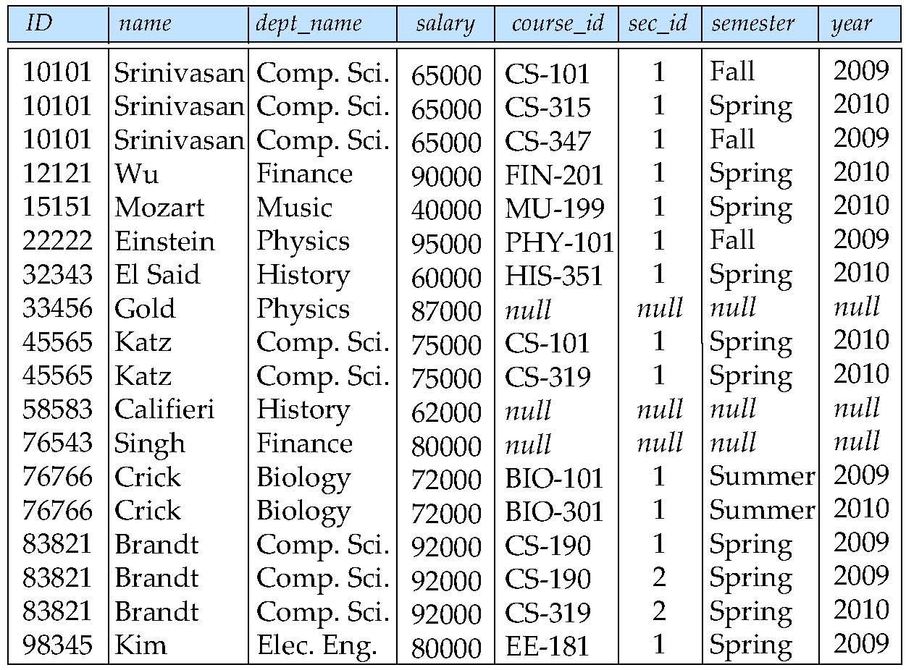
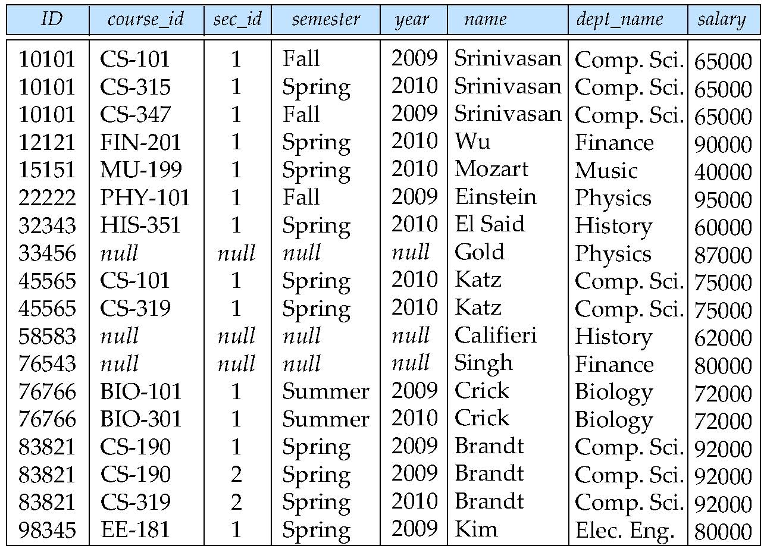
Figure 6.17: Result of instructor left_outer_jon teaches
Figure 6.18: Result of teaches right_outer_join instructor

Slide 34
Null Values
It is possible for tuples to have a null value (denoted by null) for some of their attributes
null signifies an unknown value or that a value does not exist.
The result of any arithmetic expression involving null is null.
Aggregate functions simply ignore null values (as in SQL)
For duplicate elimination and grouping, null is treated like any other value, and two nulls are assumed to be the same (as in SQL)

Slide 35
Null Values
Comparisons with null values return the special truth value: unknown
  If false was used instead of unknown,
  then not (A < 5) would not be equivalent to A >= 5
Three-valued logic using the truth value unknown:
  OR: (unknown or true) = true,
  (unknown or false) = unknown
  (unknown or unknown) = unknown
  AND: (true and unknown) = unknown,
  (false and unknown) = false,
  (unknown and unknown) = unknown
  NOT: (not unknown) = unknown
  In SQL “P is unknown” evaluates to true if predicate P evaluates to unknown
Result of select predicate is treated as false if it evaluates to unknown

Slide 36
Division (÷ ) Operator
Given relations r(R) and s(S), such that S ⊂ R, r ÷ s is the largest relation t(R-S) such that
t x s ⊆ r
E.g. let r(ID, course_id) = ∏_{ID, course_id} (takes ) and
s(course_id) = ∏_{course_id} (σ_{dept_name=“Biology”}(course )
then r ÷ s gives us students who have taken all courses in the Biology department
Can write r ÷ s as
temp1 ← ∏_{R-S} (r )
temp2 ← ∏_{R-S} ((temp1 x s ) – ∏_{R-S,S} (r ))
result = temp1 – temp2
  The result to the right of the ← is assigned to the relation variable on the left of the ←.
  May use variable in subsequent expressions.

Slide 37
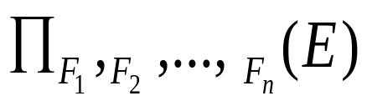
Generalized Projection
Extends the projection operation by allowing arithmetic functions to be used in the projection list.
E is any relational-algebra expression
Each of F₁, F₂, …, F_{n} are arithmetic expressions involving constants and attributes in the schema of E.
Given relation instructor(ID, name, dept_name, salary) where salary is annual salary, get the same information but with monthly salary
∏_{ID, name, dept_name, salary/12} (instructor)

Slide 38


Aggregate Functions and Operations
Aggregation function takes a collection of values and returns a single value as a result.
avg: average value
min: minimum value
max: maximum value
sum: sum of values
count: number of values
Aggregate operation in relational algebra
E is any relational-algebra expression
  G₁, G₂ …, G_{n} is a list of attributes on which to group (can be empty)
  Each F_{i} is an aggregate function
  Each A_{i} is an attribute name
Note: Some books/articles use γ instead of (Calligraphic G)

Slide 39


Aggregate Operation – Example
Relation r:
_{sum(c)} (r)
sum(c )
A
B
C
27
α
α
β
β
α
β
β
β
7
7
3
10
Find the average salary in each department: (with renaming attribute)
_{dept_name} _{avg(salary) as avg_sal} (instructor)
avg_sal

Slide 40
Relational Algebra Modification of the Database
참고자료
The content of the database may be modified using the following operations:
  Deletion
  Insertion
  Updating
All these operations can be expressed using the assignment operator
SQL의 deletion, insertion, update를 relational algebra차원에서 이해하기 위해서…….

Slide 41
Deletion in Relational Algebra
A delete request is expressed similarly to a query, except instead of displaying tuples to the user, the selected tuples are removed from the database.
Can delete only whole tuples; cannot delete values on only particular attributes
A deletion is expressed in relational algebra by:
r ← r – E
where r is a relation and E is a relational algebra query.

Slide 42
Deletion Examples in Relational Algebra
Delete all account records in the Perryridge branch.
account ← account – σ _{branch_name = “Perryridge”} (account )
Delete all loan records with amount in the range of 0 to 50
loan ← loan – σ _{amount ≥ 0 and amount ≤ 50} (loan)
Delete all accounts at branches located in Needham.
r₁ ← σ _{branch_city = “Needham”} (account branch )
r₂ ← ∏ _{account_number,} _{branch_name, balance} (r₁)
r₃ ← ∏ _{customer_name, account_number} (r₂ depositor)
account ← account – r₂
depositor ← depositor – r₃

Slide 43
Insertion in Relational Algebra
To insert data into a relation, we either:
  specify a tuple to be inserted
  write a query whose result is a set of tuples to be inserted
in relational algebra, an insertion is expressed by:
r ← r ∪ E
where r is a relation and E is a relational algebra expression.
The insertion of a single tuple is expressed by letting E be a constant relation containing one tuple.

Slide 44
Insertion Examples in Relational Algebra
Insert information in the database specifying that HJKIM is a instructor for Comp. Sci. and his ID is 12345 and his salary is $40000.
account ← account ∪ {(“12345”, “HJKIM”, “Comp. Sci”, 40000)}
Provide as a gift for all loan customers in the Perryridge branch, a $200 savings account. Let the loan number serve as the account number for the new savings account.
r₁ ← (σ_{branch_name = “Perryridge”} (borrower loan))
account ← account ∪ ∏_{loan_number, branch_name, 200} (r₁)
depositor ← depositor ∪ ∏_{customer_name, loan_number} (r₁)

Slide 45

Updating in Relational Algebra
A mechanism to change a value in a tuple without charging all values in the tuple
Use the generalized projection operator to do this task
Each F_{i} is either
  the I ^{th} attribute of r, if the I ^{th} attribute is not updated, or,
  if the attribute is to be updated F_{i} is an expression, involving only constants and the attributes of r, which gives the new value for the attribute
Update salary by increasing all balances by 5 percent.
Instructor ← ∏ _{salary * 1.05} (instructor)

Slide 46
Multi-Set Concepts
Pure Relational Algebra ➔ No Multi-set
SQL ➔ Multi-set
  Multiple copies of a tuple 이 input될수도 있고
  Projection 형태의 query 결과는 Multi-set형태의 tuple을 가질수 있고….
Therefore, we need multiset relational algebra!
Multiset relational algebra retains duplicates, to match SQL semantics
  SQL duplicate retention was initially for efficiency, but is now a feature

Slide 47
Multiset Relational Algebra
Multiset relational algebra defined as follows
  selection: has as many duplicates of a tuple as in the input, if the tuple satisfies the selection
  projection: one tuple per input tuple, even if it is a duplicate
  cross product: If there are m copies of t1 in r, and n copies of t2 in s, there are m x n copies of t1.t2 in r x s
  Other operators similarly defined
    E.g. union: m + n copies,
    intersection: min(m, n) copies
    difference: min(0, m – n) copies

Slide 48
SQL and Multiset Relational Algebra
select A1, A2, .. An
from r1, r2, …, rm
where P
is equivalent to the following expression in multiset relational algebra
∏ _{A1, .., An} (σ _{P} (r1 x r2 x .. x rm))
More generally, the non-aggregated attributes in the select clause may be a subset of the group by attributes, in which case the equivalence is as follows:
select A1, sum(A3)
from r1, r2, …, rm
where P
group by A1, A2
is equivalent to the following expression in multiset relational algebra
∏ _{A1,sumA3}( _{A1,A2} _{sum(A3)} _{as sumA3}(σ _{P} (r1 x r2 x .. x rm)))

Slide 49
Chapter 6: Formal Relational Query Languages
6.1 Relational Algebra
6.2 Tuple Relational Calculus
6.3 Domain Relational Calculus

Slide 50
Tuple Relational Calculus
A nonprocedural query language (specifying how to retrieve)
Each query is of the form
{t | P (t ) }
It is the set of all tuples t such that predicate P is true for t
t is a tuple variable, t [A ] denotes the value of tuple t on attribute A
t ∈ r denotes that tuple t is in relation r
P is a formula similar to that of the predicate calculus
TRC is based on predicate calculus which is a subset of First Order Logic

Slide 51
Predicate Calculus Formula
1. Set of attributes and constants
2. Set of comparison operators: (e.g., <, ≤, =, ≠, >, ≥)
3. Set of connectives: and (∧), or (v)‚ not (¬)
4. Implication (⇒): x ⇒ y, if x if true, then y is true
x ⇒ y ≡ ¬x v y
5. Set of quantifiers:
  ∃ t ∈ r (Q (t )) ≡ ”there exists” a tuple in t in relation r such that predicate Q (t ) is true
  ∀t ∈ r (Q (t )) ≡ Q is true “for all” tuples t in relation r
  Predicate Calculus ➔ “function”을 고려 하지 않는 First Order Logic의 subset

Slide 52
First-order logic
참고자료
formalizes fundamental mathematical concepts
is expressive (Turing-complete)
has a rich structure of decidable fragments
has a rich model and proof theory
First-order logic is also called
  Predicate logic
  First-order Predicate Calculus

Slide 53
Propositional Logic
참고자료
Propositional logic is a mathematical system for reasoning about propositions and how they relate to one another.
A propositional variable is a variable that is either true or false.
The propositional connectives are
  Negation: ¬p
  Conjunction: p ∧ q
  Disjunction: p ∨ q
  Implication: p → q
  Biconditional: p ↔ q
  True: ⊤
  False: ⊥

Slide 54
Expression in Propositional Logic
참고자료
Some Sample Propositions
  a: I will get up early this morning
  b: There is a lunar eclipse this morning
  c: There are no clouds in the sky this morning
  d: I will see the lunar eclipse
“If I get up early this morning,
but it's cloudy outside,
I won't see the lunar eclipse.
a ∧ ¬c → ¬d

Slide 55
What is First Order Logic?
참고자료
First-order logic is a logical system for reasoning about properties of objects.
Augments the logical connectives from propositional logic with
    predicates that describe properties of objects, and
    functions that map objects to one another,
    quantifiers that allow us to reason about multiple objects simultaneously.

Slide 56
Expressions in First Order Logic
참고자료
Example: “Everyone loves someone else.”
∀p. (Person(p) → ∃q. (Person(q) ∧ p ≠ q ∧ Loves(p, q)))
For every person,
there is some person
who isn't them
that they love.
Example: “There is someone everyone else loves.”
∃p. (Person(p) ∧ ∀q. (Person(q) ∧ p ≠ q → Loves(q, p)))
There is some person
who everyone
who isn't them
loves.

Slide 57
TRC Queries
Find the ID, name, dept_name, salary for instructors whose salary is greater than $80,000
{t | t ∈ instructor ∧ t [salary ] > 80000}
As in the previous query, but output only the ID attribute value
{t | ∃ s ∈ instructor (t [ID ] = s [ID ] ∧ s [salary ] > 80000)}
Notice that a relation on schema (ID) is implicitly defined by the query

Slide 58
TRC Queries (cont.)
Find the names of all instructors whose department is in the Watson building
{t | ∃s ∈ instructor (t [name ] = s [name ]
∧ ∃u ∈ department (u [dept_name ] = s[dept_name] “
∧ u [building] = “Watson” ))}
Find the set of all courses taught in the Fall 2009 semester, or in the Spring 2010 semester, or both
{t | ∃s ∈ section (t [course_id ] = s [course_id ] ∧
s [semester] = “Fall” ∧ s [year] = 2009
v ∃u ∈ section (t [course_id ] = u [course_id ] ∧
u [semester] = “Spring” ∧ u [year] = 2010)}

Slide 59
TRC Queries (cont.)
Find the set of all courses taught in the Fall 2009 semester, and in the Spring 2010 semester
{t | ∃s ∈ section (t [course_id ] = s [course_id ] ∧
s [semester] = “Fall” ∧ s [year] = 2009
∧ ∃u ∈ section (t [course_id ] = u [course_id ] ∧
u [semester] = “Spring” ∧ u [year] = 2010)}
Find the set of all courses taught in the Fall 2009 semester, but not in
the Spring 2010 semester
{t | ∃s ∈ section (t [course_id ] = s [course_id ] ∧
s [semester] = “Fall” ∧ s [year] = 2009
∧ ¬ ∃u ∈ section (t [course_id ] = u [course_id ] ∧
u [semester] = “Spring” ∧ u [year] = 2010)}

Slide 60
Safety of Expressions in TRC
It is possible to write tuple calculus expressions that generate infinite relations.
For example, { t | ¬ t ∈ r } results in an infinite relation if the domain of any attribute of relation r is infinite
To guard against the problem, we restrict the set of allowable expressions to safe expressions.
An expression {t | P (t )} in the tuple relational calculus is safe if every component of t appears in one of the relations, tuples, or constants that appear in P
  NOTE: this is more than just a syntax condition.
    E.g. { t | t [A] = 5 ∨ true } is not safe --- it defines an infinite set with attribute values that do not appear in any relation or tuples or constants in P.

Slide 61
Universal Quantification
Find all students who have taken all courses offered in the Biology department
  {t | ∃ r ∈ student (t [ID] = r [ID]) ∧
  (∀ u ∈ course (u [dept_name]=“Biology” ⇒
  ∃ s ∈ takes (t [ID] = s [ID ] ∧
  s [course_id] = u [course_id]))}
  Note that without the existential quantification on student, the above query would be unsafe if the Biology department has not offered any courses.

Slide 62
Chapter 6: Formal Relational Query Languages
6.1 Relational Algebra
6.2 Tuple Relational Calculus
6.3 Domain Relational Calculus

Slide 63
Domain Relational Calculus
A nonprocedural query language equivalent in power to the tuple relational calculus
Each query is an expression of the form:
{ < x₁, x₂, …, x_{n} > | P (x₁, x₂, …, x_{n})}
  x₁, x₂, …, x_{n} represent domain variables
  P represents a formula similar to that of the predicate calculus

Slide 64
DRC Queries
Find the ID, name, dept_name, salary for instructors whose salary is greater than $80,000
  {< i, n, d, s> | < i, n, d, s> ∈ instructor ∧ s > 80000}
As in the previous query, but output only the ID attribute value
  {< i> | < i, n, d, s> ∈ instructor ∧ s > 80000}
Find the names of all instructors whose department is in the Watson building
{< n > | ∃ i, d, s (< i, n, d, s > ∈ instructor
∧ ∃ b, a (< d, b, a> ∈ department ∧ b = “Watson” ))}

Slide 65
DRC Queries (cont.)
Find the set of all courses taught in the Fall 2009 semester, or in the Spring 2010 semester, or both
{<c> | ∃ a, s, y, b, r, t ( <c, a, s, y, b, t > ∈ section ∧ s = “Fall” ∧ y = 2009 )
v ∃ a, s, y, b, r, t ( <c, a, s, y, b, t > ∈ section ∧ s = “Spring” ∧ y = 2010)}
This case can also be written as
{<c> | ∃ a, s, y, b, r, t ( <c, a, s, y, b, t > ∈ section ∧
( (s = “Fall” ∧ y = 2009 ) v (s = “Spring” ∧ y = 2010))}
Find the set of all courses taught in the Fall 2009 semester, and in the Spring 2010 semester
{<c> | ∃ a, s, y, b, r, t ( <c, a, s, y, b, t > ∈ section ∧ s = “Fall” ∧ y = 2009 )
∧ ∃ a, s, y, b, r, t ( <c, a, s, y, b, t > ∈ section ∧ s = “Spring” ∧ y = 2010)}

Slide 66
Safety of Expressions in DRC
The expression:
{ < x₁, x₂, …, x_{n} > | P (x₁, x₂, …, x_{n} )}
is safe if all of the following hold:
All values that appear in tuples of the expression are values from dom (P ) (that is, the values appear either in P or in a tuple of a relation mentioned in P ).
For every “there exists” subformula of the form ∃ x (P₁(x )), the subformula is true if and only if there is a value of x in dom (P₁) such that P₁(x ) is true.
For every “for all” subformula of the form ∀_{x} (P₁ (x )), the subformula is true if and only if P₁(x ) is true for all values x from dom (P₁).

Slide 67
Universal Quantification
Find all students who have taken all courses offered in the Biology department
  {< i > | ∃ n, d, tc ( < i, n, d, tc > ∈ student ∧
  (∀ ci, ti, dn, cr ( < ci, ti, dn, cr > ∈ course ∧ dn =“Biology”
  ⇒ ∃ si, se, y, g ( <i, ci, si, se, y, g> ∈ takes ))}
  Note that without the existential quantification on student, the above query would be unsafe if the Biology department has not offered any courses.
* Above query fixes bug in page 246, last query

Slide 68
Expressive Power of Languages
Relational
Algebra
Tuple
Relational
Calculus
Domain
Relational
Calculus
Tuple Relational Calculus is based on predicate calculus
which is a subset of First Order Logic
First Order Logic is turing-quivalent!
SQL query is transformed into Relational Algebra expression!

Slide 69
End of Chapter 6

