Slide 1
Practical RDF Chapter 1. RDF: An Introduction
Shelley Powers, O’Reilly
SNU IDB Lab.
Hyewon Lim

Slide 2
Outline
The Semantic Web and RDF: A Brief History
The Specifications
When to Use and Not Use RDF
Some Uses of RDF/XML
Related Technologies

Slide 3
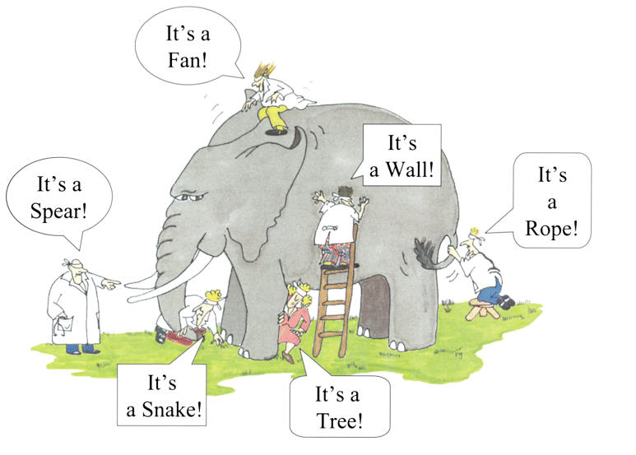
Introduction
Blind people and the elephant
RDF is elephant, and we are the blind people
http://www.proprofs.com/quiz-school/story.php?title=blind-men--elephant
Notes:
* RDF is very much like that elephant, and we’re very much like the blind people,
each grabbing at a different aspect of the specification, with our own interpretations of what it is and what it’s good for.
* we’re discovering what the blind people discovered: not all interpretations of RDF are the same.

Slide 4
The Semantic Web and RDF: A Brief History (1/3)
What is the RDF?
Based within the Semantic Web effort
Resource Description Framework (RDF) is a language designed to support the Semantic Web, in much the same way that HTML is the language that helped initiate the original web. RDF is a framework for supporting resource description, or metadata, for the web. RDF provides common structures that can be used for interoperable XML data exchange. – W3C

Slide 5
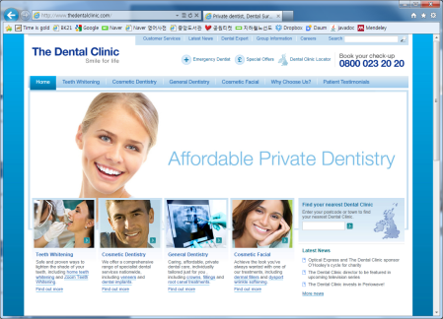
The Semantic Web and RDF: A Brief History (2/3)
What is the semantic web?
Bring structure to the meaningful content of Web pages (Tim Berners-Lee, May, 2001)
Not only can we find data about a subject
We can also infer additional material not available through straight keyword search
Pages has keywords such as “treatment, medicine, physical, therapy”
Also knows doctor’s work,
return appointment times
Software Agents
clinic’s web pages

Slide 6
The Semantic Web and RDF: A Brief History (3/3)
A Brief History
In 1997, the first working draft
A mechanism for working with metadata that promotes the interchange of data between automated processes
In 1999, the first recommended RDF specification
In 2000, the candidate recommendation for the RDF Schema specification
In 2001, the creation of a new RDF core Working Group
http://www.w3c.org/RDF/
Notes:
1997년에 처음 제안되었을 때부터 지금까지 불변하는 RDF의 목적: A mechanism for working with metadata that promotes the interchange of data between automated processes

Slide 7
The Specifications (1/3)
The specifications
Provide the fundamental framework behind RDF and both validity & consistency to RDF
RDF Concepts and Abstract Syntax
RDF Semantics
RDF/XML Syntax Specifications
RDF Schema
RDF Primer
RDF Test Cases
RDF Model & Syntax
An additional resource to learn more
about RDF and RDF/XML
Contains a list of issues arising from the original RDF specification release, their resolutions, and the test cases

Slide 8
The Specifications (2/3)
RDF Concepts and Abstract Syntax and RDF Semantics
The fundamental framework behind RDF
The underlying assumptions and structures that makes RDF unique from other metadata models
The validity and consistency to RDF
RDF/XML syntax
The recommended serialization technique for RDF
RDF Vocabulary Description Language: RDF Schema
It is not a replacement for XML Schema or the user of DTDs
Used to define specific RDF vocabularies; to specify how the elements of the vocabularies relate to each other

Slide 9
The Specifications (3/3)
RDF Primer
A good resource to learn more about RDF and RDF/XML
RDF Test Cases
A list of issues arising from the original RDF specification
Their resolutions
The test cases for use by RDF implementers

Slide 10
When to Use and Not Use RDF (1/3)
The Difference between RDF/XML and XML
XML
RDF/XML
Tree-structured nature (= hierarchical)
→ All related elements must be nested within the elements they’re related to
Flatter triple-based pattern
→ can associate two separate XML structures with each other through a URI

Slide 11
When to Use and Not Use RDF (2/3)
When to Use
Not for people to read, but for an automated process
When processing
In XML, an element isn’t complete until you reach its end tag
This can result in some strain on memory use
The elements that contain other element must be retained in memory until their internal data members are processed
RDF/XML allow you to process the first element quickly
When querying
In XML, you have to provide the entire structure
In RDF/XML, all you have to do is to remember the triple nature of the specification
The ability to join data from two separate vocabularies easily
Without having to negotiate structural differences between the two

Slide 12
When to Use and Not Use RDF (3/3)
Not to Use
Page organization or display
XHTML and CSS are optimized for the particular uses
Cf. RDF’s purpose: capture specific statements about a resource
SOAP or XML-RPC (= other uses of XML)
The level of complexity that RDF/XML adds to the process
We want to keep SOAP request as small, light weight and uncomplicated answers as possible
RDF/XML does add to the overhead of the XML
There is no need to combine this message with other vocabularies

Slide 13
Some Uses of RDF/XML
Mozilla project
Define Web Ontology Language (OWL), W3C
RSS (Really Simple Syndication, RDF Site Summary)
Relationship between XML, RDF/XML, and OWL
“The Semantic Web will build on XML’s ability to define customized tagging schemes and RDF’s flexible approach to representing data. The next element required for the Semantic Web is a Web ontology language which can formally describe the semantics of classes and properties used in web documents. In order for machines to perform useful reasoning tasks on these documents, the language must go beyond the basic semantics of RDF Schema” -- W3C OWL WG

Slide 14
Related Technologies
XML, DTD, XML Schemas
to formalize the XML structure used within a specific instance of RDF/XML
Merging RDF with other formats, Ch 3
Tools and utilities work with RDF/XML
Jena, RAP, Redland’s multi-language RDF API
Ch 7, 8, 9

