Slide 1
A Computational model for plot units
Goyal Amit, Riloff Ellen and Daume III Hal
Computational intelligence 2012
27June. 2014
SNU IDB Lab.
Hyun Geun Soo

Slide 2
Introduction
Overview of plot unit
A manual analysis of affect states and plot units
AESOP
Evaluation
Conclusion

Slide 3
Introduction
Early computational models of plot units relied on large amounts of manual knowledge engineering
Our work aim to delve meaning
emotions and affect for narrative text understanding

Slide 4
Overview of plot units
“emotional reactions and states of affect are central to the notion of a plot or story structure” (Lehnert 1981)
“affect states”
Lowest level componets in plot unit
Emotional reaction to events and states
Three type
Positive , negative , mental
Not event per

Slide 5
Overview of plot units
“primitive plot unit structures”
Two affect states and one causal link
“causal link”
Motivations, actualizations, terminations, equivalences

Slide 6
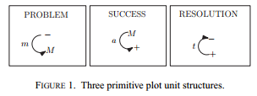
Overview of plot units
PROBLEM : “John lost his job so he decided to rob a bank”
SUCCESS : “Jill proposed to George and he accepted”
RESOLUTIONS : “Lee was ﬁred but soon got a new job”

Slide 7
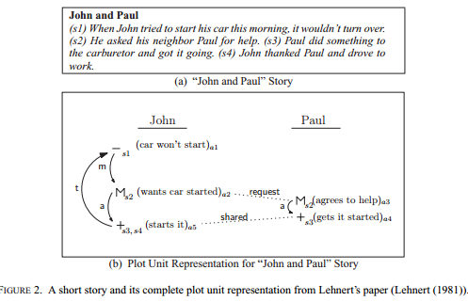
Overview of plot units

Slide 8
A MANUAL ANALYSIS OF AFFECT STATES AND PLOT UNITS
“Fable”
@good
(1) they have a small cast of characters
(2) they typically revolve around a moral, which is exempliﬁed by a concise plot
@bad
anthropomorphic characters, flowery language, archaic vocabulary
Dataset
@34 of AESOP’s fables from a Web
@true plot
@two characters

Slide 9
A MANUAL ANALYSIS OF AFFECT STATES AND PLOT UNITS
“affect origin classes”
E, S, PG-D, PG-S, PG-I, PG-C

Slide 10
A MANUAL ANALYSIS OF AFFECT STATES AND PLOT UNITS
(E) Direct Expressions of Emotion: this category covers +/− affect states that arise from expressions that explicitly represent an emotional state.
(e.g.) “Max was disappointed” “Max was pleased”
(S) Situational Affect States: this category covers+/−affect states that represent good or bad situations that characters ﬁnd themselves in.
(e.g.) “Wolf, who had a bone stuck in his throat,... ” “The Old Woman recovered her sight... ”

Slide 11
A MANUAL ANALYSIS OF AFFECT STATES AND PLOT UNITS
(PG-D) Direct Expressions of Plan/Goal: this category covers M affect states that arise from a plan or goal that is explicitly stated.
(e.g.) “the lion wanted to ﬁnd food” = a mental affect state.
(PG-S) Speech Acts: this category covers M affect states that come from a speech act between characters.
(e.g.) “the wolf asked an eagle to extract the bone”

Slide 12
A MANUAL ANALYSIS OF AFFECT STATES AND PLOT UNITS
(PG-I) Inferred Plans/Goals: this category accounts for M affect states that arise from plans or goals that are inferred from an action.
(e.g.) “the lion hunted deer,” = a mental state
(PG-C) Plan/Goal Completion: this category includes +/− affect states that represent the completion (successful or failed) of a plan or goal.
(e.g.) if an eagle extracts a bone from a wolf’s throat, then both the wolf and the eagle will have positive affect states because both were successful in their respective goals.

Slide 13
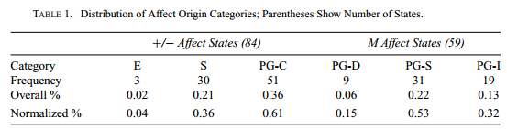
A MANUAL ANALYSIS OF AFFECT STATES AND PLOT UNITS

Slide 14
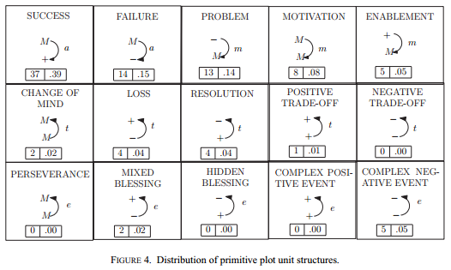
A MANUAL ANALYSIS OF AFFECT STATES AND PLOT UNITS

Slide 15
AESOP
AESOP process
1) affect state recognition - pos , neg , men
2) character identification
3) affect state projection - apply “affect projection rules”
4) link creation

Slide 16
“Affect State Recognition”
FrameNet - we use verb list (+ - m)
MPQA Lexicon - words list (+ -)
OpinionFinder - contextual polarity classifier (+ - m)
Semantic Orientation Lexicon - words list ( + - )
Speech Act Verbs - produce ( m )

Slide 17
“Character Identification”
simplifying assumption
(1) There are only two characters per fable
(2) Both characters are mentioned in the fable’s title
characters are often animals
- we handcrafted a simple rule based coreference system
(0) we apply heuristics to determine number and gender based on word lists,WordNet …. ( process of elimination )
(1) WordNet is used to obtain a small set of nonpronominal, nonstring-match resolutions by exploiting hypernym relations (ex. linking peasant with man)

Slide 18
“Affect State Projection”
Use verb argument structure
“affect projection rules”
Rule 1: AGENT VP : “Mary laughed(+)”
Rule 2: VP PATIENT : “John was rewarded(+)”
Rule 3: AGENT VP PATIENT : “John asked(M) Paul for help”
Rule 4: AGENT VERB1 to VERB2 PATIENT
(a) refer to the same character => rule1: “Bob decided to teach himself..”
(b) Different => Rule1 to VERB1 and Rule2 to VERB2

Slide 19
“Creating Causal and Cross Character Links”
cross-character link : two characters in a clause have affect states that originated from the same word
causal link : Between each pair of chronologically consecutive affect states for the same character
AESOP only produces forward causal links (m and a) and does not produce backward causal links

Slide 20
Evaluation
Test set
15 fables with gold standard annotations
measured
the accuracy of the affect states , links separately

Slide 21
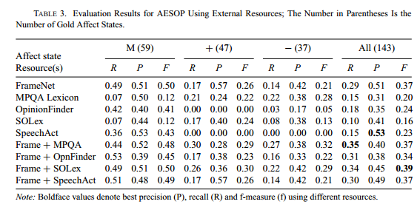
Evaluation

Slide 22
Conclusion
First computational model to fully automate the process of generating plot unit representations

