Slide 1
Massive Semantic Web data compression with MapReduce
Jacopo Urbani, Jason Maassen, Henri Bal
Vrije Universiteit, Amsterdam
HPDC (High Performance Distributed Computing) 2010
20June. 2014
SNU IDB Lab.
Lee, Inhoe

Slide 2
Outline
Introduction
Conventional Approach
MapReduce Data Compression
MapReduce Data Decompression
Evaluation
Conclusions

Slide 3
Introduction
Semantic Web
An extension of the current World Wide Web
A information = a set of statements
Each statement = three different terms;
subject, predicate, and object
<http://www.vu.nl> <rdf:type> <dbpedia:University>

Slide 4
Introduction
the terms consist of long strings
Most semantic web applications compress the statements
to save space and increase the performance
the technique to compress data is dictionary encoding
Notes:
Since the terms consist of long strings (e.g. URIs), most Semantic Web applications, like RDF storage engines, compress the statements to a more compact representation so that they can save space and increase the performance.

Slide 5
Motivation
Currently the amount of Semantic Web data
Is steadily growing
Compressing many billions of statements
becomes more and more time-consuming.
A fast and scalable compression is crucial
A technique to compress and decompress Semantic Web statements
using the MapReduce programming model
Allowed us to reason directly on the compressed statements with a consequent increase of performance [1, 2]
Notes:
Crucial 중대한
consequent 결과.?

Slide 6
Outline
Introduction
Conventional Approach
MapReduce Data Compression
MapReduce Data Decompression
Evaluation
Conclusions

Slide 7
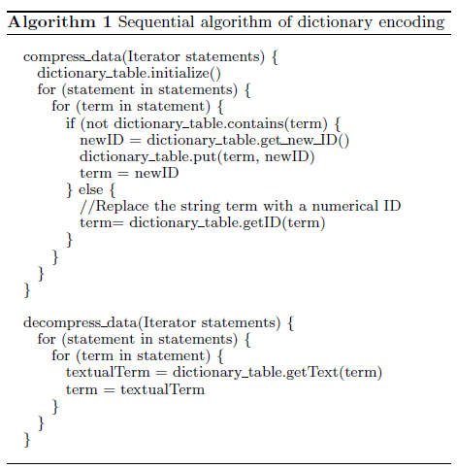
Conventional Approach
Dictionary encoding
Compress data
Decompress data
Notes:
<Problem 1>
The computation of these two algorithms can be “naively“ distributed by partitioning the input and processing the partitions on several machines. In this scenario one machine will store the dictionary table and the other machines will query it to retrieve the numerical IDs. The problem with this approach is that all machines will constantly need to query the dictionary, generating massive network communication to the table's location. If the infrastructure is not fast enough this communication will quickly become a performance bottleneck.
<problem 2>
if we want to compress English text we can store the dictionary table in the main memory
However, in a collection of billions of web statements there are normally hundreds of millions of unique terms. If the URI's average length is 80 bytes, then 300 million entries take about 24 GB of space. Unless we use a machine with a very large amount of memory, we are obliged to store the table on disk and a lookup on a data structure stored on disk is significantly slower that a lookup in the main memory.

Slide 8
Outline
Introduction
Conventional Approach
MapReduce Data Compression
MapReduce Data Decompression
Evaluation
Conclusions

Slide 9
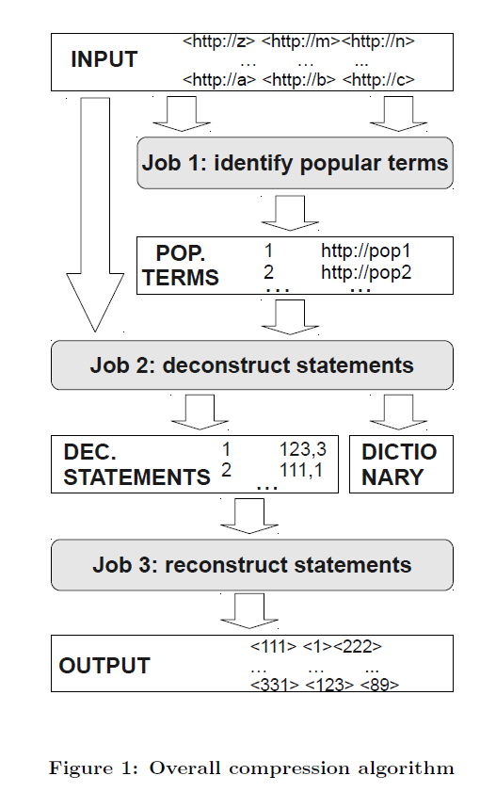
MapReduce Data Compression
job 1: identifies the popular terms and assigns them a numerical ID
job 2: deconstructs the statements, builds the dictionary table and replaces all terms with a corresponding numerical ID
job 3: read the numerical terms and reconstruct the statements in their compressed form
Notes:
We propose an alternative algorithm which does not use an external dictionary, but instead builds it internally. We prevent eventual load balancing problems by sampling the most common resources and caching them locally.
We do not execute one job for each part of the statements, but instead we first deconstruct the statements, replace the terms with the numerical IDs, and finally reconstruct them.
The first job identifies the popular terms and assigns them a numerical ID
The second job (section 3.2) deconstructs the statements, builds the dictionary table and replaces all terms with a corresponding numerical ID
The last job (section 3.3) will read the numerical terms and reconstruct the statements in their compressed form
Deconstruct 해체
Reconstruct 재구성

Slide 10
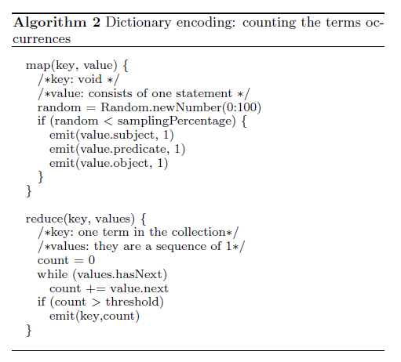
Job1 : caching of popular terms
Identify the most popular terms and assigns them a numerical number
count the occurrences of the terms
select the subset of the most popular ones
Randomly sample the input
Notes:
Term is highly skewed.
The purpose of the first job is to identify the most popular terms so that we can treat them in a different way.

Slide 11
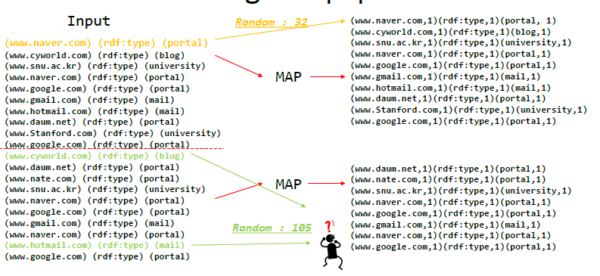
Job1 : caching of popular terms
Notes:
Sampling percentage : 100
1만 추가해서 보내

Slide 12
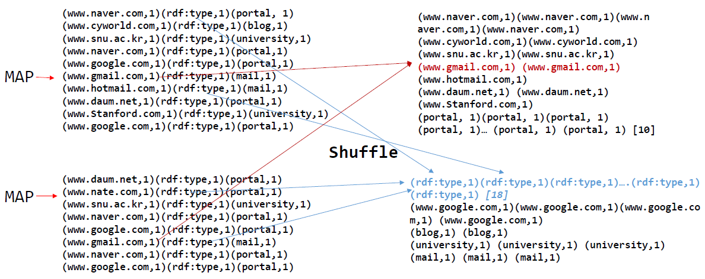
Job1 : caching of popular terms
Notes:
Key별로 모아서

Slide 13
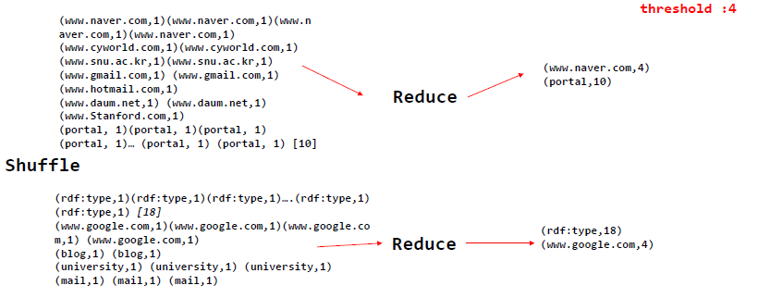
Job1 : caching of popular terms
Notes:
Value다 더해서
Threshold보다 큰거 emit

Slide 14
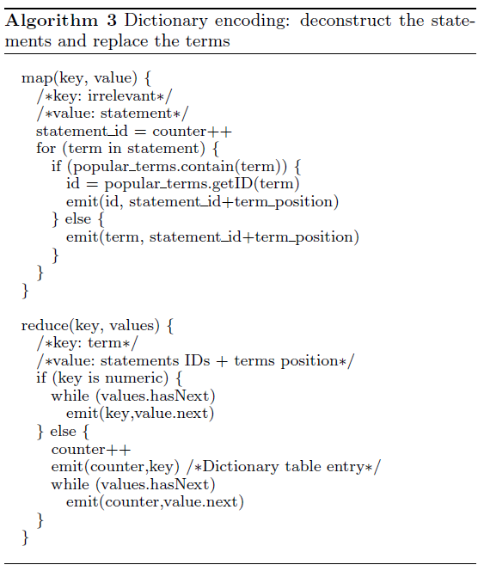
Job2: deconstruct statements
Deconstruct the statements and compress the terms with a numerical ID
Before the map phase starts, loading the popular terms into the main memory
The map function reads the statements and assigns each of them a numerical ID
Since the map tasks are executed in parallel, we partition the numerical range of the IDs so that each task is allowed to assign only a specific range of numbers
Notes:
is designed to avoid having to launch one job for each part of the statement.
Few Popular term can fit in main memory
8bytes 사용하면 앞에 4bytes는 id of task 나머지 4bytes는 incremental number within the task

Slide 15
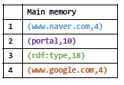
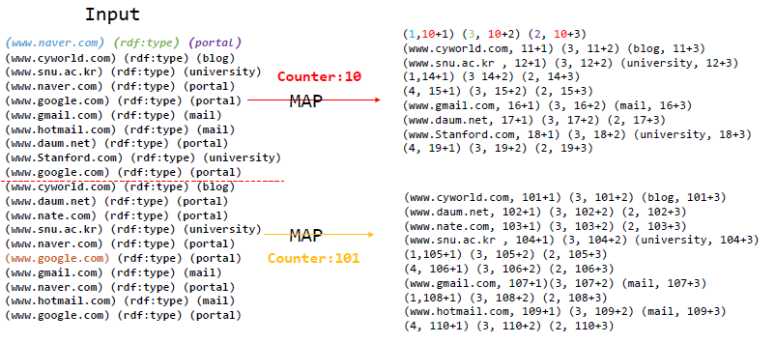
Job2: deconstruct statements
Notes:
For each term(www.naver.com), map function emits one intermediate pair (1, 10+1)
Popular 인지 아닌지에 따라 key가 달라짐
Popular면 in memory cache에 있는 numerical ID가 key가 되고
아니면 그냥 바로 (cyworld.com) key가 됨
두 경우 모두 Value는
Statement ID + position of term(1=subject, 2=predicate, 3=object)

Slide 16
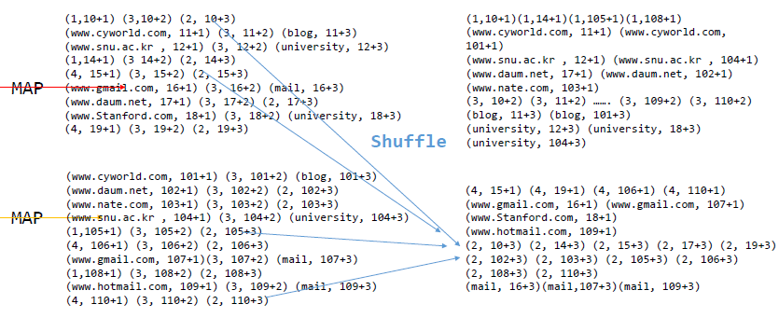
Job2: deconstruct statements
Notes:
Key 로 shuffle

Slide 17
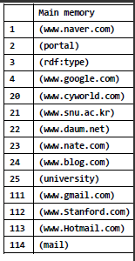
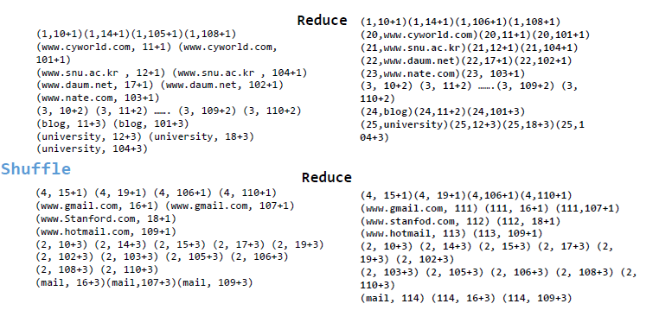
Job2: deconstruct statements
Notes:
We use a long number which is split in two parts:
the first will contain the reduce task number while
the second will be used as internal counter
Key가 숫자면 바로 emit하고
문자면 (숫자ID, text) 추가로 emit하고 (숫자 ID, value)

Slide 18
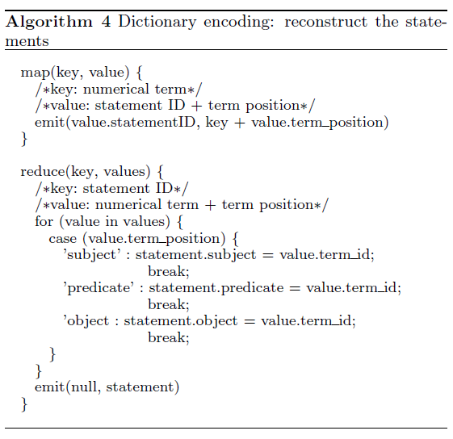
Job3: reconstruct statements
Read the previous job’s output and reconstructs the statements using the numerical IDs

Slide 19
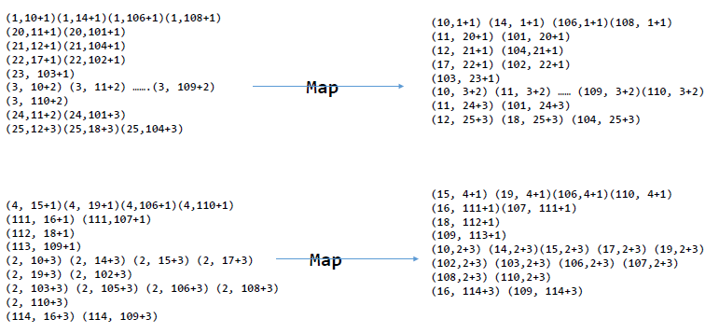
Job3: reconstruct statements
Notes:
MAP function does a partial swap between the key and the value.
It emits a new pair which has as key the statement ID and as value the term plus its position.

Slide 20
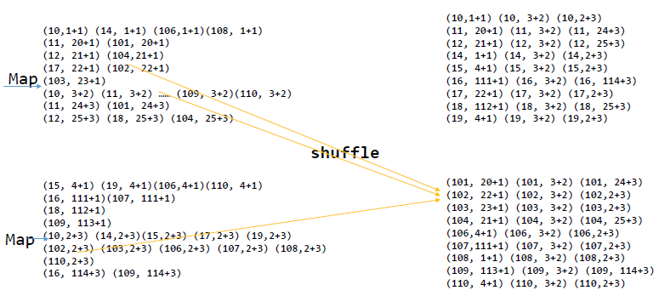
Job3: reconstruct statements
Notes:
각 키당 3개씩 (1,2,3)

Slide 21
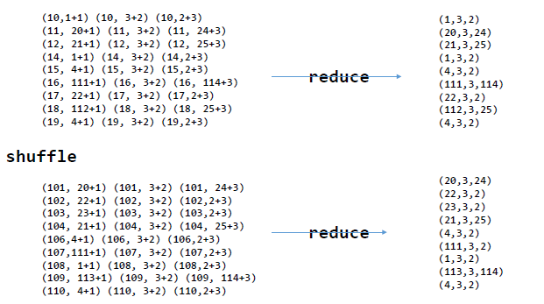
Job3: reconstruct statements
Notes:
the reduce function will read the three values and reconstruct the original statement with the numerical terms at the positions contained in the pairs values.
(1,3,2)
Naver, rdf, portal

Slide 22
Outline
Introduction
Conventional Approach
MapReduce Data Compression
MapReduce Data Decompression
Evaluation
Conclusions

Slide 23
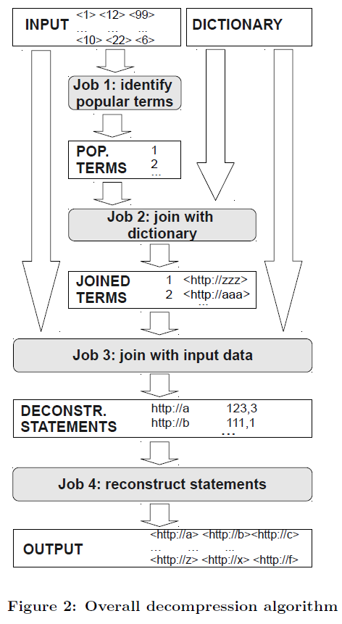
MapReduce data decompression
Join between the compressed statements and the dictionary table
job 1: identifies the popular terms
job 2: perform the join between the popular resources and the dictionary table
job 3: deconstruct the statements and decompresses the terms performing a join on the input
job 4: reconstruct the statements in the original format
Notes:
In order to decompress the data, we must perform a join between the compressed statements and the dictionary table.
Mapreduce join에서 normally, key봐서 맞는거 join하면 load balancing문제에 영향을 많이 받는다.
왜냐하면 엄청 popular한 term이 있고 그룹이 single 머신에서 수행되기 때문에
이걸 해결하기 위해 caching the dictionary table of popular term
Problem
MapReduce는 input을 homogeneous set of pair라고 가정하는데
여기서 2개의type이 있다. (statement and dictionary table)
-> wrapping statement and dictionary table in a data structure해서 uniform한 collection으로 보이게끔

Slide 24
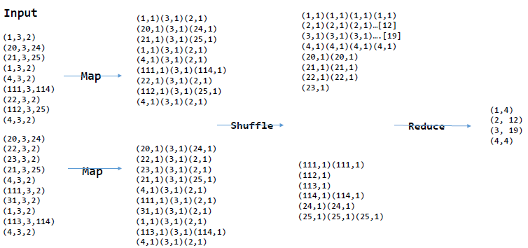
Job 1: identify popular terms
Notes:
Compress 1번처럼 count하고 모아서 세고

Slide 25
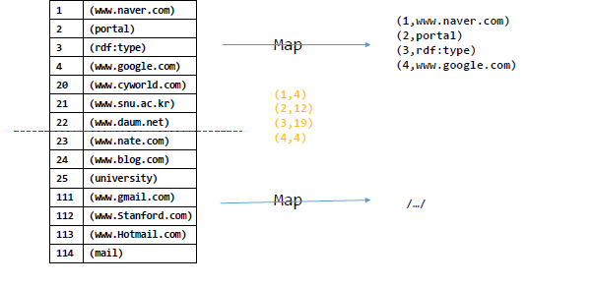
Job 2 : join with dictionary table
Notes:
The purpose of this job is
to retrieve the corresponding textual equivalents of the popular terms
Dictionary table contains hundreds of millions of entries, we need to launch a MapReduce job to retrieve them
The map function loads the popular terms in memory and reads the entries of the dictionary table. If the table entry matches one of the popular terms, then the function outputs the table entry.
For this task a reduce function is not required

Slide 26

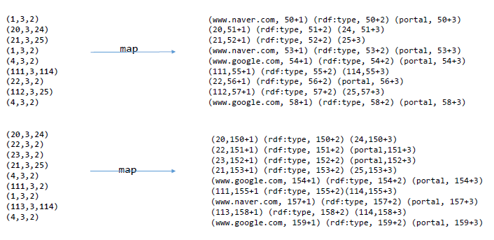
Job 3: join with compressed input
Notes:
deconstructs the statements and performs the join with the dictionary table
Before the map function starts, we load in memory a hash table with the popular table dictionary entries calculated in the previous job. (1, naver.com) (popular term, text)
Input은 statement거나 dictionary table의 entry 일 수 있다.
STATEMENT의 경우, 3.2에서와 같이 deconstruct한다. (1,3,2) -> (1, 50+1) (3, 50+2) (2, 50+3) 이렇게 세 개로 나누고 term이 popular한 거면
(naver, 50+1) (rdf, 50+2) (portal, 50+3) 이렇게 hash table보고 text로 바꿔준다.
Dictionary entry인 경우, (Numerical ID, text)로 emit

Slide 27
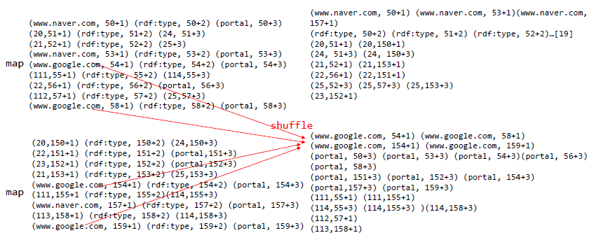
Job 3: join with compressed input
Notes:
we set a specific partitioner function to assign the pairs to the reduce tasks. The pairs with already converted terms will be randomly sent to the reducers and immediately returned. The other pairs will be grouped as usual and the join will be performed by the reduce function.
Key값으로 셔플하고

Slide 28
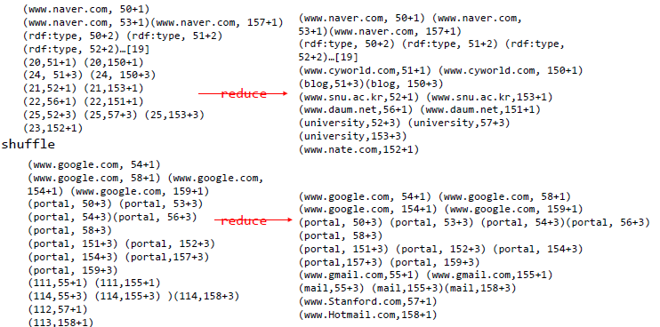
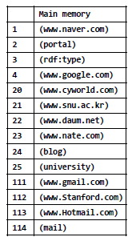
Job 3: join with compressed input
(20, www.cyworld.com)
(21, www.snu.ac.kr) …. (113, www.hotmail.com) (114, mail)
Notes:
(20, cyworld)

Slide 29
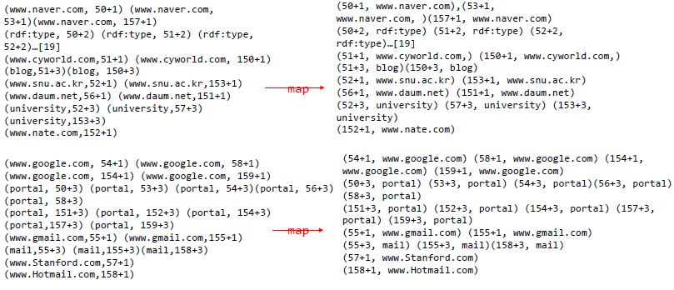
Job 4: reconstruct statements
Notes:
3.3 과 비슷
SWAP하고

Slide 30
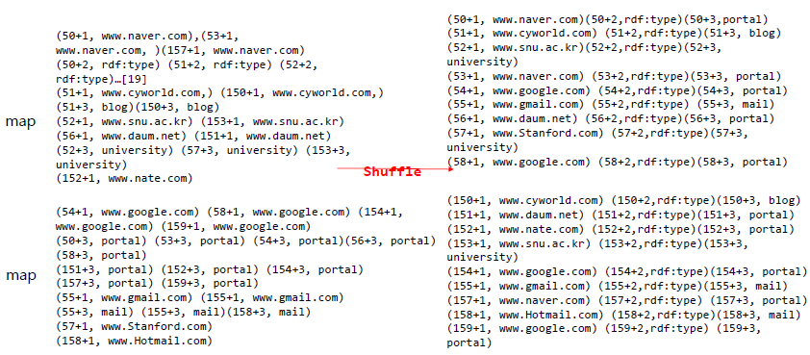
Job 4: reconstruct statements
Notes:
키값으로 모아서

Slide 31
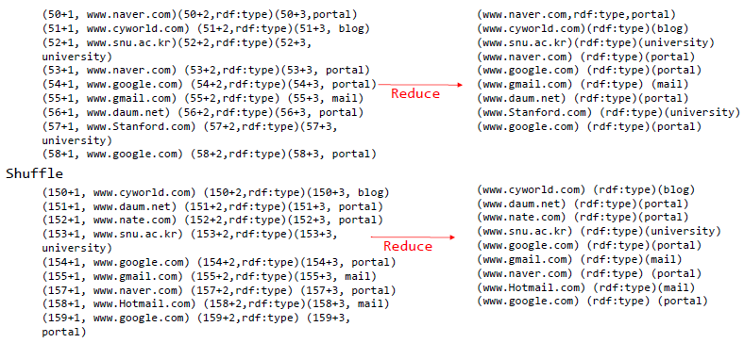
Job 4: reconstruct statements
Notes:
하나의 statement로

Slide 32
Outline
Introduction
Conventional Approach
MapReduce Data Compression
MapReduce Data Decompression
Evaluation
Conclusions

Slide 33


Evaluation
Environments
32 nodes of the DAS3 cluster to set up our Hadoop framework
Each node
two dual-core 2.4 GHz AMD Opteron CPUs
4 GB main memory
250 GB storage
Notes:
http://cs.vu.nl/das3
The Distributed ASCI Supercomputer 3

Slide 34
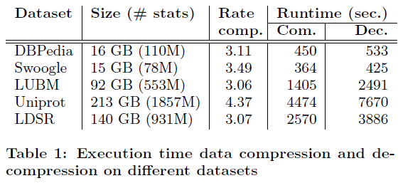
Results
The throughput of the compression algorithm is higher for a larger datasets than for a smaller one
our technique is more efficient on larger inputs, where the computation is not dominated by the platform overhead
Decompression is slower than Compression
Notes:
The purpose of the tests was to evaluate the performance of our approach on different inputs
Comp. Rate = input / (compressed statements + dictionary table)
Larger dataset (400K stats/s for Uniprot)
Smaller (214K stats/s for Swoogle)
De
183K stats/s for Swoogle
242K stats/s for Uniprot
Decompression is slower than Compression
14%(swoogle), 44%(LUBM)
차이는 input size도 아니고, unique term도 아니다 좀더 실험 필요

Slide 35
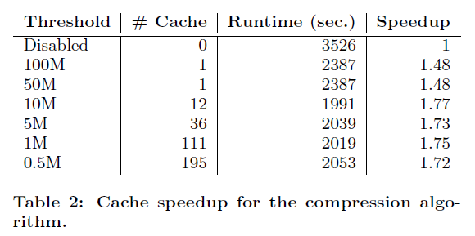
Results
The beneficial effects of the popular-terms cache
Notes:
We evaluated the beneficial effects of the popular-terms cache by launching the compression algorithm on a fixed input (LDSR) and changing the size of the cache
처음엔 cache disabled하고 popular term threshold 내리면서 cache 늘려봄
<빨간박스> Disabled랑 100M보면 runtime 줄어듬을 볼 수 있다
Threshold내리면 Runtime 좋아지는데..
<파란박스>
10M아래로는 별로 변화 없다.
Shows 12개의 very small number of terms are responsible for the degradation of the performance!!

Slide 36
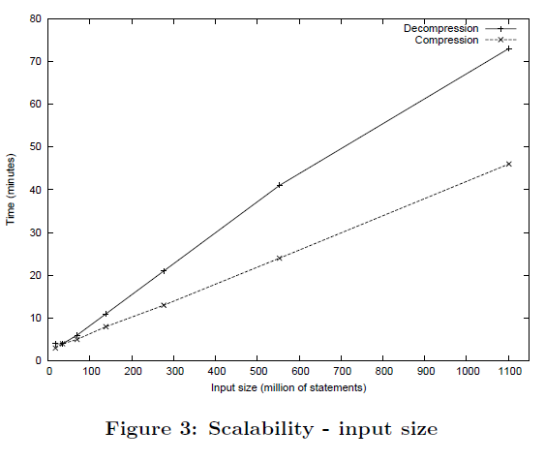
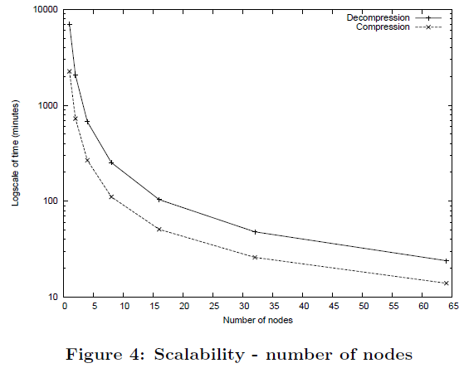
Results
Scalability
Different input size
Varying the number of nodes
Notes:
We tested the scalability of our algorithm by launching the execution with different input sizes and varying the number of nodes.
we used the LUBM benchmark tool to generate artificial datasets of different sizes.
<왼쪽 그래프>
17 million statements. 부터 시작해서 1.1billion까지 사이즈 2배로 늘려가며
compression algorithm has a better scalability than the decompression algorithm regarding the input size
<오른쪽 그래프>
execution on a fixed input on clusters with a different number of nodes.
1node부터 64노드까지 실험
Y축이 runtime (logarithm scale)
처음에는 super linear
32~64 구간에는 linear scalability
1->2: 3.11(com.) 3.41(dec.)배 빨라짐
32->64: 1.85(com) 2(dec.)배 빨라짐
Super linear한 이유는 첫째로 platform overhead로 추정
둘째로, disk I/O
왜냐하면 1node일때 dec.이 3.1배느린데 64node일때는 1.71배 느리다.
Dec.이 Com.보다 I/O가 많기에.. 이것도 추정

Slide 37
Outline
Introduction
Conventional Approach
MapReduce Data Compression
MapReduce Data Decompression
Evaluation
Conclusions

Slide 38
Conclusions
Proposed a technique to compress Semantic Web statements
using the MapReduce programming model
Evaluated the performance measuring the runtime
More efficient for larger inputs
Tested the scalability
Compression algo. scales more efficiently
A major contribution to solve this crucial problem in the Semantic Web
Notes:
We believe that this MapReduce technique has given a major contribution to solve this crucial problem in the Semantic Web and it was essential for our work on large scale reasoning.

Slide 39
References
[1] J. Urbani, S. Kotoulas, J. Maassen, F. van Harmelen, and H. Bal. Owl reasoning with mapreduce: calculating the closure of 100 billion triples. Currently under submission, 2010.
[2] J. Urbani, S. Kotoulas, E. Oren, and F. van Harmelen. Scalable distributed reasoning using mapreduce. In Proceedings of the ISWC '09, 2009.

Slide 40
Outline
Introduction
Conventional Approach
MapReduce Data Compression
Job 1: caching of popular terms
Job 2: deconstruct statements
Job 3: reconstruct statements
MapReduce Data Decompression
Job 2: join with dictionary table
Job 3: join with compressed input
Evaluation
Runtime
Scalability
Conclusions

Slide 41
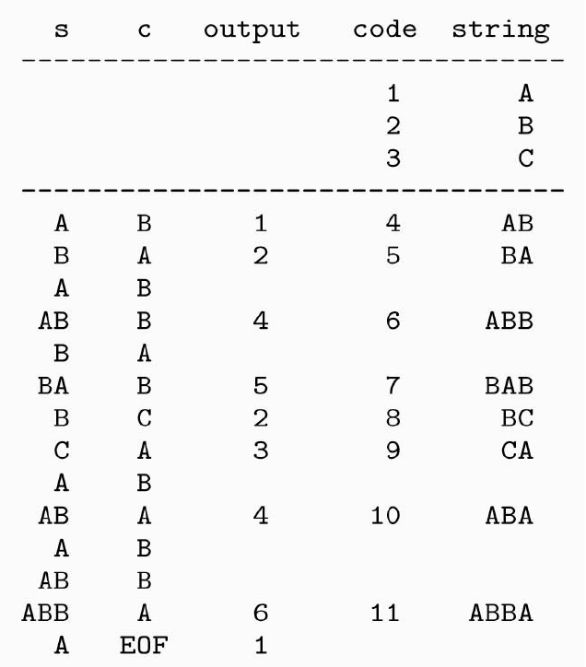
Conventional Approach
Dictionary encoding
Input : ABABBABCABABBA
Output : 124523461
Notes:
1
The computation of these two algorithms can be “naively“ distributed by partitioning the input and processing the partitions on several machines. In this scenario one machine will store the dictionary table and the other machines will query it to retrieve the numerical IDs. The problem with this approach is that all machines will constantly need to query the dictionary, generating massive network communication to the table's location. If the infrastructure is not fast enough this communication will quickly become a performance bottleneck.
2
if we want to compress English text we can store the dictionary table in the main memory
However, in a collection of billions of web statements there are normally hundreds of millions of unique terms. If the URI's average length is 80 bytes, then 300 million entries take about 24 GB of space. Unless we use a machine with a very large amount of memory, we are obliged to store the table on disk and a lookup on a data structure stored on disk is significantly slower that a lookup in the main memory.

