Slide 1

Session 30
UML Modeling Tools
Written by Thomas A. Pender
Published by Wiley Publishing, Inc.
November 2, 2011
Presented by Hyewon Kim

Slide 2
Contents
Explaining the Purpose and Function of Modeling Tools
Explaining Evaluation Criteria for Modeling Tools
Evaluating UML Modeling Tools

Slide 3


Explaining the Purpose and Function of Modeling Tools
To store
the information about the diagrams
To draw the diagrams
To run the cross checks
Modeling Tools
To maintain the integrity
To keep track of versions
To generate the code
Using the power of the computer!

Slide 4

Explaining Evaluation Criteria for Modeling Tools (1/2)
How do I choose the right tool for my project?
The basic
  Type and version of the UML supported
  Platform support
  Printing
  HTML documentation
  Repository
  Code generation
  Integrated editor
  Version control
The features
that should pretty much be provided
by every modeling tool

Slide 5
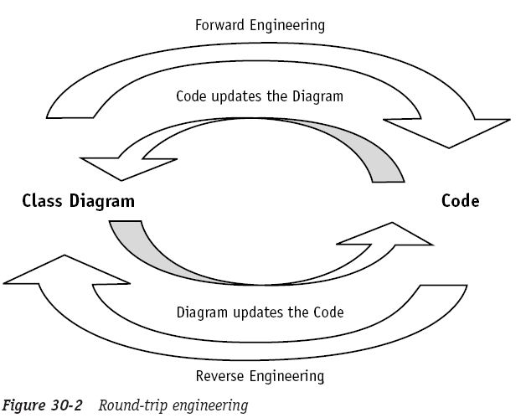
Explaining Evaluation Criteria for Modeling Tools (2/2)
How do I choose the right tool for my project?
Extended features
  Round-trip engineering
  Data modeling integration
  Customization
  XML Metadata Interchange
  Team development
The features DON’T appear in all tools!

Slide 6

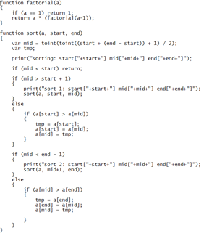




Evaluating UML Modeling Tools
Identify your financial limits
Identify the features that are most valuable to you
Get an evaluation copy
Check that the tool supports UML 1.4
Generate some code
Reverse engineer some code
Generate all the reports
Find out if the vendor supports customization through scripting
1.4
Feature

Slide 7
The End

